Slide 1

The Internet Of Things

Slide 2
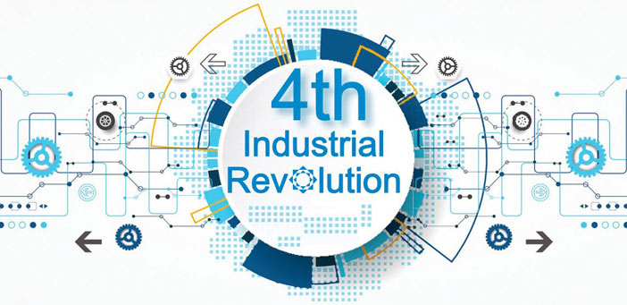
According to the Word Economic Forum ” We stand on the brink of a technological revolution that will fundamentally alter the way we live, work, and relate to one another. In its scale, scope, and complexity, the transformation will be unlike anything humankind has experienced before”
CENTRO ESCOLAR UNIVERSITY

Slide 3
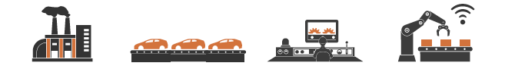
INDUSTRIAL REVOLUTIONS
1st
1760s
2nd
1870s
3rd
1960s
4th
NOW
Steam engine
Mechanization
Electricity
Mass production
Computers
Automation
Internet
Hyper-connectivity
Revolutions have triggered profound changes in economic systems and social structures.
CENTRO ESCOLAR UNIVERSITY

Slide 4


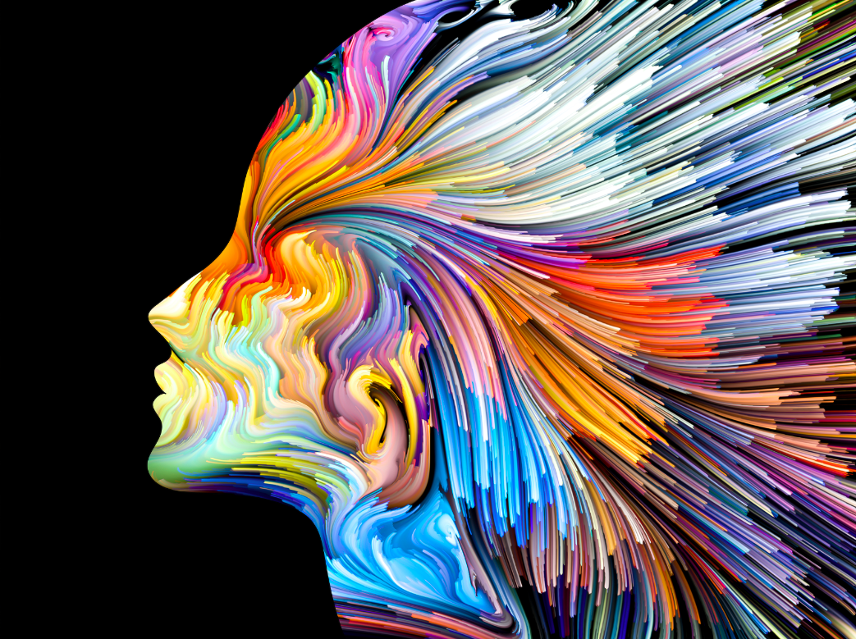
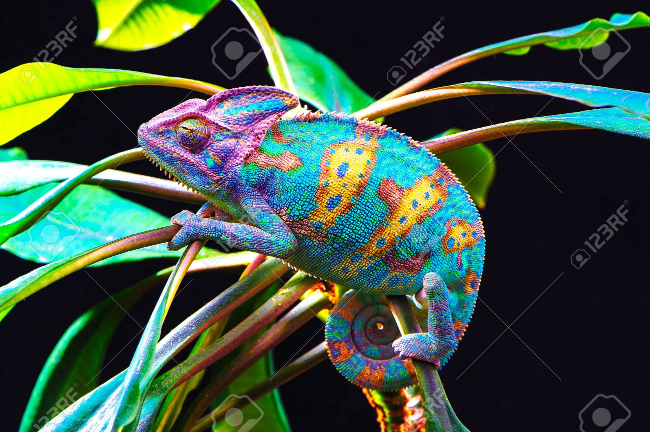
INDUSTRIAL REVOLUTIONS
diSruption
age of
accelerations
profound
and
systemic
change
momentous change
CENTRO ESCOLAR UNIVERSITY

Slide 5
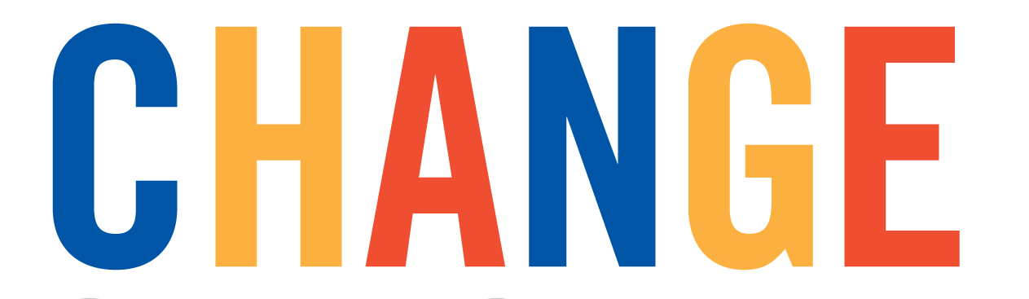
Technologies Driving
Internet of Things (IoT)
Artificial Intelligence (AI)
Biotechnology
Robotics
Data Analytics
Virtual reality
Quantum computations
Blockchain
CENTRO ESCOLAR UNIVERSITY

Slide 6
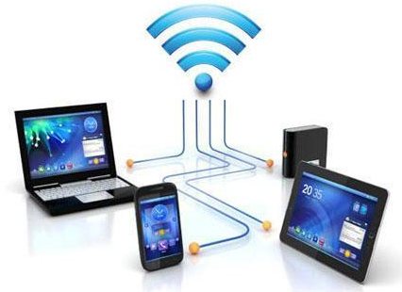
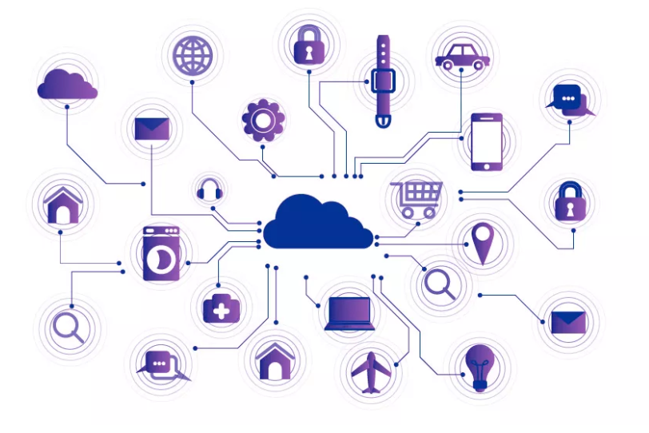

What is Internet of Things?
CENTRO ESCOLAR UNIVERSITY

Slide 7
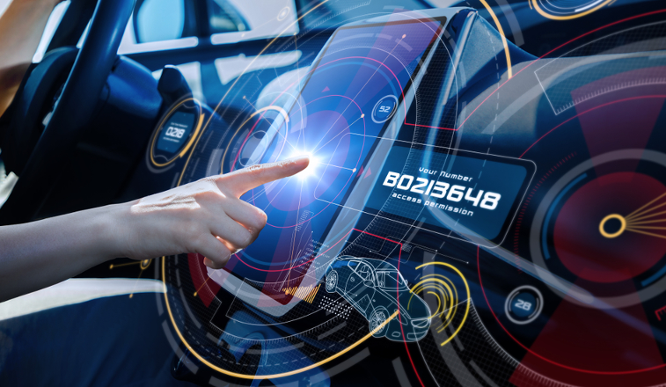
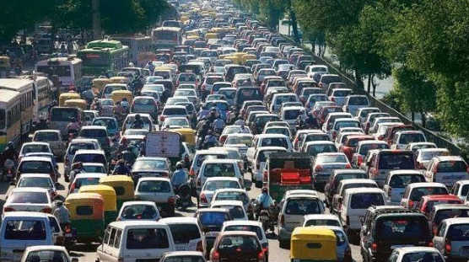
How Does This Impact You?
CENTRO ESCOLAR UNIVERSITY

Slide 8
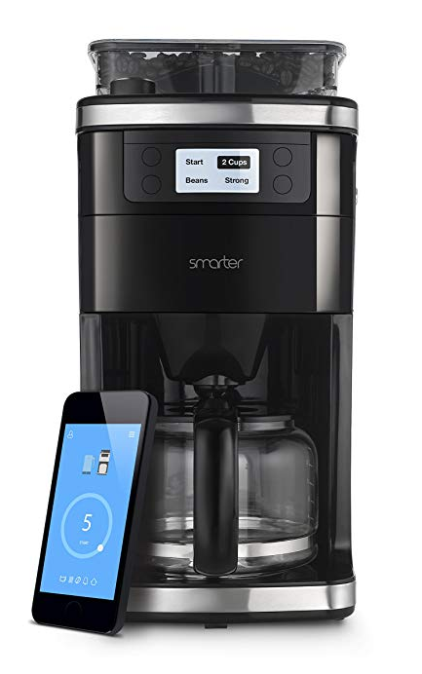

How Does This Impact You?
CENTRO ESCOLAR UNIVERSITY

Slide 9
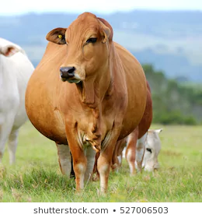
IoT-based Smart Farming
Utilize wireless IoT applications to collect data regarding the location, well-being, and health of their livestock
Monitor pregnant cows:
Sensor powered by battery is expelled when its water breaks.
This sends an information via the Internet to the rancher.
CENTRO ESCOLAR UNIVERSITY

Slide 10
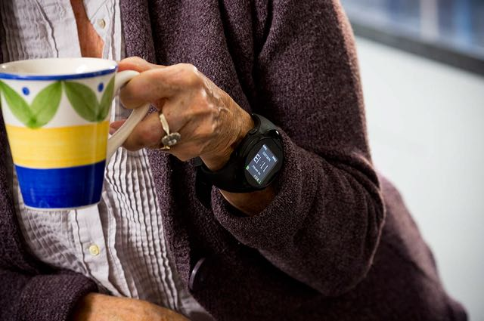
IoT for the Elderly
With a built-in accelerometer that automatically detects falls
Medication reminder
With a GPS, which allows an emergency operator to locate and provide directions to the individual.
CENTRO ESCOLAR UNIVERSITY

Slide 11
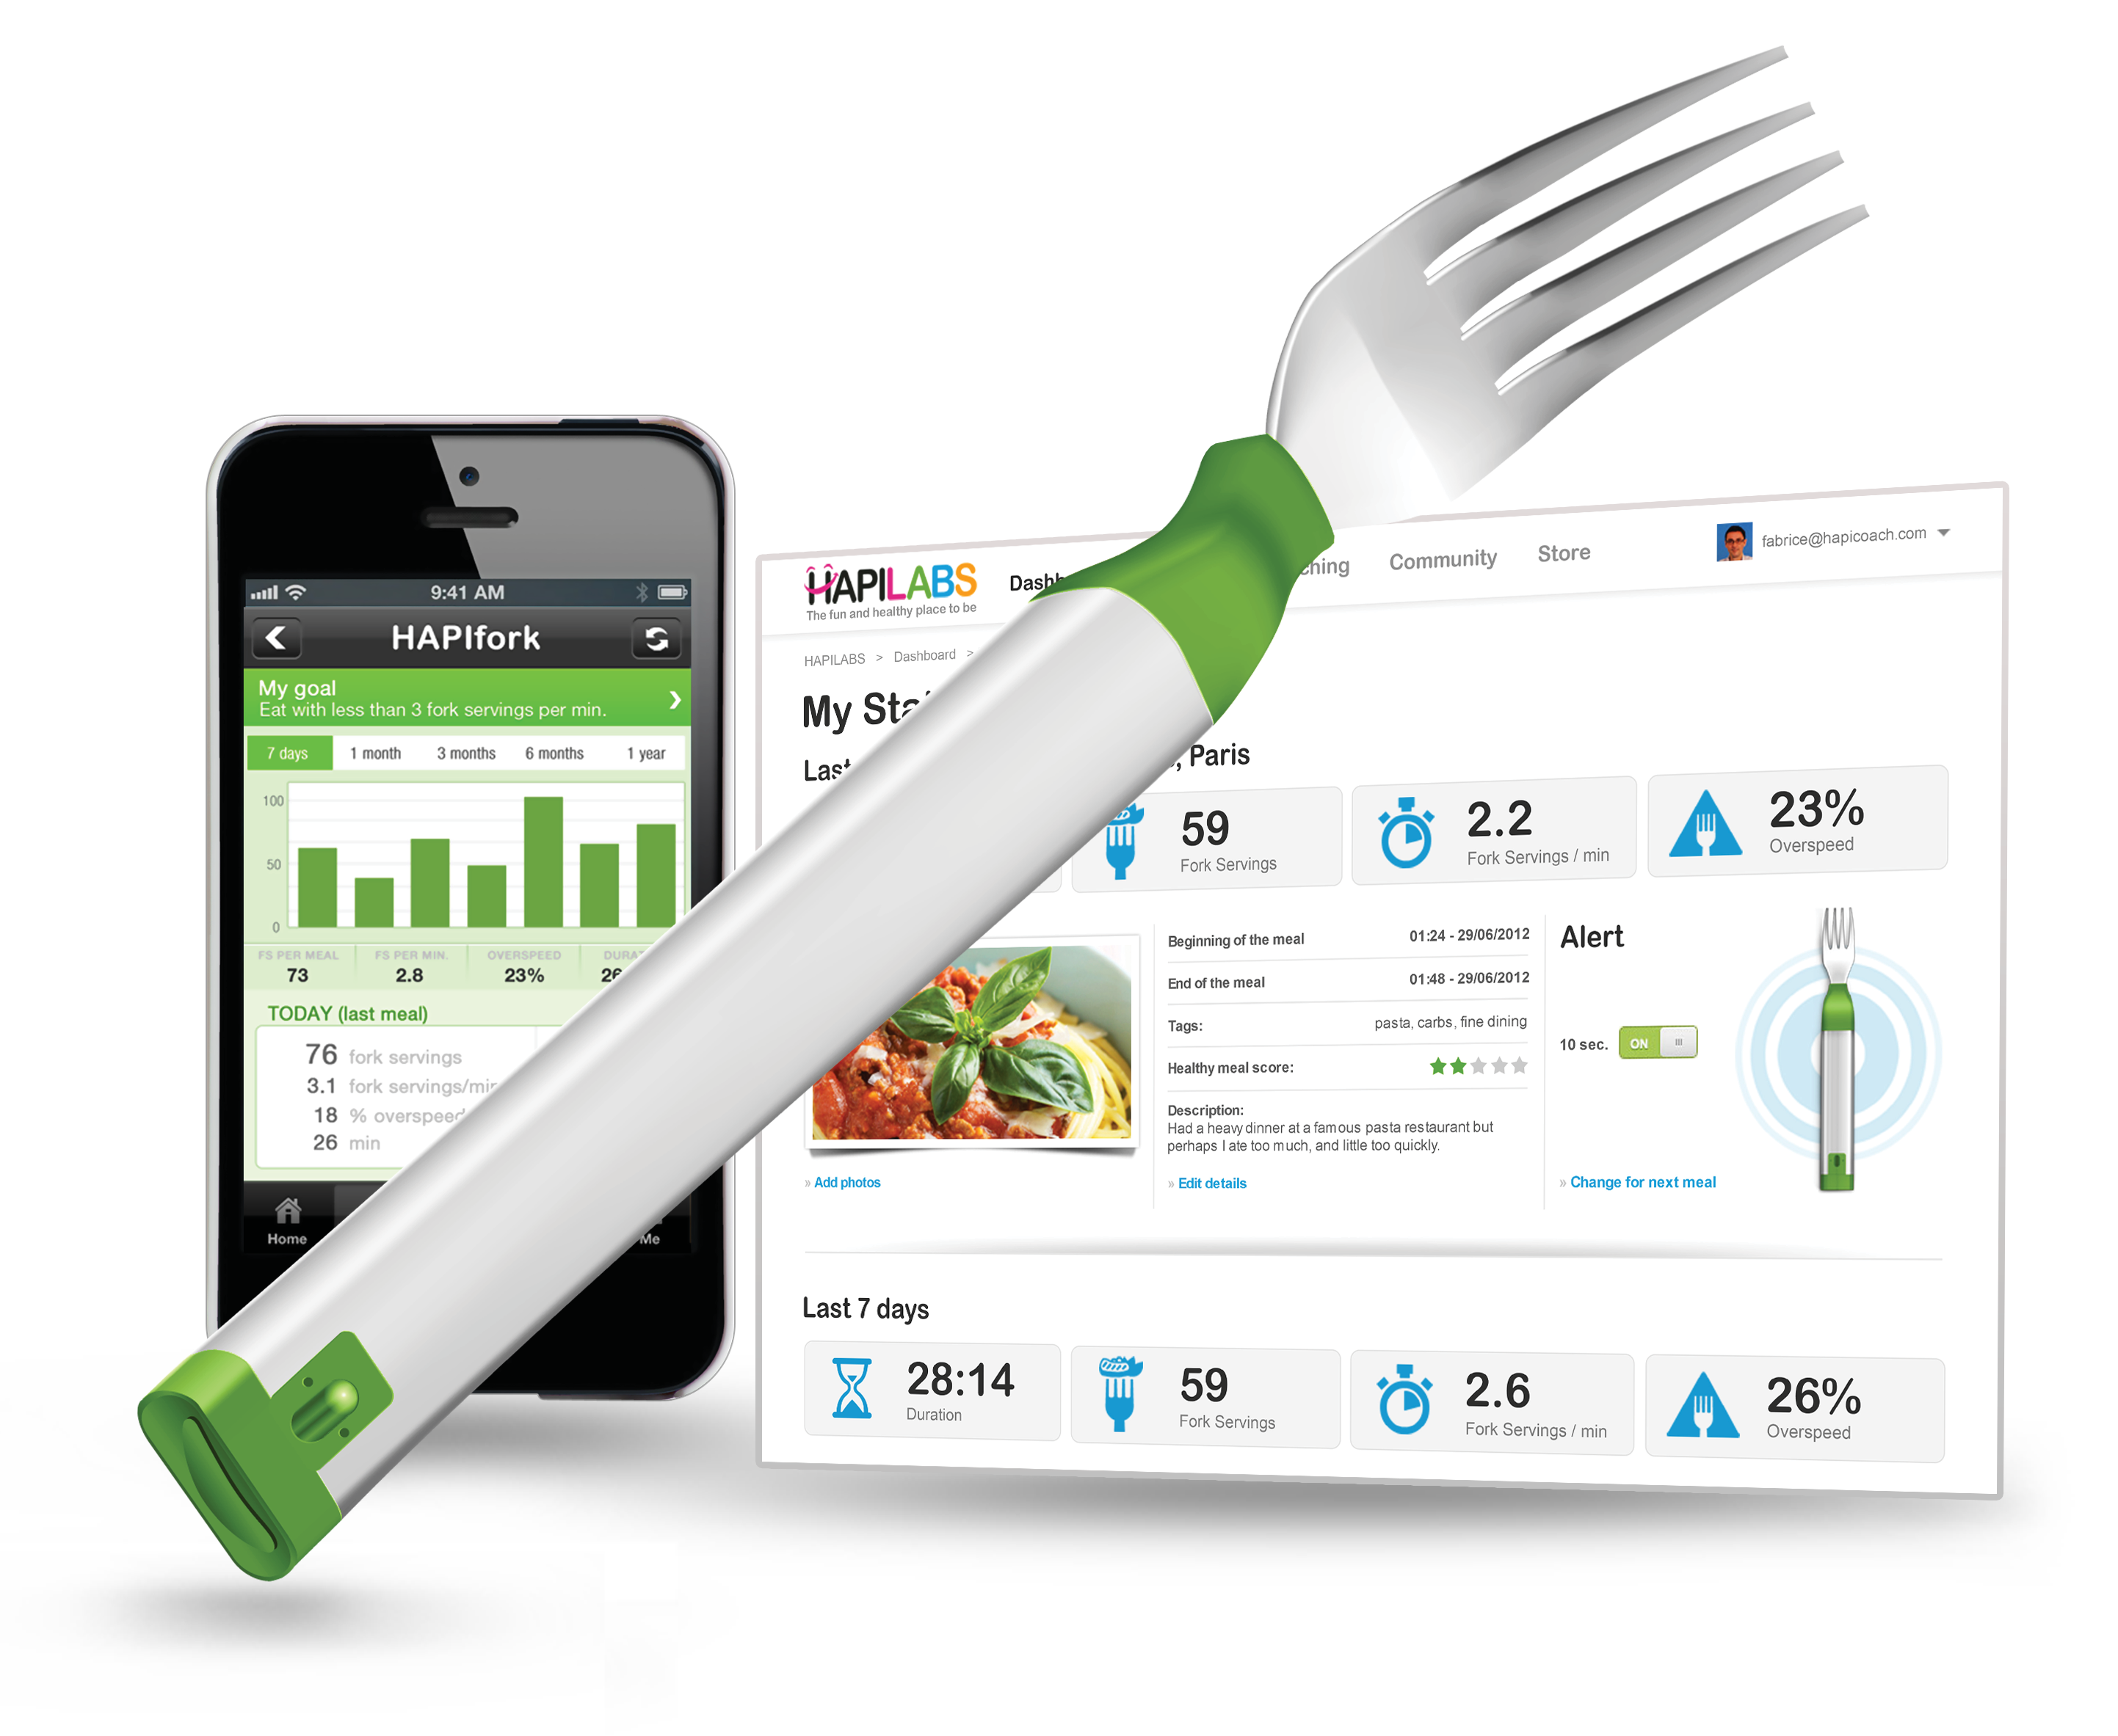
HAPIfork
The HAPIfork is an electronic fork that helps you monitor and track your eating habits.
It also alerts you with the help of indicator lights and gentle vibrations when you are eating too fast.
http://www.hapi.com/products-hapifork.asp
CENTRO ESCOLAR UNIVERSITY

Slide 12
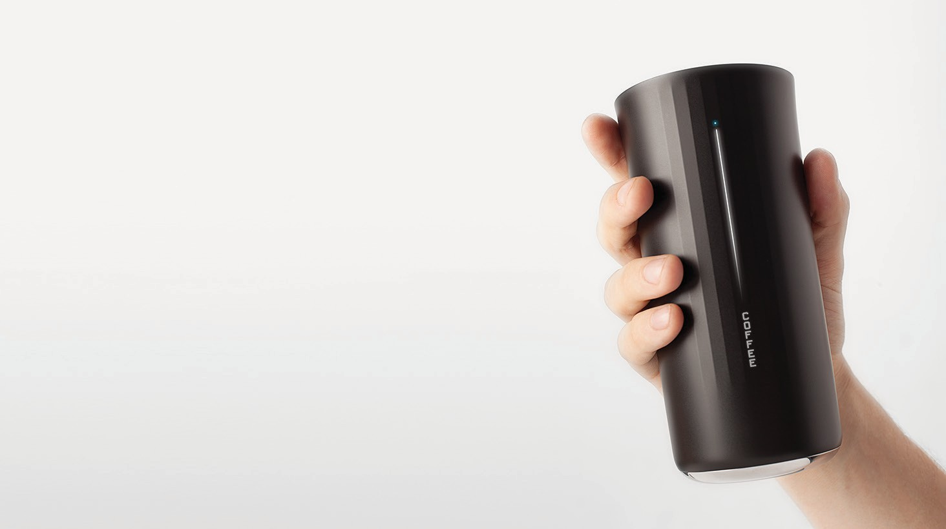
MyVessyl Cup
It can hold 13 ounces of liquid. The battery takes 60 minutes to fully charge and will last for 5-7 days. Also has wire-free charging.
https://www.myvessyl.com/
CENTRO ESCOLAR UNIVERSITY

Slide 13
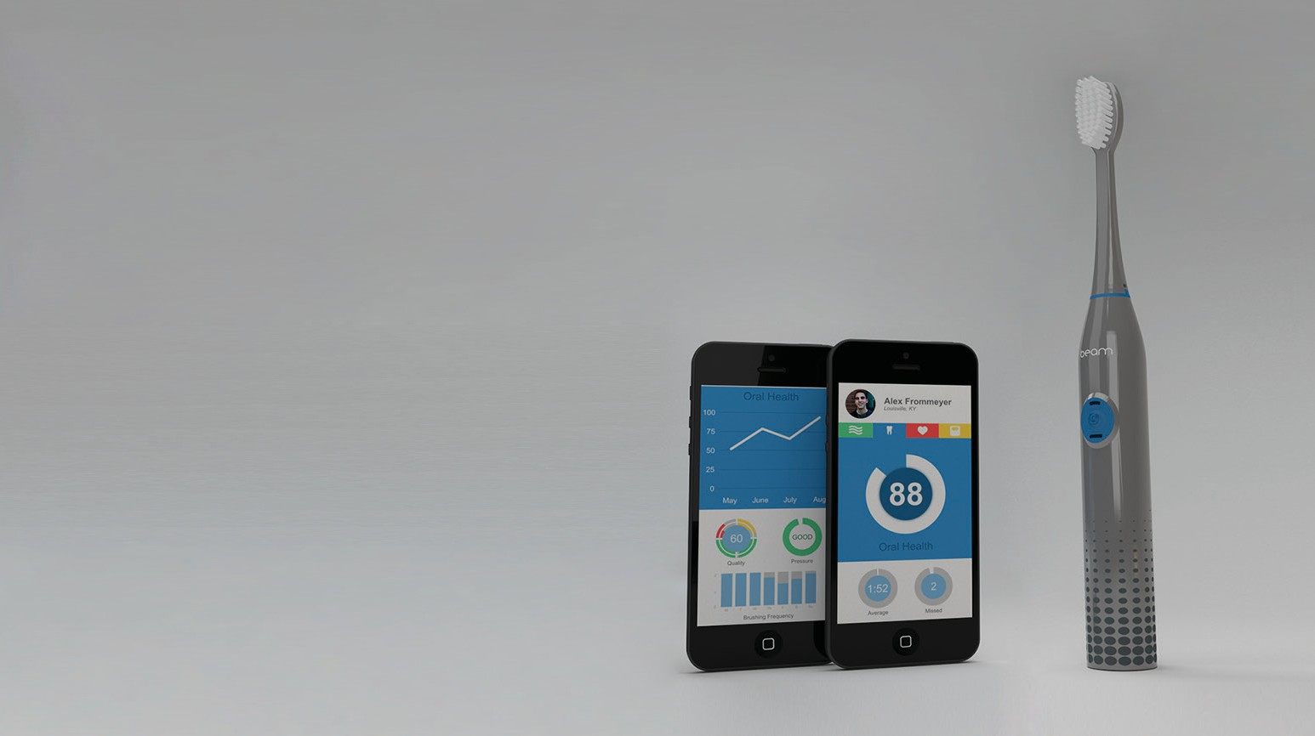
Smart Tooth Brush
The Beam Brush is a connected toothbrush that engages users with their daily hygiene routine.
http://www.beamtoothbrush.com/toothbrush/
CENTRO ESCOLAR UNIVERSITY

Slide 14
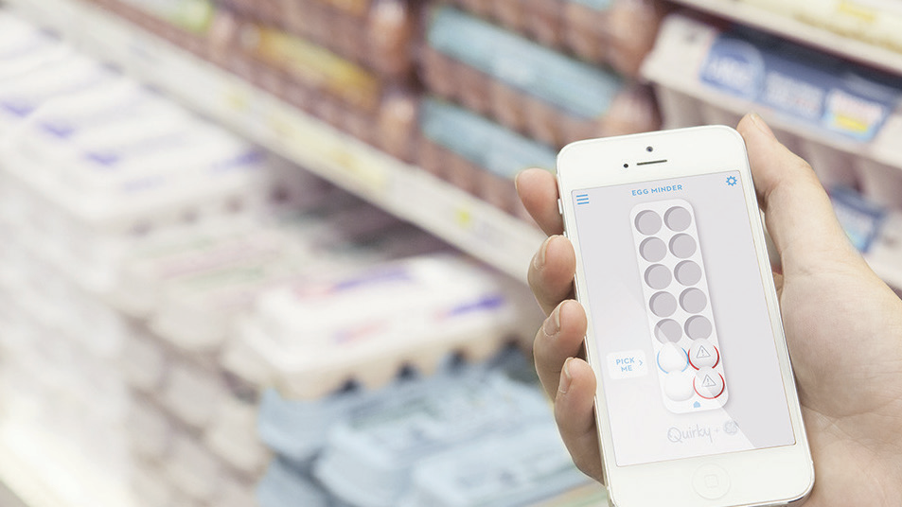
Smart Egg Tray
Egg Minder syncs with your smartphone to tell you how many eggs you’ve got at home (up to 14 eggs) and when they’re going bad.
http://www.quirky.com/shop/619
CENTRO ESCOLAR UNIVERSITY

Slide 15
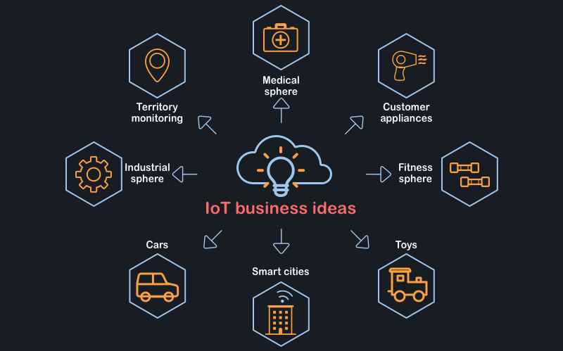
IoT business opportunities
CENTRO ESCOLAR UNIVERSITY

Slide 16
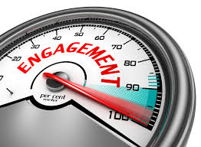
IoT − Advantages
Improved Customer Engagement – Current analytics suffer from blind-spots and significant flaws in accuracy; and as noted, engagement remains passive. IoT completely transforms this to achieve richer and more effective engagement with audiences.
CENTRO ESCOLAR UNIVERSITY

Slide 17
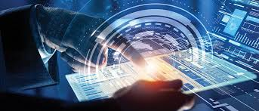
IoT − Advantages
Technology Optimization – The same technologies and data which improve the customer experience also improve device use, and aid in more potent improvements to technology. IoT unlocks a world of critical functional and field data.
CENTRO ESCOLAR UNIVERSITY

Slide 18
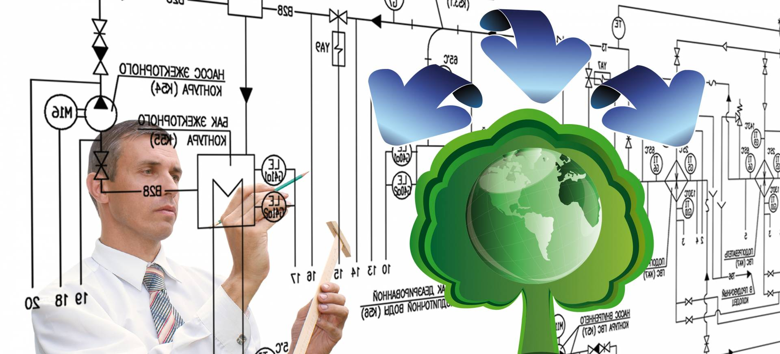
IoT − Advantages
Reduced Waste – IoT makes areas of improvement clear. Current analytics give us superficial insight, but IoT provides real-world information leading to more effective management of resources.
CENTRO ESCOLAR UNIVERSITY

Slide 19
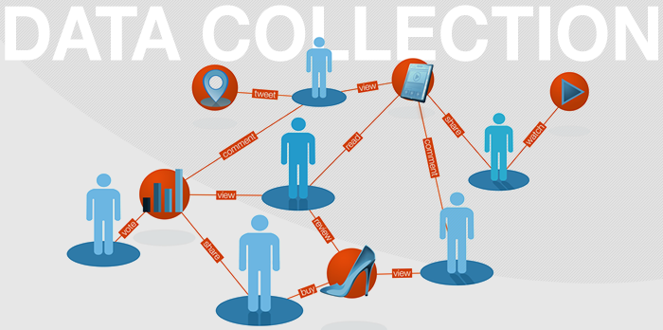
IoT − Advantages
Enhanced Data Collection – Modern data collection suffers from its limitations and its design for passive use. IoT breaks it out of those spaces, and places it exactly where humans really want to go to analyze our world. It allows an accurate picture of everything.
CENTRO ESCOLAR UNIVERSITY

Slide 20
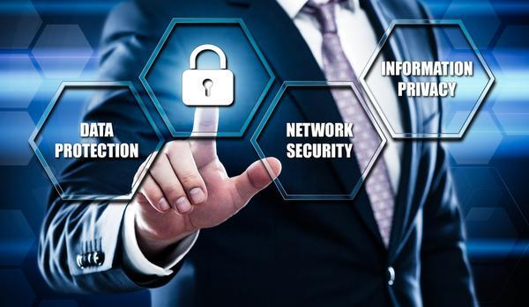
IoT − Disadvantages
Security – IoT creates an ecosystem of constantly connected devices communicating over networks. The system offers little control despite any security measures. This leaves users exposed to various kinds of attackers.
CENTRO ESCOLAR UNIVERSITY

Slide 21

IoT − Disadvantages
Privacy – The sophistication of IoT provides substantial personal data in extreme detail without the user's active participation.
CENTRO ESCOLAR UNIVERSITY

Slide 22
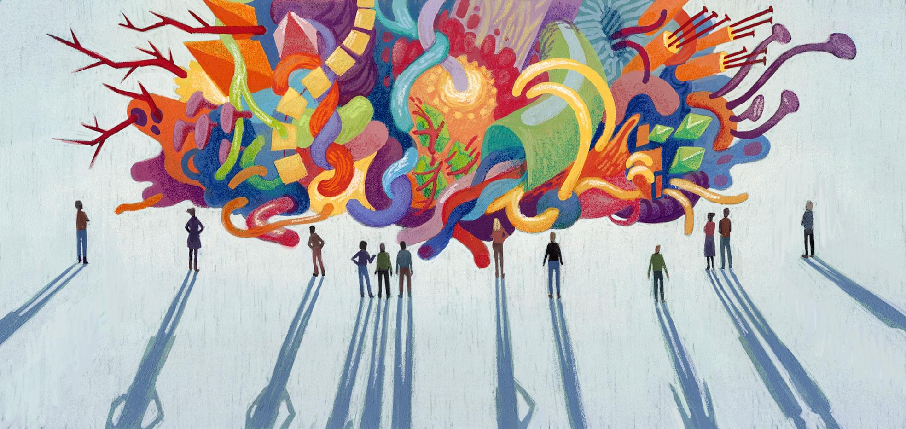
IoT − Disadvantages
Complexity – Some find IoT systems complicated in terms of design, deployment, and maintenance given their use of multiple technologies and a large set of new enabling technologies.
CENTRO ESCOLAR UNIVERSITY

Slide 23
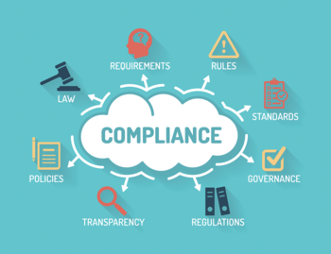
IoT − Disadvantages
Compliance – IoT, like any other technology in the realm of business, must comply with regulations. Its complexity makes the issue of compliance seem incredibly challenging when many consider standard software compliance a battle.
CENTRO ESCOLAR UNIVERSITY

Slide 24




Securing IoT Devices
Authentication – IoT devices connecting to the network create a trust relationship, based on validated identity through mechanisms such as: passwords, tokens, biometrics, RFID, X.509 digital certificate, shared secret, or endpoint MAC address.
Network Enforced Policy – controls all elements that route and transport endpoint traffic securely over the network through established security protocols.
Authorization – a trust relationship is established based on authentication and authorisation of a device that determines what information can be accessed and shared.
Secure Analytics: Visibility and Control – provides reconnaissance, threat detection, and threat mitigation for all elements that aggregate and correlate information.
CENTRO ESCOLAR UNIVERSITY

Slide 25
THANK YOU!
JOSAN D. TAMAYO
CENTRO ESCOLAR UNIVERSITY
+639328917167
JTAMAYO@CEU.EDU.PH
CENTRO ESCOLAR UNIVERSITY

