Slide 1



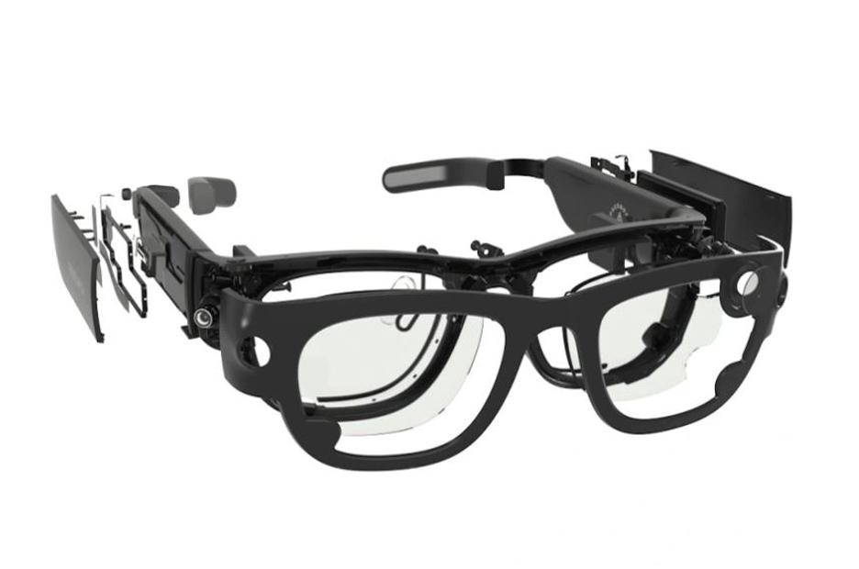
Final Project Presentation
3D objects detection – Aria glasses
Hands-Free Museum Audio Guide on Meta Aria Smart Glasses
Students: Arthur Friler, Daniel Sitbon
Field-tested at the Tel Aviv Museum of Art
Supervisor: Ben Kretzu
Semester: Winter, 2025-2026
Date: 24/08/26

Slide 2
Outline
1
Motivation & Project Goal Why a hands-free, attention-driven guide
2
Background & Related Work Project Aria, enabling AI and the gap we fill
3
Our Solution Perception, recognition, narration, playback control
4
Personalized Visitor Experience Language, age, expertise and description length
5
Demo & Results Live demo, latency benchmark, Tel Aviv Museum field test
6
Business Case & Next Steps Go-to-market, limitations, future work
2

Slide 3
Motivation
Audio guides should follow the visitor's attention - not the other way around.
Traditional audio guides
What we want
Manual: type a number or scan a code for each work
Hands and eyes busy with a device, not the art
Fixed, pre-recorded track per catalogued item
Nothing to say about un-catalogued works
No idea what the visitor is actually looking at
Fully hands-free - stop in front of a work and it speaks
Narration follows the visitor's attention (motion + dwell)
Descriptions generated on the fly, never pre-recorded
Works for catalogued and free-visit (unknown) works
Low latency: first sound in under 3 s
Business angle One system serves any collection - no per-museum recording, no manual tagging. Lower content cost, instant multilingual coverage (EN / FR / ES) and per-visitor personalization, delivered as a SaaS / licensing offer to museums, galleries and heritage sites - tested on site in collaboration with the Tel Aviv Museum of Art.
3

Slide 4
Project Goal
Deliver a hands-free, personalized museum audio guide on Meta Aria smart glasses: it detects when the visitor stops in front of a work, recognizes it with a vision-language model, and speaks a generated description adapted to the visitor - with low latency, on any collection.
Goals
Assumptions & Constraints
Seamless, low-latency narration driven by visitor attention
Natural guide narration, personalized per visitor (language, age, expertise, length)
Handle both catalogued and free-visit (unknown) works
Walk / pause / resume behaviour that feels natural in a gallery
Validate in a real museum, not only in the lab
Real-time egocentric RGB + IMU stream from Aria glasses
Cloud vision / TTS - network latency must be hidden
Aria is a capture device: all compute runs off-glass
Prototype / POC built by a 2-person team (Python)
4

Slide 5
Background: The Project Aria Platform
Project Aria (Meta Reality Labs) is a research pair of smart glasses for egocentric, multi-modal AI - a data-capture and streaming device, not an on-device compute platform. [Engel et al., 2023]
RGB POV camera
Dual IMU
Microphones
Forward point-of-view, what the wearer sees
Head motion / immobility (up to 1 kHz)
7-mic spatial audio array
VRS streaming
MPS
Time-aligned sensor streams over USB / Wi-Fi
Trajectory, point cloud, eye-gaze post-processing
Final system uses two streams: the RGB camera (what is in view) and the IMU (walking vs. standing still) - streamed over Wi-Fi.
5

Slide 6
Enabling AI Building Blocks
Vision & Language
Prompt Engineering
Text-to-Speech
GPT-5.6-terra Vision via the Responses API (migrated from GPT-5.4-mini)
Open-set recognition from a single compressed frame
No per-museum training or tagging
Same call streams the guide script sentence by sentence
System prompt built per visitor profile (language, register, depth, length)
Structured tokens: ARTWORK / NONE / END
Exclusion list against false positives; reproductions count as the work
Museum catalog injected as a closed candidate list, cached by the provider
GPT-4o-mini-TTS with verbal style instructions (migrated from TTS-1)
Voice and speaking rate per age group (fable / nova / shimmer)
Per-sentence synthesis for low latency
Framing phrases pre-generated and cached on disk
Cloud models give strong recognition and natural speech; our engineering effort went into hiding their latency.
6

Slide 7
Literature Survey
Vallez et al., 2020 - “Automatic Museum Audio Guide”, Sensors
Approach
Limitations / Gap
Headset with a small camera + embedded vision board (EoT)
Recognizes paintings with FAST keypoints + a Random Forest classifier
Plays the matching audio when a painting is recognized
Closed-set: only pre-catalogued paintings
Audio is fixed / pre-recorded per work
No notion of where the visitor is looking
Cannot handle unknown / free-visit works
Strengths
Truly hands-free; recognition runs continuously
Very low power - runs a full day on battery
Validated in a real-museum pilot; users preferred it to classic guides
7
Notes:
Vallez et al., 2020"העבודה הרלוונטית הראשונה היא של

Slide 8
Literature Survey
Taverriti et al., 2016 - Real-time Wearable CV for Museums, ACM MM
Approach
Limitations / Gap
Ego-vision wearable camera + motion sensors
Compact CNN for object classification & artwork recognition
Infers context: looking at a work vs. walking vs. talking
Recognition trained per collection (closed-set)
Delivered content is still pre-defined
Uses coarse context, not an explicit gaze signal
No generative, on-the-fly narration
Strengths
Context-aware - reacts only when the visitor attends a work
Real-time on a mobile device
Builds an interest profile from what / how long is observed
8
Notes:
הם הוסיפו מודעות להקשר. מצלמת אגו-ראייה עם חיישני תנועה ו-CNN קומפקטית מסווגת יצירות אמנות אך גם מסיקה האם המבקר מסתכל על יצירה, הולך או מדבר. היא בונה פרופיל עניין מזמן התצפית. ובכל זאת, הזיהוי הוא סגור לכל אוסף, התוכן מוגדר מראש, ואין נרטיב יצירתי."

Slide 9
Literature Survey
Zhang, Tas & Koniusz, 2017 - Artwork ID from Wearable Cameras, arXiv
Approach
Limitations / Gap
Wearable camera captures works as the visitor strolls
CNN pre-trained on ImageNet, fine-tuned per museum
Builds a detailed record of the visit
Requires fine-tuning on each museum's collection
Closed-set recognition; no open-set ability
Focus on identification, not narration
No real-time audio delivery
Strengths
Studies real wearable-camera conditions (blur, angle, glare)
Quantifies how museum space affects recognition accuracy
Practical guidance for robust artwork ID
9
Notes:
מצלמה לבישה לוכדת את העבודה בזמן שהמבקר מטייל, כאשר צוות CNN אומן מראש ב-ImageNet ומכוון לפי מוזיאון. תרומתם היא בעיקר אמפירית - הם חוקרים את התנאים האמיתיים של מצלמות לבישות: טשטוש, זווית, סנוור. אבל שוב, זיהוי דורש כוונון עדין בכל מוזיאון, זה סט סגור, ואין העברת שמע בזמן אמת."

Slide 10
Literature Survey: Summary & Our Contribution
Work | Hands-free | Recognition | Coverage | Narration | Trigger
Vallez 2020 | Yes | FAST + Random Forest (closed-set) | Catalogued only | Pre-recorded | Continuous CV
Taverriti 2016 | Yes | CNN (closed-set) | Catalogued only | Pre-defined | Visit context
Zhang 2017 | Yes (camera) | Fine-tuned CNN (closed-set) | Catalogued only | Record / none | Continuous
Ours (Aria) | Yes | Vision-Language Model (open-set + closed catalog) | Catalogued + free visit | Generative + personalized | Stop & dwell (IMU)
Our contribution: motion-triggered playback, generative narration personalized per visitor, and a plain-text catalog that makes recognition work on any collection - no per-museum training, no infrastructure in the gallery.
10

Slide 11
Our Solution: System Overview
A multi-threaded streaming pipeline - each stage runs in parallel and communicates through queues.
PERCEIVE
UNDERSTAND
SPEAK
Aria stream
Motion gate
Artwork
recognition
Narration
Audio
playback
RGB POV
+ IMU
IMU: walking
vs. standing still
VLM: ARTWORK +
description / NONE
LLM stream ->
TTS (profile voice)
pygame ->
in-ear audio
Control logic: de-duplicate works already narrated; play a cached opener and announce the title to mask latency; pause the moment the visitor starts walking and resume exactly where the narration stopped; discard frames captured before the last stop so the audio always matches the current view.
11

Slide 12
Our Solution: Attention Detection (IMU)
Standing still means interest; walking means move on - the body, not a button, drives the guide.
1
Walking detector (motion.py)
2
Calibrated hysteresis
Rolling std-dev of accelerometer norm over a 1 s window
Still = gravity only; walking = periodic oscillation
Runs at ~10 Hz on the Aria IMU stream
Thresholds tuned on the real stream: enter 0.75 / exit 0.30
Debounce: 5 consecutive samples to declare walking
Stop is immediate - better to mute late than miss a stop
IMU stream
Walking?
Standing still
Analyse & narrate
A cheap sensor signal gates every expensive cloud call - and replaces the earlier out-of-frame trigger, which fired far too often.
12

Slide 13
Our Solution: Walk / Pause / Resume
Standing still
artwork
Narrating
walk_event
Walking
still
Back in front
artwork detected
sentence by sentence
finish sentence, pause
resume where it stopped
Never cut mid-sentence
Progress saved per work
The current sentence always finishes; the pause gate is checked before the next one
Remaining sentences are stored the instant walking is detected
Resume, never regenerate
Freshness filter
Welcome-back phrase, then the saved sentences - guide finished means silence
Sentences from frames older than the last stop are dropped, headers included
13

Slide 14
Our Solution: Recognition & Prompt Design
Open-set recognition (VLM)
Latency-hidden narration
One compressed frame per stop is sent to GPT-5.6-terra Vision (Responses API); the system prompt is rebuilt from the visitor profile.
Cached opener plays instantly, then the title: “This is X”
Description streamed sentence by sentence, one TTS call each
5 to 18 sentences depending on the visitor profile
END signal triggers a closing phrase instead of a hard stop
Two latencies measured: UX (opener) and REAL (first true sentence)
ARTWORK: <name>
+ description sentences (profile length)
NONE if nothing notable / END when done
Exclusion list removes false positives (ceilings, lamps, furniture, people)
Asymmetric doubt: unsure it is art -> NONE; art but unidentified -> describe anyway
Reproductions (screen, poster, postcard) count as the work itself
Optional catalog section narrows recognition to a closed candidate list
14

Slide 15
Our Solution: The Museum Catalog
Closed-set matching (museum_db.py)
Incremental working method
Matching what the camera sees against a short closed list is a far easier task for the model than open-set recognition.
Start from a bare list of titles and artists - minutes of work from the museum's own checklist
Test in the gallery, then enrich only the works the model misses
Add visual and notes fields to suppress invented details
Text only: no reference photographs of the collection needed
Records missing a required field are filtered and reported at load time
"id", "title" -> required
"artist", "year", "type", "room"
"visual", "notes" -> only if needed
One JSON file per museum, loaded once and injected into the system prompt
Prompt stays static for the session, so the provider cache absorbs its cost
Titles are copied verbatim, giving canonical names that stabilize re-visits
15

Slide 16
Personalized Visitor Experience
Five questions at launch
What the visitor hears
A short questionnaire builds a visitor profile that is frozen for the whole visit.
Vision prompt rebuilt per profile: output language, register, depth
Voice per age group: fable (child), nova (teen / adult), shimmer (senior)
Native accent and speaking style passed as TTS instructions
Opener, welcome-back and closing phrases localized EN / FR / ES
Control tokens stay in English, so the pipeline parsing never changes
Adding a language = one entry plus a phrase set, no code change
language: EN / FR / ES
age: child / teen / adult / senior
knowledge: novice / intermediate / expert
length: short / medium / long
museum: catalog used as recognition aid
Length presets of 5-8, 9-13 or 14-18 sentences, enforced in prompt and playback
Age and expertise are independent axes - a child can be an expert
Museum choice loads the catalog injected into the recognition prompt
16

Slide 17
Latency Hiding & Pre-generated Audio
Pre-generated TTS cache
Hiding the cloud round-trip
Opening, welcome-back and closing phrases are synthesized once with gpt-4o-mini-tts instead of at every launch.
Cached opener plays in under 3 s, before any model has answered
Artwork title announced live - content-dependent, cannot be cached
Sentence streaming: audio plays while the next sentence is still written
Small queues keep the narration aligned with what is in view now
Stale frames are skipped outright - a full vision pass costs 10-20 s
tts_cache/<lang>/<age>/<pool>/<sha1>.mp3
288 clips, ~20 MB, versioned with the code
missing clip -> logged, never a live call
Idempotent script: a new language or phrase only generates what is missing
17

Slide 18
Engineering & Robustness
✓
Zero-friction launch
run.sh checks and installs dependencies, pairs the SDK and finds the glasses by ARP scan with a cached IP
✓
Wireless streaming
Phone hotspot is the reference setup
✓
Clean shutdown
Ctrl+C unsubscribes the Aria client then stops the stream
✓
Session audio recording
Every clip actually heard is saved with a pre-playback timestamp, ready to align with the demo video
✓
Hardened de-duplication and logging
EN / FR / ES stop-words removed and threshold raised to 0.6; every played clip is logged with its type and text
18

Slide 19
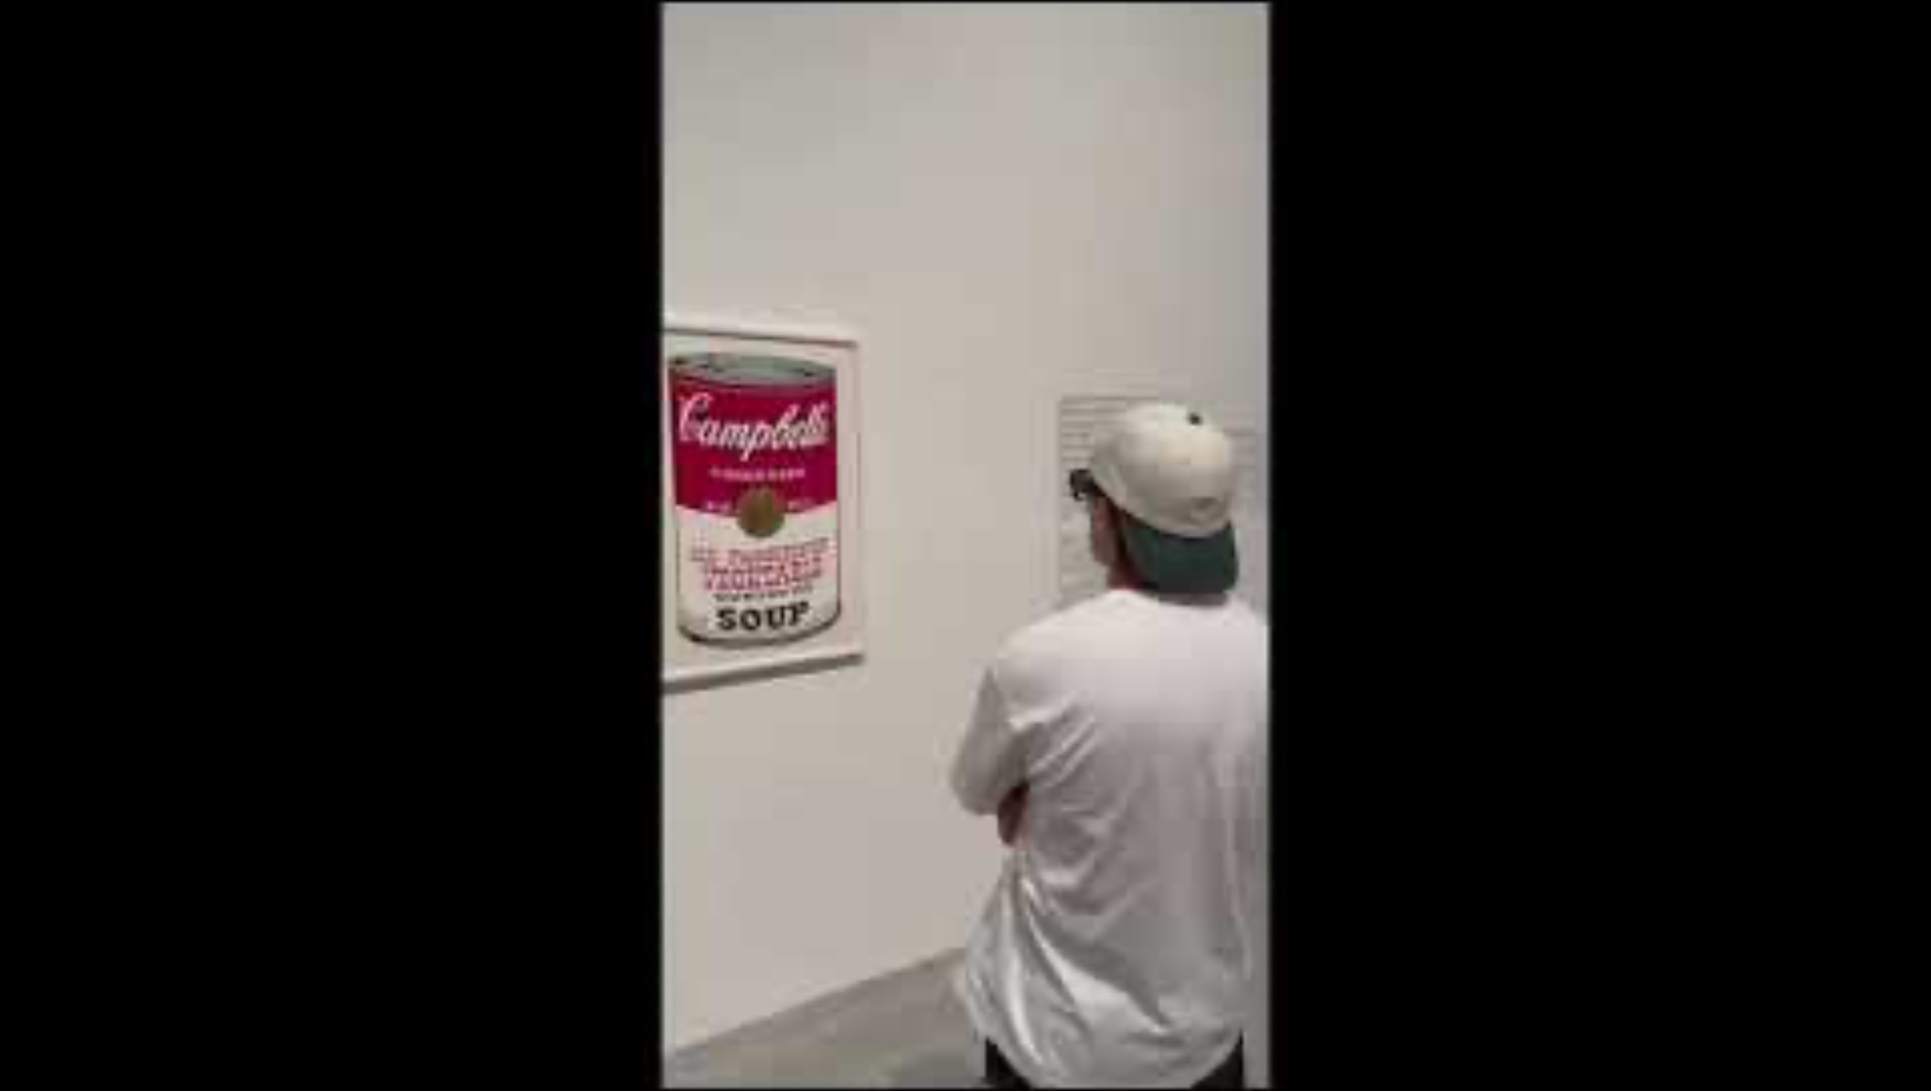
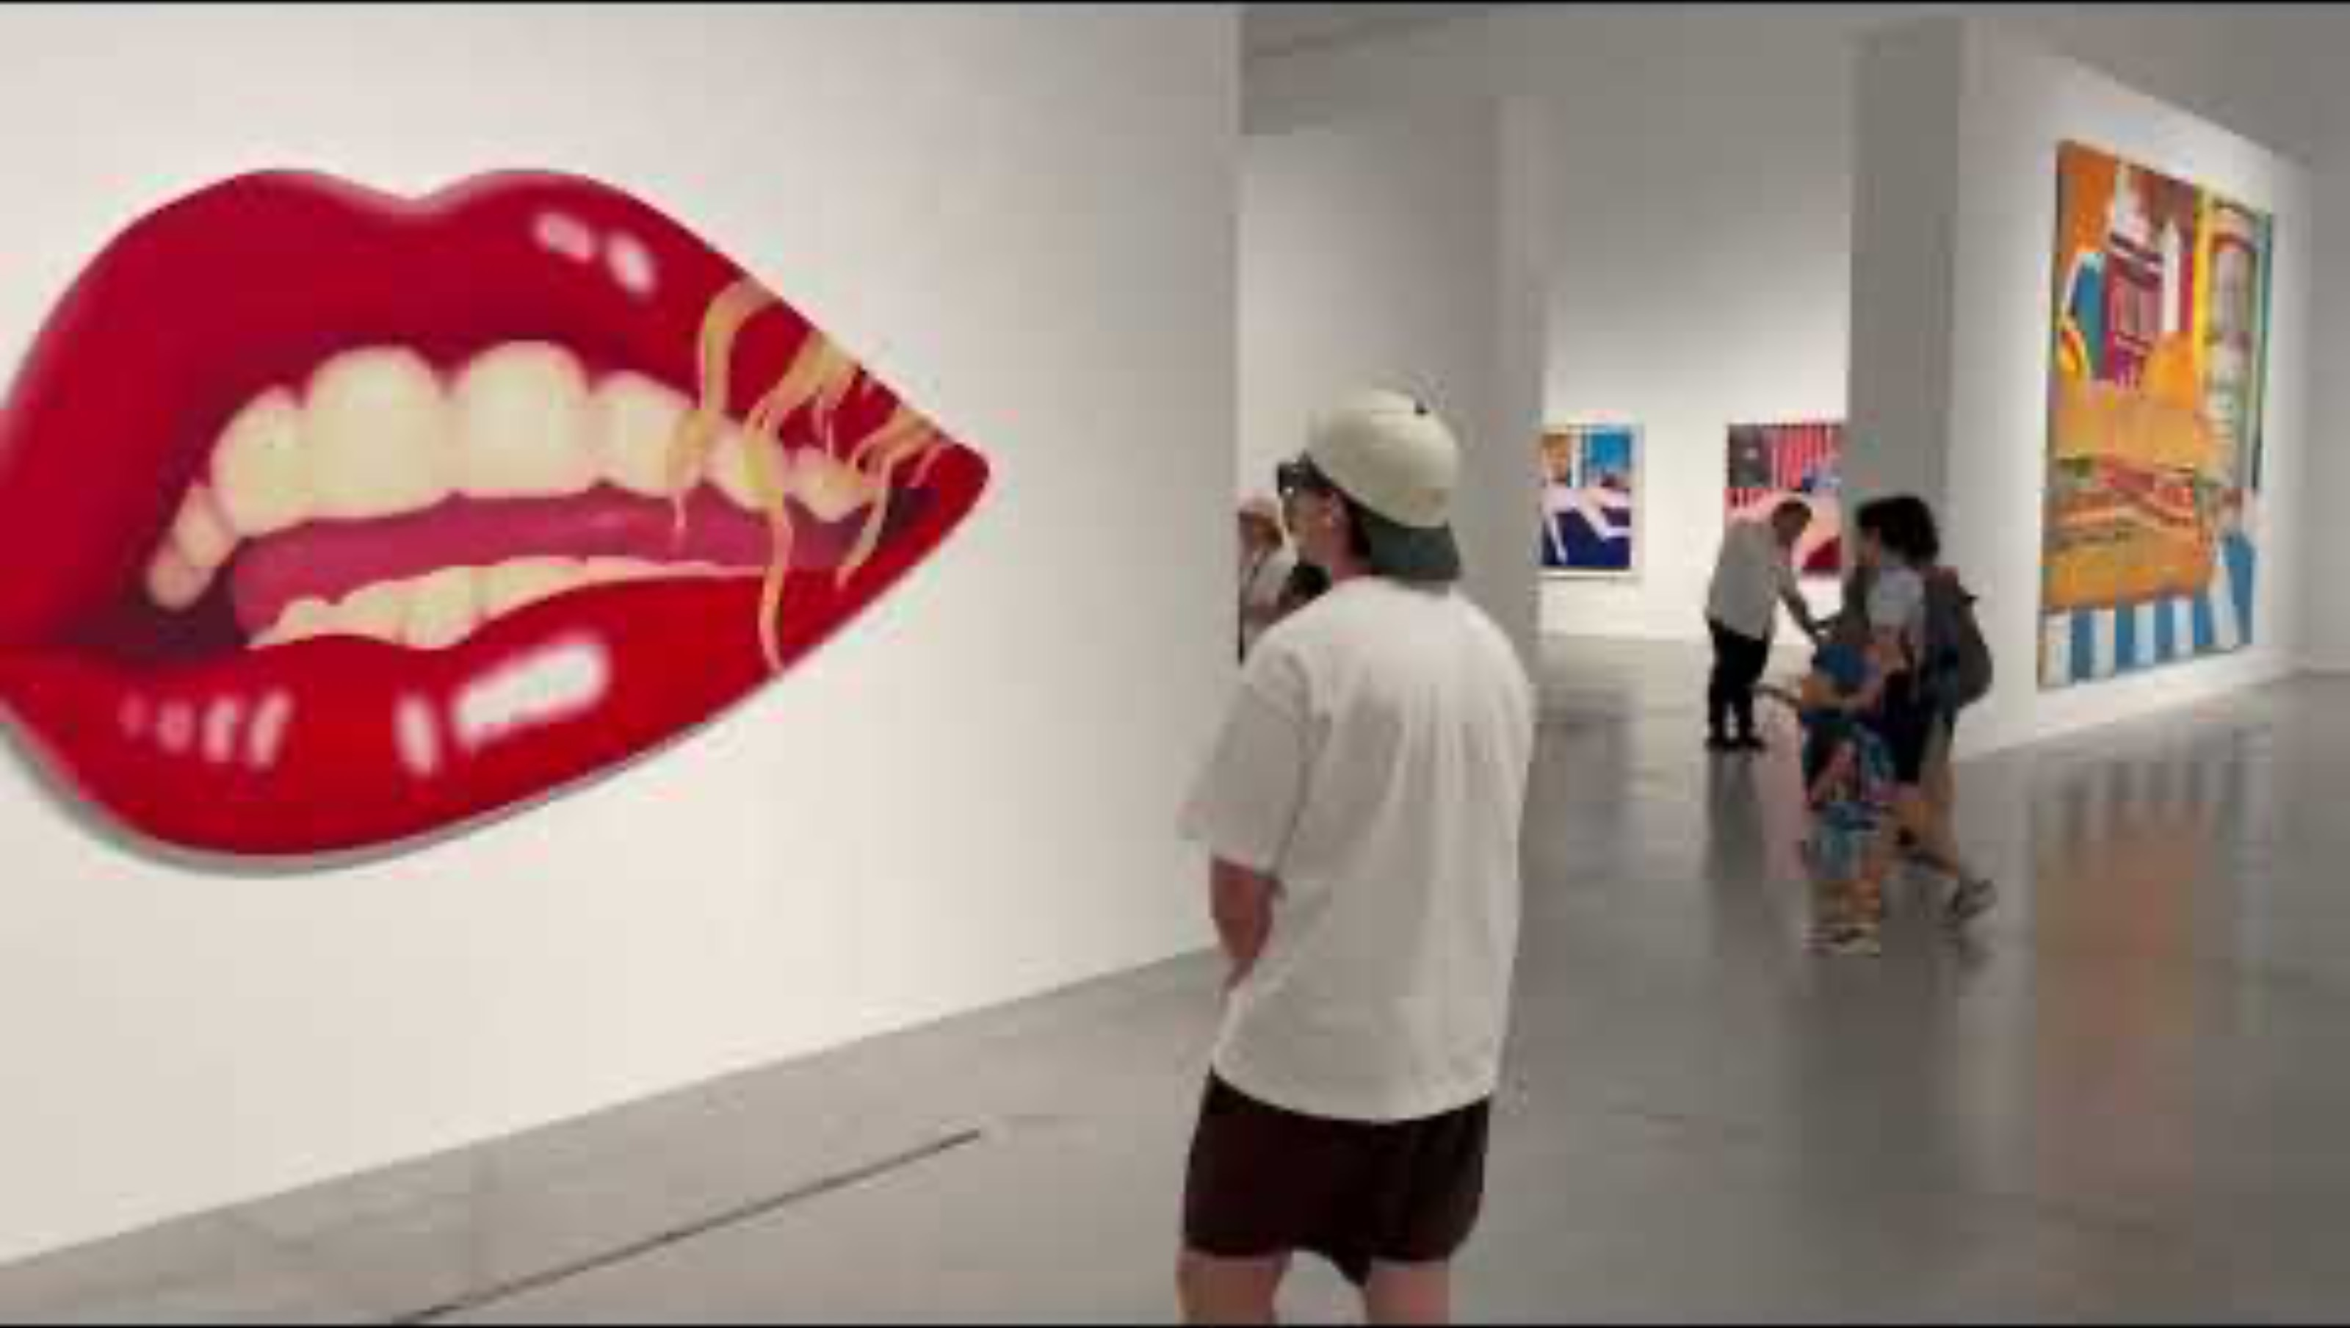
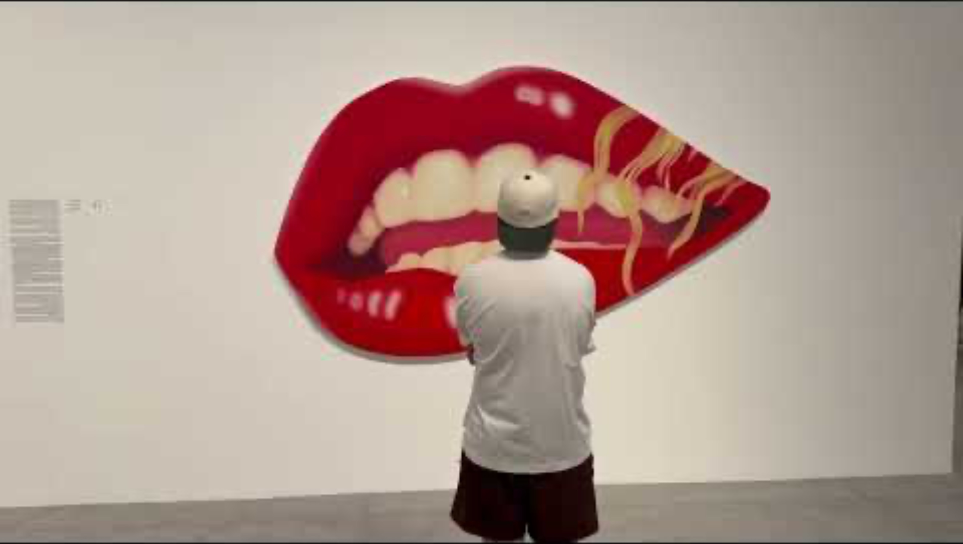
Live Demo: Three Scenarios
Recorded on site at the Tel Aviv Museum of Art, in collaboration with the museum. Audio is the guide track captured during the session.
1 · Novice, age 8
Short wording, child voice and pace
2 · Artwork to artwork
Walking pauses at the end of the sentence; the next work starts a new description
3 · Expert mode: interrupt & return
Deeper description; walking away interrupts, returning resumes where it stopped
19

Slide 20
Results: Measured Latency
Two metrics were defined: UX = time to the first sound the visitor hears, REAL = time to the first description sentence. Figures below are the delivered setup (gpt-5.6-terra + gpt-4o-mini-tts) over Wi-Fi.
UX latency
REAL latency
≈ 3 s
≈ 8 s
Cached opener - the wait is never silent
First generated description sentence
Timeline (per new artwork)
Visitor stops
(t = 0)
Generic opener
= UX latency
First real sentence
= REAL latency
Table 4.1 (early comparison, one run each): gpt-5.4-mini + tts-1 2.98 / 7.75 s, gpt-4o-mini + tts-1 4.58 / 10.00 s,
gpt-5.4-mini + gpt-4o-mini-tts 4.12 / 9.29 s (UX / REAL) - the choice at that point, not the delivered setup.
20

Slide 21
Field Test: Tel Aviv Museum of Art
✓
Visit 1 - Year Zero exhibition, no catalog
Open-set recognition returned generic descriptions on works that are not world-famous; famous works were recognized well in the same conditions
✓
The finding that shaped the system
A general VLM is limited by what it knows about a given collection - the answer is narrowing the candidate space, not a larger model
✓
Mechanism validated off site
A 3-work catalog: all three matched correctly, and a famous work outside the catalog was named without being forced onto any entry
✓
Visit 2 - Tom Wesselmann exhibition, 11-work catalog
Minimal schema only (id, title, artist - visual and notes left empty); the 5 works presented on site were all recognized correctly, in gallery lighting and at an angle
✓
What the field test proves
The catalog grew almost fourfold with no loss of match quality - a bare title list, produced in minutes, is enough for a museum to adopt the method
21

Slide 22
Business Case & Go-to-Market
The content cost of an audio guide drops to near zero - the guide is generated, not recorded.
What museums pay for today
What we offer
Script, voice talent and studio time for every work, in every language
Each new exhibition means new recordings and manual tagging
Devices to buy, charge, clean and hand out
Nothing available for temporary or un-catalogued works
Generative guide: no recording, no per-collection training
Multilingual on day one - EN / FR / ES, one entry per new language
Personalized per visitor: language, age, expertise, length
Hardware-agnostic: Aria + laptop today, Ray-Ban Meta + phone tomorrow
Go-to-market Pilot with the Tel Aviv Museum of Art as reference site, then galleries, heritage sites and city tours. Annual site licence plus per-visit usage; the only variable cost is cloud inference, which falls with every model generation.
22

Slide 23
Challenges & Limitations
Catalog dependency
Without a catalog the model only names world-famous works and returns a generic description for all the rest
Experience quality therefore depends on the museum providing at least a list of titles
Name-based re-recognition
Returning to a work is matched on the title string, so overlapping titles can still count as two works
Mitigated: stop-words removed, threshold raised to 0.6. Real fix is visual matching (CLIP / ORB)
Cloud dependency and latency
Vision and TTS round-trips cost several seconds and require a stable connection
Cached opener and sentence streaming hide most of it; a local model remains untested
23

Slide 24
Future Work
1
Catalogs at exhibition scale Extend catalogs to a whole exhibition and study their effect on latency; define a working procedure with curatorial teams for full checklists, or photograph the wall labels and convert them
2
Streaming speech synthesis Begin speaking a sentence before its synthesis completes, offsetting the extra latency of the advanced TTS engine
3
Local model on the device Study running a local model on the device to reduce the dependency on the network and on an external service
4
Adapt to Meta Ray-Ban glasses Commercial consumer hardware with integrated camera and speakers - the whole experience on a device the visitor holds, with no laptop. Sensor-stream access, especially the motion signal the pause logic relies on, must be examined separately
24

Slide 25
Summary
Goal: a hands-free museum guide on Meta Aria that narrates the artwork the visitor stops in front of - in their language, at their level.
Delivered
Why it is new
Live end-to-end pipeline on the Aria stream, EN / FR / ES
Motion-driven control: walk to pause, stop to resume where it left off
Personalization by language, age, expertise and length - voice included
Museum catalog turning open-set recognition into closed-set matching
About 3 s to the first sound, about 8 s to the first generated sentence
Attention-driven
narration follows where the visitor stops
Catalog-assisted
a bare list of titles is enough
Field-tested at the Tel Aviv Museum of Art: 5 of 5 works recognized in the Tom Wesselmann exhibition, with an 11-work catalog.
Personalized
Key conclusions: visitor motion is a better control signal than field of view · matching against a closed list beats open-set recognition · hiding latency is as effective as shortening it.
language, age, expertise, length
Next: visual re-recognition, catalogs at exhibition scale, streaming TTS, on-device model, port to Meta Ray-Ban.
25

Slide 26
Acknowledgements
Ben Kretzu - project supervisor
For being available throughout the project, for listening carefully whenever we were stuck, and for advice that shaped the key design decisions of this system.
Roni Trabelsi - Tel Aviv Museum of Art
For opening the museum's doors to us and making the field tests possible in real galleries, with real works and real visitors - the validation this project rests on.
Thank you.
26

