Slide 1
Hass Avocado Dashboard
By Daniely Mosquera
DA Consulting
Expect to Grow

Slide 2
Objectives
Show the territorial scope of avocado consumption.
Provide information about avocado sales by region, type and year.
Highlight key performance indicators such us bags sold, average price and total volume.

Slide 3
Region Geocode
Area_LatLong spreadsheet
Area_Delimitation
spreadsheet
Connection to Avocado Table
Identified all the regions based on https://hassavocadoboard.com/
Created the “None” region for Alaska and Hawaii.
Selected a city from each region to represent the region.
Selected latitude and longitude based on Zip_LatLong table.
Assigned a region to each state on t_us_state_dim
Added Up the Cities Honolulu and Ankorage with Zero values for sales indicators
06/01/2022

Slide 4
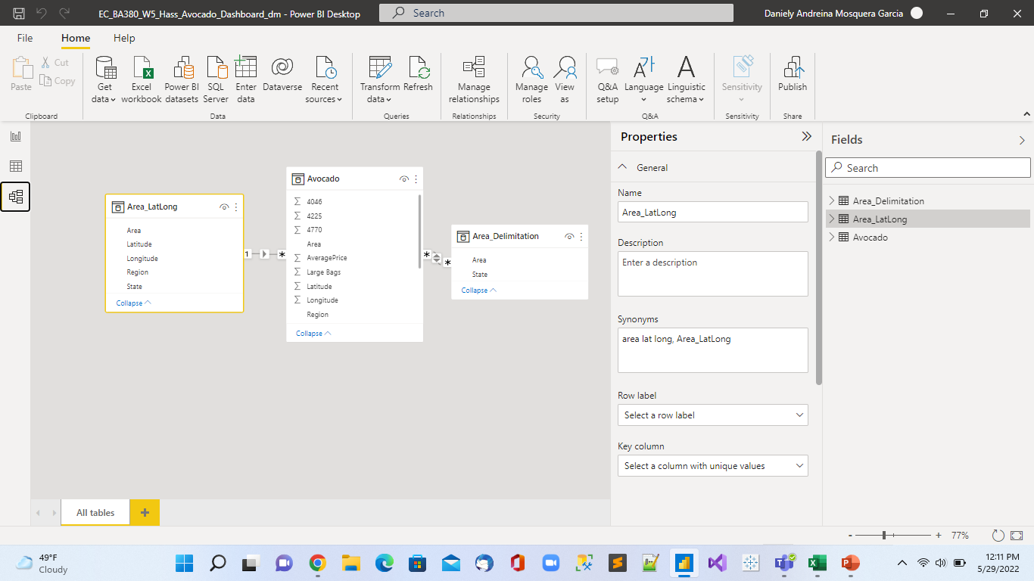
Model

Slide 5
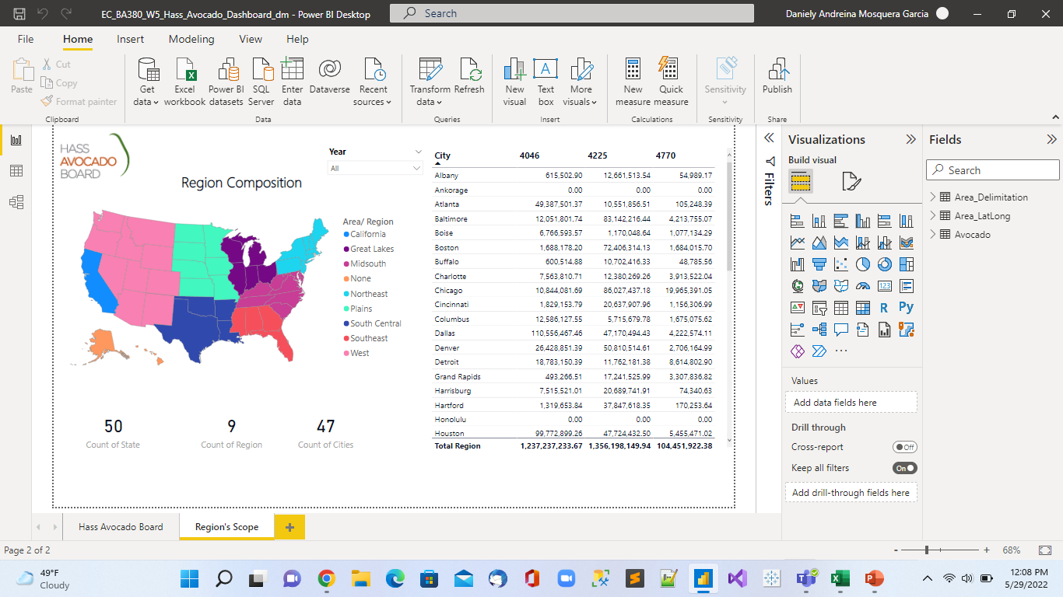

Slide 6
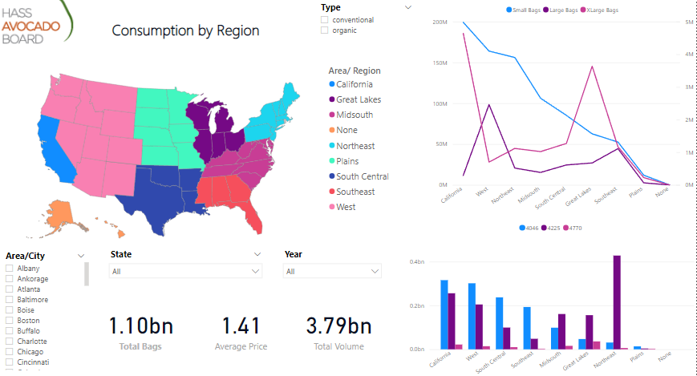
06/01/2022

Slide 7
Resolution
City found in more that one state- Chose the state with more occurrences on the Zip_LatLong Table.
Larger Metropolitan Regions_ Chose only one zip code to represent the whole area.

Slide 8
Thank you!
Daniely Mosquera
DA Consulting
dam53@ensign.edu

