Slide 1
Word Cloud Dashboard
By Daniely Mosquera
June 25, 2022
DA Consulting

Slide 2
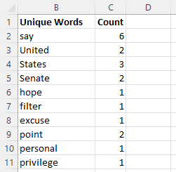
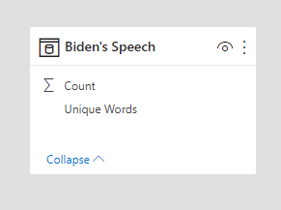
What did you build and how does it work?
Picked a President’s Biden speech
Created Txt file to prepare data
Created Xls file- Word Count
Designed dashboard:
Word cloud, slicers, cards.

Slide 3
What is the purpose and objective of your dashboard?
Highlight the words used the most by President Biden in his speech.
Highlight the words less used by President Biden in his speech.
Show the narrative of his political discourse.

Slide 4
What does this dashboard teach us about your data source?
Descriptive discourse with presence of some argumentative elements.
Persuasion elements.
Rhetorical approach.

Slide 5
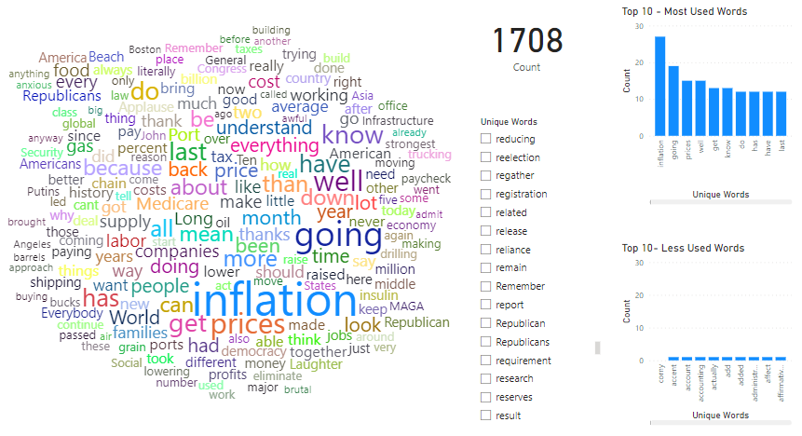

Slide 6
Thank you!

