Slide 1
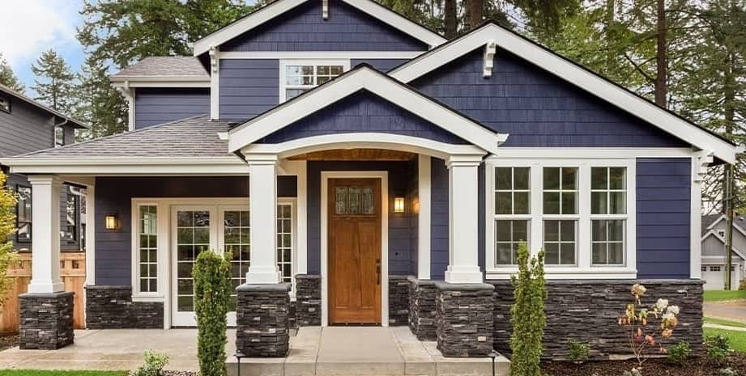
House prices prediction
By Daniely Mosquera
DA Consulting

Slide 2
What did you build and how does it work?
Prepared Data Set
Multiple Linear Regression
Machine Learning Model
Predict House Prices
(84% of the data can be explained by the model)
Power BI Dashboard

Slide 3
What is the purpose and objective of your project?
Study variables that might affect House pricing.
Identify the variables showing more correlation with House Pricing.
Create a model to predict house pricing.

Slide 4
What does your solution teach us about predicting your dependent variable?
The Top 5 delimiters of House Pricing are:
Quality of the material on the exterior
Ground Living Area Sq. Ft.
Garage Car Capacity
Total Sq. Ft. of Basement Area
Basement Finished Sq. Ft.

Slide 5

Thank you!

