Slide 1
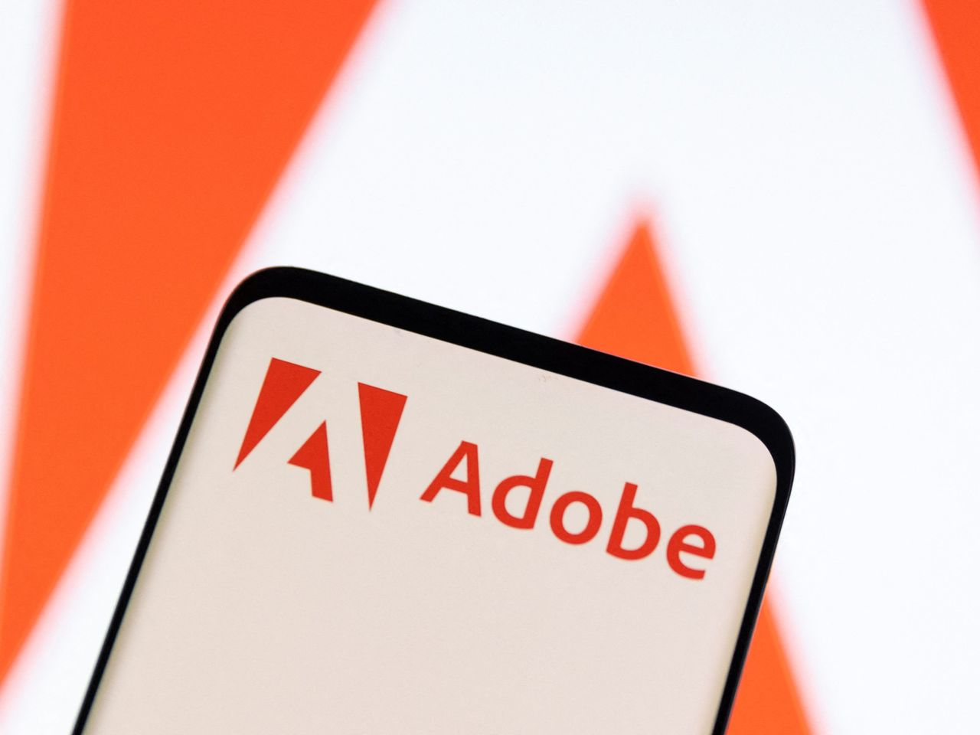
BY
ADS19A00133Y

Slide 2
INTRODUCTION
Adobe originally called Adobe Systems Incorporated is an American multinational computer software company incorporated in Delaware and headquartered in San Jose, California. It has historically specialized in software for the creation and publication of a wide range of content, including graphics, photography, illustration, animation, multimedia/video, motion pictures, and print. Its flagship products include Adobe Photoshop image editing software; Adobe Illustrator vector-based illustration software; Adobe Acrobat Reader and the Portable Document Format (PDF); and a host of tools primarily for audio-visual content creation, editing and publishing. Adobe offered a bundled solution of its products named Adobe Creative Suite, which evolved into a subscription software as a service (SaaS) offering named Adobe Creative Cloud.

Slide 3
BACKGROUND HISTORY
The company was started in John Warnock's garage. Naming the company after the Adobe Creek that ran behind Warnock's home. Interpress eventually evolved into PostScript. Adobe was founded in December 1982 by John Warnock and Charles Geschke, who established the company after leaving Xerox PARC to develop and sell the PostScript page description language. In 1985, Apple Computer licensed PostScript for use in its LaserWriter printers, which helped spark the desktop publishing revolution. Adobe later developed animation and multimedia through its acquisition of Macromedia, from which it acquired Adobe Flash; video editing and compositing software with Adobe Premiere, later known as Adobe Premiere Pro; low-code web development with Adobe Muse; and a suite of software for digital marketing management.

Slide 4
CHALLENGES
Security: Hackers have exploited vulnerabilities in Adobe programs, such as Adobe Reader, to gain unauthorized access to computers. Adobe's Flash Player has also been criticized for, among other things, suffering from performance, memory usage and security problems. A report by security researchers from Kaspersky Lab criticized Adobe for producing products having top 10 security vulnerabilities. Observers noted that Adobe was spying on its customers by including spyware in the Creative Suite 3 software and quietly sending user data to a firm named Omniture. When users became aware, Adobe explained what the suspicious software did and admitted that they: "could and should do a better job taking security concerns into account".
Pricing: Adobe’s products are unique in nature because the company has invested in an area that is lucrative but with limited competition. However, for a long time, the pricing of its products has been inhibitive to the mass market. The company sells its products at premium prices. The pricing approach locks out the mass market and zeros in on the professional market. Most Adobe products are professional software that is used for specific trades.

Slide 5
SOLUTION
Enhanced the Security Features of the Products: Adobe improved the safety features of its products as a way to secure them against piracy. It requires the company to invest in research and development to create reliable methods of fighting piracy. Hackers are unpredictable, and their intentions are varied across the globe. Thus developing a system that is hard to hack requires tremendous effort.
Stick with the Professional Market: The company stuck with the professional market which has served its interests for a long time. The professional market is small and easy to manage compared to the mass market. However, it has been blamed for the stagnation of the company’s share value. Its growth is insignificant because it is a tiny niche in the technological market. The downside of depending on the professional market is that the company is forced to price its products highly (Sako, 2012). The pricing strategy has the effect of locking out other professionals who are not ready to pay premium prices. The move also escalates the risk of the products being pirated because they will remain expensive yet popular.

Slide 6
GROWTH TRAJECTORY
As of 2022, Adobe has more than 26,000 employees worldwide. Adobe also has major development operations in the United States in Newton, New York City, Arden Hills, Lehi, Seattle, Austin and San Francisco. It also has major development operations in Noida and Bangalore in India.
During the 1990s Adobe’s revenues from PostScript licensing continued to increase, as did its sales of PostScript fonts; by the end of 1998 the Adobe Type Library encompassed more than 2,500 typefaces. An ever-larger share of the company’s revenues, however, came from sales of application software, initially for the Macintosh platform but later also for the UNIX and Windows operating systems. By 1997 almost 80 per cent of Adobe’s total revenues came from application sales, and that year marked the first time that Windows-product revenues exceeded Macintosh-product revenues.
Adobe generates 90% of its revenue from subscriptions, providing a strong cash flow profile given the highly visible nature of its future financial performance.

Slide 7
RANKING
Since 2000, Fortune has recognized Adobe as one of the 100 Best Companies to Work For. In 2021, Adobe was ranked 16th. Glassdoor recognized Adobe as the Best Place to Work. In October 2021, Fast Company included Adobe on their Brands That Matter list. In October 2008, Adobe Systems Canada Inc. was named one of "Canada's Top 100 Employers" by Media Corp Canada Inc. and was featured in Maclean's news magazine.
Adobe received a five-star rating from the Electronic Frontier Foundation with regard to its handling of government data requests in 2017.

