Slide 1
FINAL PROJECT VIVA VIDEO
BY
MOJISOLA ZAINAB ANOFIU
(ENG21B00136Y)

Slide 2
Project Introduction
The field of study with regard to this project is Computer Engineering, whereas the subject area is AN IMPROVED AUTOMATIC ARTICLE SUMMARIZATION SYSTEM.
Automatic Article summarization is a feature of machine learning, natural language processing (NLP), and data mining. As data volumes grow and the need to handle them more efficiently grow, it is becoming a popular study topic. The goal is to discover the core of the supplied text set and reduce its size while covering the key concepts and general meaning and avoiding repetition. Although there is growing interested in summarization and new approaches are constantly being developed, there are still unanswered questions about how to achieve a deeper understanding of the document topic (natural language understanding, NLU), how to handle long documents, and how to improve evaluation methods.

Slide 3
Problem Statement
The internet is now accessible to the general people via a variety of devices such as smartphones and smartwatches. As a result, a wealth of knowledge is now accessible via the internet. More information on the internet may make it difficult to select only important information from large documents. A manual summary of information is a complex and time-consuming task due to the content.

Slide 4
General and Specific Objectives
General Objective
The aim of this project is to create an automatic summarization system that allows users to request from a pool of data and summarize it and also have the ability to upload documents and get a summarized version of it. It is also aimed at allowing users to be able to discover, consume and digest relevant information faster.
Specific Objectives
To help users know how to discern the most important ideas in a text and how to ignore irrelevant information.
Help users in integrating central ideas in a meaningful way.
To give users the ability to upload data and extract the summarized version of the uploaded data.
To validate and evaluate the performance of the system research

Slide 5
Literature Review
Many other research works have contributed to the development of an automated article summarization system and the systems have been yielding good results. These related works together with the techniques used and their limitations are listed below;
Gaps:
Amjad, (January 13, 2011) Coherent citation-based summarization of scientific paper. Topic words, Page Rank, and Lex Rank, Technique were limited to the use of the key phrase, and it couldn’t go further to summarize other types of data.
John, (march 2011) Personalized and automatic social summarization of events in videos. The technique gave lots of issues as it didn’t drop some redundant words
Ibrahim F. (January 2010) Semantic Graph Reduction Approach for Abstractive Text Summarization Semantic graph-based approach This technique is limited to single document summarization it cannot be used for multiple document summarization

Slide 6
Methodology Used
The Adopted methodology for the proposed system is Agile. Agile software development is a collection of iterative software development approaches in which requirements and solutions emerge through collaboration among self-organizing cross-functional teams. In general, agile methods and processes promote a disciplined project management process that encourages frequent inspection and adaptation, a leadership philosophy that promotes teamwork, self-organization, and accountability, a set of engineering best practices designed to allow for the rapid delivery of high-quality software, and a business approach that aligns development with customer needs and company goals.

Slide 7
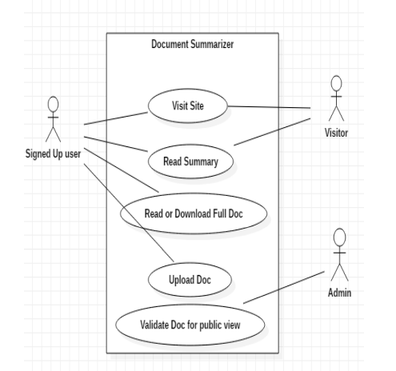
USE CASE DIAGRAM
Use-case diagrams describe the high-level functions and scope of a system. These diagrams also identify the interactions between the system and its actors. The use cases and actors in use-case diagrams describe what the system does and how the actors use it, but not how the system operates internally.

Slide 8
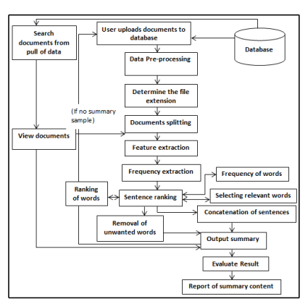
Architecture framework of the summary
An architecture framework (or simply A framework) is the collection of processes, templates and tools that software teams use to plan and build large, enterprise-grade application architecture systems.

Slide 9
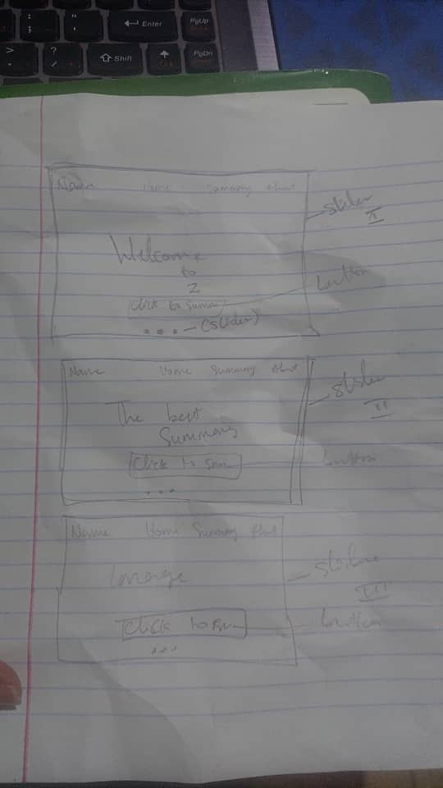
outcome
System/analysis Sketching phase

Slide 10
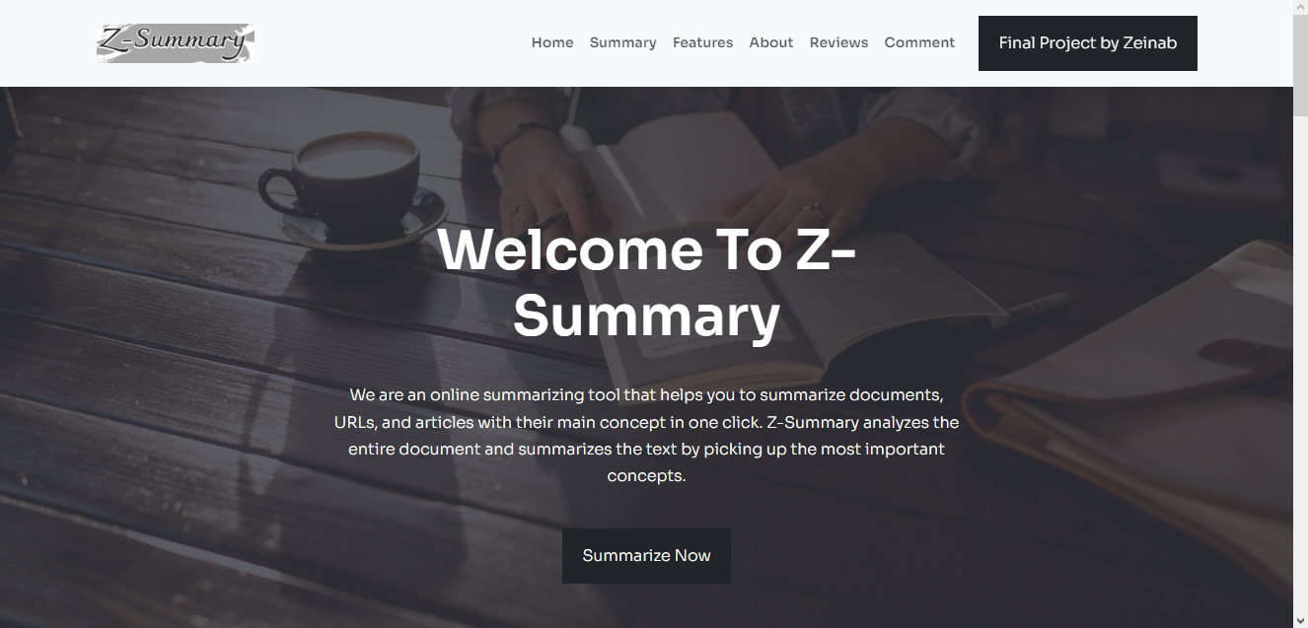
outcome
User interface 1

Slide 11
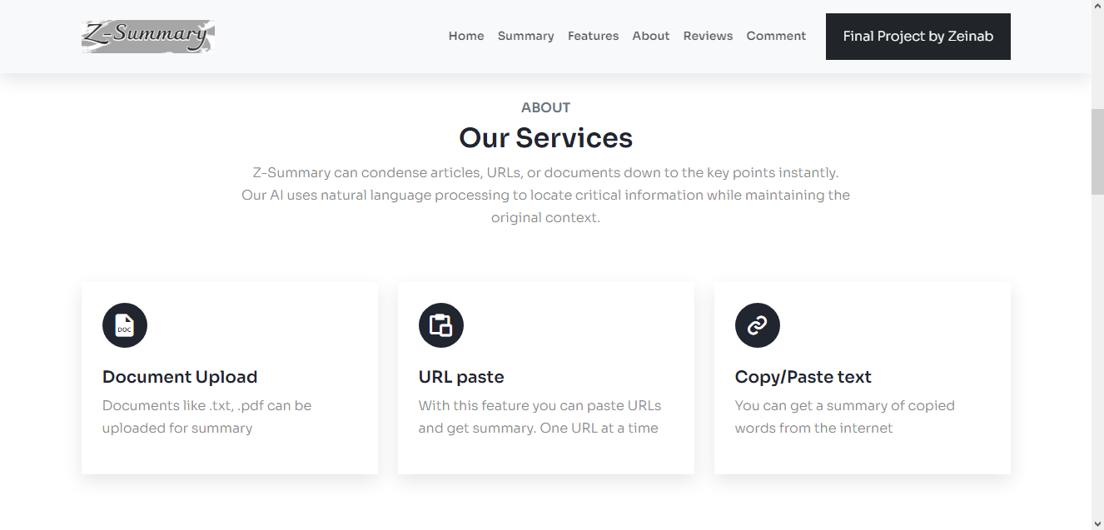
Outcome
User Interface II

Slide 12
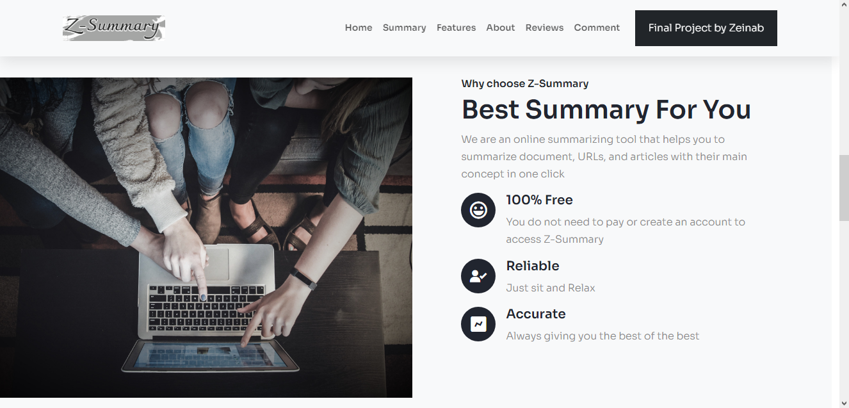
outcome
User interface III

Slide 13
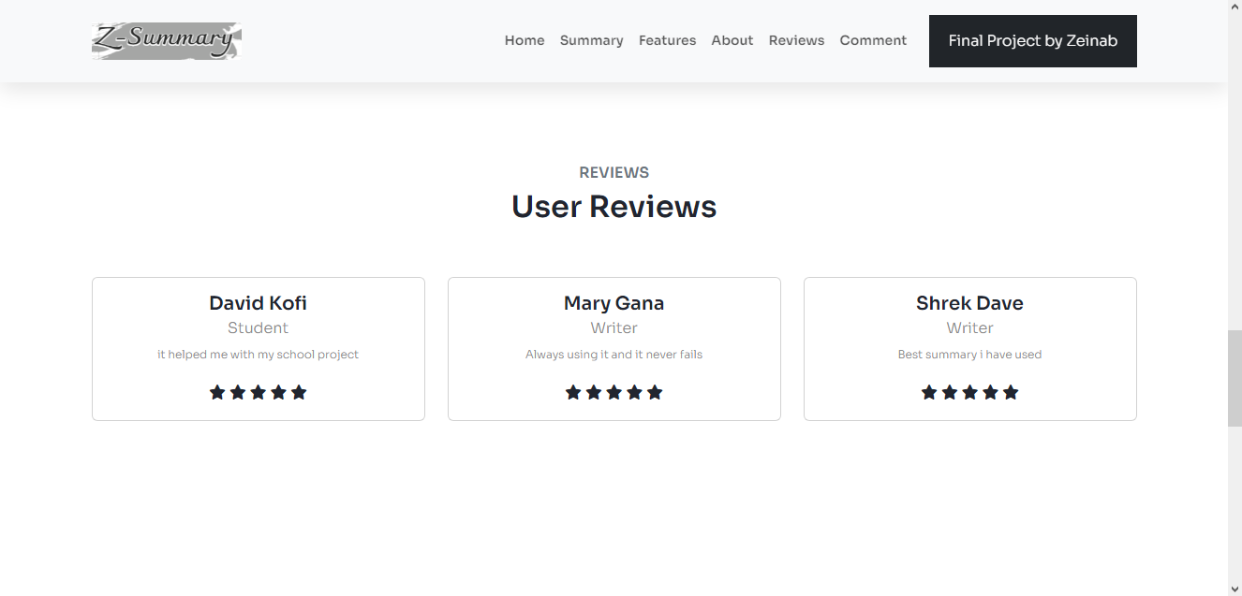
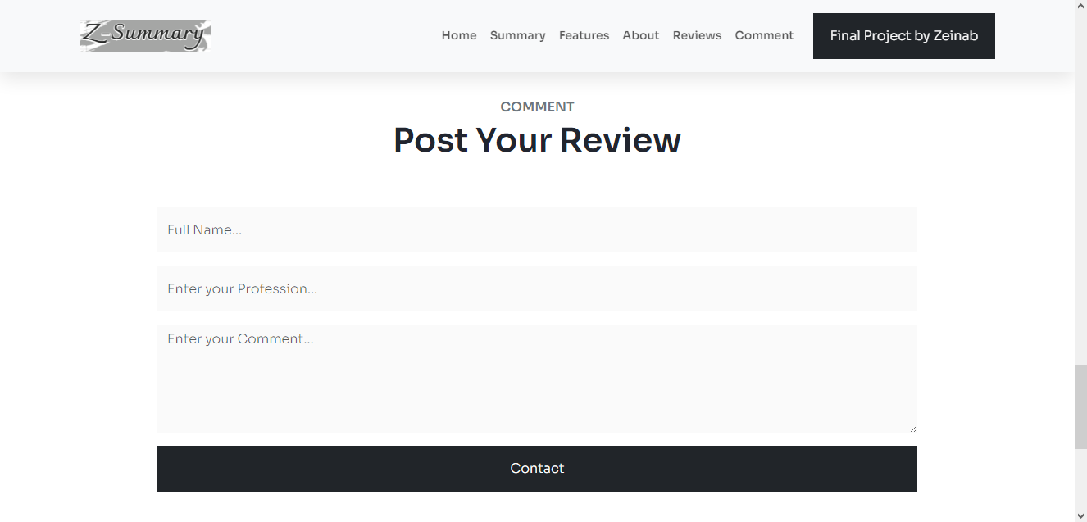
Outcome – user interface IV

Slide 14
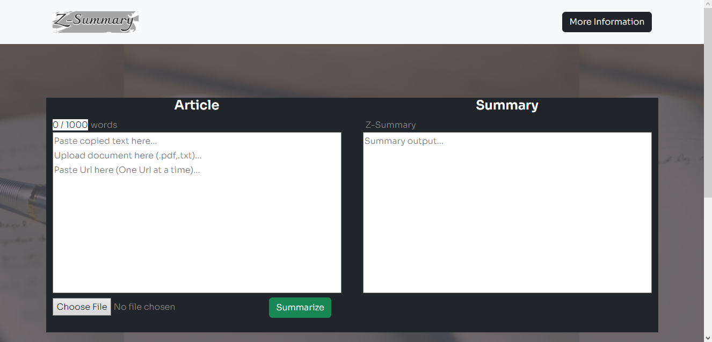
outcome
Summary interface I

Slide 15
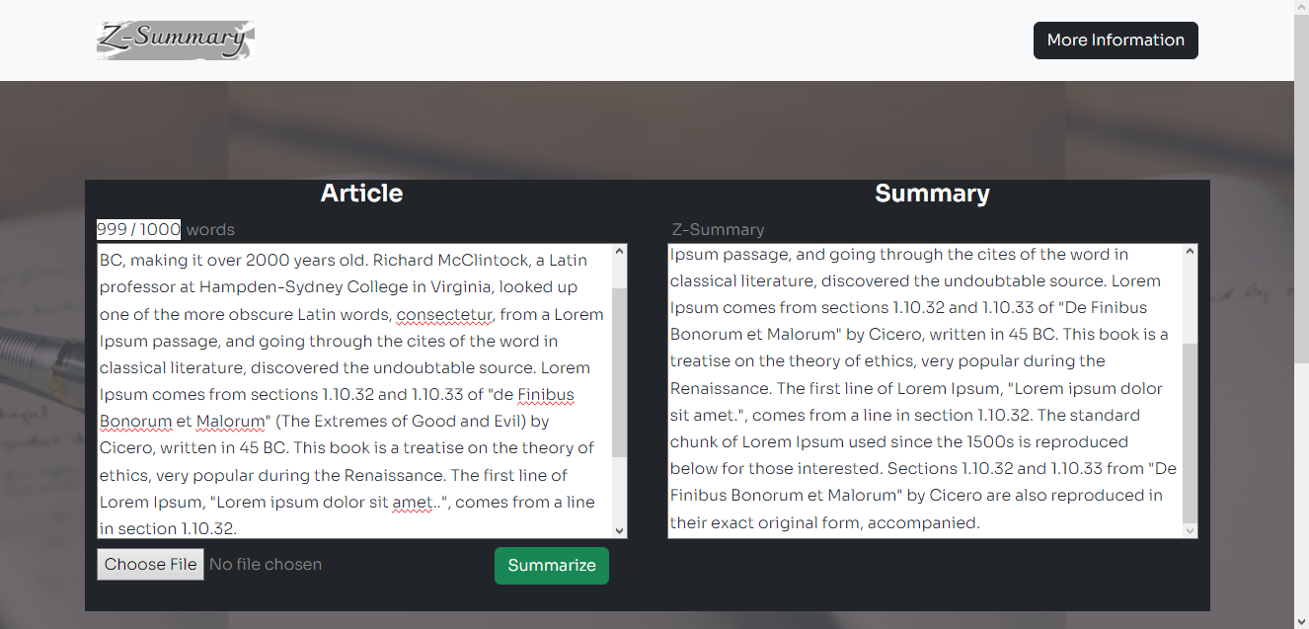
outcome
Summary interface II

Slide 16
Discussion, conclusion and recommendation
Discussion:
With the growth of the internet and big data, individuals are becoming overwhelmed by the vast amount of information and documents available on the internet. Many researchers are motivated to develop a technology solution that can automatically summarize texts as a result of this. This text summarizing provides summaries that incorporate all relevant information from the original material and include important sentences.
Recommendation:
The researcher advises moving on with the system's implementation while evaluating it for the addition of new modules or components that have been left out due to time and financial constraints. Users using this system should; As new issues occur, increase the number of solutions.
Regularly copy the summary text in case of a calamity or system breakdown.
Make sure that hardware components are constantly functioning properly. If necessary, replacement should be made.

Slide 17
Discussion, conclusion and recommendation
Conclusion:
We are in an era of technological advancement and rapid progress in almost all aspects of living. It is therefore of great importance if our articles, texts and documents are computerized to meet the increasing needs in summary. The project’s objective was to find a more efficient and easy way of carrying out the functions of helping people summarize their articles or documents including students to save difficulties encountered during reading. In achieving the general objective mentioned, this project will specifically concentrate on the following:
The system shall allow users to access the webpage.
The system shall enable users to upload documents online.
The system shall provide output to users.
The system shall help in generating an easy text summary for every file, text or URL
The system shall maintain better user relationships.
This project gives an overview of previous research and studies on the topic of Automatic Text Summarization

Slide 18
Demonstration of the system

Slide 19
THANK YOU

