Slide 1
Reinforcement Learning of Antibody CDRH3 Loops
A multimodal developability and binding judge for antibody design
IgLM prior + REINVENT agent, five oracles across sequence and structure
Daniela A. Gonzalez · antibody RL project · reproducible CPU pipeline

Slide 2
The problem
• Antibody specificity is largely set by the CDRH3 loop on a fixed framework
• Language models (IgLM) generate plausible CDRH3 but optimize no objective
• Reinforcement learning (REINVENT) can steer them, as AB-Gen showed for HER2
• But developability matters as much as binding, and it is multimodal:
– sequence rules (liabilities, charge, humanness)
– structural surface properties (TAP: hydrophobic and charge patches)
• Open question: when does RL actually help?

Slide 3
The approach
• Frozen IgLM prior generates CDRH3; a trainable copy is the RL agent
• REINVENT augmented likelihood: pull the agent toward log P_prior + sigma S(x)
– The prior term is a leash that keeps sequences antibody-like
• Five oracles across two modalities score each candidate:
– sequence: liabilities, physicochemistry, AbLang2 humanness
– structure: TAP-style metrics on an ABodyBuilder2 model
– binding: HER2 classifier from the Mason trastuzumab DMS
• Everything runs on CPU (IgLM 12.9M checkpoint)
Following AB-Gen (Xu 2023) and REINVENT (Olivecrona 2017).

Slide 4
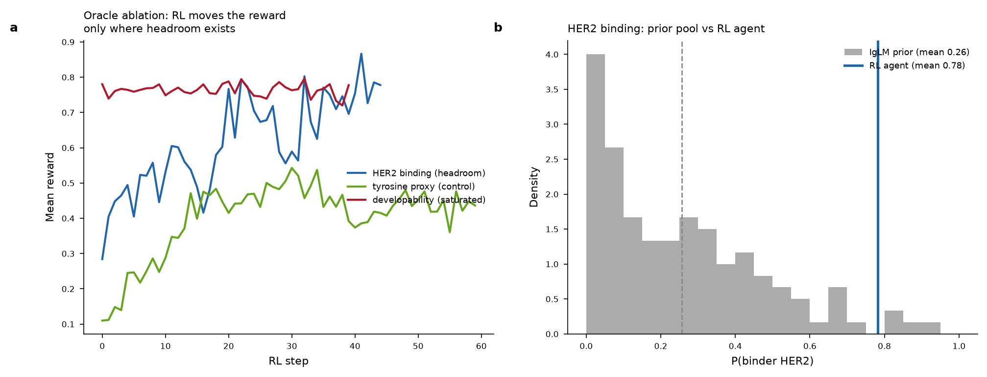
Headline: RL optimizes only where the reward has headroom
RL raises HER2 binding 0.28 to 0.78; the saturated developability reward stays flat.

Slide 5
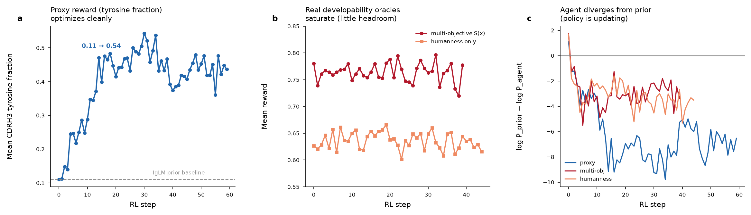
The loop is sound: a proxy control proves it optimizes
Tyrosine-fraction proxy rises 0.11 to 0.54; developability is flat; the agent departs the prior (KL).

Slide 6
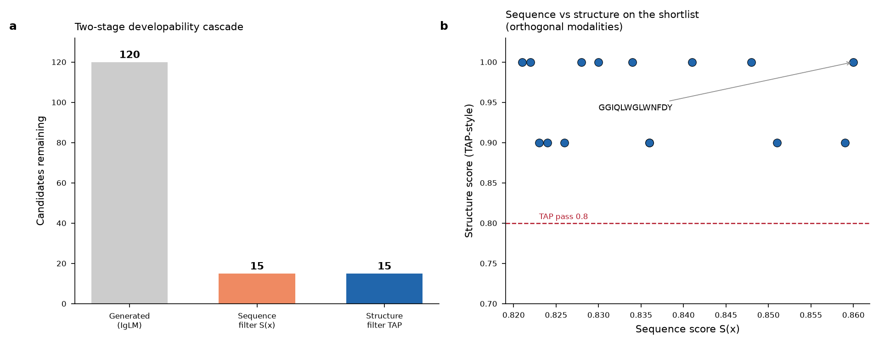
Sequence and structure are orthogonal modalities
Two-stage cascade (120 to 15 to TAP filter). Sequence and structure scores are uncorrelated (r about 0).

Slide 7
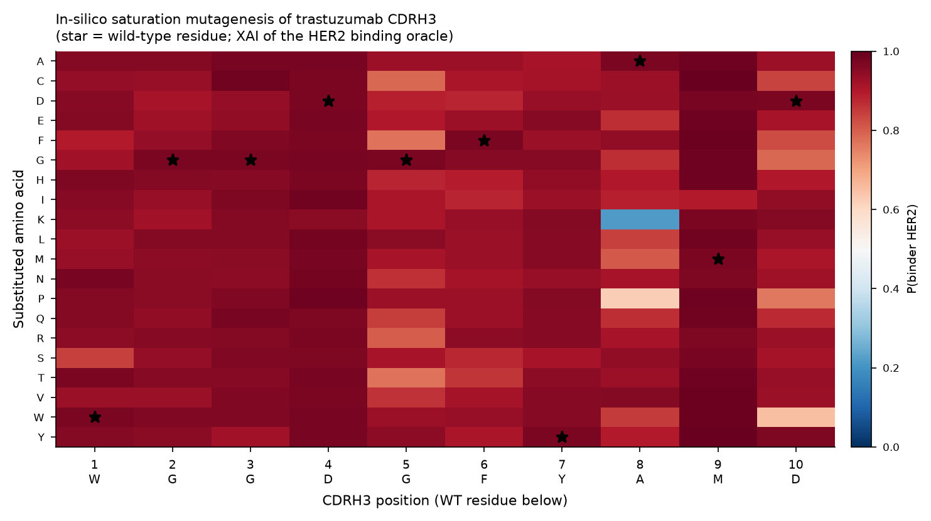
The binding oracle reproduces the benchmark and is explainable
one-hot AUC 0.911 (matches Mason ~0.91). Saturation mutagenesis: wild-type trastuzumab sits at the optimum.

Slide 8
Key numbers
• Binding oracle (Mason HER2 DMS, 36,391 sequences):
– one-hot MLP AUC 0.911 · ESM2 length-agnostic AUC 0.859
• Oracle ablation on the IgLM prior pool:
– developability 0.755 (saturated) vs HER2 binding 0.256 (headroom)
– RL against HER2 binding: 0.284 to peak 0.867 to 0.782
• AB-Gen benchmark (agent vs prior):
– uniqueness 1.00, novelty 1.00, diversity 0.81, success 0.53

Slide 9
Honest scope
• IgLM 12.9M checkpoint, not 558M (the reason it runs on CPU)
• TAP-style reimplementation from the paper (official code not public)
• Option A pairs a germline VL the model did not generate; B loses SFvCSP
• Binding oracle is a transferred proxy, not a validated affinity model
• Reward hacking (length collapse) observed and controlled by the prior leash
A reproducible pipeline and controlled proxies, not a therapeutic.

Slide 10
Path to a stronger preprint
• Structural validation: co-fold top RL binders onto HER2 (PDB 1N8Z)
• Multiple frameworks via ANARCI/IMGT for a controlled comparison
• Affinity (not classification) binding oracle for finer headroom
• Learning curves with moving-average overlay; larger batch on GPU
• Six notebooks, src modules, trained models and histories all provided
See README_PROJECT.md for the full index.

