Slide 1
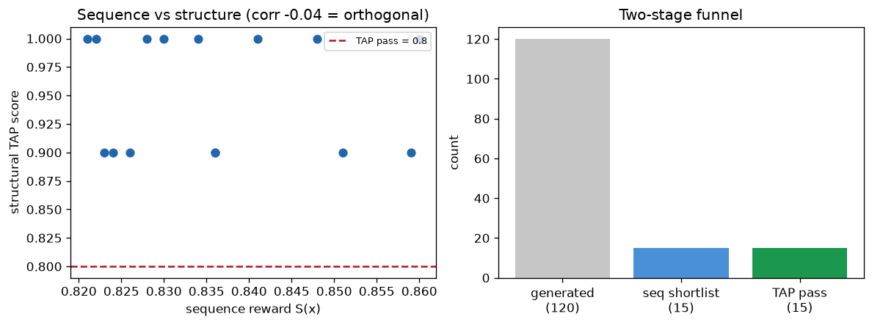
The cascade — cheap sequence filter, then expensive structure filter
120 generated -> top 15 by sequence S(x) -> fold + TAP >= 0.8
Biology
Structure sees aggregation patches
that sequence cannot — residues far
in sequence, close on the surface.
Computation
corr(S, TAP) = -0.04 -> orthogonal.
TAP reorders loops that S(x) ranks
equally. A real second modality.
Strategy
Cheap-then-expensive: filter on
sequence first, fold only survivors.
Same result, a fraction of the compute.
Top candidate GGIQLWGLWNFDY — best on both axes. This is the multimodal evaluator in action: sequence + structure, uncorrelated.

