Slide 1
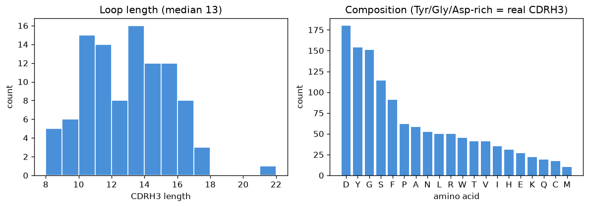
Generator — EDA: sanity check of what we produced
What am I checking?
Before feeding the loops to the oracles and RL, I verify they look like real CDRH3 — not arbitrary strings. Two checks: length distribution and amino-acid composition.
Length centers on ~11 to 15 residues — the range of real human CDRH3.
Composition is Gly / Tyr / Asp / Ser-rich — exactly the residues enriched in real CDRH3.
Conclusion: IgLM learned genuine antibody statistics, not random peptides. Pool is ready.

