Slide 1
Data Science Capstone project
Daniel Arroyo
01-09-2021

Slide 2

Outline
Executive Summary
Introduction
Methodology
Results
Conclusion
Appendix

Slide 3

Executive Summary
Summary of methodologies
Many python libraries were used through different stages helping us understand and prepare de data, analyze and visualize from many angles with plots and SQL queries among other things.
Summary of all results
We can quite guess if SpaceX is going to land successfully the first stage of the rocket launch thanks to many machine learning models made in this project,

Slide 4

Introduction
Project background and context
The commercial space age is here, companies are making space travel affordable for everyone. Many people are into this market but SpaceX shines between all of them because of their relatively inexpensive rocket launches (Falcon 9 = 62 millions) much of the savings is because SpaceX can reuse first stage.
Sometimes the first stage does not land. Sometimes it will crash. Other times, Space X will sacrifice the first stage due to the mission parameters like payload, orbit, and customer.
As a data scientist working for the new rocket company SpaceY that would like to compete with SpaceX. We will have to gather information about SpaceX and create our own dashboards.
Problems you want to find answers
We will need to determine the price of each launch and if SpaceX will reuse the first launching stage by training a machine learning model and using other public information.

Slide 5

Methodology
Data collection methodology:
Describe how data were collected
Perform data wrangling
Describe how data were processed
Perform exploratory data analysis (EDA) using visualization and SQL
Perform interactive visual analytics using Folium and Plotly Dash
Perform predictive analysis using classification models
How to build, tune, evaluate classification models

Slide 6
Methodology

Slide 7
Data collection
Describe how data sets were collected.
In order to collect data through SpaceX API. First, we settled a series of helper functions that will help us use the API to extract information using identification numbers in the launch data. Then we started requesting rocket launch data from SpaceX API, decode the response content as JSON and turn it to a Pandas dataframe. We will now use the API again to get information about the launches using the IDs given for each launch. The data obtained from specified columns is stored in lists and those list are combined into a dictionary that will be used to create the Pandas dataframe. Finally, we will remove the Falcon 1 launches keeping only the Falcon 9 launches which are the aim of the analysis.
You need to present your data collection process use key phrases and flowcharts
Key phrases and flowcharts are shown in the next slideshows.

Slide 8
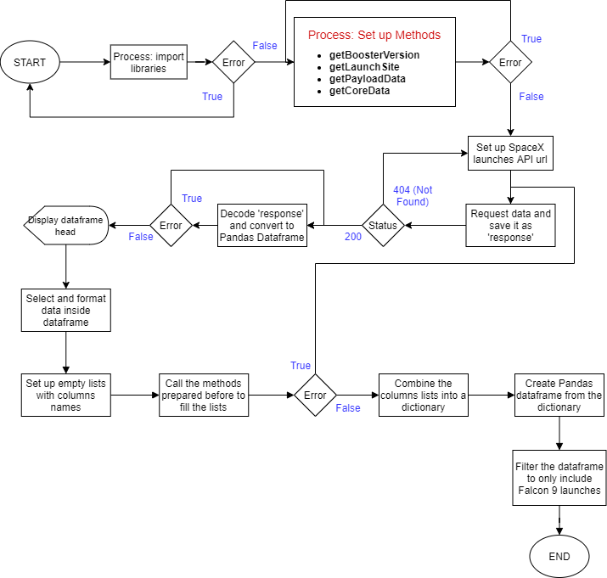
Data collection – SpaceX API
Added a flowchart of SpaceX API calls here
Present your data collection with SpaceX REST calls using key phrases and flowcharts
Its important to set up all SpaceX API endpoints right in most of the cells like.
Add the GitHub URL of the completed SpaceX API calls notebook (must include completed code cell and outcome cell), as an external reference and peer-review purpose
spacex_url="https://api.spacexdata.com/v4/launches/past"
https://github.com/DaniArroyo/Data-Science-Capstone/blob/main/Capstone_SpaceX_DataCollection.ipynb

Slide 9
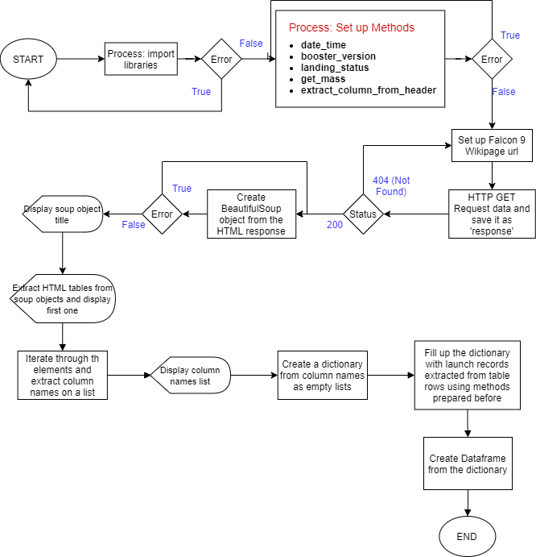
Data collection – Web scraping
Add a flowchart of web scraping here
Present your web scraping process use key phrases and flowcharts
Its important to set up correctly the Wikipage URL and have some HTML structure knowledge to manipulate SOUP object and response data.
static_url="https://en.wikipedia.org/w/index.php?title=List_of_Falcon_9_and_Falcon_Heavy_launches&oldid=1027686922"
Add the GitHub URL of the completed web scraping notebook, as an external reference and peer-review purpose
https://github.com/DaniArroyo/Data-Science-Capstone/blob/main/Web%20Scraping%20Lab.ipynb

Slide 10
Data wrangling
Describe how data were processed
Add the GitHub URL of your completed data wrangling related notebooks, as an external reference and peer-review purpose
First, identify null values in each column and identify their type: numerical or categorical. To know more about the data, we use value_counts() method in some columns to determine the count of each outcome.
Now we iterate through landing_outcomes() keys to create a set with the bad outcomes, then we iterate again to add 1 if the landing was successful or 0 if the outcome is found inside the set we created before.
Lastly with the last set we made we create a column in the dataframe called class and using method mean() we can get the success rate which is 0.6666.
https://github.com/DaniArroyo/Data-Science-Capstone/blob/main/Data%20Wrangling.ipynb

Slide 11
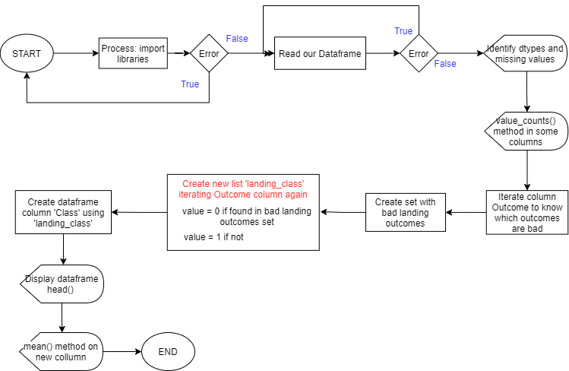
Data wrangling
You need to present your data wrangling process using key phrases and flowcharts

Slide 12
EDA with data visualization
Summarize what charts were plotted and why used those charts
Most used charts are scatter plots which are the best to observe and show relationships between two numeric variables using parameters like hue that produce points with different colors.
There's also used a bar chart to visualize the relationship between success rate of each orbit type.
Lastly a linear chart to see how the success rate increase through years.
Add the GitHub URL of your completed EDA with data visualization notebook, as an external reference and peer-review purpose
https://github.com/DaniArroyo/Data-Science-Capstone/blob/main/EDA%20with%20Visualization%20lab.ipynb

Slide 13
EDA with SQL
Summarize performed SQL queries using bullet points
All queries are SELECT with 1 or 2 required CONDITIONS, most statements have methods like MIN(), MAX(), AVG() and most used one is COUNT().
Also, in some of them there's used SUBQUERIES commonly known as a query inside another query,
Finally, last query contains statements GROUP BY AND ORDER BY to sort and group data about the landing outcomes.
Add the GitHub URL of your completed EDA with SQL notebook, as an external reference and peer-review purpose
https://github.com/DaniArroyo/Data-Science-Capstone/blob/main/EDA%20With%20SQL.ipynb

Slide 14
Build an interactive map with Folium
Summarize what map objects such as markers, circles, lines, etc. you created and added to a folium map
Explain why you added those objects
First object used are markers that help us visualize locations like launch sites and their proximities by pinning them on the map, on the other hand coordinates are just plain numbers that can not give intuitive insights about places.
Circles used have the same purpose as markers in this folium maps but with less customization.
As we have many launch records with the exact same coordinate, we used marker clusters to simplify from having many markers in the same coordinate.
Last object used are Polylines to draw a line between launch sites and their proximities like Cabrillo Highway and VAFB SLC-4E launch site.
Add the GitHub URL of your completed interactive map with Folium map, as an external reference and peer-review purpose
https://github.com/DaniArroyo/Data-Science-Capstone/blob/main/Visual%20Analytics%20with%20Folium%20lab.ipynb

Slide 15
Build a Dashboard with Plotly Dash
Summarize what plots/graphs and interactions you have added to a dashboard
Explain why you added those plots and interactions
Add the GitHub URL of your completed Plotly Dash lab, as an external reference and peer-review purpose
https://github.com/DaniArroyo/Data-Science-Capstone/blob/main/Interactive%20Dashboard.py

Slide 16
Predictive analysis (Classification)
Summarize how you built, evaluated, improved, and found the best performing classification model
You need present your model development process using key phrases and flowchart
First, we choose the columns that will be our ‘y’ and ‘x’ and split their values as train and test data. Next step is to create a GridSearchCV object for different models (4 in our case), each one with their own parameters, then fit the object to find the best parameters for each model and their best score.
Finally, we can calculate their accuracy on test data and plot a confusión matrix to compare all models performance.
Add the GitHub URL of your completed predictive analysis lab, as an external reference and peer-review purpose
https://github.com/DaniArroyo/Data-Science-Capstone/blob/main/Machine%20Learning%20Prediction%20lab.ipynb

Slide 17
Results
Exploratory data analysis results
Through EDA we found out strong relationships between Payload mass and some of the orbits like GTO(negative) or Polar LEO ISS(positive), or between orbit and success rate.
Also, we can observe that the success rate since 2013 kept increasing till 2020.
Interactive analytics demo in screenshots
We created interactive folium maps to understand important facts about the success rate of SpaceX rocket launch in each launch site. Also, we build an interactive analytics dashboard.
Predictive analysis results
Most of the machine learning models that we built have great accuracy and have a high chance of predicting whether SpaceX is not going to land the first stage successfully or not.

Slide 18
EDA with Visualization

Slide 19
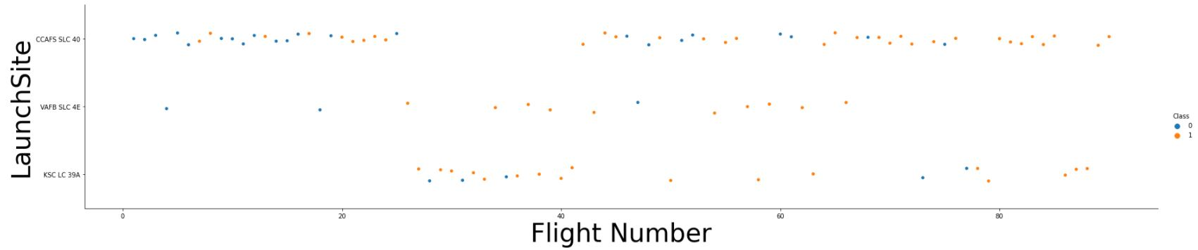
Flight Number vs. Launch Site
Show a scatter plot of Flight Number vs. Launch Site
Show the screenshot of the scatter plot with explanations
In this scatter plot we can see that CCAFS SLC 40 had intervals between 4 and 3 unsuccessful landings before start getting successful ones having a 60% successful landing rate in 55 landings followed up by VAFB SLC 4E having a 77% in 13 landings and lastly by KSC LC 39A having 77.2% in 22 landings. Let's keep in mind that it was the first launchsite used in this analysis with most landings than the other 2.

Slide 20
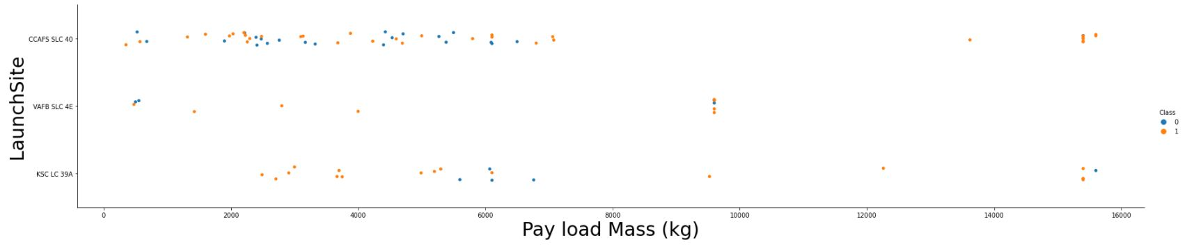
Payload vs. Launch Site
Show a scatter plot of Payload vs. Launch Site
Show the screenshot of the scatter plot with explanations
In this scatter plot we can see that CCAFS SLC 4O Has a higher success rate on a bigger payload Mass range than others 2 launch sites which have way less success rate on specific payload Mass ranges like KSC LC 39A launch site in range between 2000Kg and 5000Kg.

Slide 21
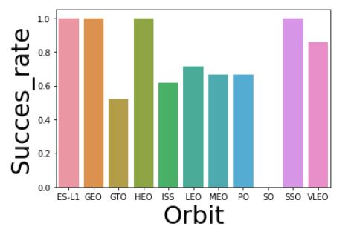
Success rate vs. Orbit type
Show a barchart for the success rate of each orbit type
Show the screenshot of the scatter plot with explanations
ES-L1, GEO, HEO and SSO are the orbits that have the highest success rate followed by VLEO orbit. GTO, ISS, LEO, MEO and PO orbits can be found at 50% - 70% success rate range.
To conclude S0 orbit has the lowest success rate with only 1 unsuccessful landing leading to a 0% success rate.

Slide 22
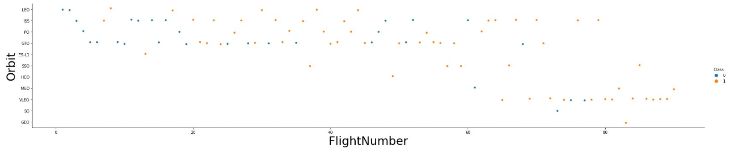
Flight Number vs. Orbit type
Show a scatter point of Flight number vs. Orbit type
Show the screenshot of the scatter plot with explanations
In orbits like LEO, SSO and VLEO the success appears related to the number of flights; on the other hand, there seems to be no relationship between flight number when in GTO and ISS orbit.

Slide 23
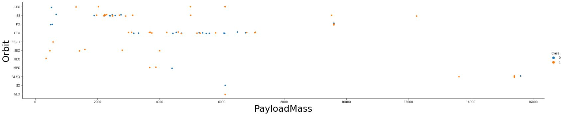
Payload vs. Orbit type
Show a scatter point of payload vs. orbit type
Show the screenshot of the scatter plot with explanations
Here we see that heavy payloads have a negative influence on GTO and MEO orbits, and a positive influence on ISS and LEO orbits. We can also see that on ISS orbit there's a Payload Mass range where rates of success are lower as it happens on PO orbit with light payloads.

Slide 24
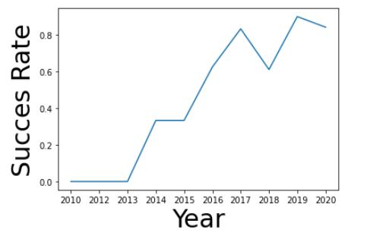
Launch success yearly trend
Show a line chart of yearly average success rate
Show the screenshot of the linear plot with explanations
As seen in this linear plot succes rate started increasing in 2013 and kept like that till 2020 with little drops in 2018 and 2020.

Slide 25
EDA with SQL

Slide 26
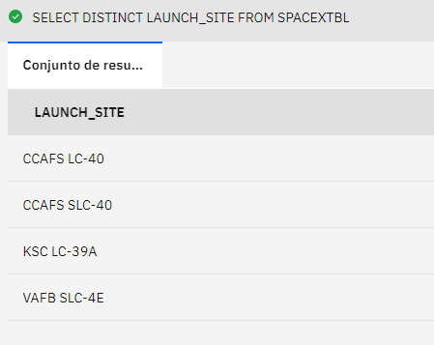
All launch site names
Find the names of the unique launch sites
Present your query result with a short explanation here
SELECT DISTINCT LAUNCH_SITE
FROM SPACEXTBL
Here we use DISTINCT statement to return only distinct (different) values.
Only 4 Launch sites are returned.

Slide 27
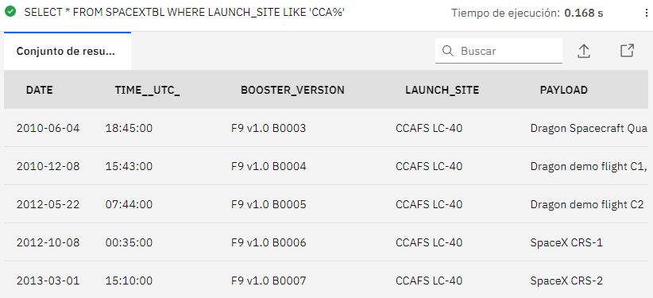
Launch site names begin with `CCA`
Find all launch sites begin with `CCA`
Present your query result with a short explanation here
SELECT * FROM SPACEXTBL
WHERE LAUNCH_SITE
LIKE 'CCA%'
In this query we use LIKE statement with ‘%’ at the end of the value which we want to use as condition

Slide 28
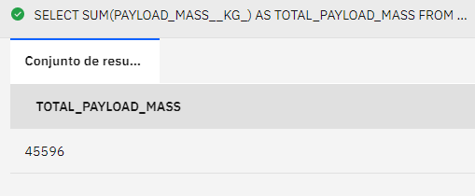
Total payload mass
Calculate the total payload carried by boosters from NASA
Present your query result with a short explanation here
SELECT SUM(PAYLOAD_MASS__KG_) AS TOTAL_PAYLOAD_MASS
FROM SPACEXTBL
WHERE CUSTOMER = 'NASA (CRS)'
In this query we use SUM() method to add up each number that meets the condition required, NASA boosters in this case.
Total payload mass carried by NASA boosters is 45596Kg.

Slide 29
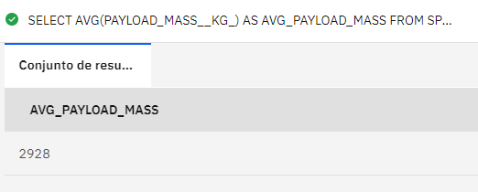
Average payload mass by F9 v1.1
Calculate the average payload mass carried by booster version F9 v1.1
Present your query result with a short explanation here
SELECT AVG(PAYLOAD_MASS__KG_) AS AVG_PAYLOAD_MASS
FROM SPACEXTBL
WHERE BOOSTER_VERSION = 'F9 v1.1'
In this query we use AVG() method to get mean payload mass that meets the condition of being carried by a specified booster version.
Average payload mass carried by F9 v1.1 booster version is 2928Kg.

Slide 30
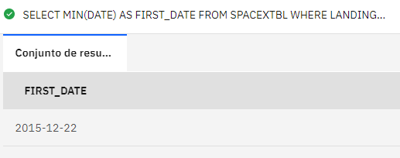
First successful ground landing date
Find the date when the first successful landing outcome in ground pad
Present your query result with a short explanation here
SELECT MIN(DATE) AS FIRST_DATE
FROM SPACEXTBL
WHERE LANDING__OUTCOME = 'Success (ground pad)'
In this query we use MIN() method to get the first date of first successful landing outcome in ground pad.
First successful landing outcome in ground pad was 2015-12-22

Slide 31
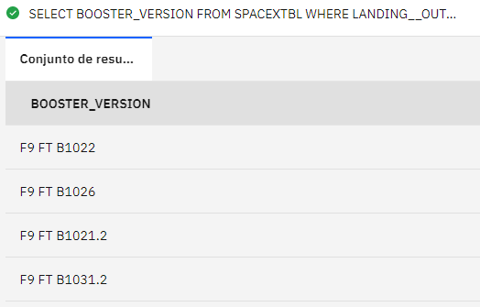
Successful drone ship landing with payload between 4000 and 6000
List the names of boosters which have success in drone ship and have payload mass greater than 4000 but less than 6000
Present your query result with a short explanation here
SELECT BOOSTER_VERSION
FROM SPACEXTBL
WHERE LANDING__OUTCOME = 'Success (drone ship)'
AND PAYLOAD_MASS__KG_ BETWEEN 4000 AND 6000
In this query we use 2 conditions to return needed booster versions, in this case only 4 booster versions will be returned.

Slide 32
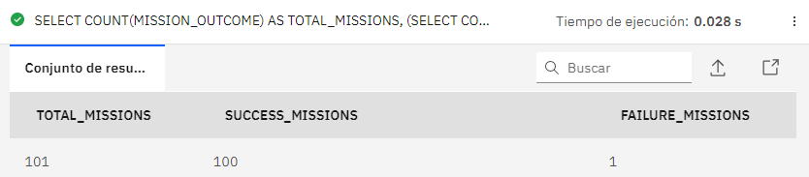
Total number of successful and failure mission outcomes
Calculate the total number of successful and failure mission outcomes
Present your query result with a short explanation here
SELECT COUNT(MISSION_OUTCOME) AS TOTAL_MISSIONS,
(SELECT COUNT(MISSION_OUTCOME) AS SUCCESS_MISSIONS FROM SPACEXTBL WHERE MISSION_OUTCOME LIKE 'Success%'),
(SELECT COUNT(MISSION_OUTCOME) AS FAILURE_MISSIONS FROM SPACEXTBL WHERE MISSION_OUTCOME LIKE 'Failure%')
FROM SPACEXTBL
In this query we use COUNT() method and subqueries to count every mission outcomes and total of all missions combined.

Slide 33
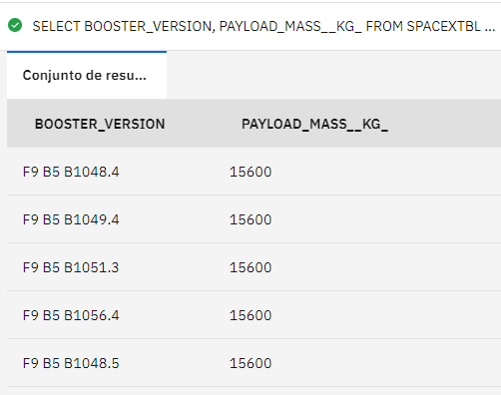
Boosters carried maximum payload
List the names of the booster which have carried the maximum payload mass
Present your query result with a short explanation here
SELECT BOOSTER_VERSION, PAYLOAD_MASS__KG_
FROM SPACEXTBL
WHERE PAYLOAD_MASS__KG_ = (SELECT MAX(PAYLOAD_MASS__KG_) FROM SPACEXTBL)
In this query we use a subquery inside the condition querying for the max value of payload mass.
As a result, 12 different booster versions are shown to us.

Slide 34
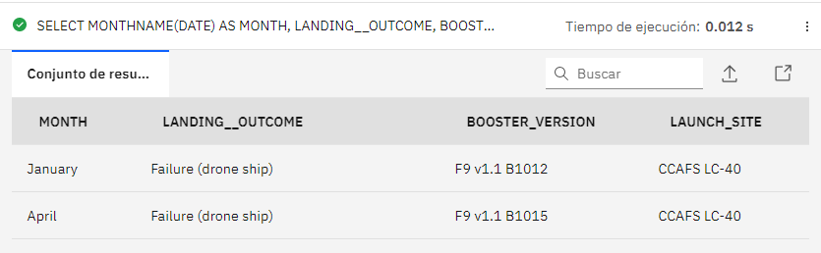
2015 launch records
List the records which will display the month names, failure landing_outcomes in drone ship ,booster versions, launch_site for the months in year 2015
Present your query result with a short explanation here
SELECT MONTHNAME(DATE) AS MONTH, LANDING__OUTCOME, BOOSTER_VERSION, LAUNCH_SITE FROM SPACEXTBL
WHERE LANDING__OUTCOME = 'Failure (drone ship)'
AND DATE LIKE '2015%'
In this query we use a MONTHNAME() method to extract month name from dates, and a couple of conditions required,
As a result, only 2 records are shown, first from January and second from April.

Slide 35
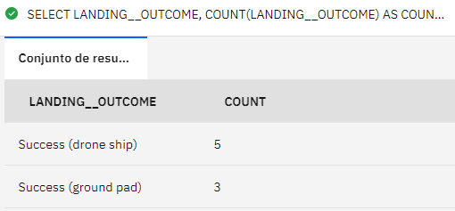
Rank success count between 2010-06-04 and 2017-03-20
Rank the count of successful landing_outcomes between the date 2010-06-04 and 2017-03-20 in descending order.
Present your query result with a short explanation here
SELECT LANDING__OUTCOME, COUNT(LANDING__OUTCOME) AS COUNT
FROM SPACEXTBL
WHERE DATE BETWEEN '2010-06-04' AND '2017-03-20' AND LANDING__OUTCOME LIKE 'Succes%'
GROUP BY LANDING__OUTCOME
ORDER BY COUNT(LANDING__OUTCOME) DESC
As a result, we only see 2 rows, each one with its own counter.
In this query we use COUNT() to count every time a landing outcome meets the required conditions, then we group by those conditions and order them in descending order.

Slide 36
Interactive map with Folium

Slide 37
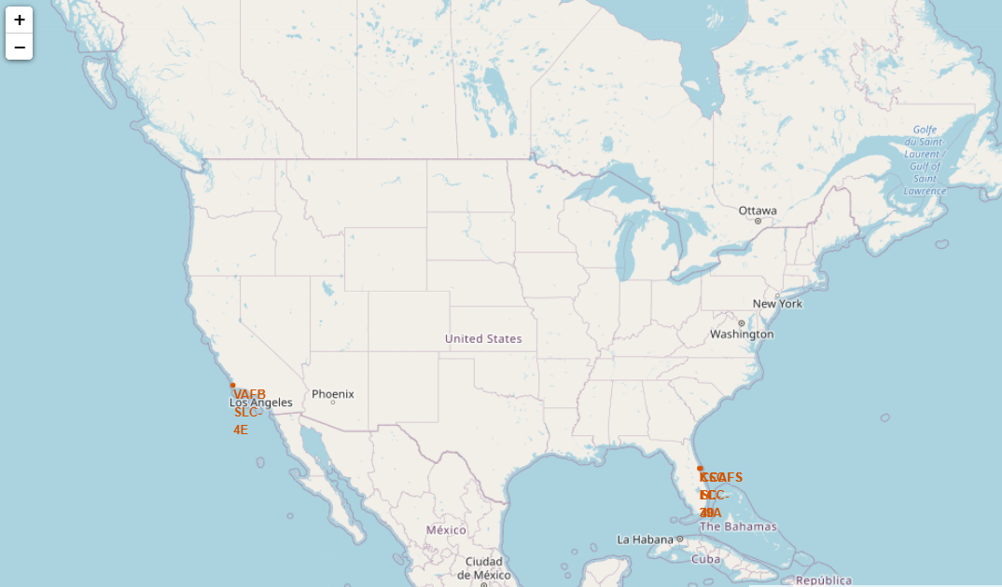
Launch sites folium map
Replace <Folium map screenshot 1> title with an appropriate title
Show the screenshot of all launch sites’ location markers on a global map
Explain the important elements and findings on the screenshot
All US launch sites are the closest they can to they Equator line inside US territory, so their spacecrafts are going to be faster if launched from those launch sites than from anywhere in US.
As we can see in the map all these launch sites are close to the coast because most rockets travel eastward, so if anything goes wrong during their ascent, the debris will essentially fall into an ocean's waters, far away from densely populated areas.
Also Launching a rocket from the east coast gives an additional boost to the rocket, due to the rotational speed of Earth.

Slide 38
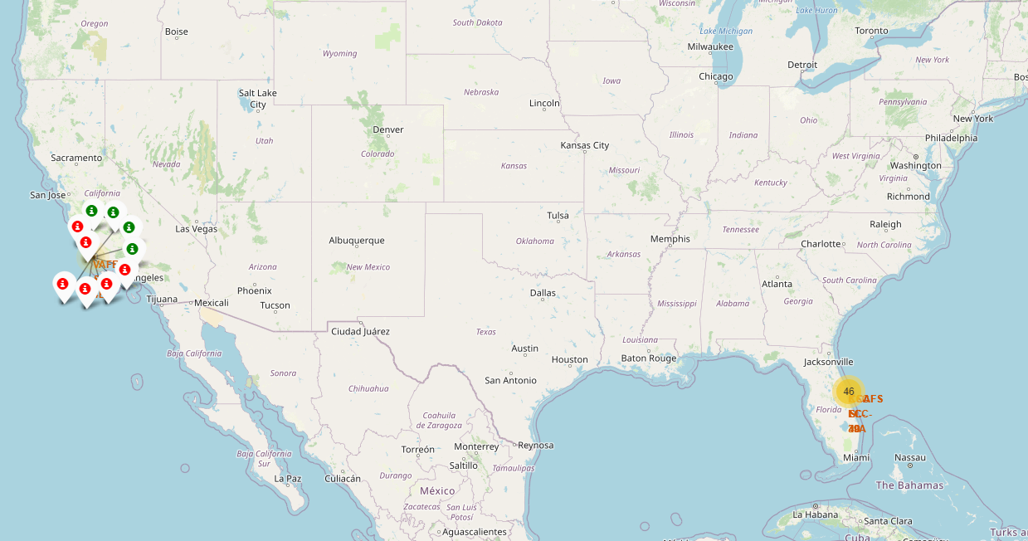
Launch records folium map
Replace <Folium map screenshot 2> title with an appropriate title
Show the screenshot of color-labeled launch records on the map
Explain the important elements and findings on the screenshot
Now we can see on map by clicking on each launch site its launch records such as how many launches does a launch site has, how many of those launches were successful and where is a higher success rate.
For example, VAFB SLC-4E launch site has a total of 10 launches, 4 of them were successful, leading to a success rate of 40%.

Slide 39
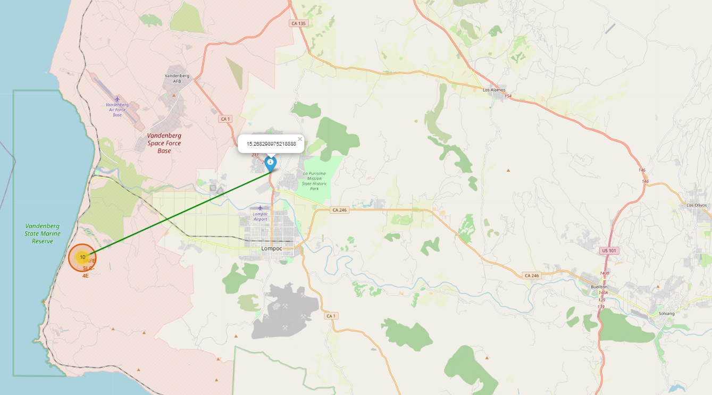
VAFB SLC-4E Launch site and proximities
Replace <Folium map screenshot 3> title with an appropriate title
Show the screenshot of a selected launch site to its proximities such as railway, highway, coastline, with distance calculated and displayed
Explain the important elements and findings on the screenshot
On this map we can see Cabrillo Highway as a blue info marker with a popup showing the distance between the highway and VAFB SLC-4E launch site which is 15.2682km.
There's also a green Polyline between the highway and VAFB SLC-4E launch site.

Slide 40
Build a Dashboard with Plotly Dash

Slide 41
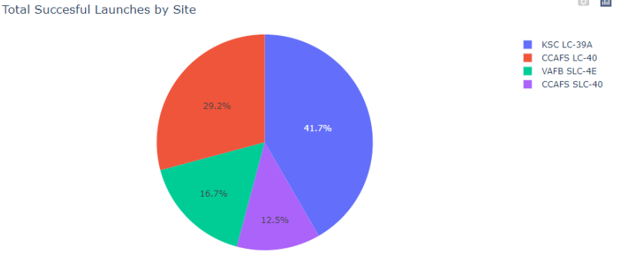
Successful Launches by Launch Site
Replace <Dashboard screenshot 1> title with an appropriate title
Show the screenshot of launch success count for all sites, in a piechart
Explain the important elements and findings on the screenshot
Here we can see that KSC LC-39A has the higher successful launches rate while CCAFS SLC-40 has the lowest one.

Slide 42
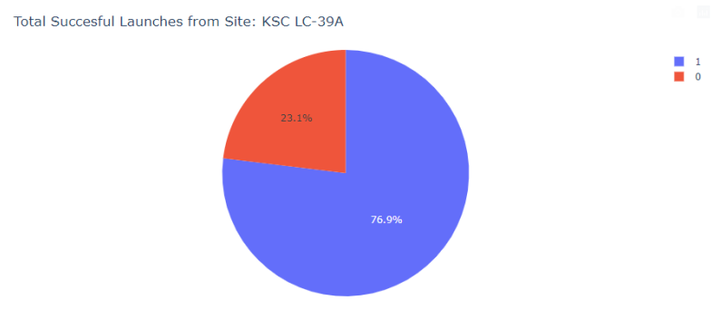
Launch Site with Highest Success Rate
Replace <Dashboard screenshot 2> title with an appropriate title
Show the screenshot of the piechart for the launch site with highest launch success ratio
Explain the important elements and findings on the screenshot
As seen before the launch site with the highest success rate is KSC LC-39 with 76.9 % followed by CCAFS LC-40

Slide 43
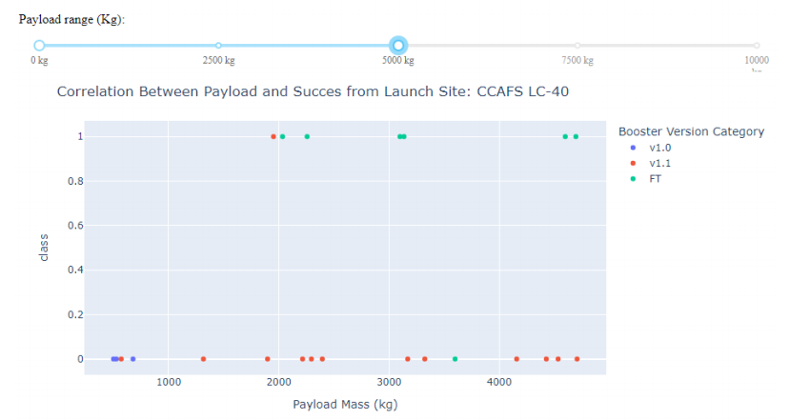
Boosters Succes Rates with Different Payloads
Replace <Dashboard screenshot 3> title with an appropriate title
Show screenshots of Payload vs. Launch Outcome scatter plot for all sites, with different payload selected in the range slider
Explain the important elements and findings on the screenshot
FT booster version has the highest success rate in this payload range while v1.0 has not a single successful launch and v1.1 only 1 out of 13

Slide 44
Predictive analysis (Classification)

Slide 45
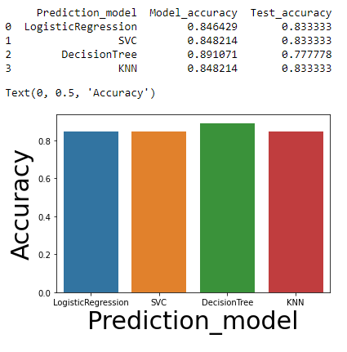
Classification Accuracy
Visualize all the built model accuracy for all built models, in a barchart
Find which model has the highest classification accuracy
As we can see in this barchart the model with a higher accuracy on training data is DecisionTree.
Also, it looks that DecisionTree model works worse with unseen data.
Lastly, we can say that other 3 models LogisticRegression, SVC (Support Vector Classifier) and KNN (K-Nearest Neighbor) have the highest classification accuracy. Mathematical operations are show on the next slideshow

Slide 46
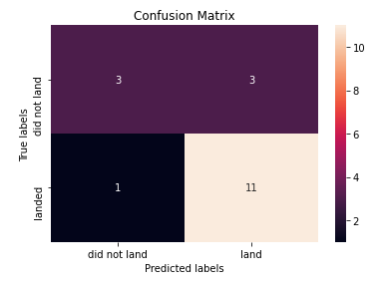
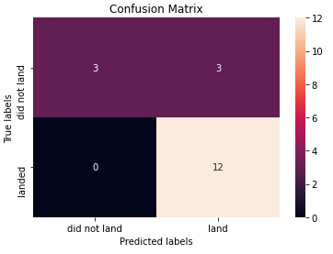

Confusion Matrix
Show the confusion matrix of the best performing model with explanation
First image shows the confusion matrix of the model with highest training accuracy (DecisionTree).
Second image shows the confusion matrix of the rest of the models LogisticRegression, SVC (Support Vector Classifier) and KNN (K-Nearest Neighbor).
14/18 = 0.7777 DecisionTree
15/18 = 0.83333 Rest of models

Slide 47

CONCLUSION
Now we understand many of the reasons why SpaceX has the highest success rate saving that much money during the process.
SpaceY will be able to reasonably accurately predict if future SpaceX launches will land the first stage of the rocket and implement it on future projects.
Machine learning classification models have similar accuracies even though they were high.

Slide 48

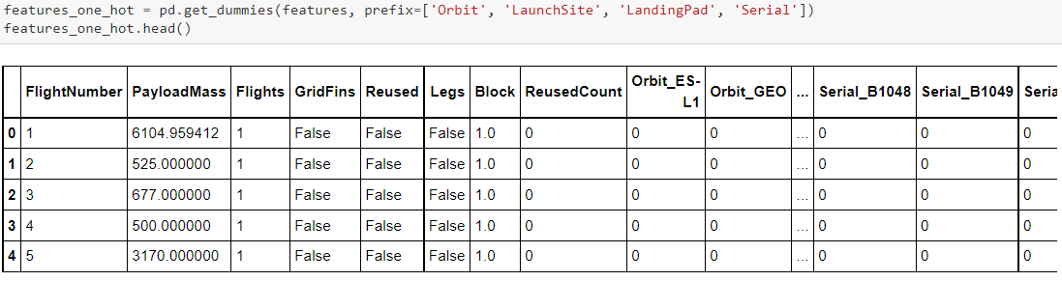
APPENDIX
Include any relevant assets like Python code snippets, SQL queries, charts, Notebook outputs, or data sets that you may have created during this project
Some of the features engineering used in the EDA with Visualization lab where some important data manipulation is made like the creation of dummy variables to categorical columns
applying OneHotEncoder or the casting of numeric columns to float64 which more suitable dtype in the case.

