Slide 1
Machine Learning & Deep Learning in Health Care
By Daniel Coimbra Salomao

Slide 2
Possibilities with Machine Learning and Deep Learning in Healthcare
Machine Reasoning:
ML/DL in healthcare represents a innovative approach where AI systems not only process data but also understand and interpret medical context.
This leap in AI technology enables more accurate diagnoses, personalized treatment plans, and predictive analytics in healthcare.
Possibilities:
With Machine Reasoning, the biggest incoming impacts of AI in healthcare take effect in Personalized Medicine, Predictive Analysis and Personalized Diagnostics.
AI development opens up new doors towards robotics automation in healthcare.

Slide 3
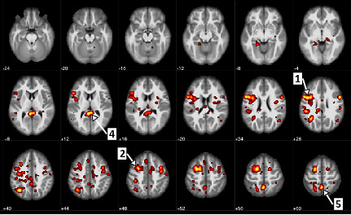
Types of AI of relevance to healthcare
Machine learning – Data Prediction and Analysis
Deep Learning – Neural Networks
Generative AI – Data Creation
Natural language processing – Human Language Processing
Physical Robots – Automates physical tasks in heathfield
Computer Vision – Analyzes and interprets visual information
IBM recently announced its scientists used AI and machine learning algorithms to predict schizophrenia with 74 percent accuracy.

Slide 4


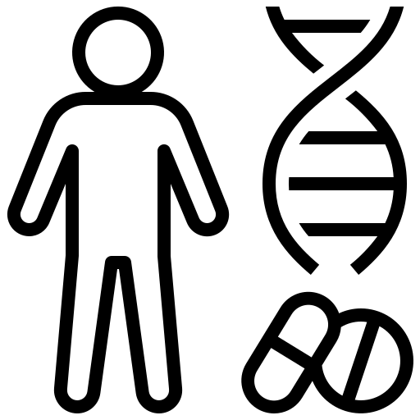



AI Trends in Healthcare
Machine Learning
Predictive Analytics for Patient Monitoring
Personalized Medicine
AI in Mental Health
Deep Learning
AI in Medical Imaging
AI-Driven Drug Discovery and Development
Robot-Assisted Surgery

Slide 5
Opportunities and Threats
Opportunities
Generative AI:
Enables analysis of immense data for new content creation.
Machine Learning & Deep Learning:
Improves adaptability and efficiency in healthcare.
Facilitates technological evolution with reduced human supervision.
Threats
Data Privacy Concerns:
Need for secure training datasets.
Risks associated with handling sensitive patient data.
Algorithmic Biases:
Potential for unequal treatment and results.
Challenges due to imperfect or incomplete data

Slide 6
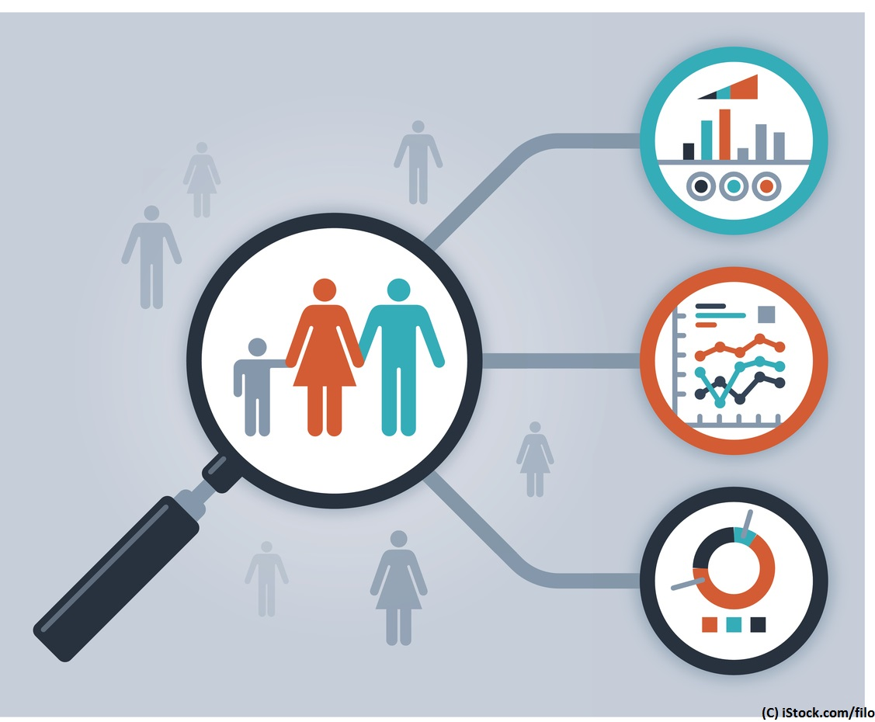
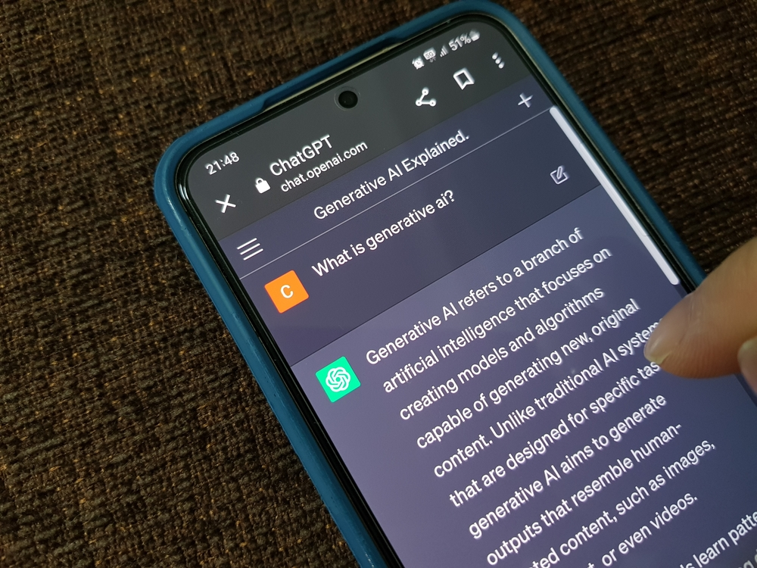
Strategic Investments for Cotiviti
Personalizing Consumer Engagement:
Utilizing Machine Learning to tailor consumer engagement programs.
Implementing data-driven healthcare recommendations for individualized experiences.
Generative AI in Data Augmentation:
Enhancing model training and simulating real-world scenarios.
Improving existing AI models for efficient healthcare operations.

Slide 7
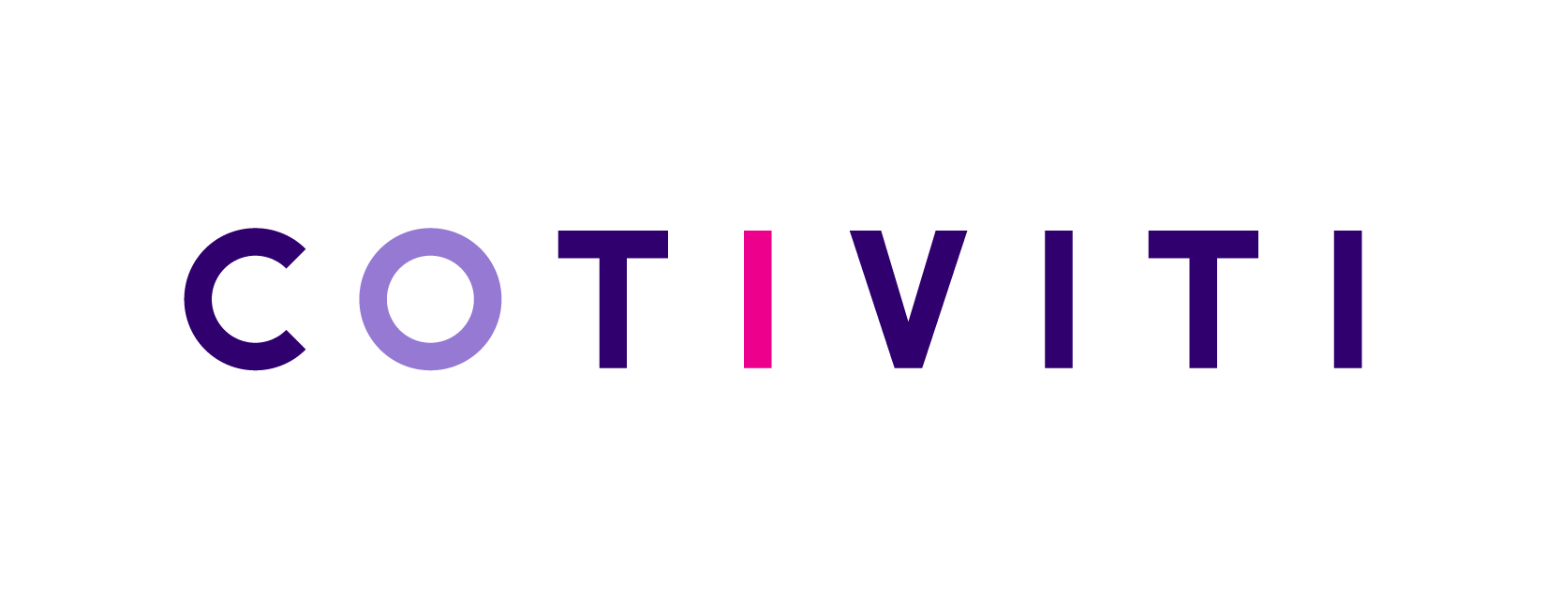
The Future of Healthcare with AI at Cotiviti
Impact of ML and DL in Healthcare:
Delivering personalized, accurate, and independent care solutions.
Adapting to new scenarios and handling diverse healthcare challenges.
Cotiviti's Path Forward:
Expanding AI capabilities with generative AI and existing technologies.
Aligning AI advancements with Cotiviti's mission to innovate healthcare services.

