Slide 1
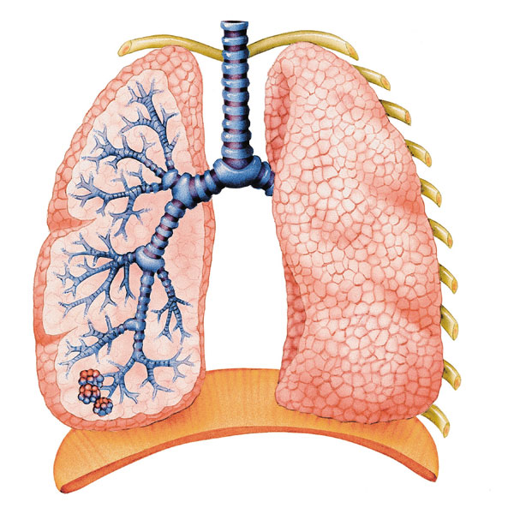
Respiratory System Physical Examination
Danial Abdoli

Slide 2
FOUR COMPONENTS OF A RESPIRATORY ASSESSMENT
INSPECTION
PALPATION
PERCUSSION
AUSCULTATION

Slide 3
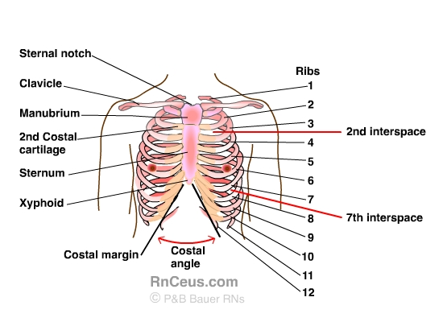

Slide 4
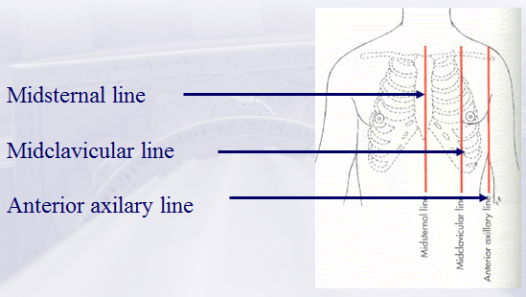
Anterior Chest Landmarks.

Slide 5
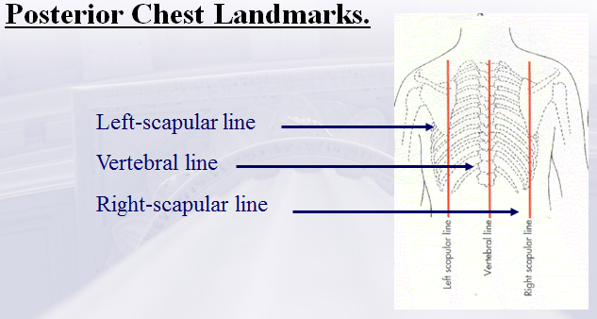

Slide 6
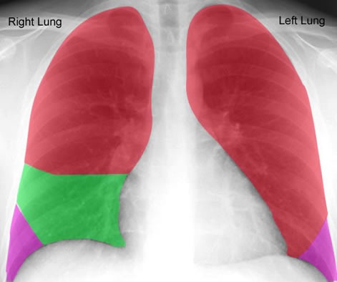

Slide 7
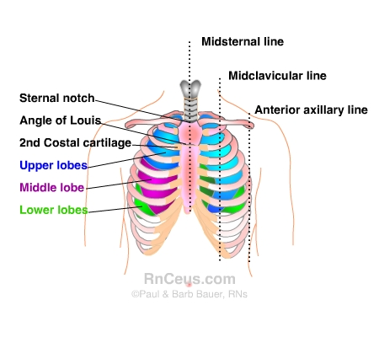

Slide 8
Look
Depth of breathing (shallow, normal, deep)
Respiratory rate
Pattern (regular vs laboured)
Movement (symmetrical vs asymmetrical)
Abnormal
Pursed lips, nasal flaring, accessory muscle use, cyanosis, clubbed fingers
Is there a cough?
Sputum (note quantity, colour)
Level of consciousness (alert vs depressed)
Confusion
Tracheal deviation
Notes:
Sputum:
Green, yellow, creamy: infection
White frothy or pink: pulmonary edema
Blood: carcinoma, PE, trauma
Black pecks: cigarette smoking or smoke inhalation
Cough: dry (viral, chf, asthma, gerd, ACE, carcinoma), moist (bronchitis, asthma, bacteria)

Slide 9
Feel
Chest movement (symmetrical vs asymmetrical)
Lightly place hands on each side of the chest wall, thumbs together at midline.
Thumbs should move apart on inspiration and fall back together on expiration.
Notes:
Unilateral restriction common in pneumothorax, pleural effusion, pneumonia

Slide 10
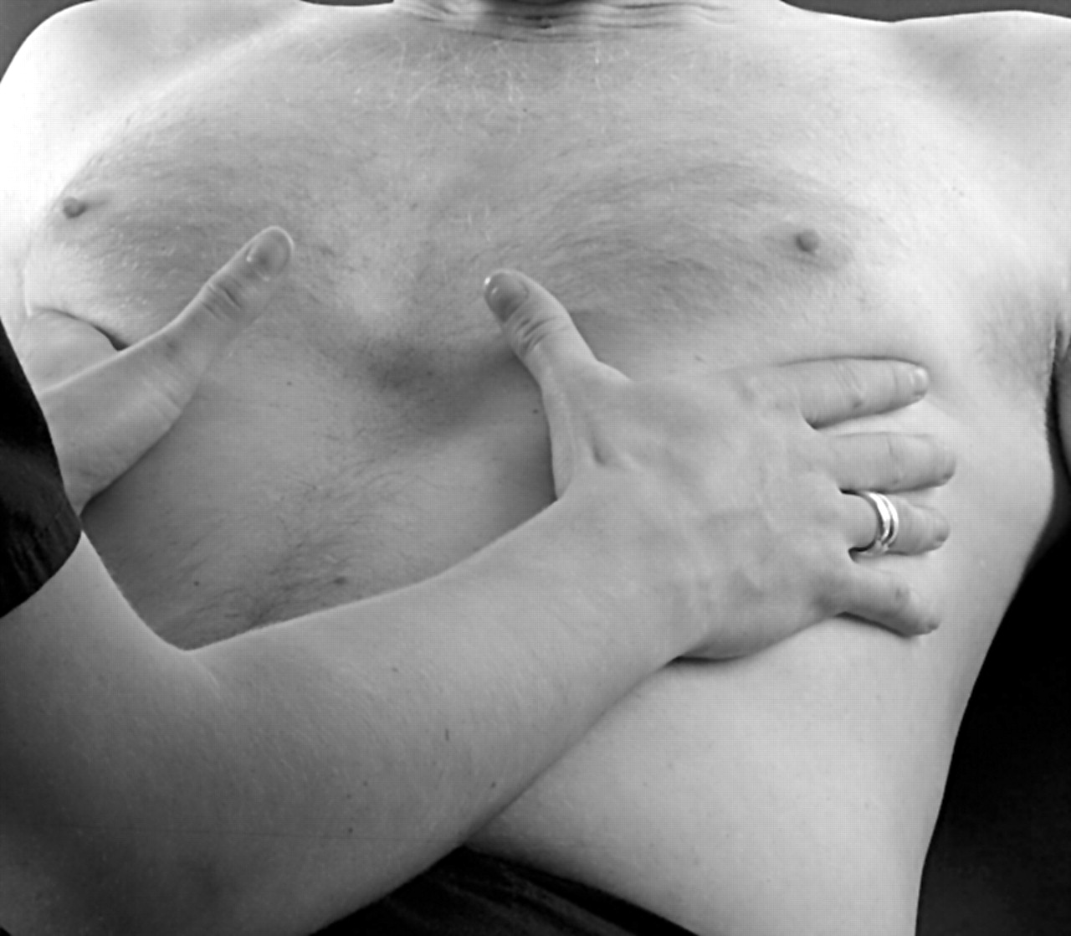
Chest Wall Expansion

Slide 11
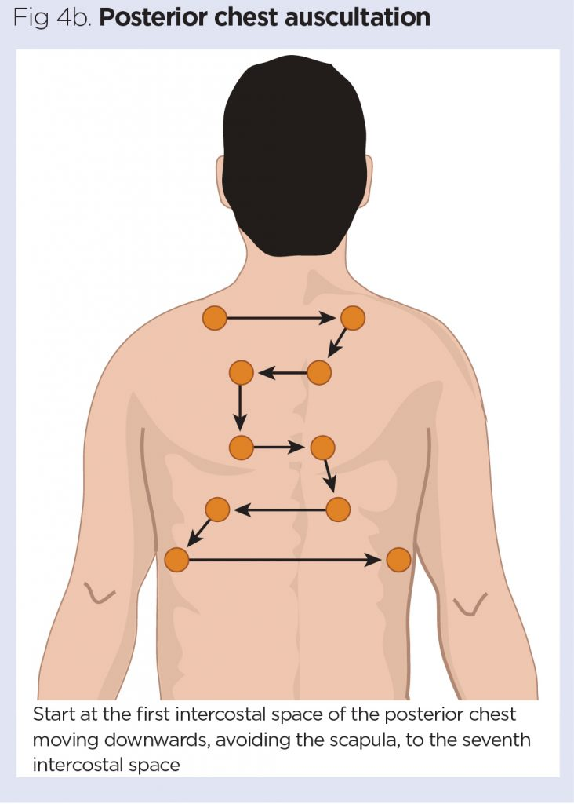
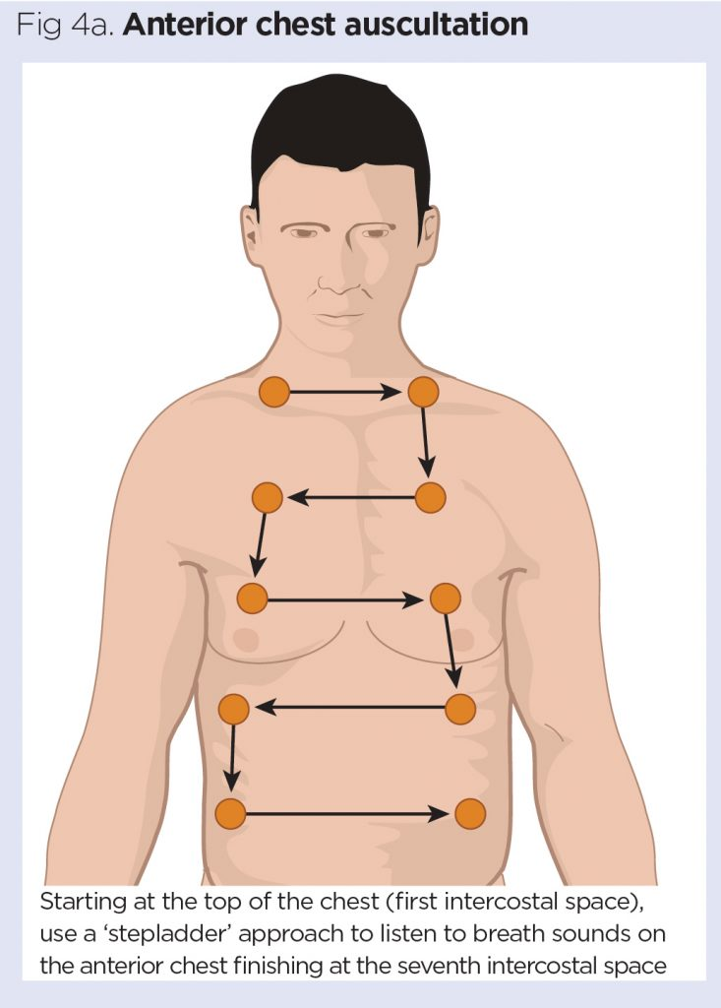
Listen
Distinguish between normal and abnormal
Breathing should be quiet
Listen with diaphragm of the stethoscope from side to side, top to bottom
https://www.nursingtimes.net/clinical-archive/assessment-skills/how-to-perform-chest-auscultation-and-interpret-the-findings-06-01-2020/

Slide 12
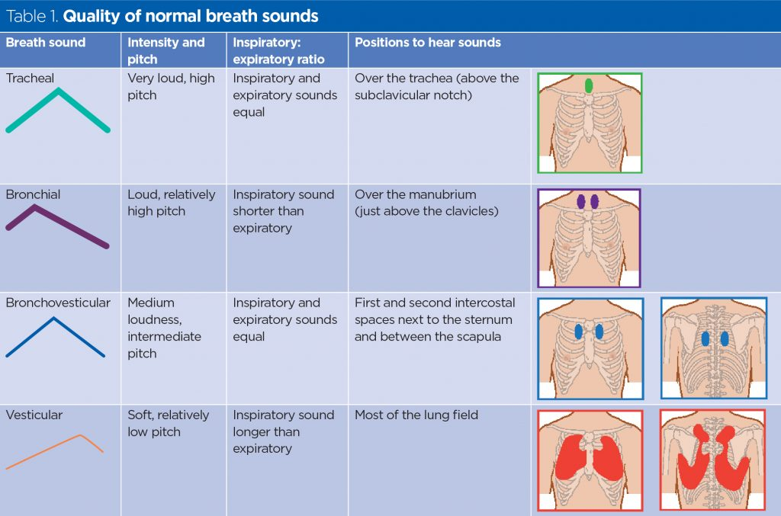
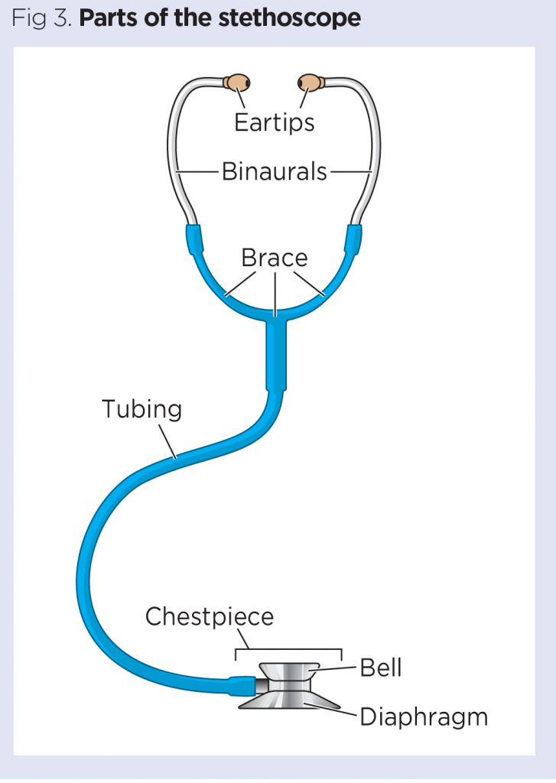
Normal Auscultation
https://www.nursingtimes.net/clinical-archive/assessment-skills/how-to-perform-chest-auscultation-and-interpret-the-findings-06-01-2020/

Slide 13
Abnormal Sounds
Include: crackles/rales, wheezes and rhonchi
Caused by:
Consolidation of secretions, compression or airway (mass), pleural effusion, collapsed lung
Absent, diminished or adventitious breath sounds
Notes:
Bronchovesicular or bronchial sounds are heard in distant lung fields.

Slide 14
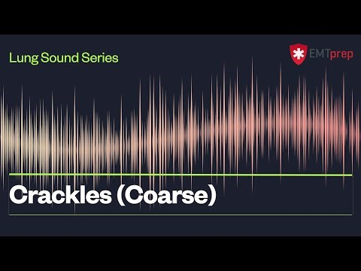
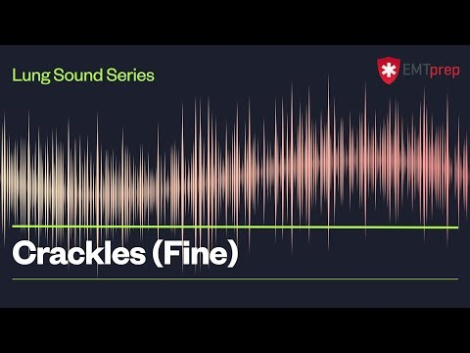
Crackles/Rales
Due to atelectasis or fluid in the small airways
Heard on inspiration – possible pulmonary edema or pneumonia
More significant if not cleared with coughing
Can be fine or coarse
Notes:
Crackles: pulmonary edema, fluid in alveoli, respiratory distress
Atelectasis: more common crackles with inspiration and expiration
Wheezing: narrowed by constriction of airway muscles, swelling, obstruction

Slide 15
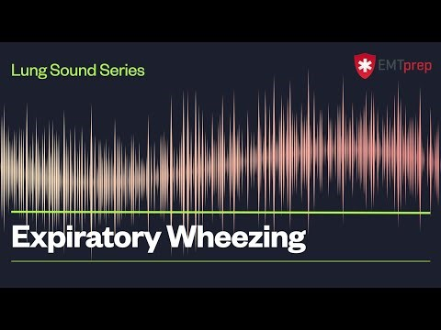
Wheezing
High pitched whistling
Can occur with inspiration or expiration, but usually more pronounced on expiration
Occurs with airway narrowing

Slide 16
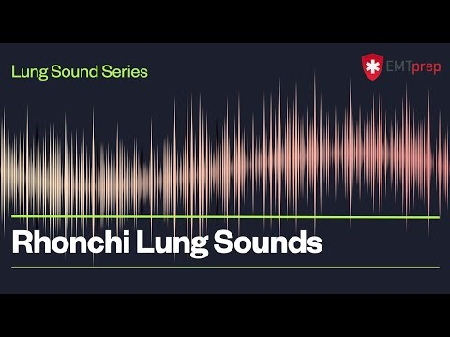
Rhonchi
Resembling a snoring or gurgling sound
Suggests secretions in large airways

Slide 17
Percussion Sounds
Sound | Description | Significance
Resonant | Long, loud, low pitched, hollow | Normal Lung sounds
Dullness | Medium in intensity and pitch, moderate length | areas of increased density/decreased air (consolidation, collapse, fibrosis, abscess, neoplasm)
Stony dull | Thudlike | unique for pleural effusion
Hyper resonant | Very loud, low pitched | areas of decreased density-increased air (pneumothorax)

