Slide 1


Basics and Foundations
Data in R
Daniel Estévez-Barcia
daeb@natur.gl

Slide 2
Data types
Type | Values | Logical_test | Coercing
Numeric | 1.5, 2.6, 3.1 | is.numeric() | as.numeric()
Integers | 3, 4, 5 | is.integer() | as.integer()
Logical | TRUE, FALSE, NA | is.logical() | as.logical()
Character | "Word1", "Word2" | is.character() | as.character()
Basics and Foundations

Slide 3
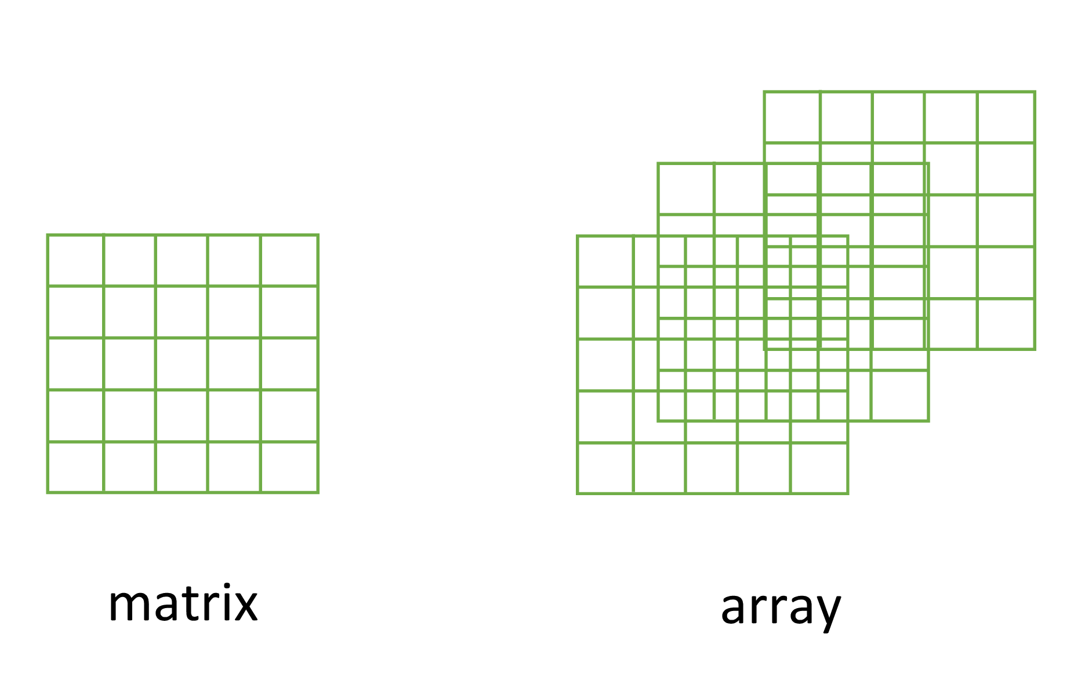
Data structures Matrices and arrays
Let’s go to the Script
matrix()
array()
Basics and Foundations

Slide 4
Exercise 1
rownames(MaxMinCapacity_Zion[,,1]) <- c(paste("district", 1:5, sep = "_"))
colnames(MaxMinCapacity_Zion[,,1]) <- c(paste("level", 1:5, sep = "_"))
Basics and Foundations

Slide 5
Data structures Lists
While vectors and matrices can only contain one data type, lists can contain, several different kinds of objects with different data types
Back to the Script
Basics and Foundations

Slide 6
Data structures Data frames
The war horse of every project
Understand the data
Clean the data
Digest the data
Visualize it
Otherwise, shit in -> shit out
Basics and Foundations

Slide 7
Data manipulation
“Happy families are all alike; every unhappy family is unhappy in its own way.”
Leo Tolstoy
“Tidy datasets are all alike, but every messy dataset is messy in its own way.”
Hadley Wickham
Basics and Foundations

Slide 8
I recommend you take a look at this
https://sfg-ucsb.github.io/fishery-manageR/data-entry-management.html#best-practices
Basics and Foundations

Slide 9

The way you are taught how data are
How you tend to receive data
id | height_cm | weight_kg | name | sex
1 | 188 | 95 | Ana | female
2 | 169 | 78 | Marta | female
3 | 164 | 56 | Antonio | male
4 | 145 | 60 | Carlos | male
5 | 205 | 87 | Sara | female
6 | 141 | 69 | Evaristo | male
7 | 146 | 86 | Julien | male
8 | 186 | 76 | Pedro | male
9 | 146 | 65 | Fernanda | female
10 | 174 | 84 | Isabel | female
11 | 164 | 94 | Diego | male
12 | 201 | 89 | Laura | female
13 | 210 | 110 | Aqaluq | male
id | H | Weight | name | sex
1 | NA | 93 | Ana | fem
2 | 171 | 62 | "Marta" | female
3 | -- | 69 | antonio | male
4 | 155 | 88 | Carlos | male
5 | 183 | 84 | Sara | Female
6 | 0 | 98 | Evaristo | malæ
7 | 192 | 57 | Julien | Mal
8 | 177 | 88 | Pedro | male
9 | 144 | 82 | Fernand | F
9 | 144 | 82 | Fernanda | woman
10 | 199 | seventy-one | Isabel | female
11 | Na | 88 | Diego | Man
12 | 151 | 71 | Laura | female
13 | 210 | 110 | Aqaluq | 1
Basics and Foundations

Slide 10
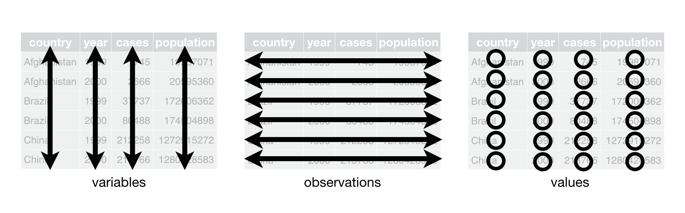
Data manipulation
Aiming for tidy data
Basics and Foundations

Slide 11
Data manipulation
Basics and Foundations

