Slide 1
Chiral Gold Nanomaterials for Photodetection Applications
BTP - 1
Daniel Gracias 200110029 | Under the guidance of Prof. Tanushree Choudhury Prof. Revathy Padmanabhan (IITPKD)
Notes:
Mention BTP, collab

Slide 2
Acknowledgement
I would like to express my gratitude to to Prof. Revathy Padmanabhan for providing me with much-needed guidance for FDTD simulations in Ansys Lumerical.
I would also like to thank Prof. Parag Bhargava for granting me access to the equipment in his lab.
Special thanks to Jeeta Ghosh for guiding me in synthesis.
Finally, I express my profound thanks to Prof. Tanushree Choudhury, for guiding me at every stage and making this project possible

Slide 3
Contents
Introduction
Significance of Project
Simulations
Nanoparticles in Colloid
Validation of Setup
Octahedral colloid
Comparing with Experimental Results
Nanoparticles on substrate
Setup
Circular Dichroism
Synthesis
Seed-Mediated Synthesis
Experimental Progress
Notes:
Workflow, titles

Slide 4
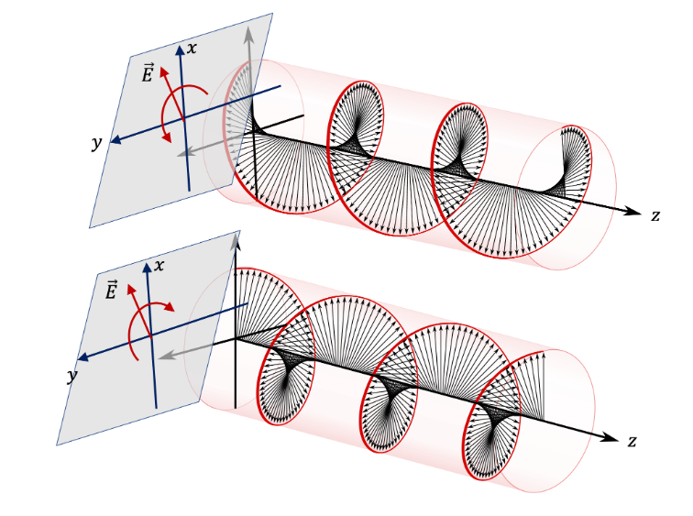
Introduction
Circular Polarized Light (CPL) : Electric field at each point has a constant magnitude and rotates at a constant rate in a plane perpendicular to propagation
Left-Handed and Right-Handed
Provides two channels of communication
Signal transmission in multiple planes
LH and RH interact differently with chiral substances
Applications
Optical Communication
Bio-Detection
Quantum Computing
Miniaturization
Schematic of circular polarized light – Left handed (top) and right handed (bottom)
http://www.physicsbootcamp.org/
Notes:
What we are trying to detect, antenna

Slide 5
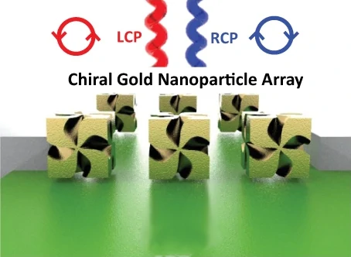
Introduction
Chirality in materials leads to Circular Dichroism (CD) – Difference in transmission of left handed- and right handed- circular polarized light
Conventional semiconductors lack intrinsic chirality required for CD
Combine conventional photodetectors with chiral materials
Enhance photodetection capability via two mechanisms:
Field Amplification
Hot electron injection
Namgung et al, Nature Communications | (2022) 13:5081
Notes:
CD graph
CD examples, data
Mirror image structure/ excitation

Slide 6
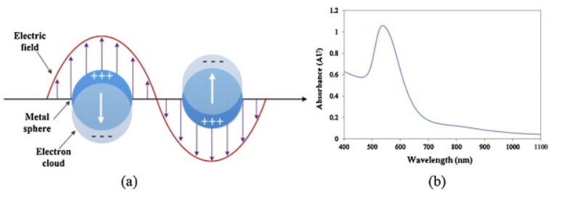
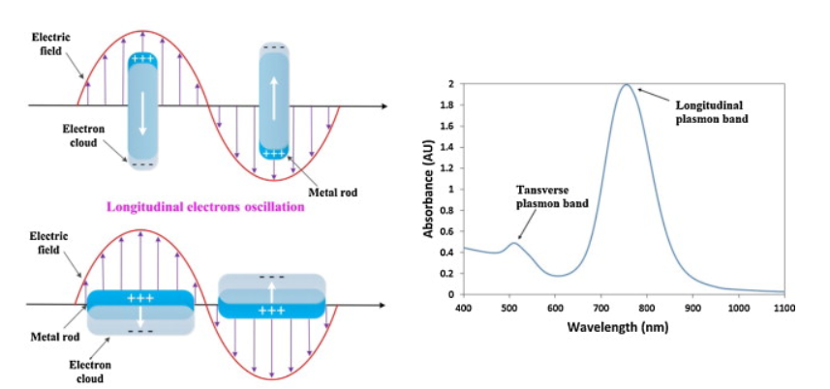
Introduction
Localized Surface Plasmon Resonance
Coherent oscillations of confined conduction electrons in resonance with electromagnetic field
Resonant frequency depend on the geometry of the nanoparticle.
Multiple modes possible depending on geometry of the particle and its orientation with respect to EM wave
Results in enhanced absorption and scattering as well as near field amplification
Chirality in the geometry of the nanoparticle results in a different plasmonic response LH and RH CPL
Cao et al, Sensors and actuators B: Chemical , 195:332–351, 2014
Notes:
Diagram

Slide 7
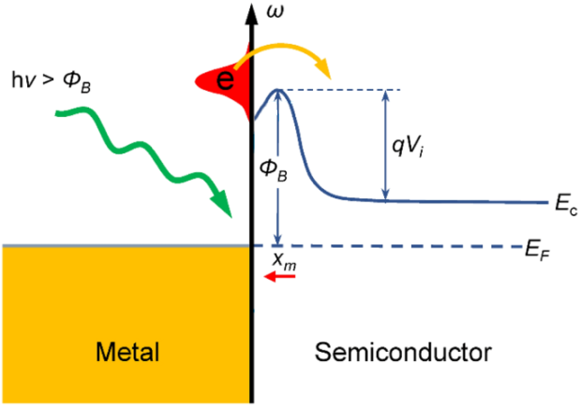
Introduction
Field Amplification
Increases sensitivity
Difference in field amplification for LH and RH CPL
Hot Electron Injection
Non-radiative damping of surface plasmons – creation of hot carrier pairs
The hot electrons can be injected across the metal-semiconductor interface, leading to an increase in photocurrent
Increases wavelength range of photodetection
Namgung et al, Nature Communications | (2022) 13:5081

Slide 8
Introduction
One figure of merit for CPL detector materials is the Kuhn Dissymmetry factor, also known as the g-factor
Chiral Materials | g | Reference
Ortho-π-Extended PDI double-[7]heterohelicene | 0.057 | Zhang et al (2021)
Hydrazine-doped C1CPDI-Ph-CF crystal | 0.12 | Shang et al (2020)
Achiral P6BT | 1.94 | Cheng et al (2020)
1D and 2D (α-PEA)2PbI4 perovskites | 0.23 | Wang et al (2019)
Cholesteric liquid crystal films | 1.9 | Han et al (2020)
Nanorod helical superstructure | 0.02 | Lan et al (2014)
Four-fold twisted nanorods | 0.106 | Ni et al (2023)
432 Helicoid | 0.2 | Kim et al (2021)
Pb-Sn Perovskite + 432 helicoid | 0.54 | Kim et al (2022)

Slide 9
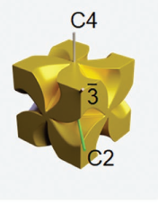
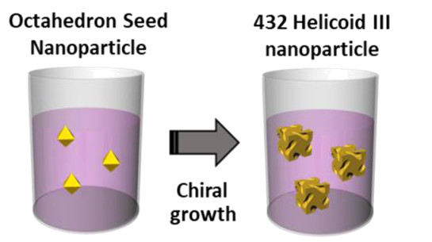
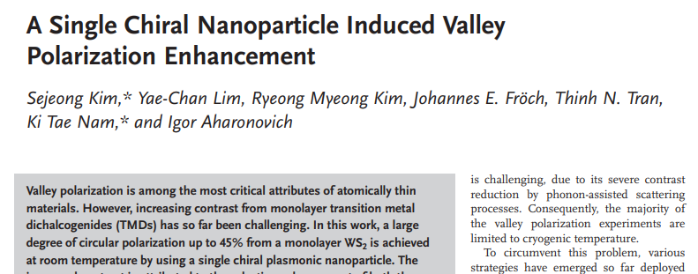
Introduction
432 Helicoid –III structure
G-factor of 0.2 obtained in previous literature Kim et al (2021)
Can be synthesized from bottom up methods
Work of Kim et al (2020) used as a starting point
Octahedral nanoparticles as intermediate
Helicoid432 III (top) growth from nano-octahedra (bottom)
Ni et al Advanced Materials, 35(1):2208299, 2023
Cho et al , ACS nano, 14(3):3595–3602, 2020
Notes:
Precedent, prev CD+simulation results

Slide 10
Simulations
Lumerical FDTD

Slide 11
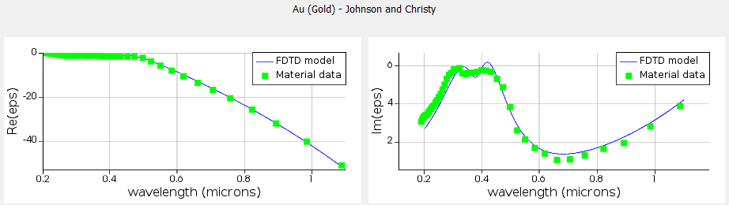
FDTD Simulations
Numerical solutions to Maxwell’s equations
Uses frequency dependant complexdielectric function to quantify material data
Objectives
Prediction of response of ensemble of gold nanoparticles in colloid
Optimizing chiral nanoparticles on a substrate for Circular Dichroism

Slide 12
FDTD Simulations Nanoparticles in Colloid
Prediction of response of ensemble of gold nanoparticles in colloid
Useful to correlate with experimental UV-Vis data
Octahedral Nanoparticles in colloid
Synthesis intermediate
Orientation dependence
VALIDATING SETUP
Single Sphere
Compare with analytical results
Response of octahedral colloid
MONTE CARLO
Size and orientation dependence
Size Dependence
SINGLE OCTAHEDRON
Comparing with experimental data
Cho et al , ACS nano, 14(3):3595–3602, 2020

Slide 13
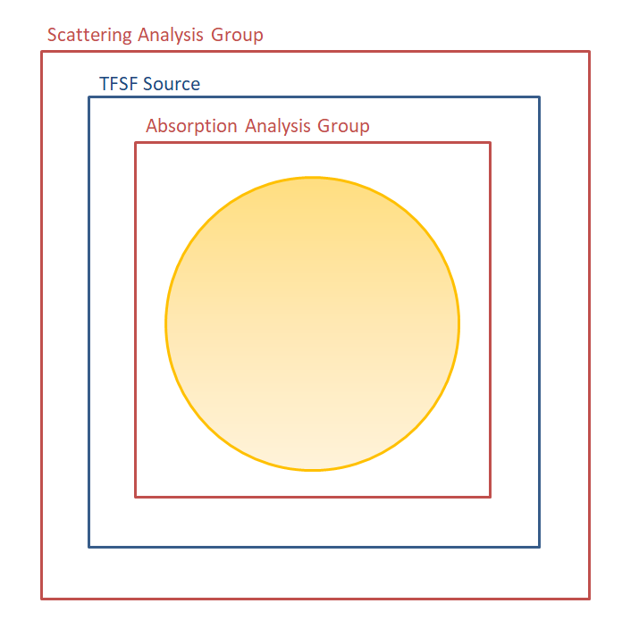
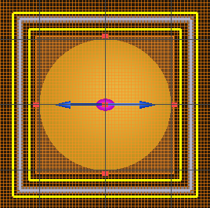
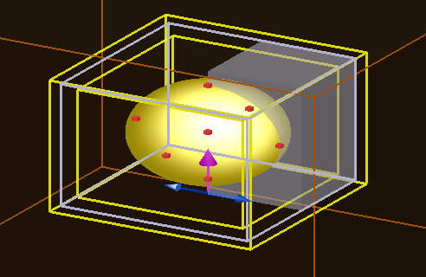
Validating setup
Single nanoparticle
PML boundary conditions
Anti-symmetric BC in x
Symmetric BC in y
Total Field- Scattering Field Source setup is used to separately record absorption and scattering
Propagation in -z
Absorption analysis group inside source region
Scattering analysis group outside source region
Mesh refinement in nanoparticle region (2.5nm for smallest)
y
x
Meshing
Sources and monitors
Notes:
Validating setup

Slide 14
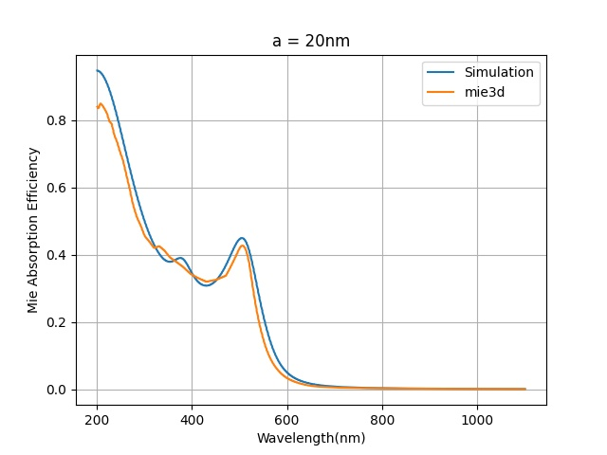
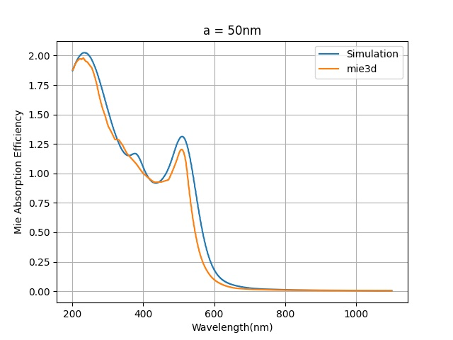
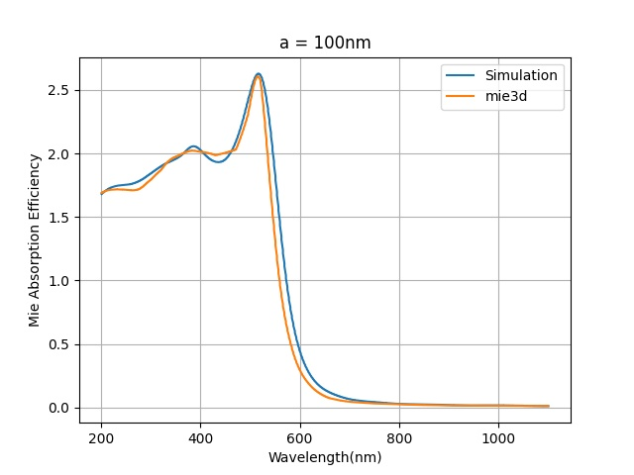
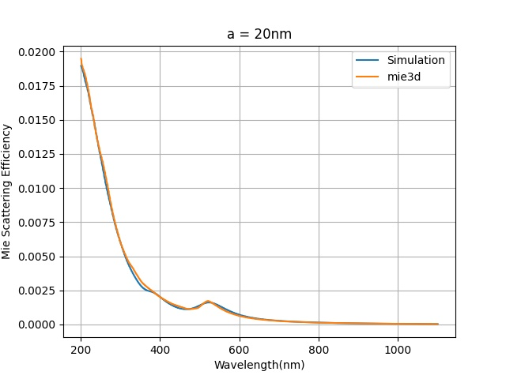
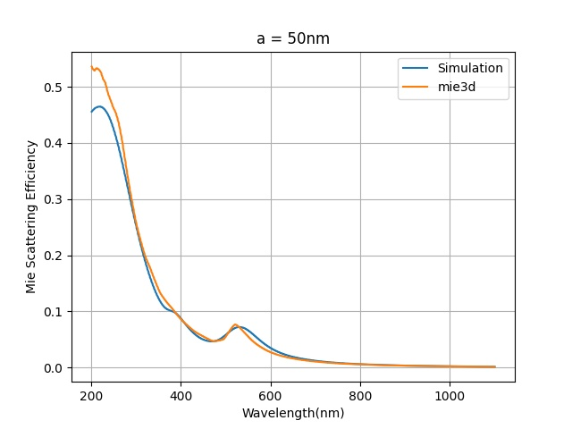
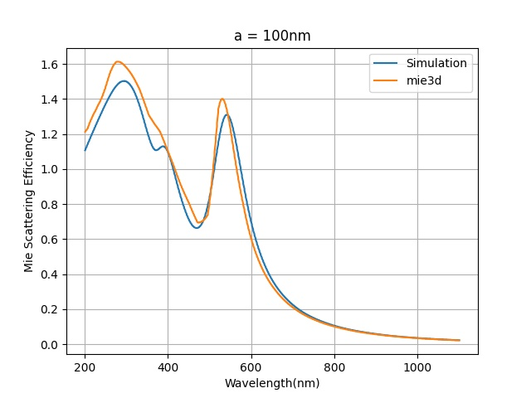
Validating Setup
Results from simulations compared to analytical solution (Mie) in order to validate setup for different sizes
Mie efficiency of absorption = absorption cross section / projected area
Notes:
Validating setup

Slide 15
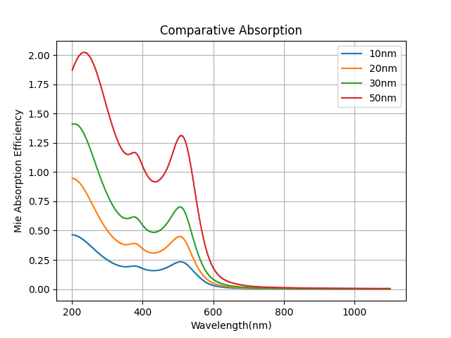
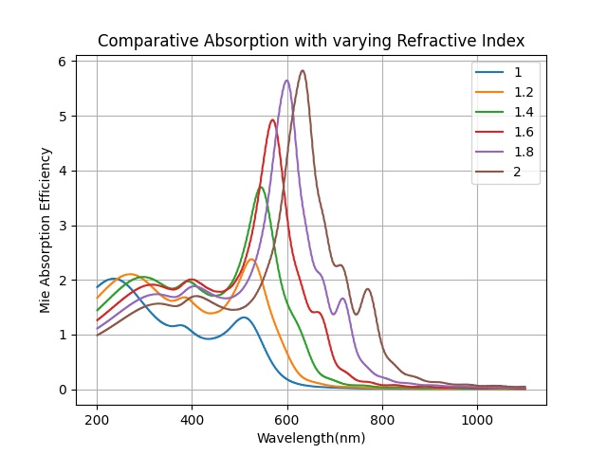
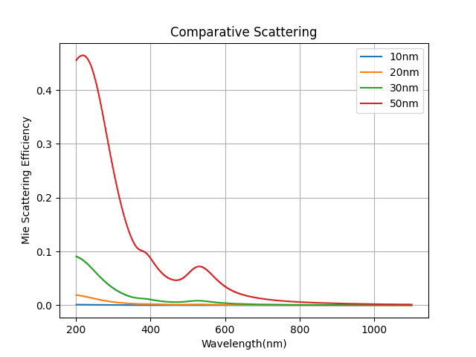
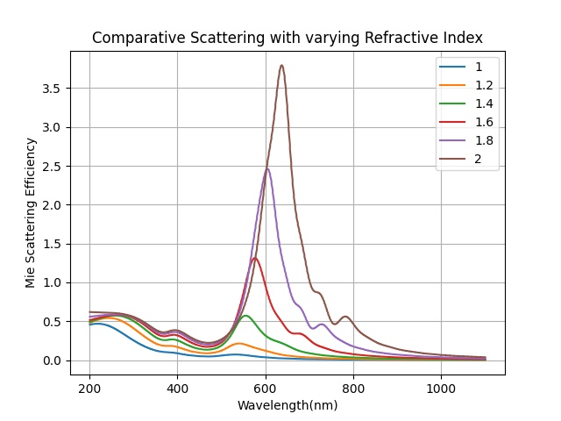
Gold Nanospheres
Variation with Size
Variation with medium RI
Contribution from scattering increases with increasing size
Red-shift of extinction wavelengths with increasing size
Results in gold colloids going from red to purple
Redshift of resonance frequency on increasing the refractive index of the medium

Slide 16
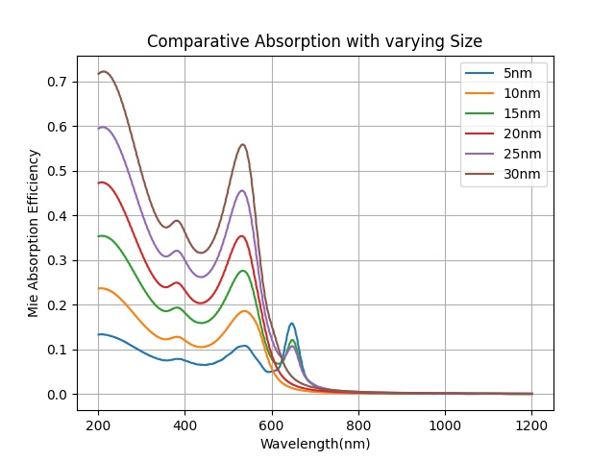
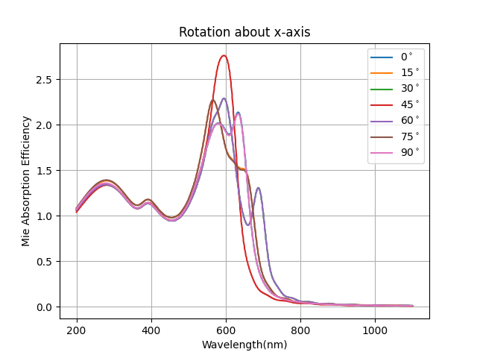
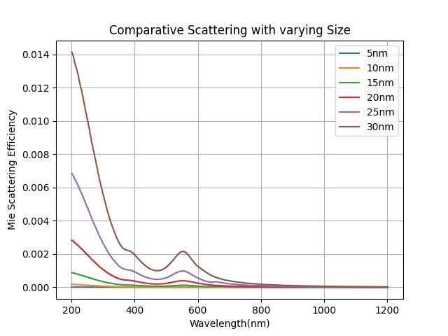
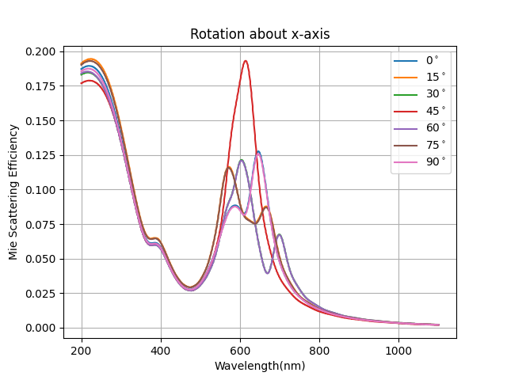
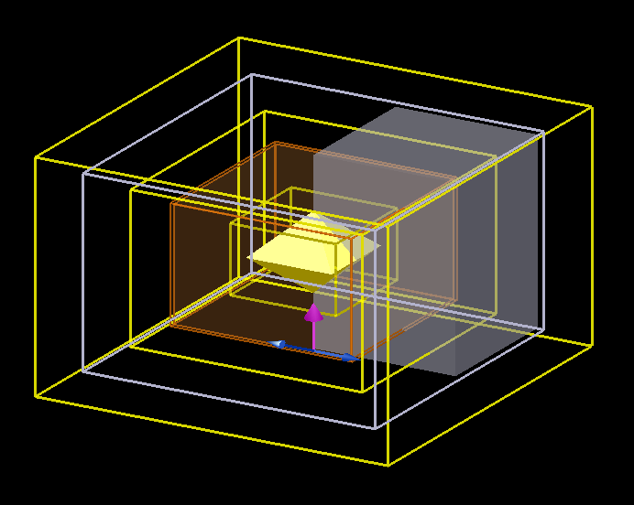
Gold Nano-octahedra
Variation with Size
Variation with x-rotation (50nm)
Meshing and monitor setup optimized during sphere simulation (meshing, sources, monitors)
While varying orientation, symmetry boundary conditions are removed
Orientation dependence can be seen in absorption and scattering spectra
Notes:
Mention takeaway
Symmetries can be maintained

Slide 17
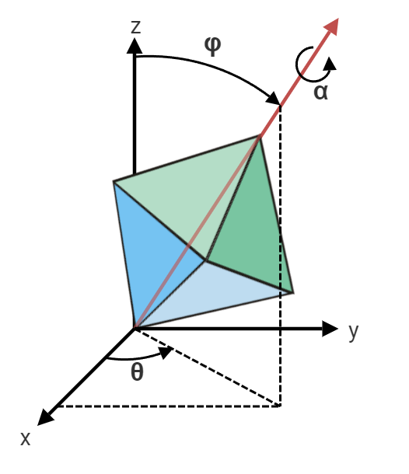
Gold Nano-octahedra Monte-Carlo Simulations
Response of a colloid is average of all orientations
Inter-particle LSPR coupling neglecting
To cover all possible angles : uniform probability distribution of angles in ranges:
α – 0⁰ to 90⁰
θ – 0⁰ to 360⁰
φ – 0⁰ to 180⁰
50 runs carried out and response averaged
Refractive index taken as 1.33 (water)
Size (distance opposite vertices) = 57nm

Slide 18
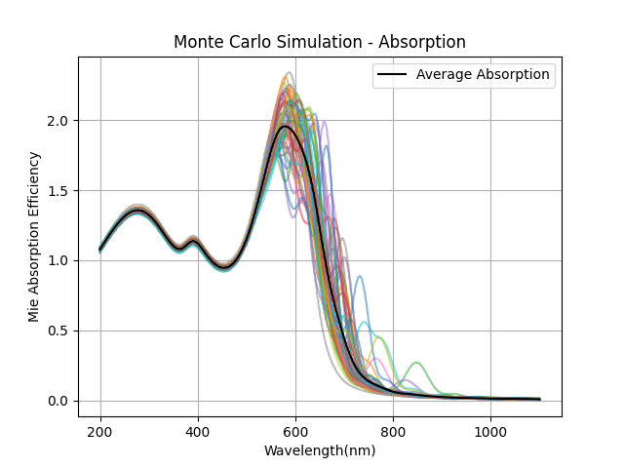
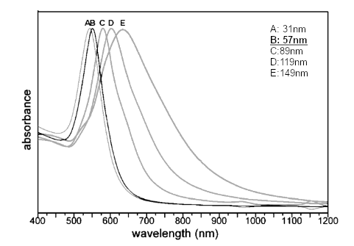
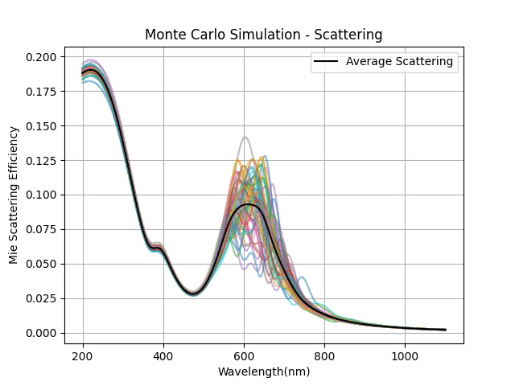
Gold Nano-octahedra Monte-Carlo Simulations
Comparing with UV-Vis data from Chang et al (2008)
Notes:
Measurement method

Slide 19
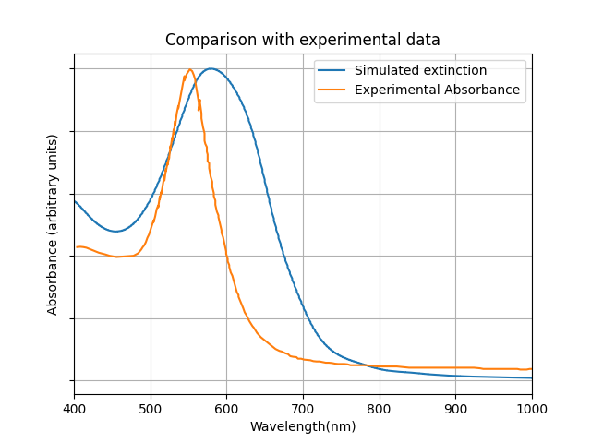
Gold Nano-octahedra Comparing with Experimental Data
UV-Vis spectroscopy calculates the attenuation of the signal as it passes through the sample
Absorption
Scattering
Extinction= Absorption + Scattering
Quantity in simulation corresponding to ‘absorbance’ in UV-Vis
Possible sources of error
Refractive index
Coupling
Notes:
Experimental absorbance

Slide 20
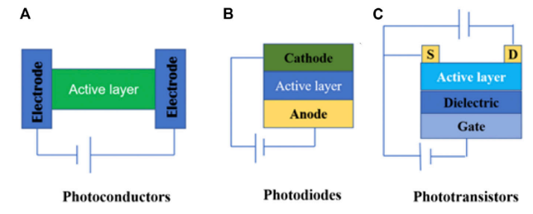
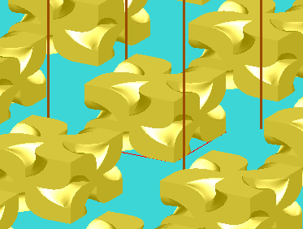
Nanoparticles on Substrate
CPL Photodetector Architectures
Photoconductors
Photodiodes
Phototransistors
Active layer consist Gold Nanoparticles dispersed on semiconductor substrate
432 Helicoid III used as an example
Zhang et al , Front. Chem. 9:711488, 2021

Slide 21
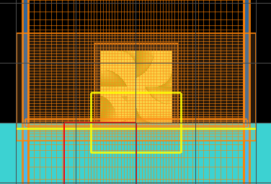
Nanoparticles on Substrate
FDTD simulation architecture, to be used in Lumerical Device to simulate photocurrent response
Periodic array of 120nm nanoparticles having period of 360nm, dispersed on a placeholder substrate with n = 1.5
Mesh refining in regions of nanoparticle and substrate interface
Monitors
Reflection monitor above source
Transmission monitor right below substrate interface
Field Monitor near interface
Periodic Boundary Condition
Absorption = 1-T -R
Notes:
Schematic
Elaborate on setup!
Introduction
Trial, setting up the simulation, depends on

Slide 22
CPL Source
Circular polarized light generally simulated two distinct sources with perpendicular linear polarizations:
Single Source setup instead of two distinct sources – suitable for 4-fold symmetry
Requires only a single run to obtain both response to both polarizations
Notes:
90 out of phase; source pov

Slide 23
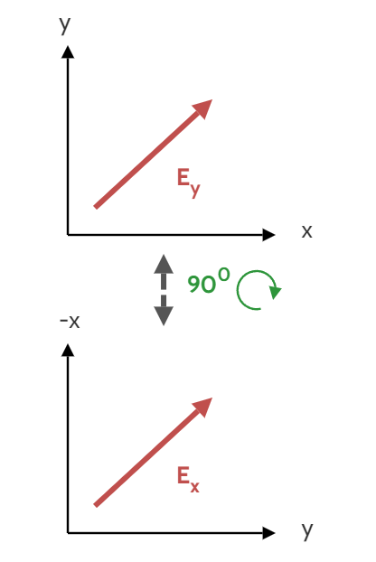
CPL Source
Takes advantage of inherent 4-fold symmetry about z
Knowing the fields corresponding to x- and y- polarized light:
Incorporated into script to obtain response of both LH and RH CPL from the same simulation run
Notes:
Y polarized has same response as X-polarized; transforming the axes

Slide 24
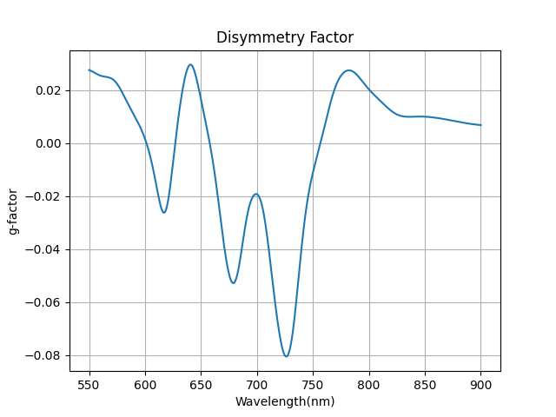
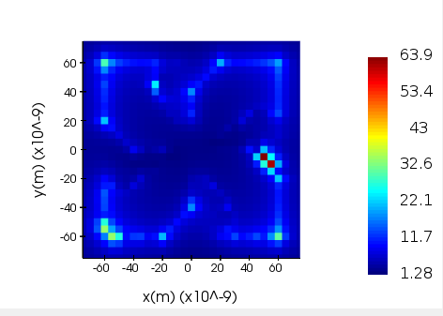
Gold Nano-Helicoids
Maximum field intensification of ~63 is seen at hotspots wavelength (732nm)
G-factor of ) 0.08 is observed at same wavelength
Need for optimization
Notes:
Geometric property

Slide 25
Synthesis
Seed Mediated Pathway

Slide 26
Synthesis of Gold Nanoparticles
Bottom Up
Vapour Deposition
Template Synthesis
Top Down
Direct Laser Writing
Electron Beam Lithography
Ion Beam Etching
Polyol Approach
Seed Mediated Synthesis
Chemical Etching
Electrochemical Approach
Photochemical Approach
Notes:
Seed mediated synthesis

Slide 27
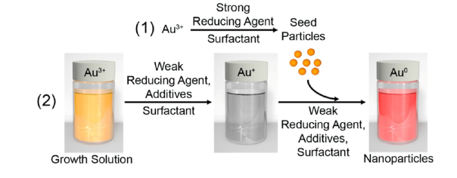
Seed Mediated Synthesis
Control over reaction kinetics allows for fine tuning of
Shape
Size
Composition
Scalable!
Carried out in two separate major steps
Personick et al , Journal of the American Chemical Society, 135(49):18238–18247, 2013.
NUCLEATION
Rapid reduction of Au³⁺ to monodisperse nuclei using NaBH₄
Restricted growth
Stabilizer
Surfactants (CTAB, CTAC, etc)
Citrate
GROWTH
Controlled reduction of Au³⁺ into Au
Seeds are introduced into the solution as sites for growth. Au⁺ is autocatalytically is reduced to Au
Kinetics of the reaction modulated to achieve control over the shape of the final product
Notes:
Droplet synthesis; separation of steps allows monodispersity; control over kinetics

Slide 28
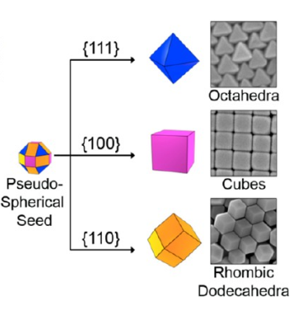
Seed Mediated Synthesis Kinetics of Growth Step
At weak reducing agent concentration, the reduction step happens rapidly, preventing the nanoparticles from reaching their equilibrium shape
Stability of facets: {111}>{110}>{100}
{111} – Octahedron
{110} – Rhombic Dodecahedra
{100} – Cubic
Personick et al , Journal of the American Chemical Society, 135(49):18238–18247, 2013.
Notes:
Larger figure

Slide 29
Seed Mediated Synthesis Kinetics of Growth Step
Role of Halide ions:
Reduction potential – [AuCl]<[AuBr]<[AuI]
Solubility – [AuCl]>[AuBr]>[AuI]
Presence of larger halide ions further slows down the reaction and favours thermodynamic product
Growth can be carried out in multiple steps to vary kinetics as well as composition
Further growth steps can be carried out using chiral reagents to result in chiral geometries
Large variety of geometries can be obtained by controlling kinetics
Reagent | Effect of increasing concentration
Seed | Larger number of particles with a smaller size
Au³⁺ | Larger Particles
Ascorbic Acid | Favours higher energy facets
Halide ion | Larger halide ions favour lower energy facets
Cho et al , ACS nano, 14(3):3595–3602, 2020
Notes:
Mention sim

Slide 30
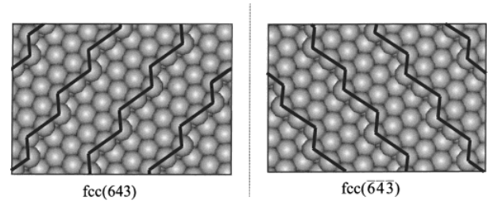
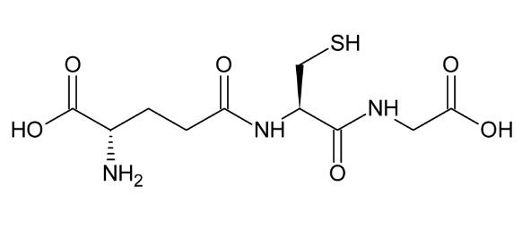
Seed Mediated Synthesis Chiral Growth
Certain crystallographic planes are inherently chiral due to the presence of terraces of lower index planes
Conditions
h ≠ k ≠ l
h x k x l ≠ 0
Chiral reagents (for example L-Glutathione) - preferentially grow one enantiomeric plane
Sholl et al , J. Phys. Chem. B, Vol. 105, No. 21, 2001

Slide 31
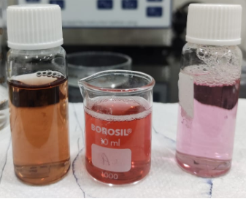
Synthesis of Nano-Octahedra
Nucleation step Seed solution (10mL) (brown)
0.25mM HAuCl₄
0.1M CTAC
0.9mM NaBH₄
Growth Step
Two phase growth step to control kinetics
Growth solutions A and B prepared with identical composition
0.25mM HAuCl₄
0.1M CTAC
2.5mM Ascorbic Acid
5 M KI
55L of seed solution added to growth solution A (turns red)
55L of growth solution A added to growth solution B (turns faint pink)
(left to right) Seed particles, first growth solution, second growth solution in synthesis of gold nano-octahedra
Notes:
Elaborate growth!
Have begun experimental phase

Slide 32
Future Work
Synthesis
Octahedron
SEM, UV-Vis Characterization
Optimize size, shape by varying synthesis parameters
Chiral
SEM, CD characterization
Optimize CD by varying synthesis parameters
Device
Electrical Characterization
SEM
Dispersing particles on substrate
Simulation
Sphere
Optimize simulation parameters by comparing with analytical results
Understand LSPR phenomena and dependencies
Octahedron
Monte-Carlo Simulations
Understand optical response of nano-octahedra colloid to compare with UV-Vis results
Device
CD response
Varying geometric parameters
Photocurrent response

Slide 33
Thank You

