Slide 1

Requirements specification.
E / R scheme
Logical model of the database.
Diagram of the database.
Screen map
Summary table
A description of the data loaded into the database
Discordia

Slide 2
Computer worm.
It affects computers with the Windows operating system.
It is the first known worm that spy and reprogram industrial systems.
Functional prototype of a cyber weapon.
It employs four zero-day vulnerabilities.
Stuxnet

Slide 3
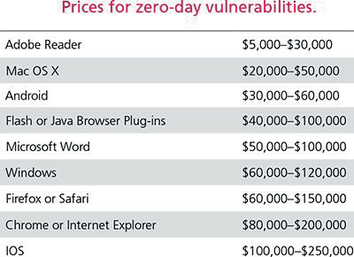
It is an attack against an application or system.
Execution of malicious code.
Vulnerabilities that are unknown.
The most dangerous instruments of a computer war.
Zero-Day

Slide 5
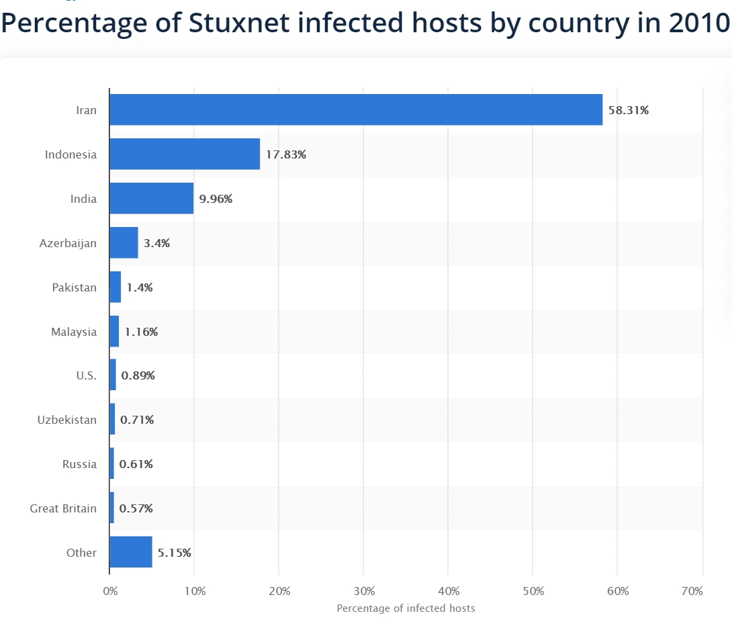
The virus was designed to slowly sabotage the nuclear power plant.
Stuxnet has already infected more than 100,000 computer systems around the world.
At first it was intended to steal information.
Code specifically designed to attack the Iranian nuclear power plant systems.

Slide 6
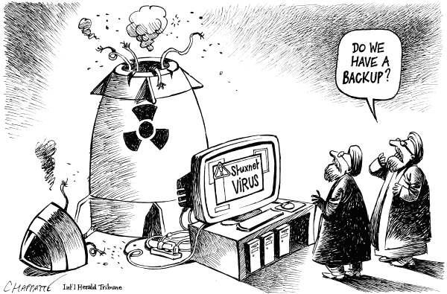
The worm found the software that controls the centrifuges
He took control of the machines.
First the centrifuges will turn dangerously fast.
Then, it slowed the centrifuges for about 50 minutes.
This was repeated for several months.
The tension caused by the speeds caused the infected machines, some, to disintegrate.
1000 centrifuges was destroyed. Around 20% of them.

Slide 7
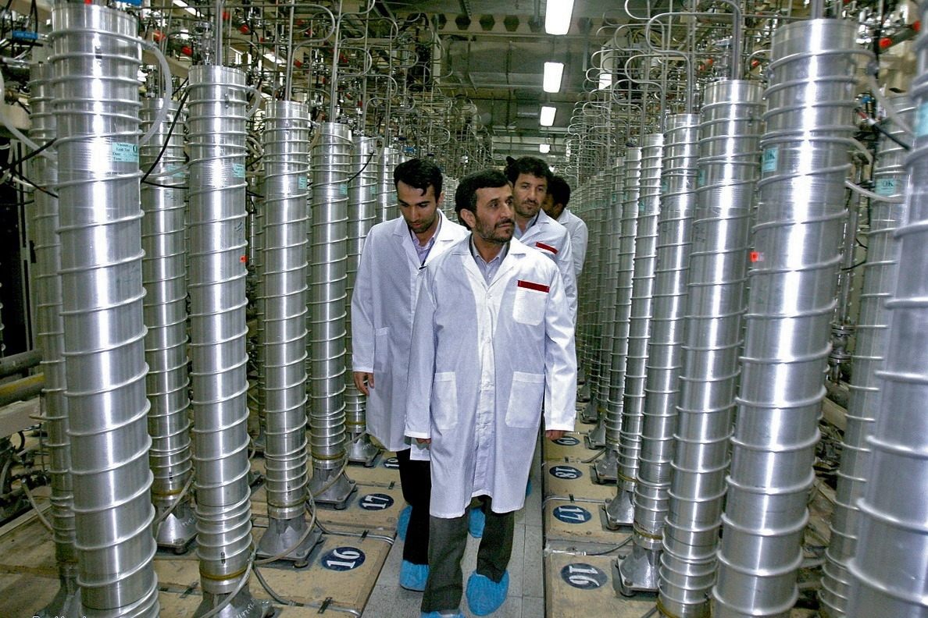
Natanz is a uranium enrichment plant.
In May 2009, Iran was enriching uranium with 4,920 centrifuges.
The amount of centrifuges dropped after the Stuxnet attack (June 2009).
Iran operated 1,148 centrifuges less (In January 2010).

Slide 8
Stuxnet was created by the United States and Israel.
Although US and Israeli officials refuse to talk about it.
The most important cause for the delay of the nuclear clock seems to be Stuxnet, the most sophisticated cyber weapon that has been used in history. The seeds for more versions and attacks.
Finally, the New York Times confirmed that a virus developed and funded by Israel and the United States.
WHO?

Slide 9
The danger of viruses today
Need to protect ourselves
World War III will be with ones and zeros.
Conclusions

