Slide 1

Fostering human agency at schools–
Effects of participatory ESD projects on sustainability competences of high school students using the example of the "KlimaRatSchule" project
Master thesis proposal presentation
MSc Environmental Governance
Dani Gargya daniela@gargya.de
03.04.2024

Slide 2
Agenda
Background
Research Questions
Methods
Proposed time schedule
Next steps
Questions and feedback

Slide 3
Background
Sustainability competences
Participatory ESD methods
Empirical data → Educational design

Slide 4



Lessons learnt so far
Outcome orientation
Goals: Competences in knowledge, attitudes, and behaviour dimensions
Empirical: knowledge-behaviour gap
Importance external factors/ environment

Slide 5




Research gap
Long-term empirical data
Innovative ESD methods (participatory approach)
Self-efficacy beliefs

Slide 6
Research design
Long-term focus with the same two schools as master thesis Lisa Pauli last year (Angell, Goethe Emmendingen)
Using same survey as Pauli with focus on changes in climate attitudes and behaviour (quantitative research)
Conducting survey with same students (knowing their involvement during project is enough, no personalised data)
Complementing with survey on self-efficacy
Sustainability competences and participatory ESD || Dani Gargya || 03.04.24

Slide 7











Research questions
3.
2.
1.
MP1
MP2
MP3 (one year later)

Slide 8
Research questions
1. How do climate attitude and behaviour among students change over time (before, during and one year after the project implementation)?
2. How do climate attitude and behaviour and self-efficacy beliefs respond to levels of involvement of the students?
3. How is climate attitude and behaviour influenced by self-efficacy beliefs?

Slide 9
Predictions
1. MAGNITUDE
2. VALIDATION
3. COMPLEMENT
Sustainability attitudes & behaviours
Sustainability attitudes & behaviours
Efficacy beliefs
Time
Efficacy beliefs

Slide 10
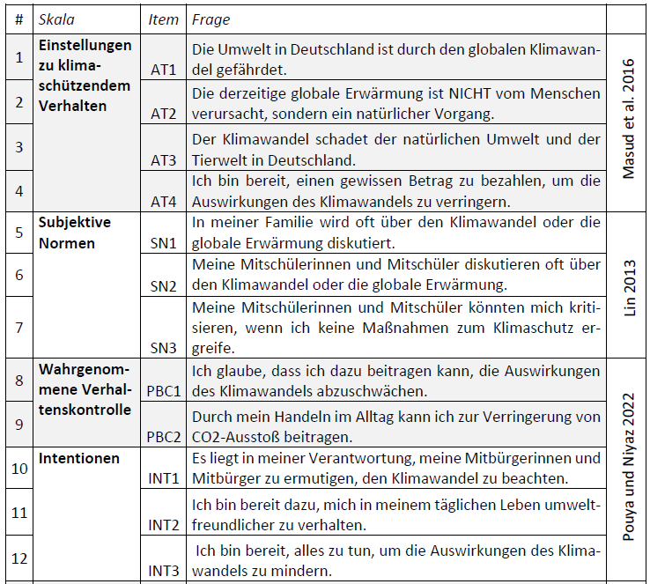
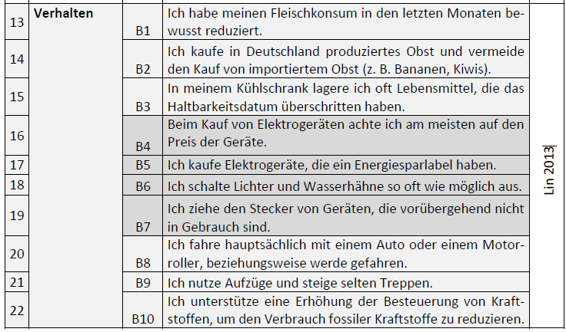
Methods – Surveys
Sustainability attitudes and behaviour – based on MA Lisa Pauli

Slide 11
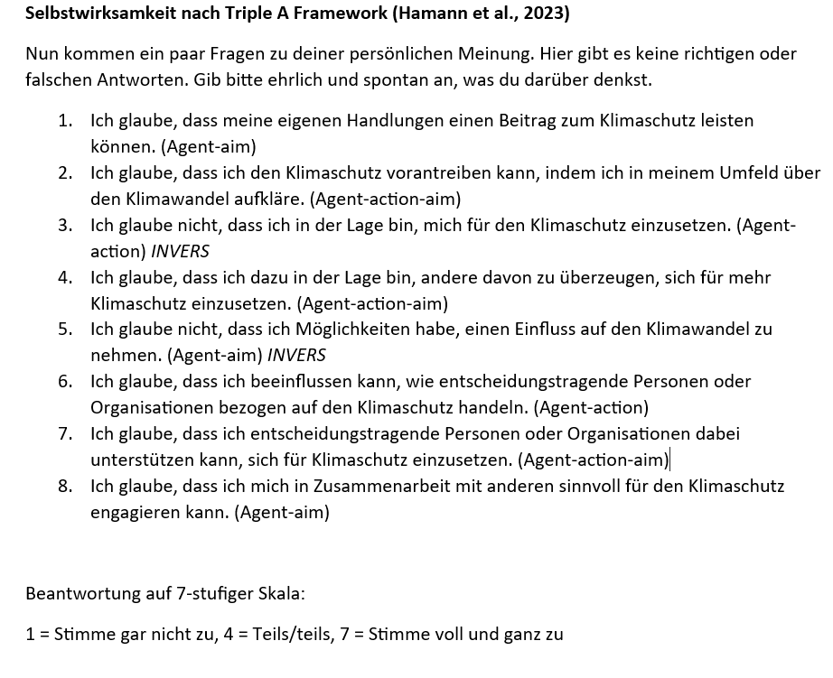
Methods – Surveys
Self efficacy beliefs– based on Hamann et al.

Slide 12
Methods – Data analysis
Climate attitude/ climate behaviour/ Self-efficacy ~ duration + level of involvement + (1|school) +

Slide 13
Proposed timetable
Hand-in: 31st July!

Slide 14
Next steps
Confirmation/additions research focus from Solare Zukunft/ IZT
Contact with schools and data collection
Permits to conduct surveys at schools
Contact existing data Lisa Pauli for analysis
Official registration

Slide 15


Questions and feedback

Slide 16
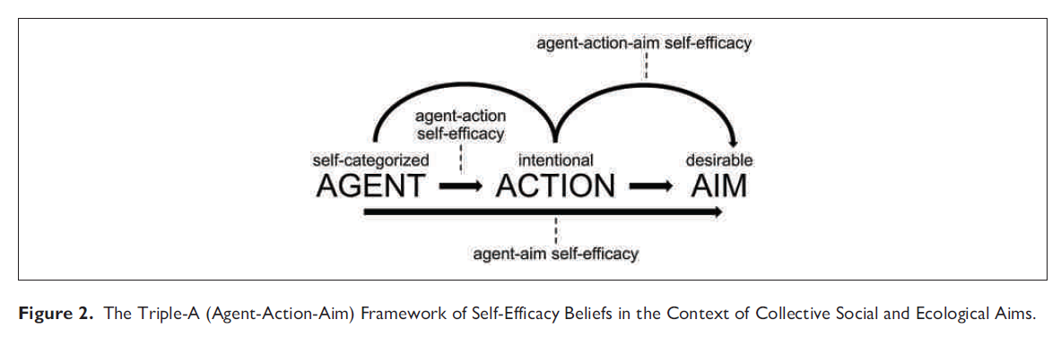
Framework self-efficacy

Slide 17
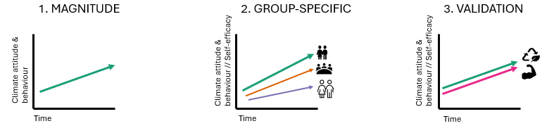
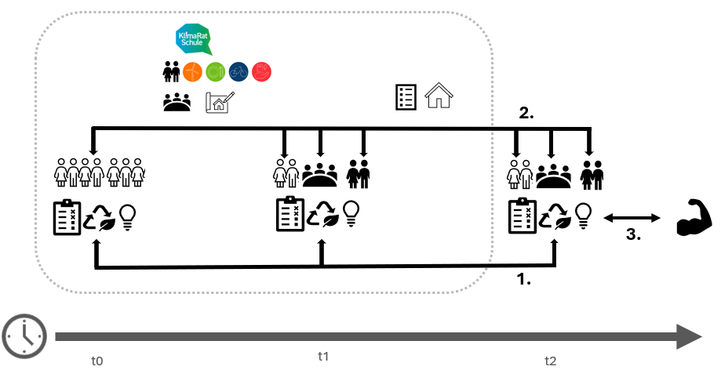
A) Predictions
B) Workflow

Slide 18
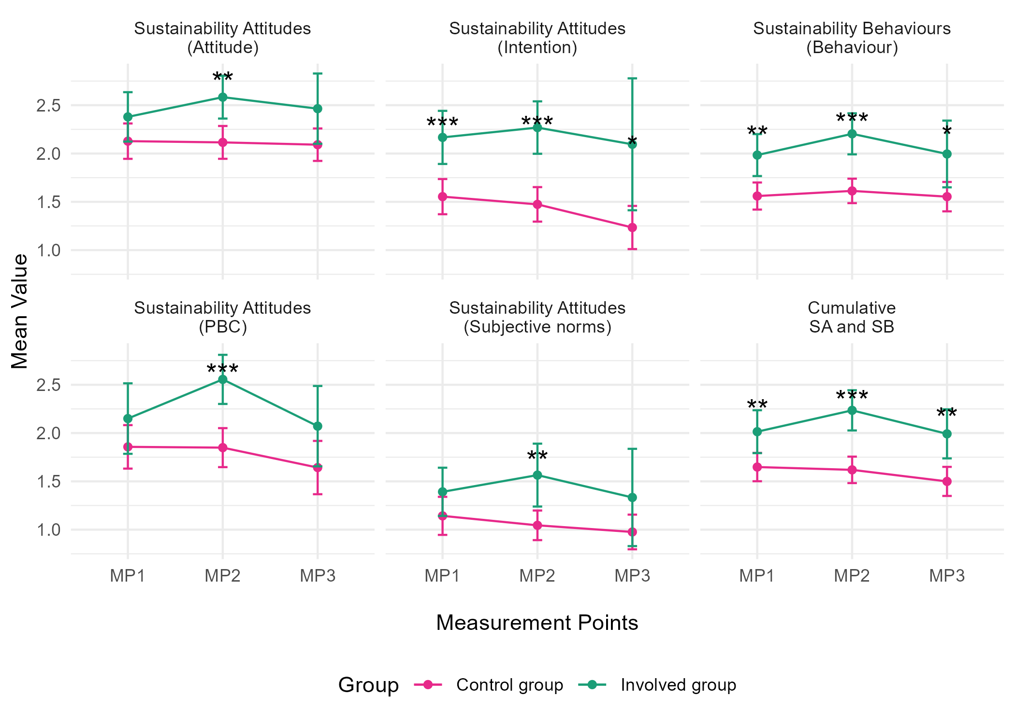
n = 20
n = 18
n = 7
n = 20
n = 18
n = 7
n = 20
n = 18
n = 7
n = 56
n = 63
n = 42
n = 56
n = 63
n = 42
n = 56
n = 63
n = 42
n = 20
n = 18
n = 7
n = 20
n = 18
n = 7
n = 20
n = 18
n = 7
n = 56
n = 63
n = 42
n = 56
n = 63
n = 42
n = 56
n = 63
n = 42

Slide 19
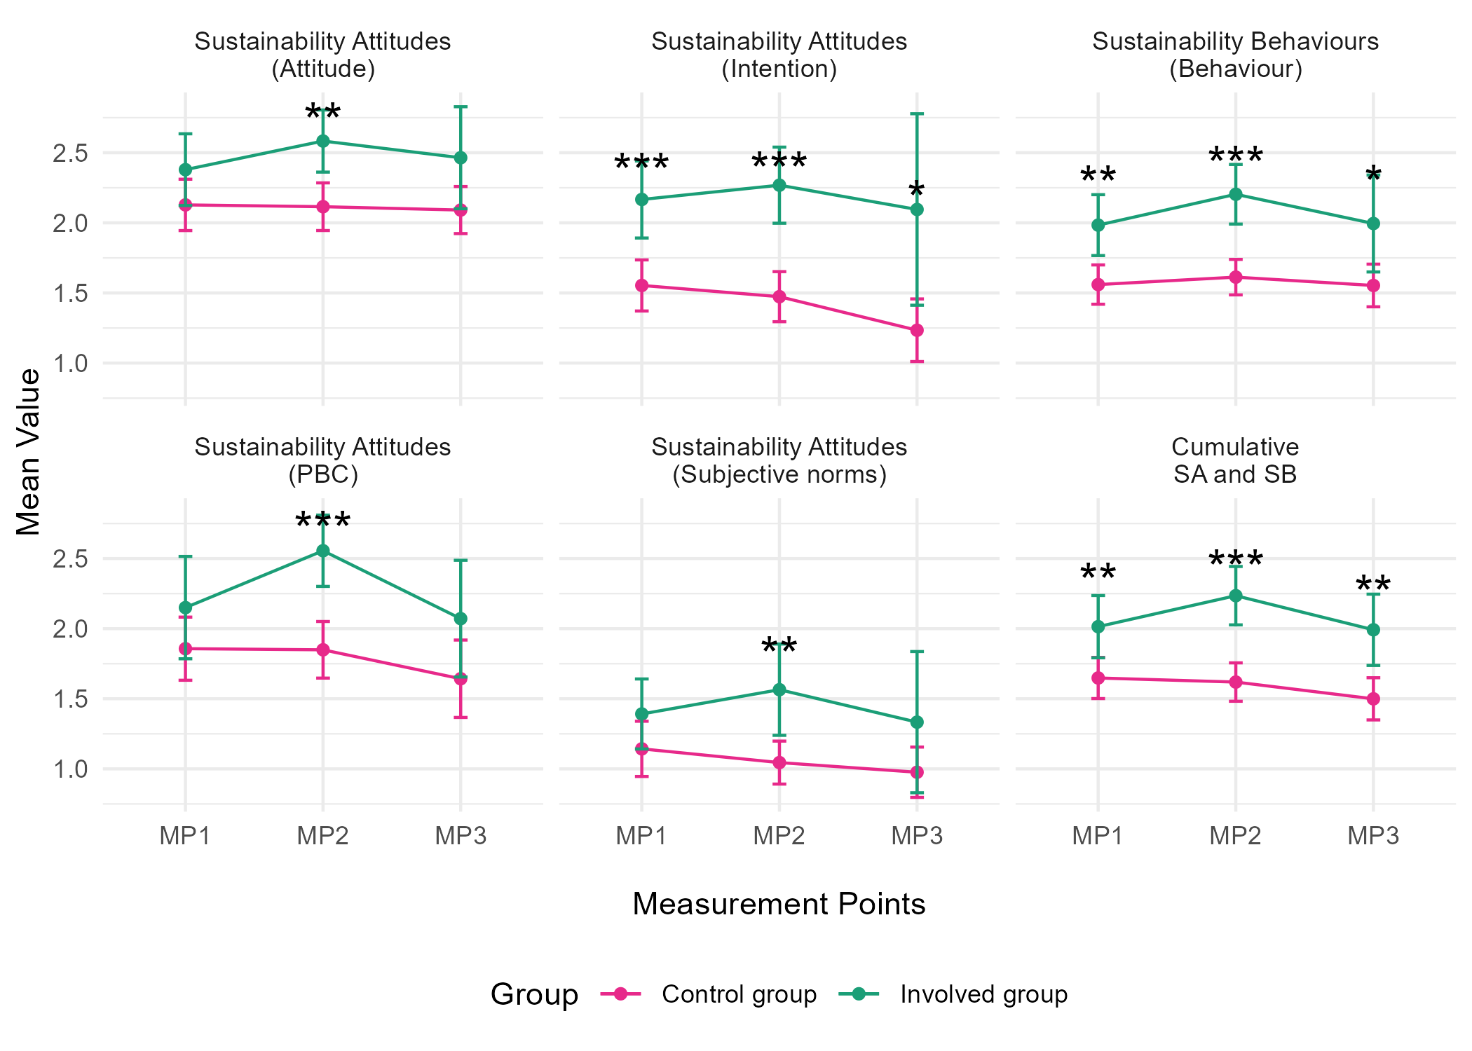
n = 20
n = 18
n = 7
n = 20
n = 18
n = 7
n = 20
n = 18
n = 7
n = 56
n = 63
n = 42
n = 56
n = 63
n = 42
n = 56
n = 63
n = 42
n = 20
n = 18
n = 7
n = 20
n = 18
n = 7
n = 20
n = 18
n = 7
n = 56
n = 63
n = 42
n = 56
n = 63
n = 42
n = 56
n = 63
n = 42

Slide 20
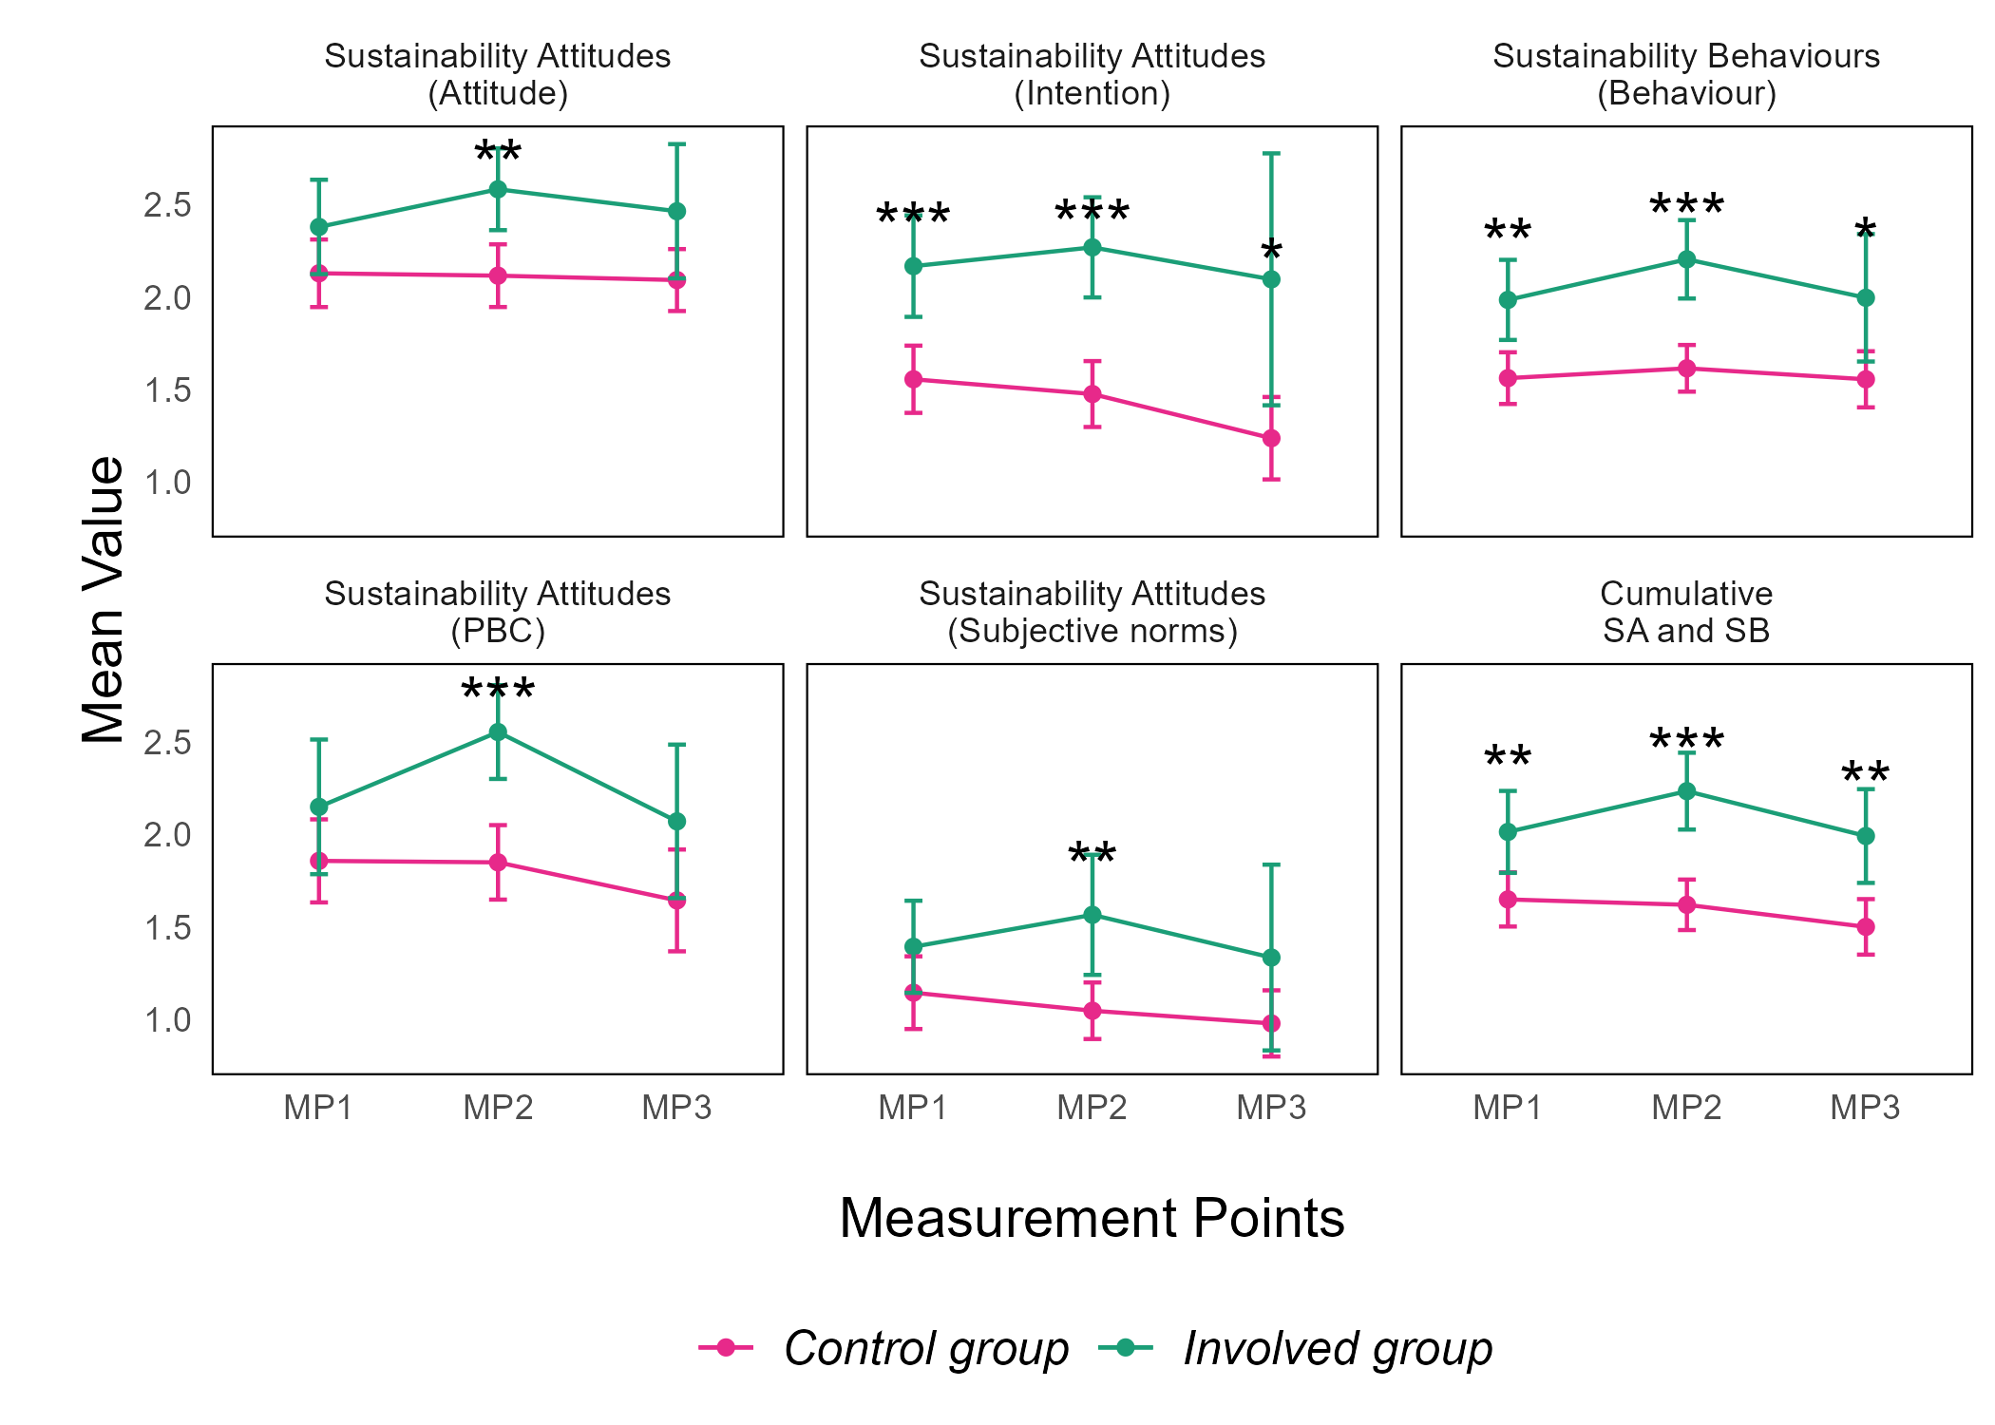
n = 20
n = 18
n = 7
n = 20
n = 18
n = 7
n = 20
n = 18
n = 7
n = 56
n = 63
n = 42
n = 56
n = 63
n = 42
n = 56
n = 63
n = 42
n = 20
n = 18
n = 7
n = 20
n = 18
n = 7
n = 20
n = 18
n = 7
n = 56
n = 63
n = 42
n = 56
n = 63
n = 42
n = 56
n = 63
n = 42

Slide 21
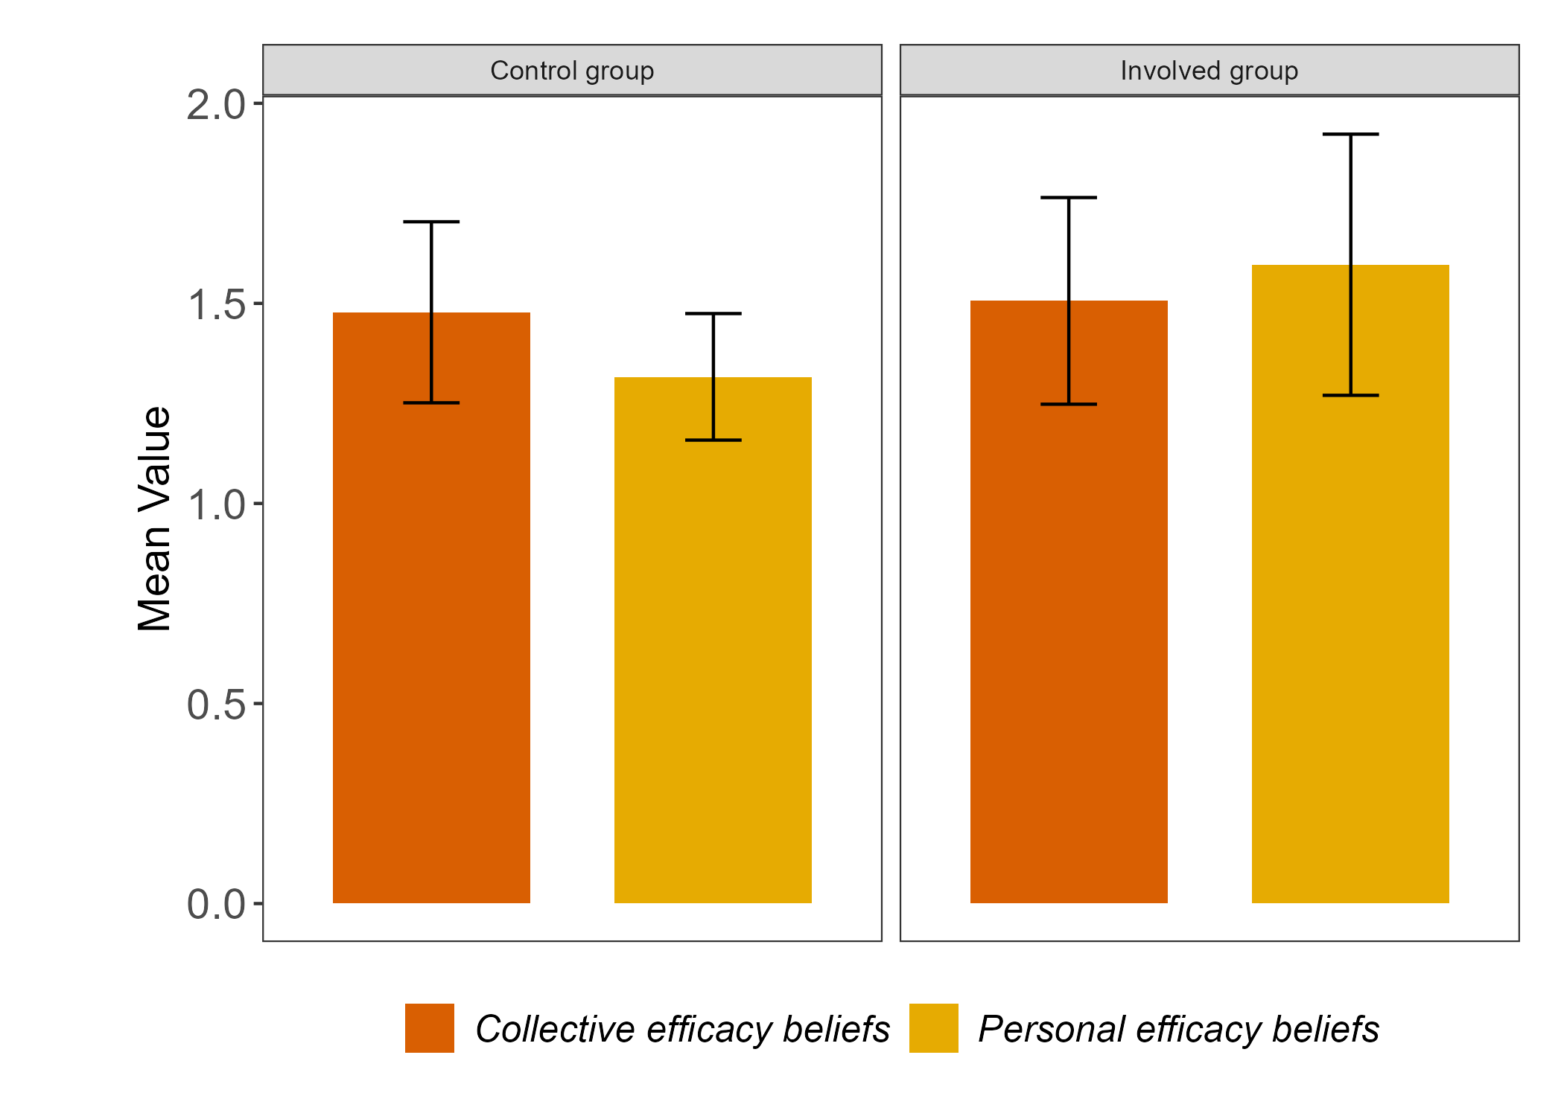
n = 42
n = 7

Slide 22
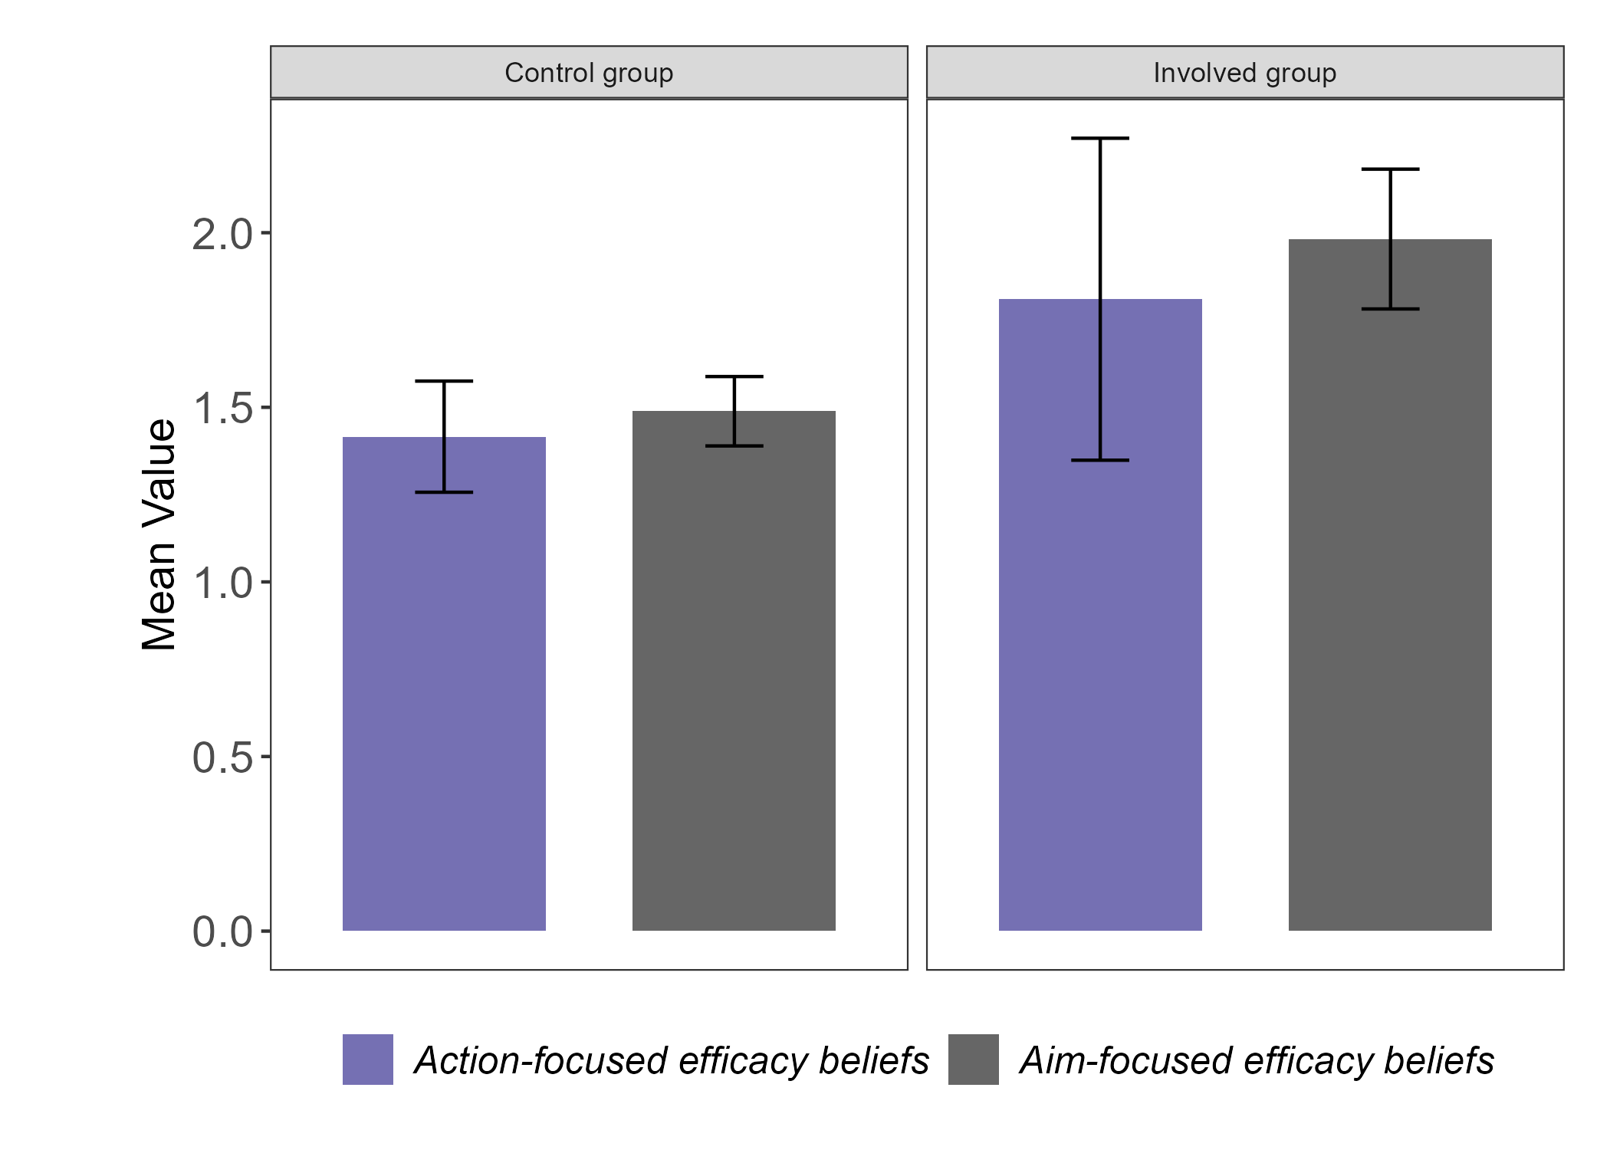
n = 42
n = 7

