Slide 1

Fostering human agency at schools–
Effects of participatory ESD projects on (individual and collective) self-efficacy beliefs using the example of the "KlimaRatSchule" project
Master thesis proposal presentation
MSc Environmental Governance
Dani Gargya
06.03.24

Slide 2
Agenda
Background
Research Questions
Methods
Proposed time schedule
Questions and feedback

Slide 3
Background

Slide 4
Lessons learnt so far

Slide 5
Research gap

Slide 6









Research questions
1.
3.
2.
Notes:
Psychological and structural factors?

Slide 7
Research questions

Slide 8
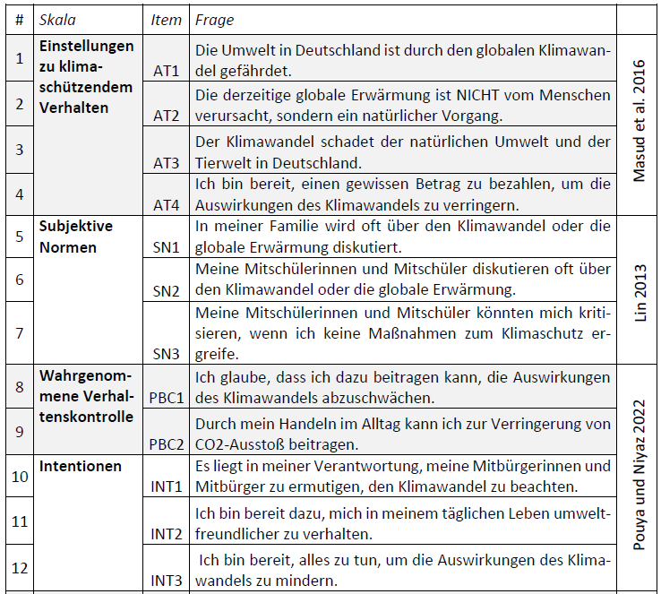

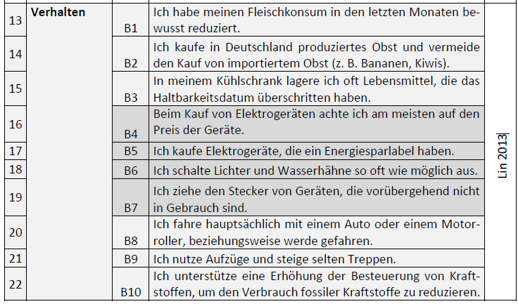
Methods

Slide 9
Methods – Data analysis

Slide 10


Questions and feedback

