Slide 1

Fostering human agency at schools–
Effects of participatory ESD projects on (individual and collective) self-efficacy beliefs using the example of the "KlimaRatSchule" project
Master thesis proposal presentation
MSc Environmental Governance
Dani Gargya
06.03.24

Slide 2
Agenda
Background
Research Questions
Methods
Proposed time schedule
Questions and feedback

Slide 3
Background

Slide 4
Lessons learnt so far

Slide 5
Research gap

Slide 6













Workflow
2.
3.
1.
t0
t1
t2

Slide 7
Predictions
1. MAGNITUDE
2. GROUP-SPECIFIC
3. VALIDATION
Climate attitude & behaviour
Climate attitude & behaviour // Self-efficacy
Climate attitude & behaviour // Self-efficacy
Time
Time
Time

Slide 8
Research questions
1. Do students experience changes in climate attitude and behaviour over time?
2. How do climate attitude and behaviour and self-efficacy beliefs respond to levels of involvement of the students?
How does the project evolution influence the magnitude of the changes in climate attitude and behaviour?
How do desirability of the aim and group identification influence the magnitude of the self-efficacy beliefs?
3. How is climate attitude and behaviour influenced by self-efficacy beliefs?

Slide 9
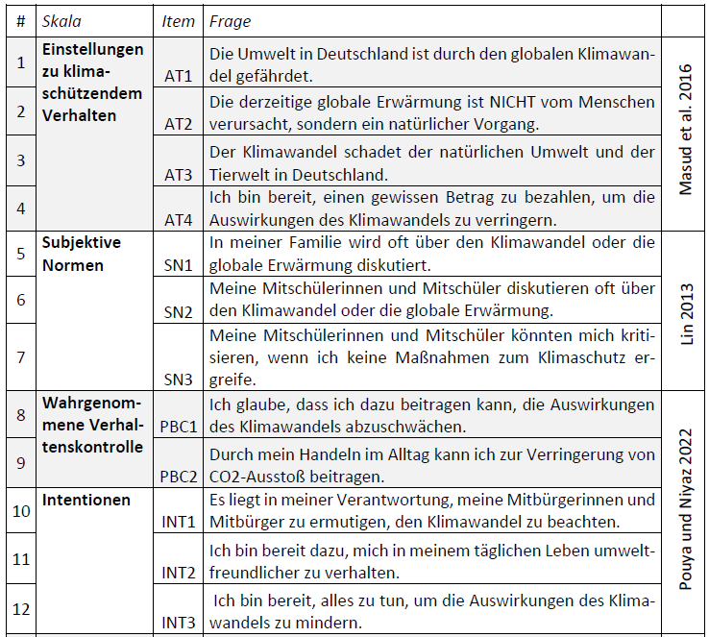

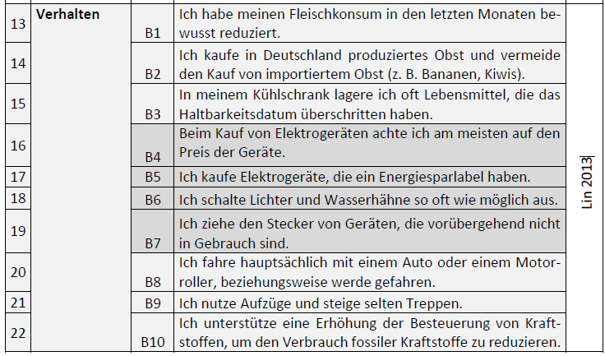
Methods

Slide 10
Methods – Data analysis

Slide 11


Questions and feedback

Slide 12
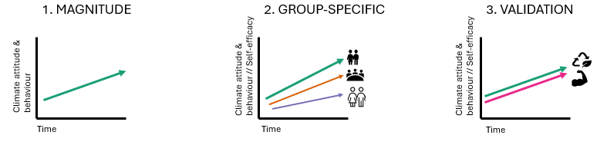
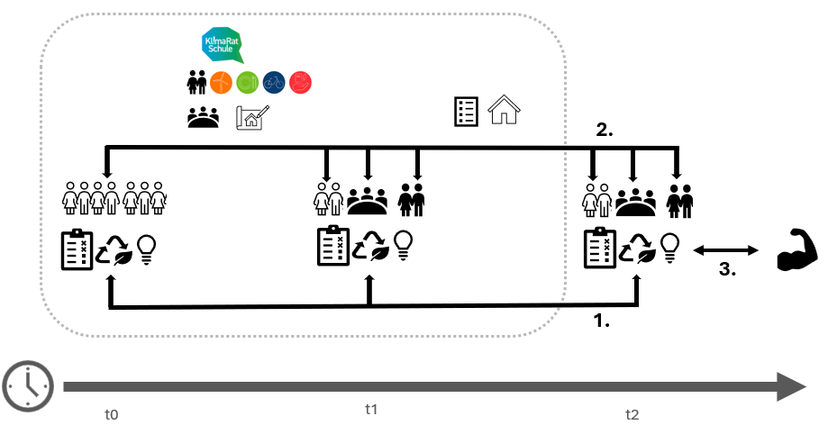
A) Predictions
B) Workflow

