Slide 1
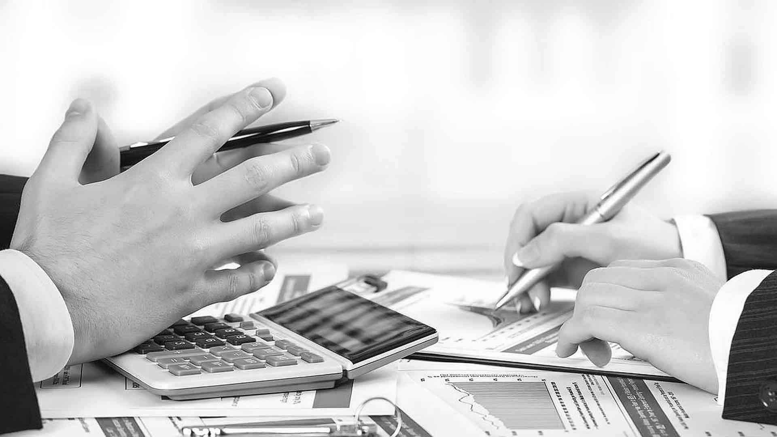

Graduation Roadshow Group 2 | Mr. Black
How To
Communicate Effectively

Slide 2

Team Members
Li, Zecheng Cronus
Chu, Lingyan Lynn
Pan, Chao Rophie
Dang, yuanlong Lucien
Gong, Shichen Daniel

Slide 3
Story 1
T
Wt is t iss of t’s rep...
What’s the meaning of “wt”
R
What is the issue of today’s report?
T
What
I mean what’s “wt” short for
R
T
What is t iss...

Slide 4

Story 1 - Analysis
Trader’s MVS
Different Culture Backgrounds

Slide 5
Story 1 - Actions
RESPECT
PROCESS
1
Sharing for new joiners (Abbreviation Words)
Summarize the requirements and send emails to trader for confirmation
Add Explanations for the Abbreviation Words in Email
2
Notes:
Respect for both Culture and MVS differences
Training for new joiners (Abbreviation Words)
Avoid using Abbreviation Words in email which may lead to misunderstanding
Summarize the requirements and send email to the trader for confirmation

Slide 6
Story 2
No Response after an email was sent out

Slide 7
Story 2 – Analysis
1
New Connection
2
Very little communication in daily work

Slide 8

Story 2 – Actions
Elaborate what exactly do you want from him in the email
1
2
Communication Priority
3
Upload Avatar
4
Collaborate

Slide 9
Ineffective Communication - Samples

Slide 10
Ineffective Communication
“You” Language and Directives
Universal Statements
Tough on the Person, Soft on the Issue
Invalidate Feelings
Consequences of Ineffective Communications – The Three “F”s

Slide 11
Ineffective Communication
Fundamental Human Rights
“
We have the right to be treated with respect
We have the right to express our feelings, opinions and wants
We have the right to have our opinions different than others
”

Slide 12
Effective Communication
“I” Language
Evidence and Consequence
Soft on the Person, tough on the Issue
Listen and Validate Feelings
More …

Slide 13
Nov 2019
??
Dec 2019
Share the knowledge in each team
Q1 2020
Share the knowledge in a big team
Nov ~ Dec 2019
Do more researches on effective communication, read the books listed below:
1.
2.
3.
Dec 2019
Post relevant materials to collaborate
Further
We will keep Mr. Black a long-term team

Slide 14
THANK YOU

