Slide 1
COURSE ASSIGNMENT
GROUP 3

Slide 2
Used design patterns
Client-server connection
Model-View-Controller
Adapter
Proxy
Singleton
Flyweight
Observer
RMI

Slide 3
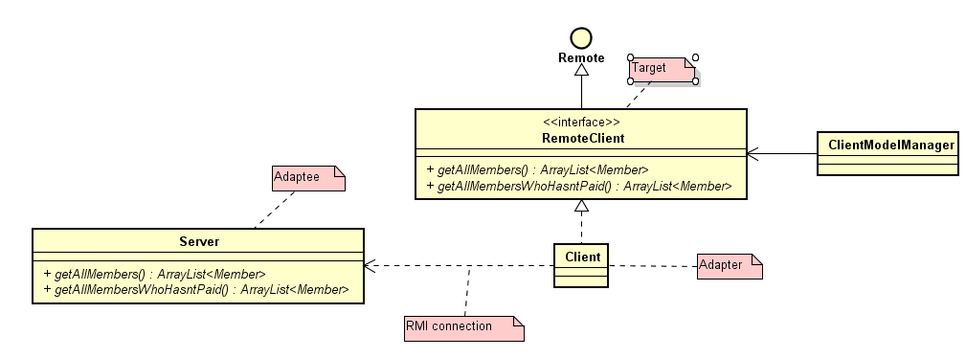
Adapter

Slide 4
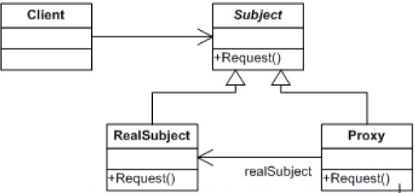
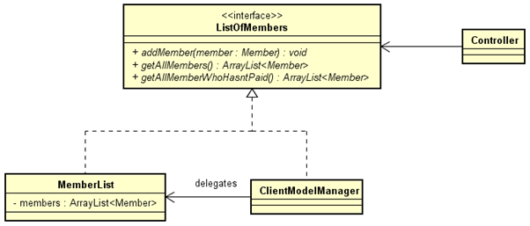
PROXY

Slide 5
SINGLETON

Slide 6
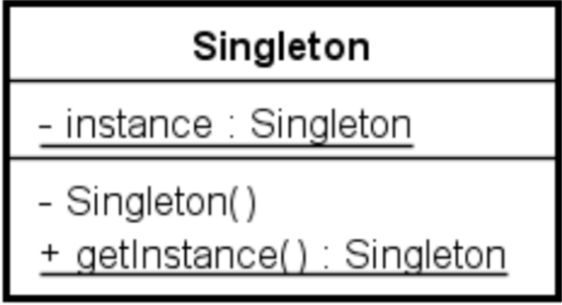
Singleton - general

Slide 7

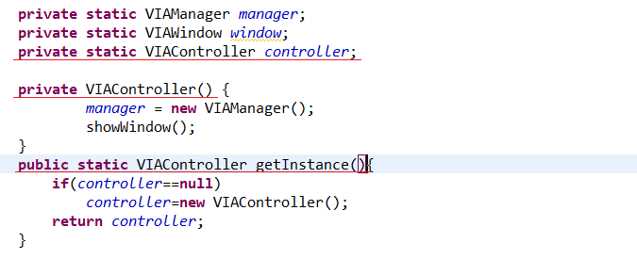
SINGLETON

Slide 8

Singleton test

Slide 9
FLYWEIGHT

Slide 10

Flyweight - general

Slide 11
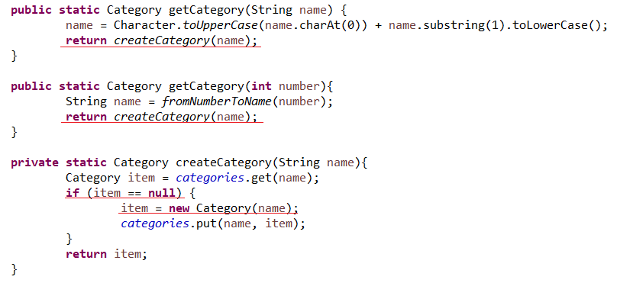
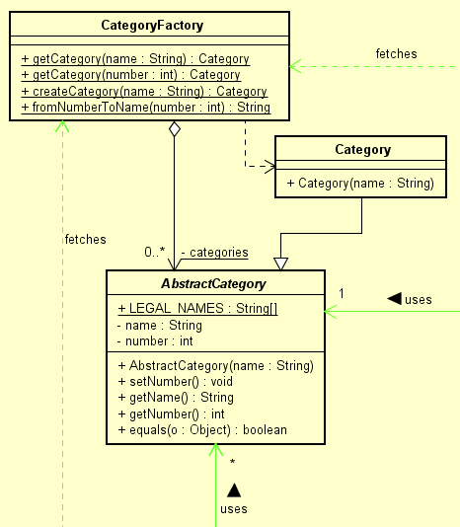
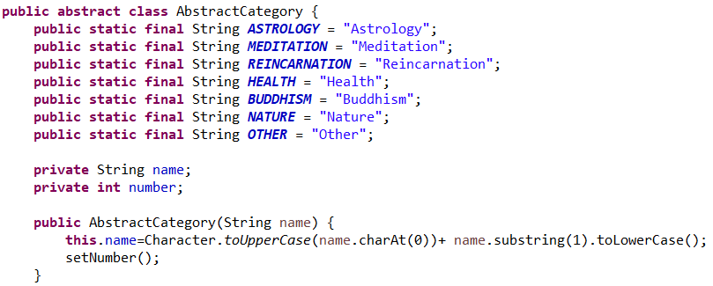
FLYWEIGHT

Slide 12


Flyweight test

Slide 13
Observer

Slide 14
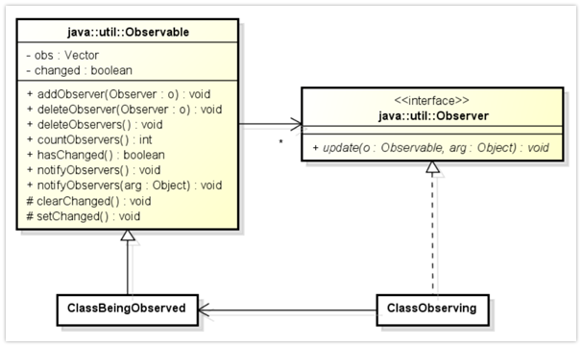
Observer - general

Slide 15
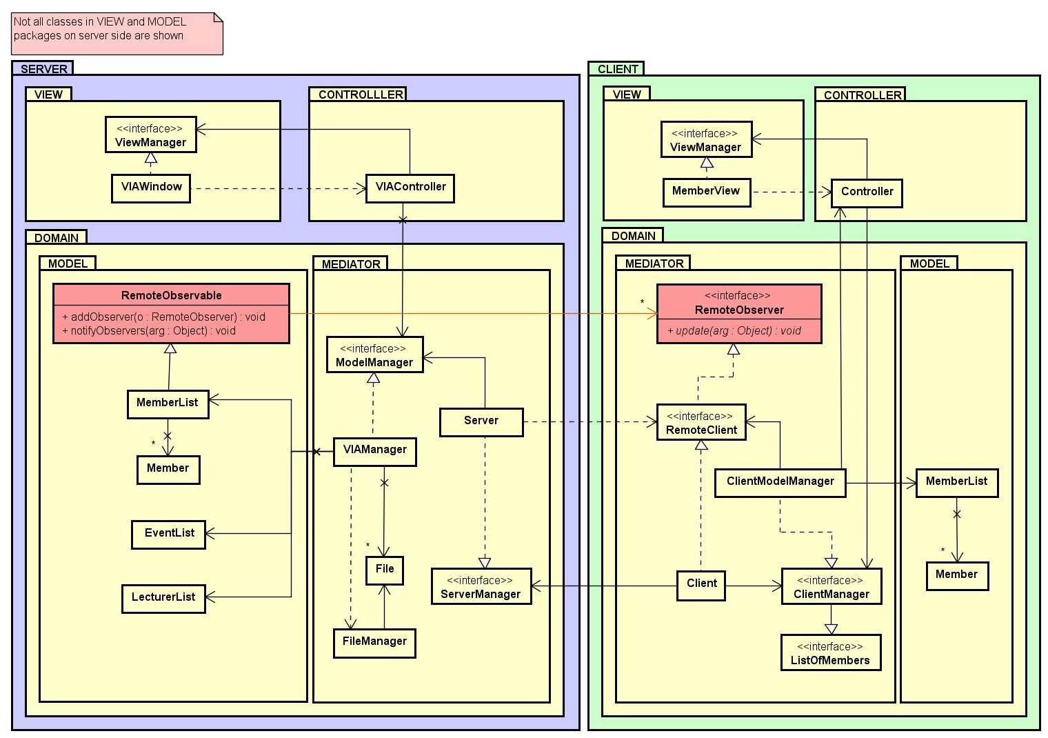
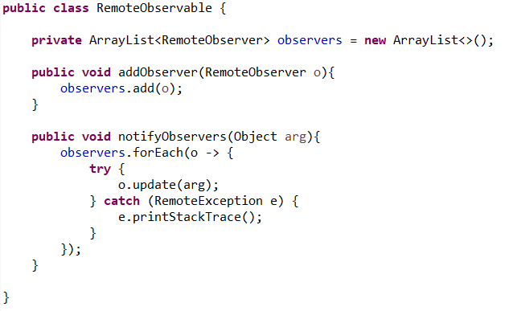
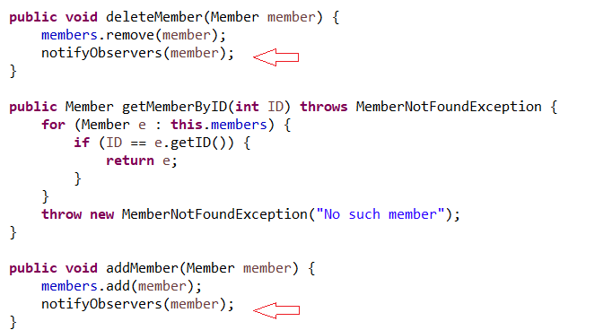
Observer

Slide 16

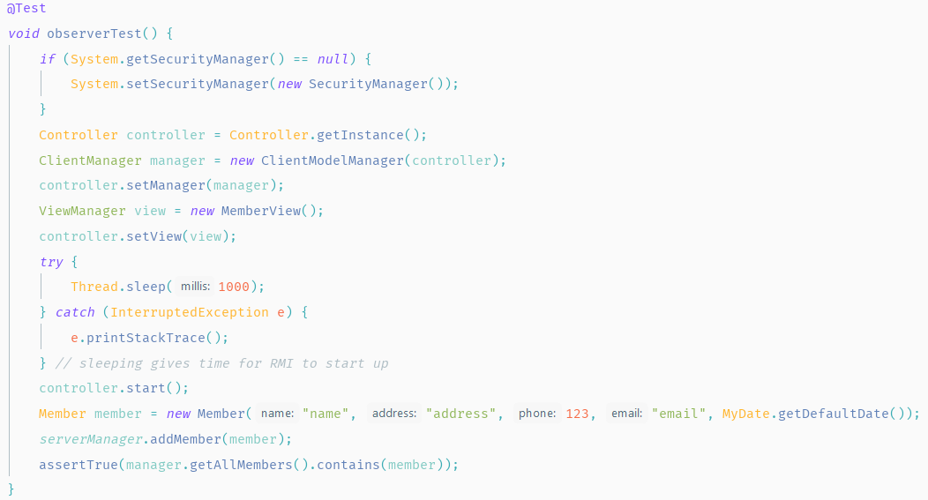
Testing observer

Slide 17
RMI CLIENT-SERVER CONNECTION

Slide 18
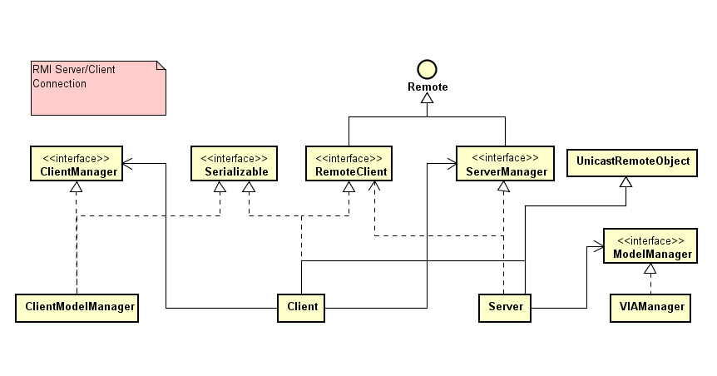

Slide 19
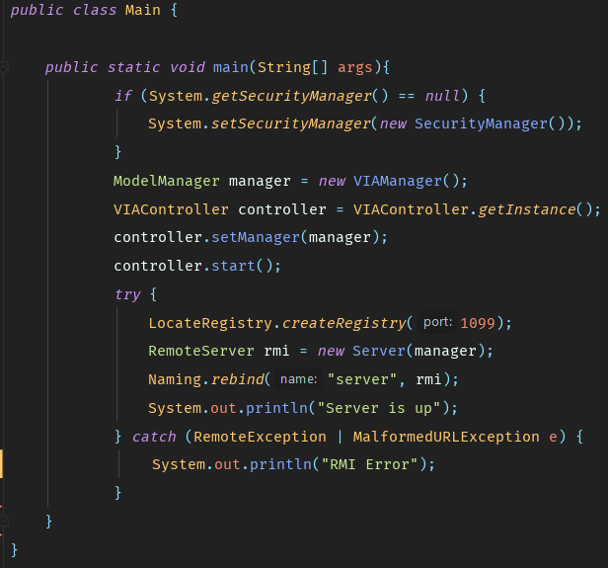
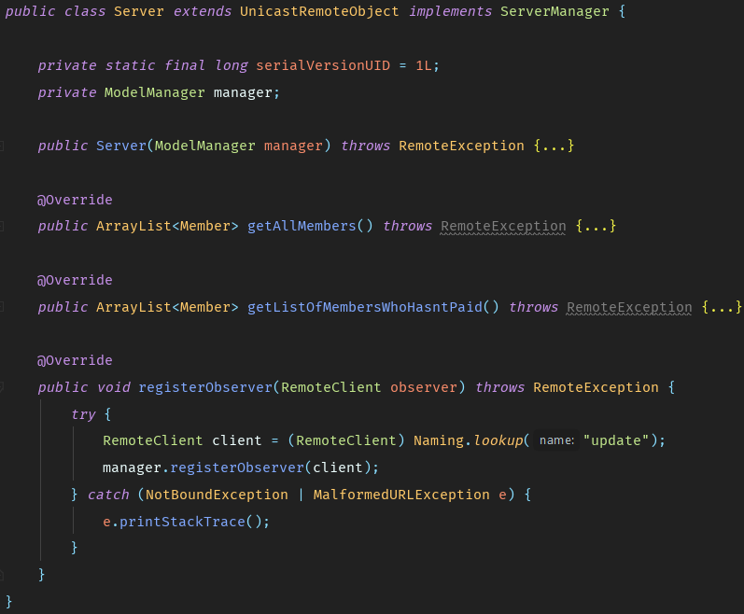

Slide 20
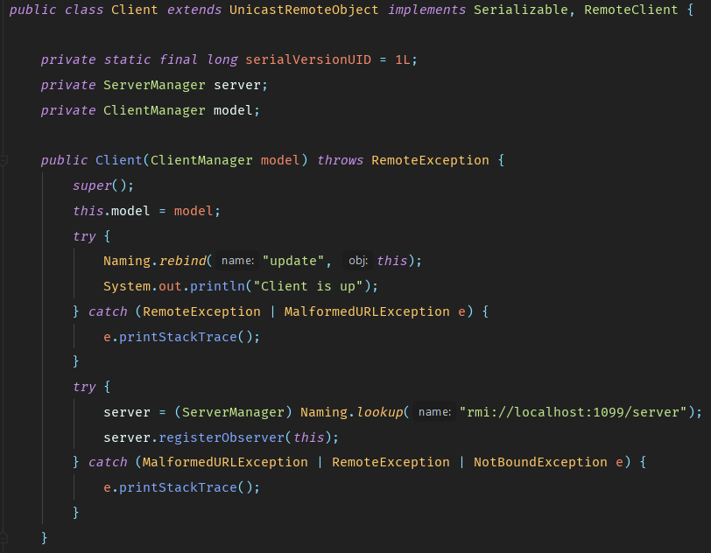
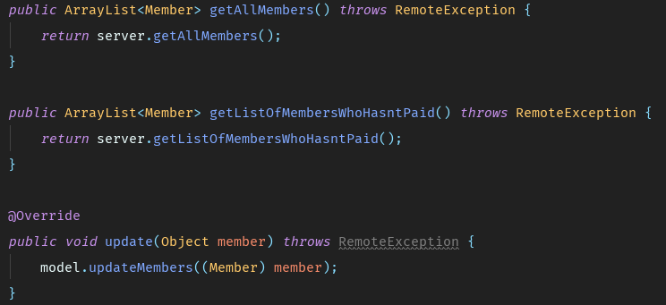

Slide 21
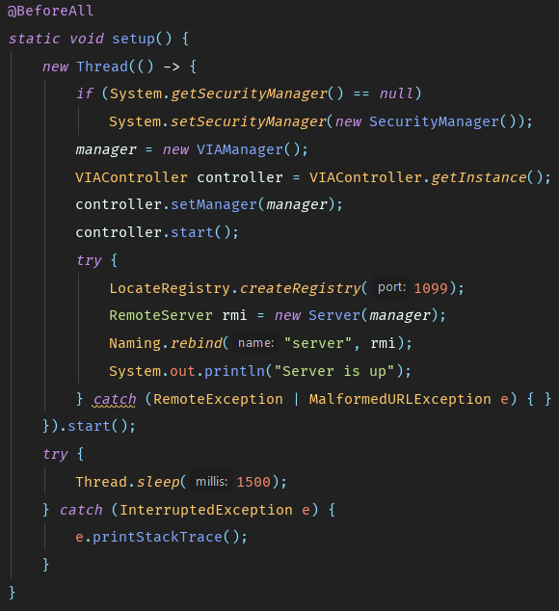
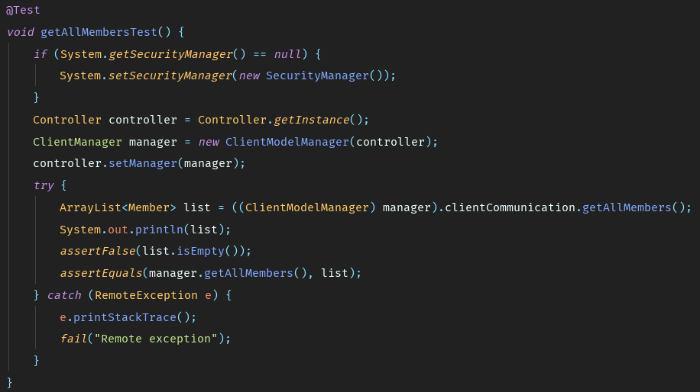
RMI TESTS

Slide 22
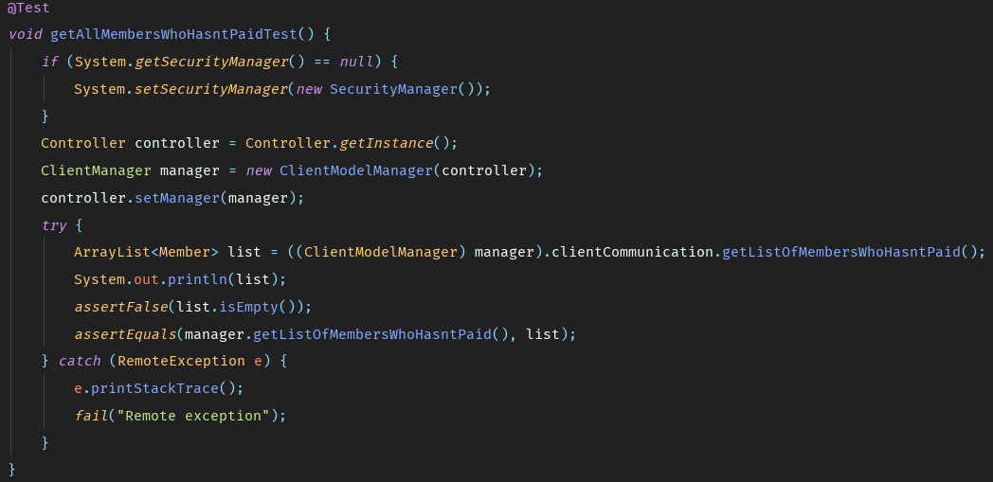

Slide 23
MODEL-VIEW-CONTROLLER

Slide 24
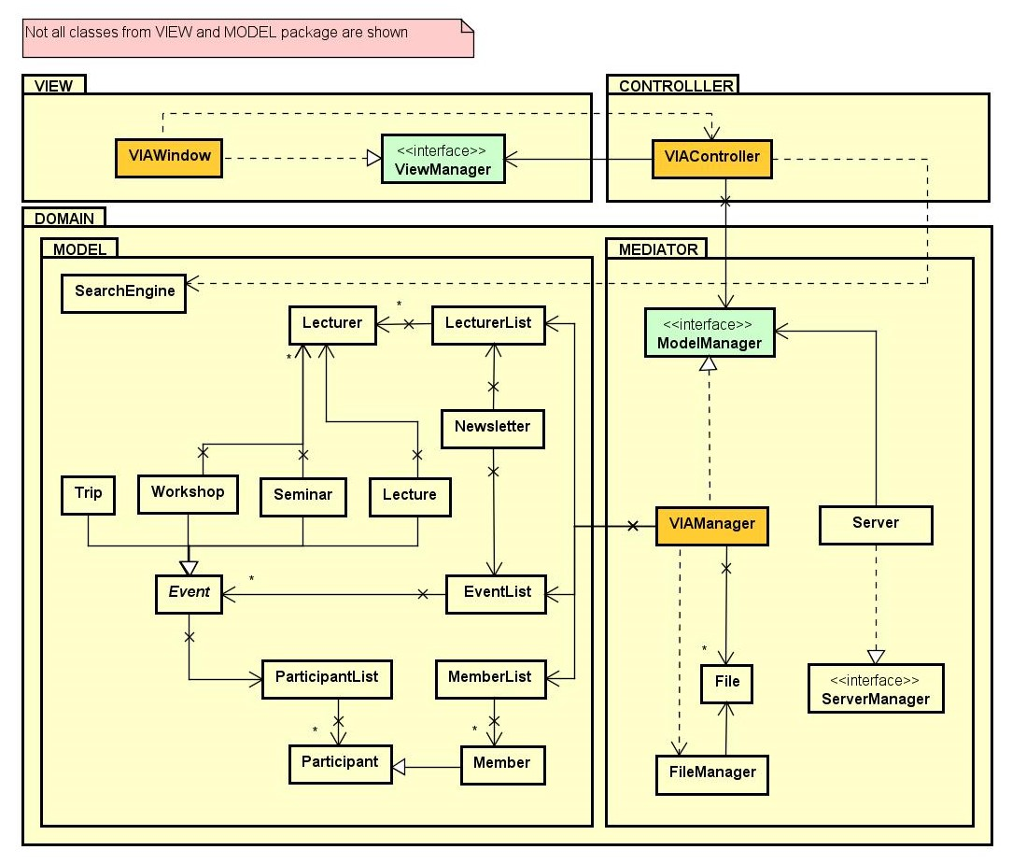
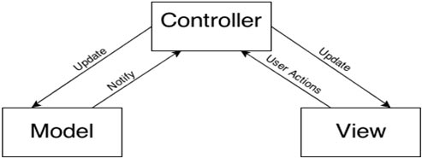
MVC -server

Slide 25
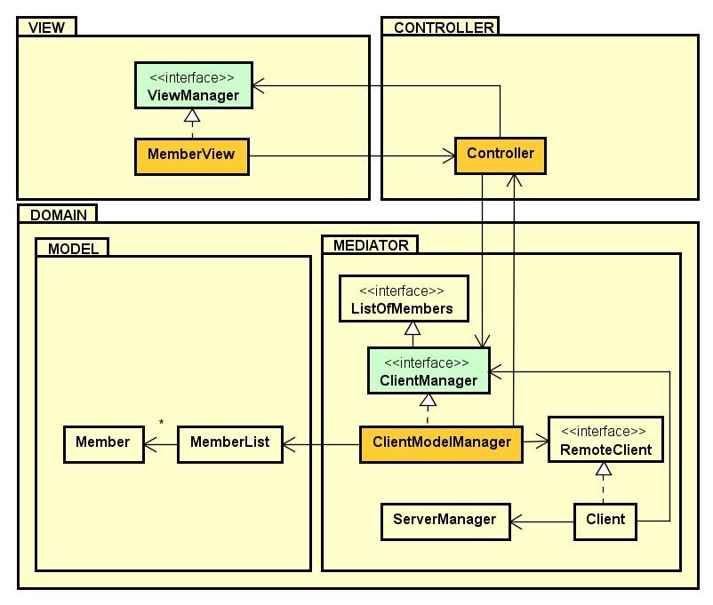
MVC - client

Slide 26

Sequence diagram for deleting member

Slide 27
THANK YOU FOR YOUR ATTENTION!

