Slide 1
Client and Server
ICT Semester 2

Slide 2
Sockets and RMI
Sockets
Lower-level netwoking (messages, raw data)
Can implement own protocol layer
More control
RMI
Higher-level networking (methods, objects)
Protocol layer handled by RMI
Security issues (Security manager)

Slide 3
Sockets and RMI - creation
Sockets
No Registry
Doesn't have to have a connection
No association between the client and server interface
The server doesn’t have to extend any classes nor implement any interfaces
RMI
Has a Registry which is binded to a name
There is always a connection
Has an association between client and the server’s interface
The server extends the UnicastRemoteObject and implements an interface extending the Remote

Slide 4
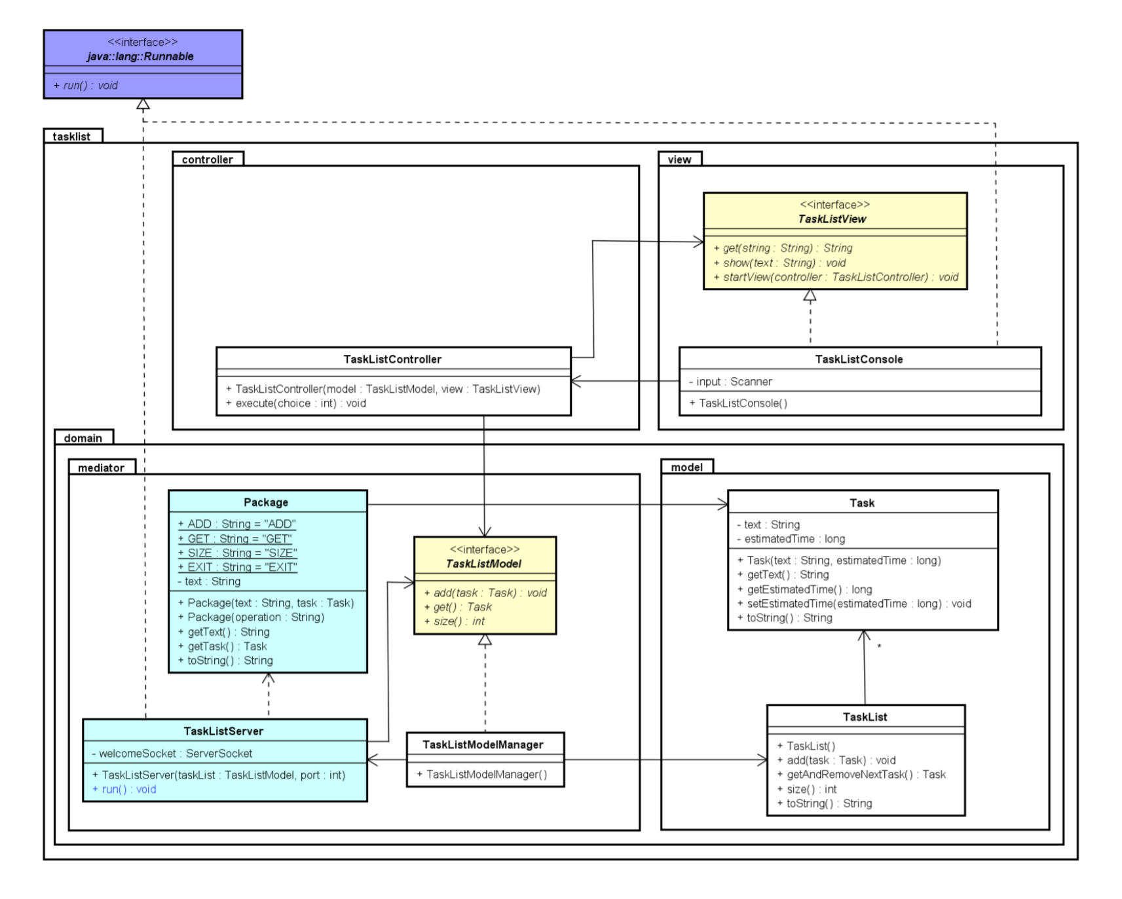
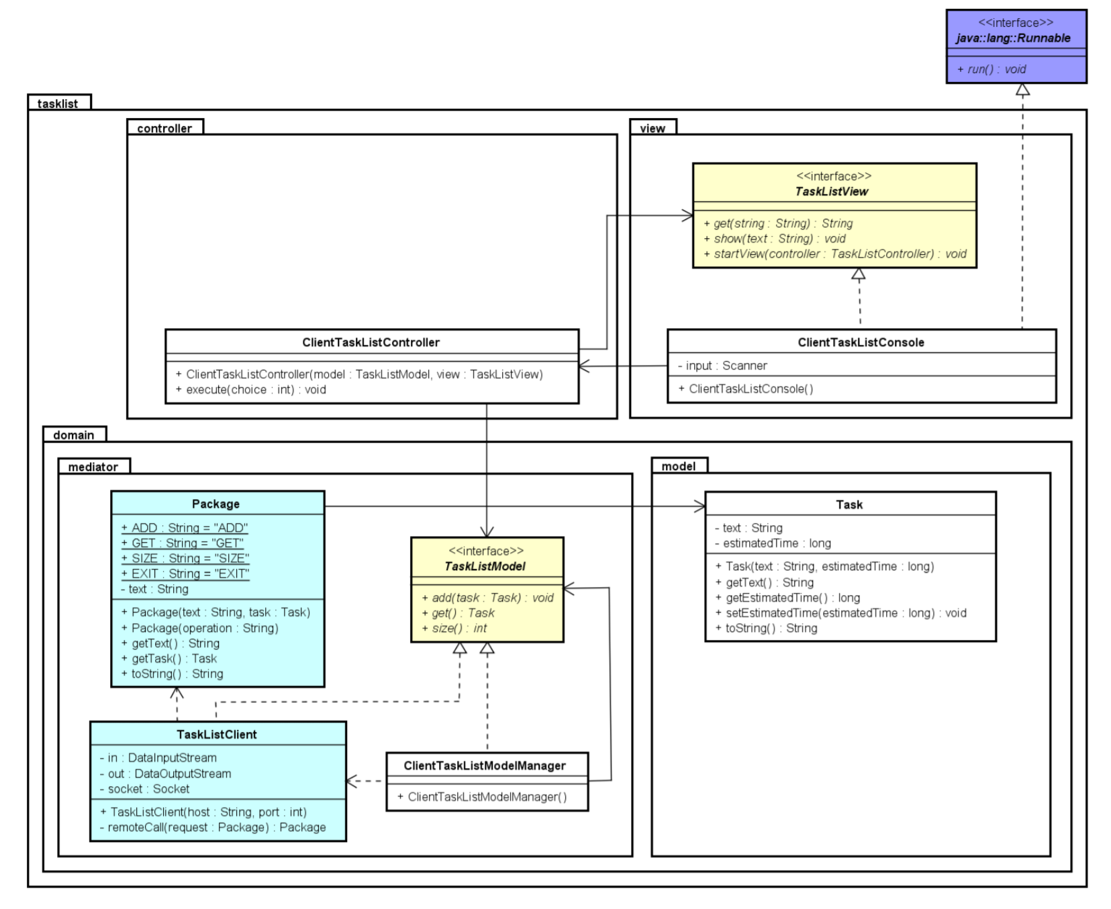
Sockets in UML

Slide 5
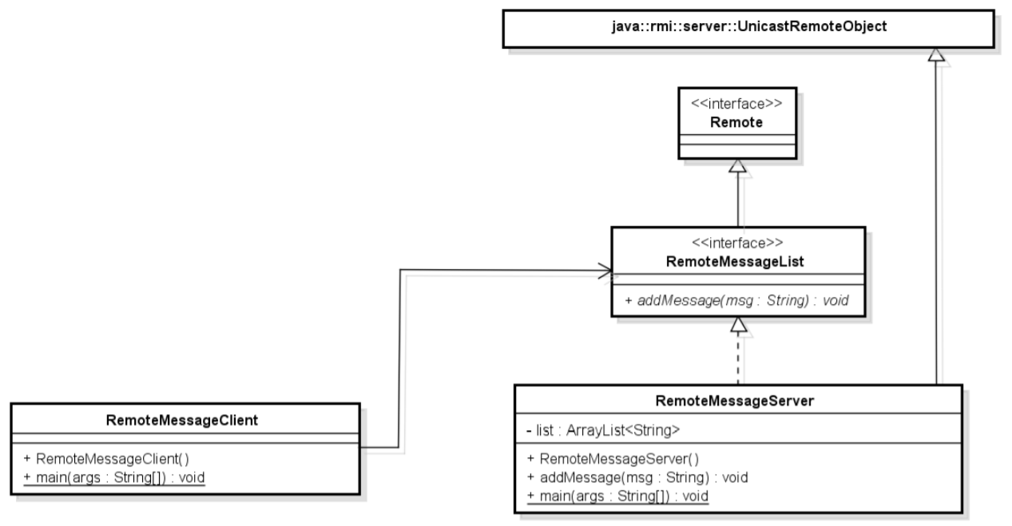
RMI in UML

Slide 6
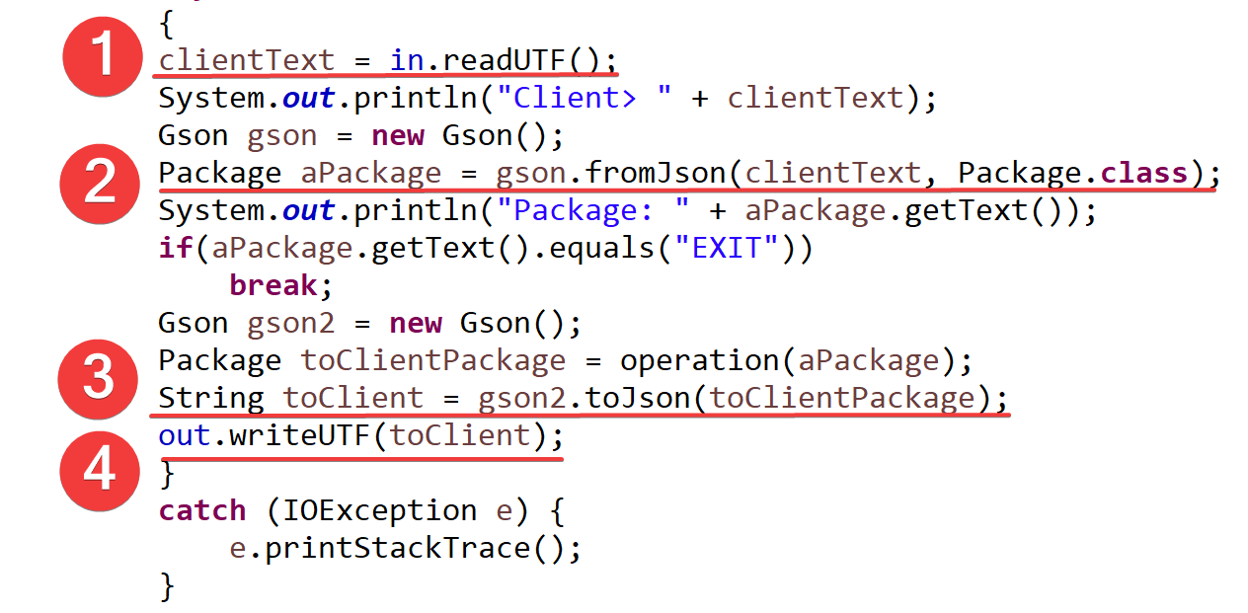
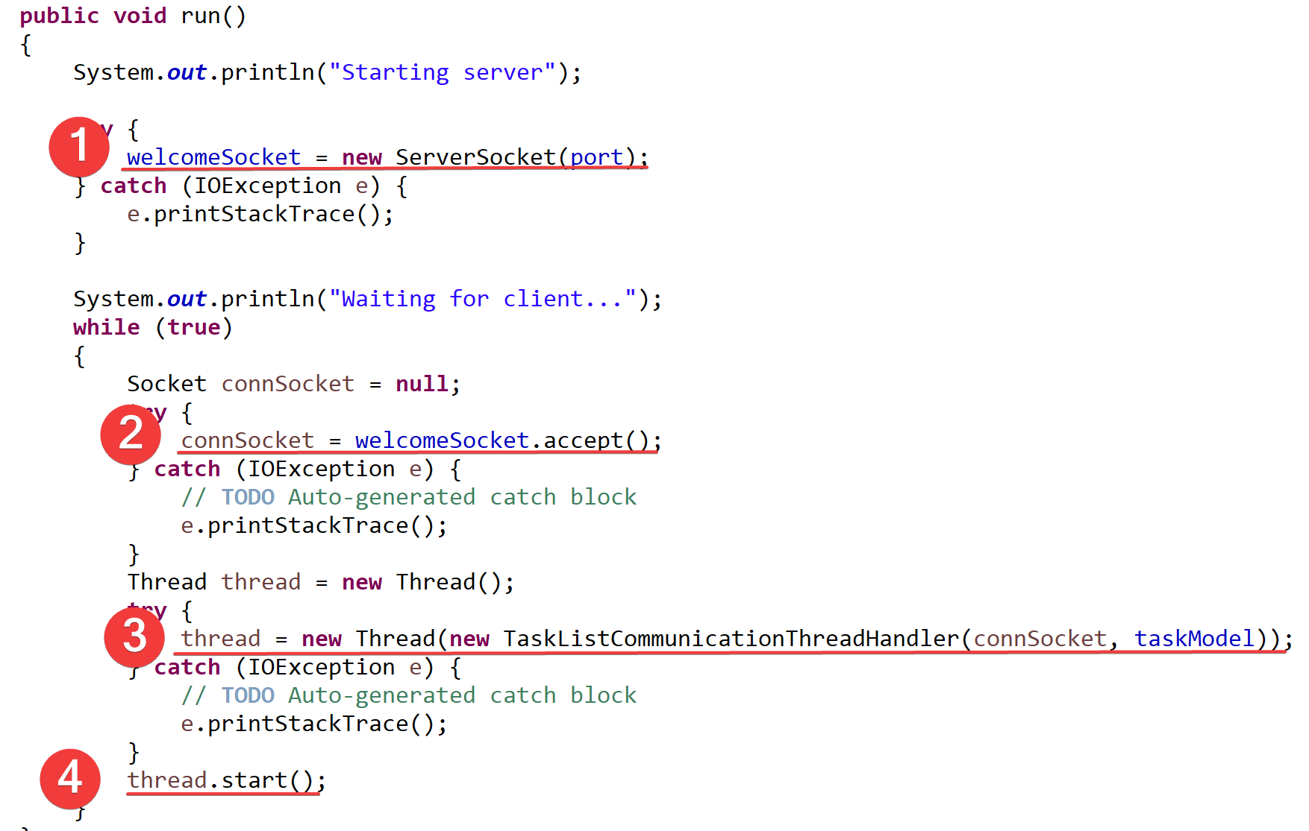
Sockets in code - server

Slide 7
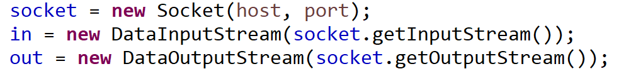
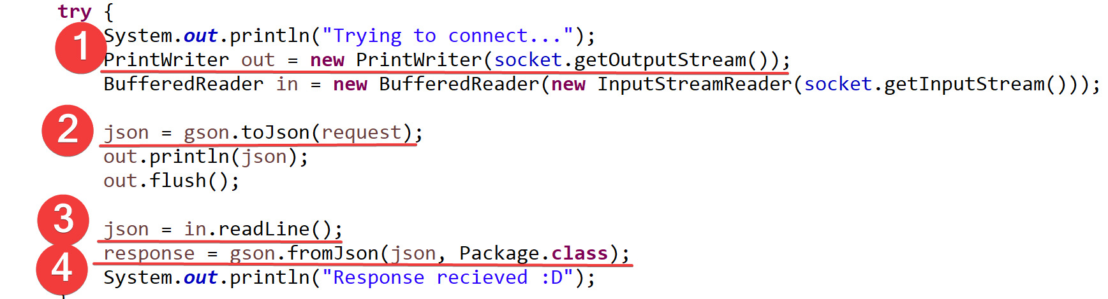
Sockets in code - client

Slide 8

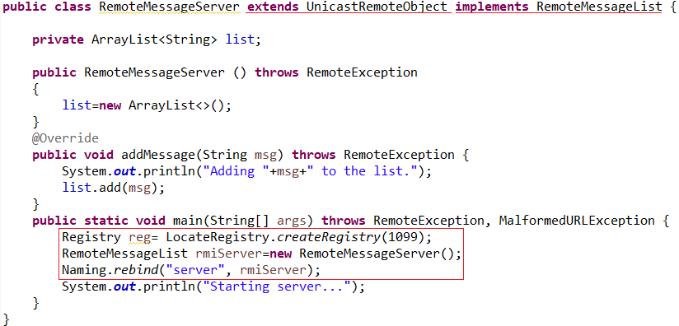
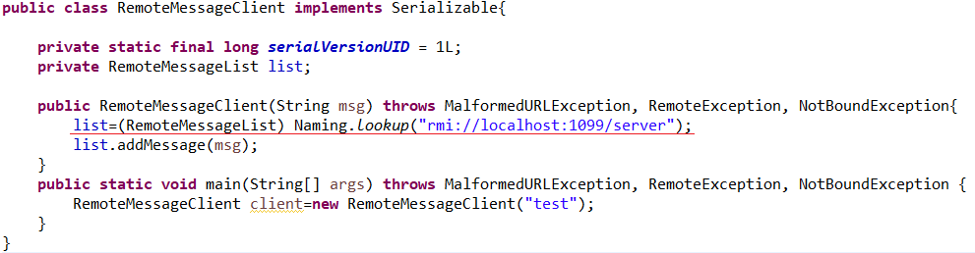
RMI in code

