Slide 1
Observer Design Pattern
ICT 2nd semester

Slide 2
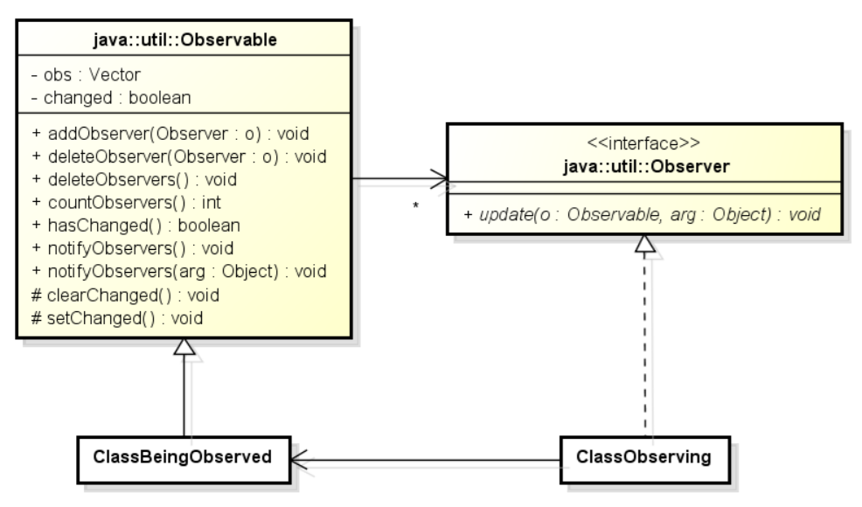
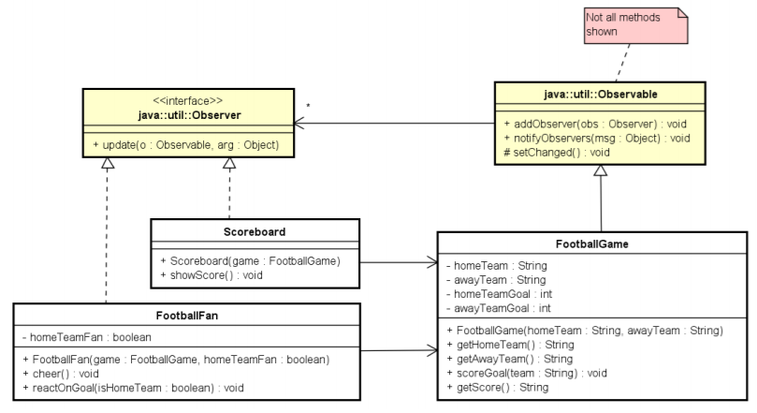
Observer shown in UML
Exercise 14.01A

Slide 3
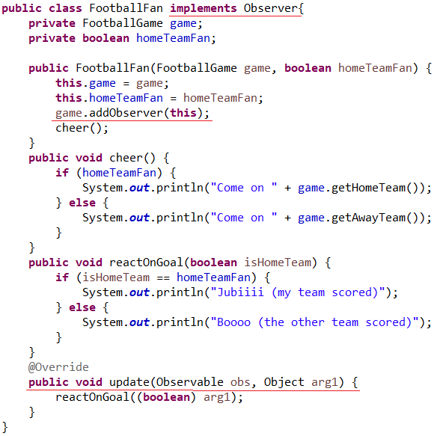
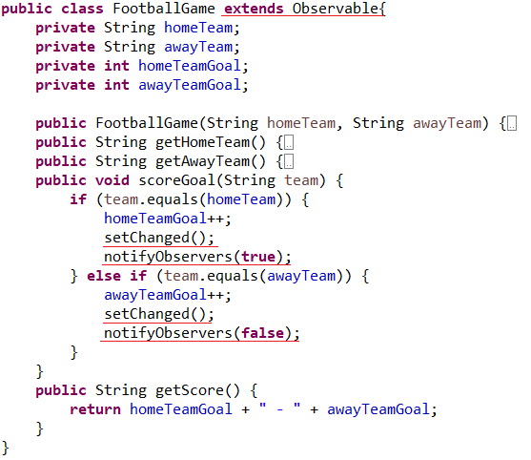
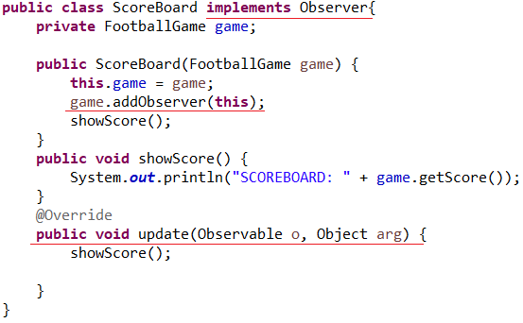
Observer shown in code

Slide 4
Time permits?

Slide 5
Problems
Observable is not abstract
Cannot be used in RMI
Observer is not generic (sending objects, may need to cast in update)
Observable is not an interface (addObserver may need casting)
NotifyObservers is not using threads
Extend Observable (multiple inheritance)

Slide 6
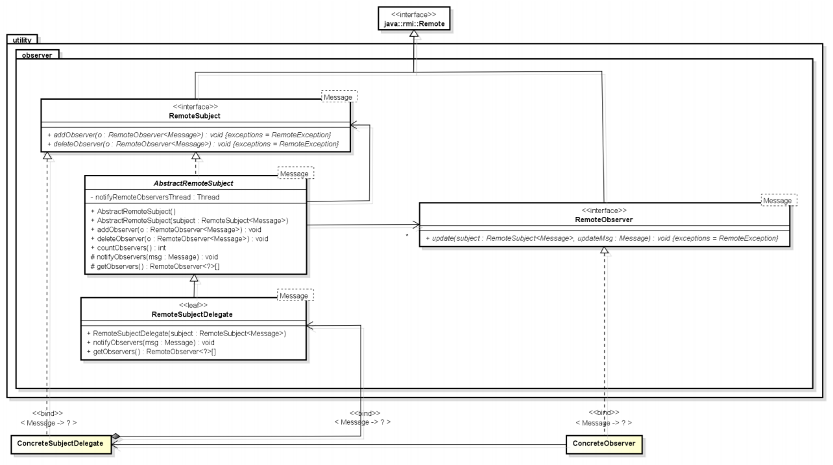
Remote Observer
Observable is not abstract
Cannot be used in RMI
Observer is not generic
Observer is not an interface
Extend Observable

