Slide 1
Remote Message Invocation
ICT 2nd semester

Slide 2
How to connect using RMI?
Create a registry on a port
Create a server object and bind it to a name
Lookup the name and bind the client to it
Run the server
Run the client

Slide 3
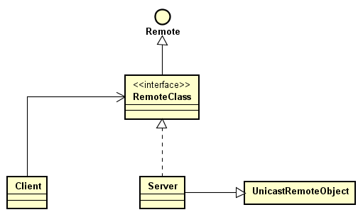
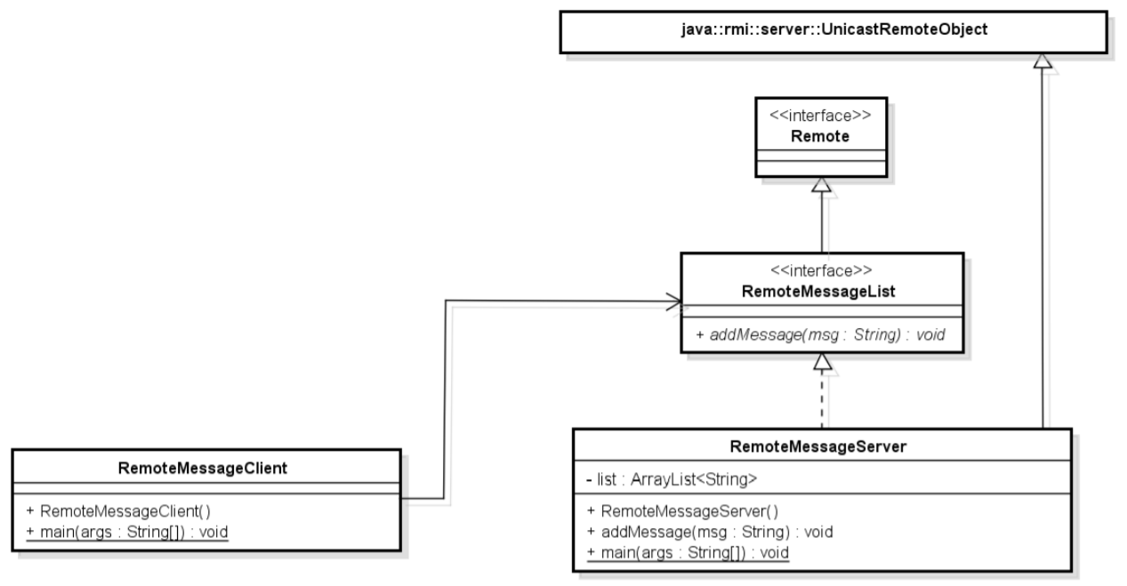
RMI shown in an UML class diagram
Exercise 7.01
Or UnicastRemoteObject.exportObject(RMIServer, port);

Slide 4

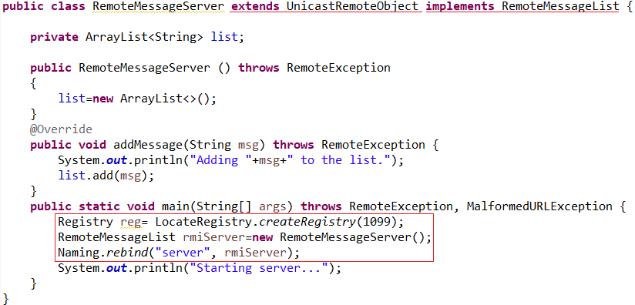
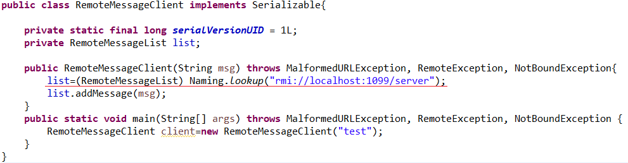
RMI in code

Slide 5
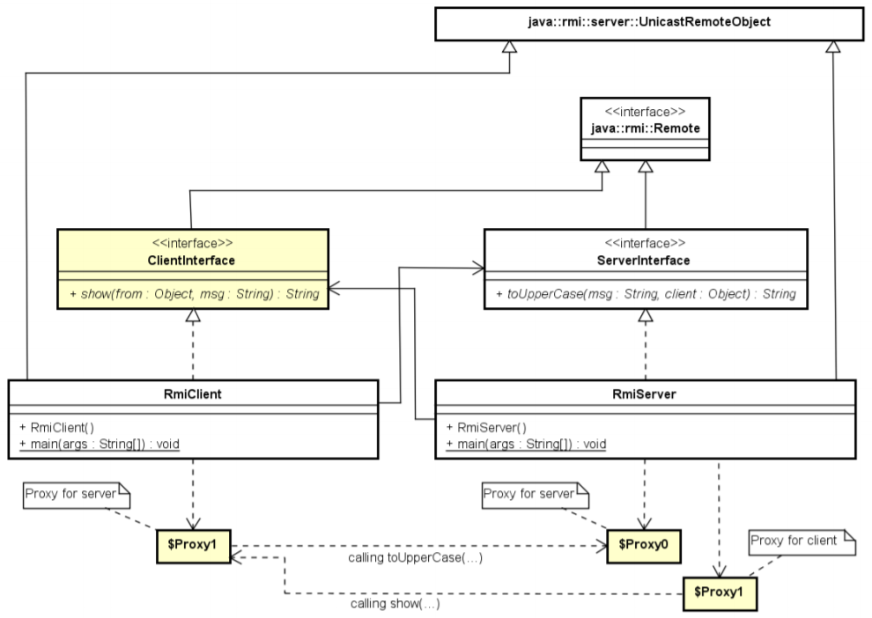
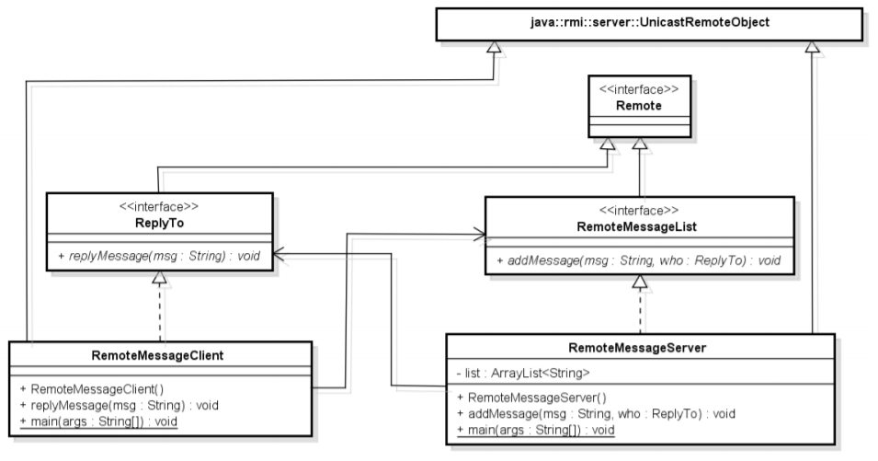
RMI callback in an UML class diagram

Slide 6
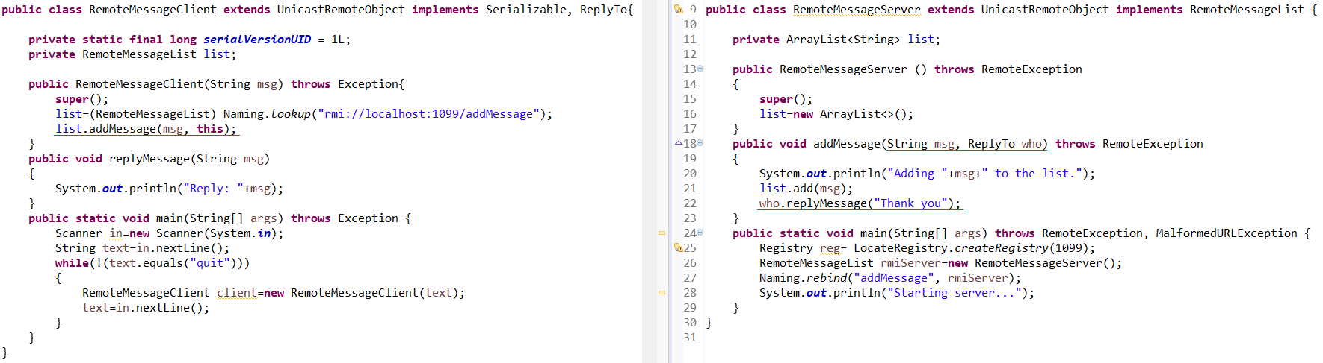
RMI callback in code

