Slide 1
Singleton and Flyweight
ICT Semester 2

Slide 2
Why Singleton?

Slide 3
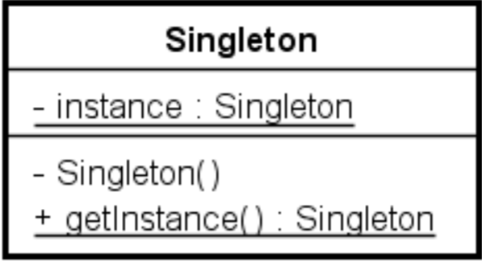
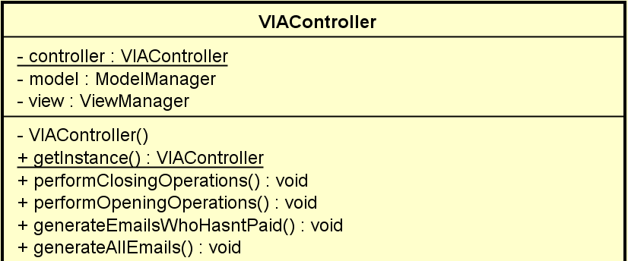
Singleton

Slide 4
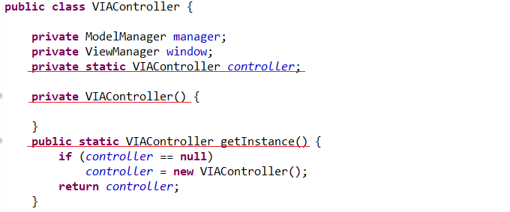
Singleton

Slide 5
Why Fliweight?

Slide 6
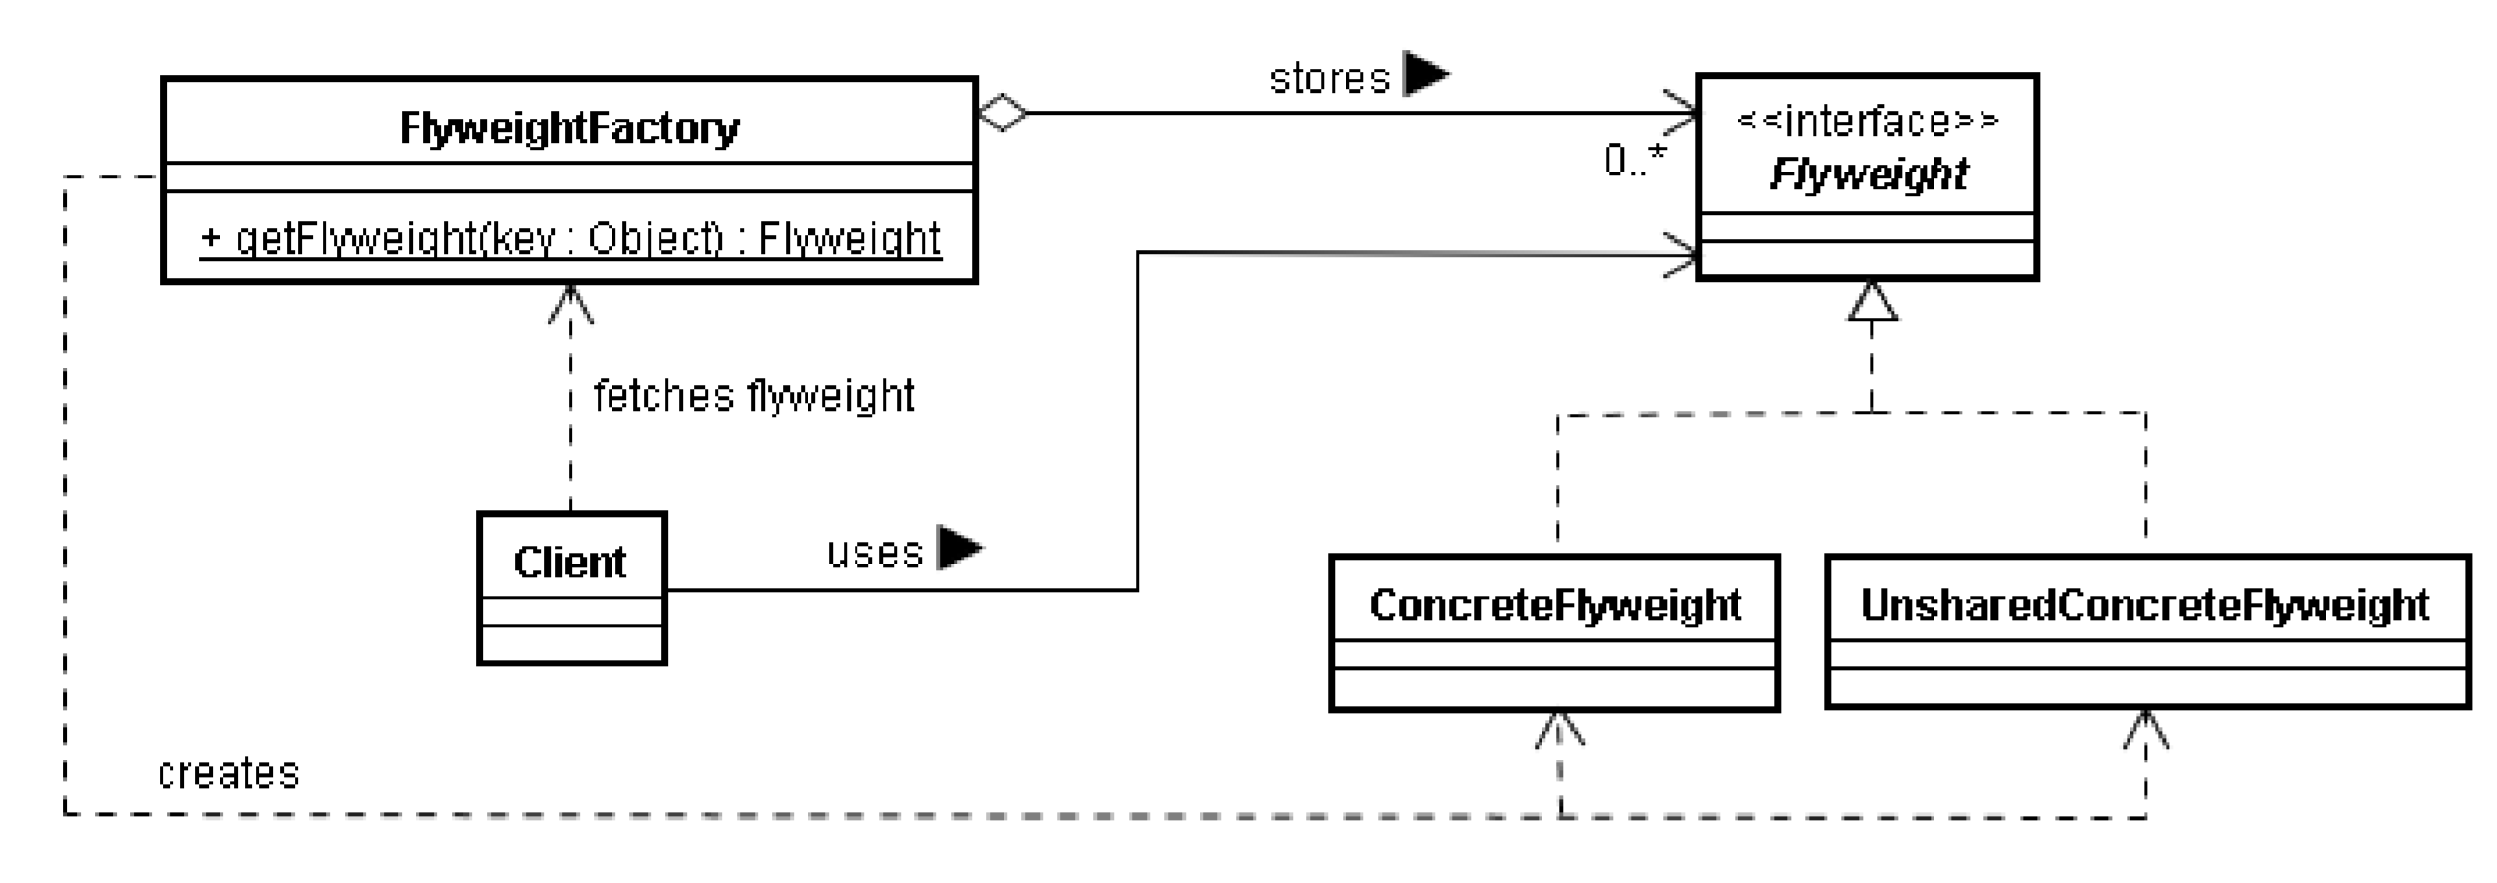
Flyweight

Slide 7
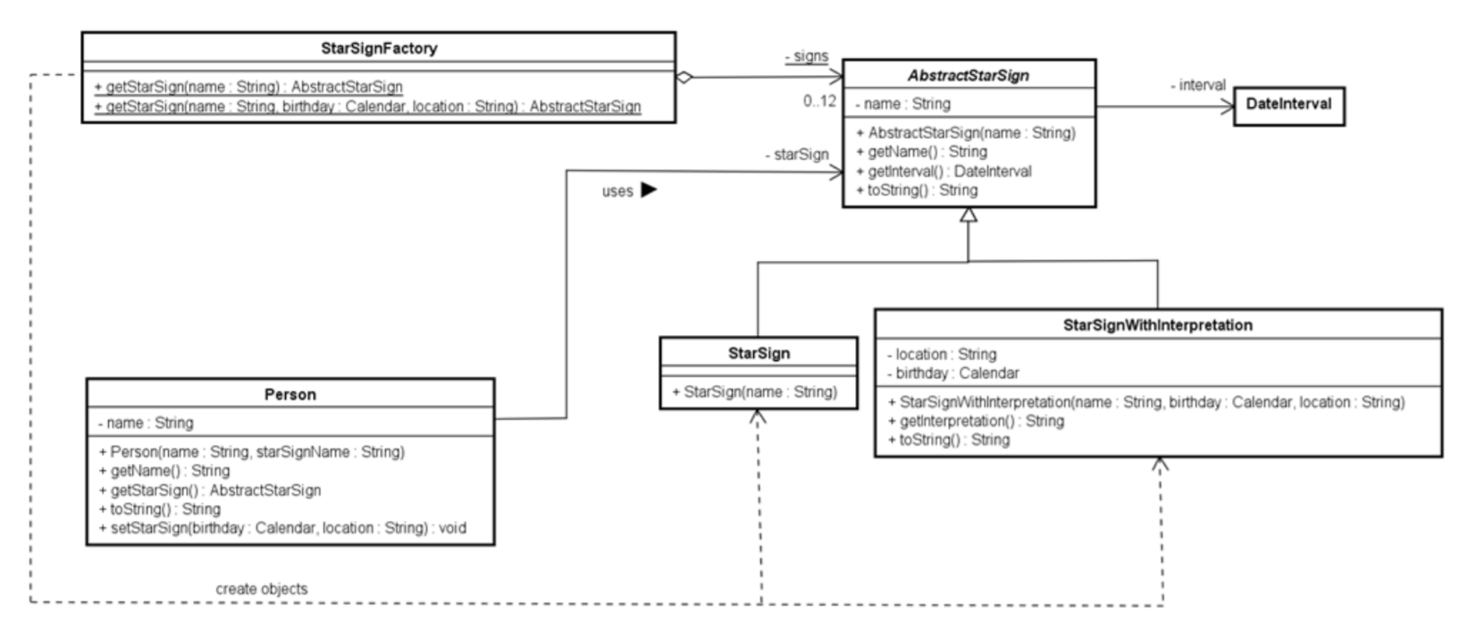
Flyweight

Slide 8
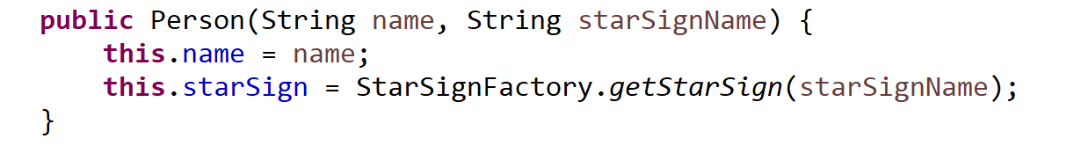
Flyweight

Slide 9
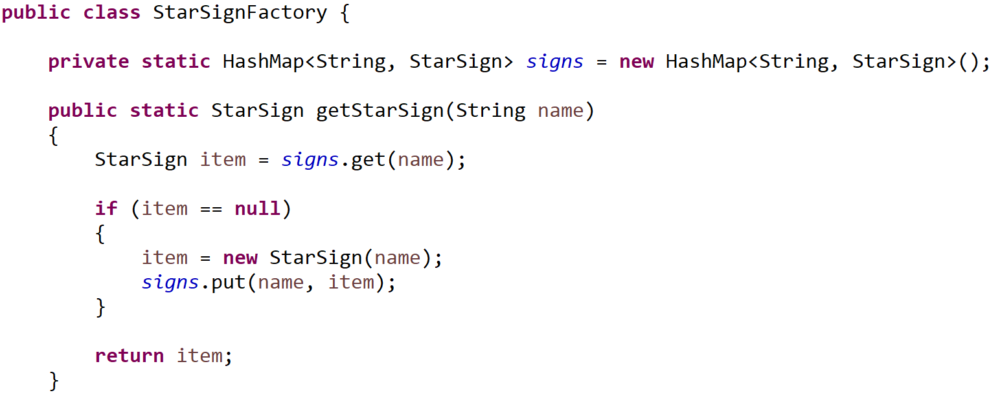
Flyweight

