Slide 1
Sockets
ICT 2nd semester

Slide 2
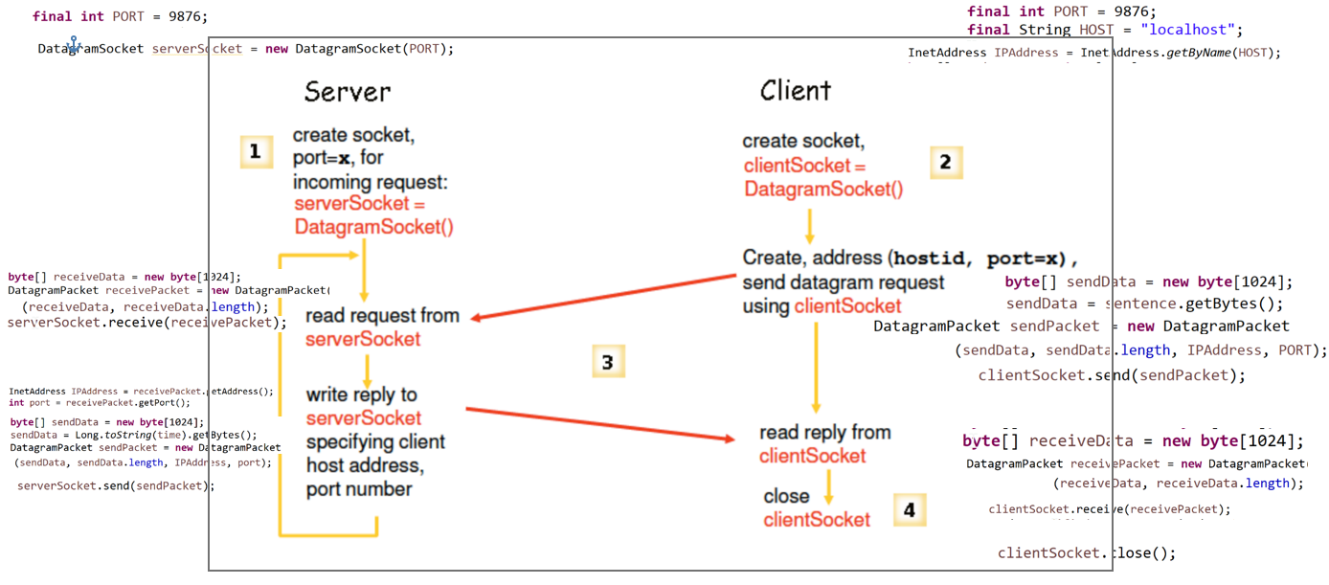
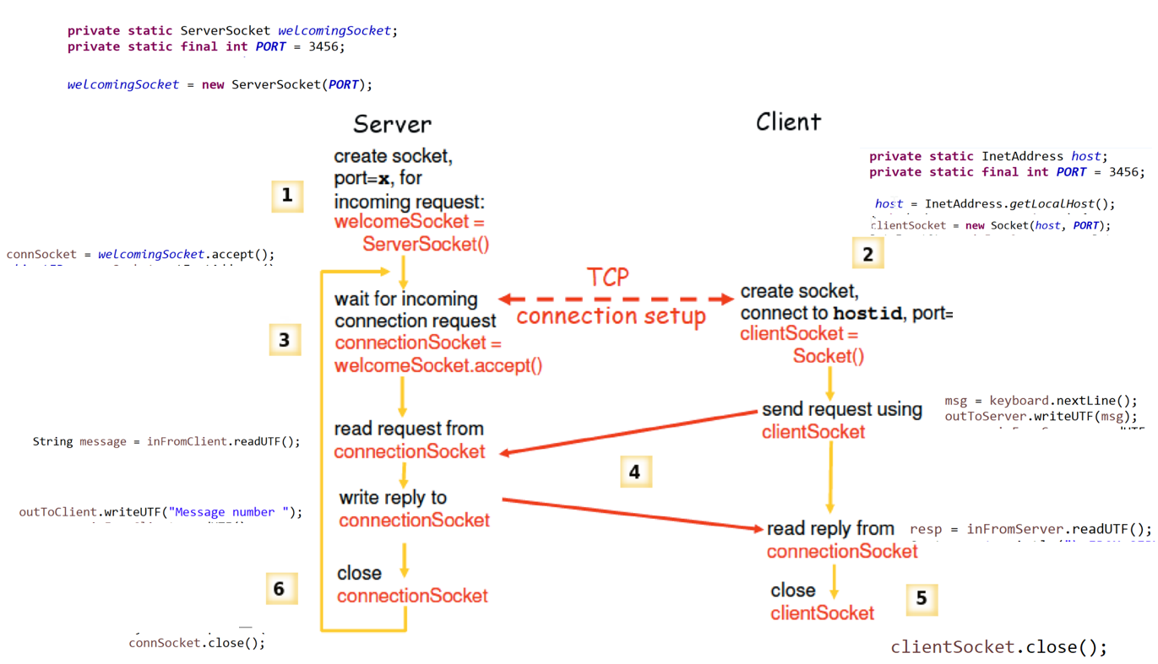
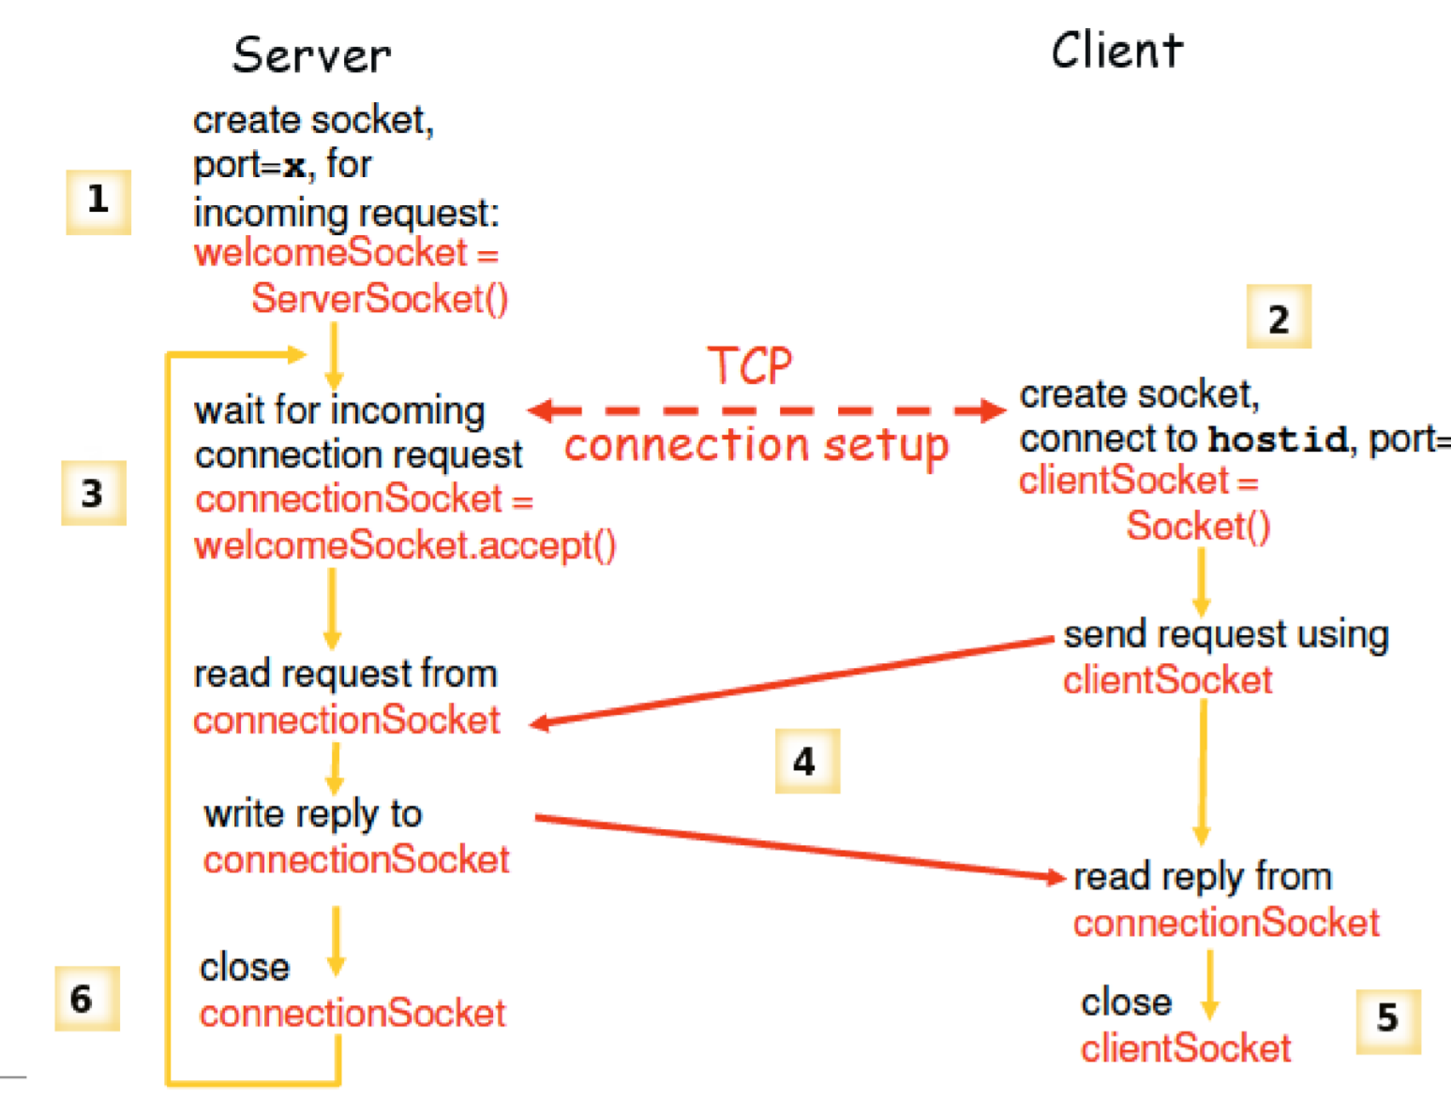
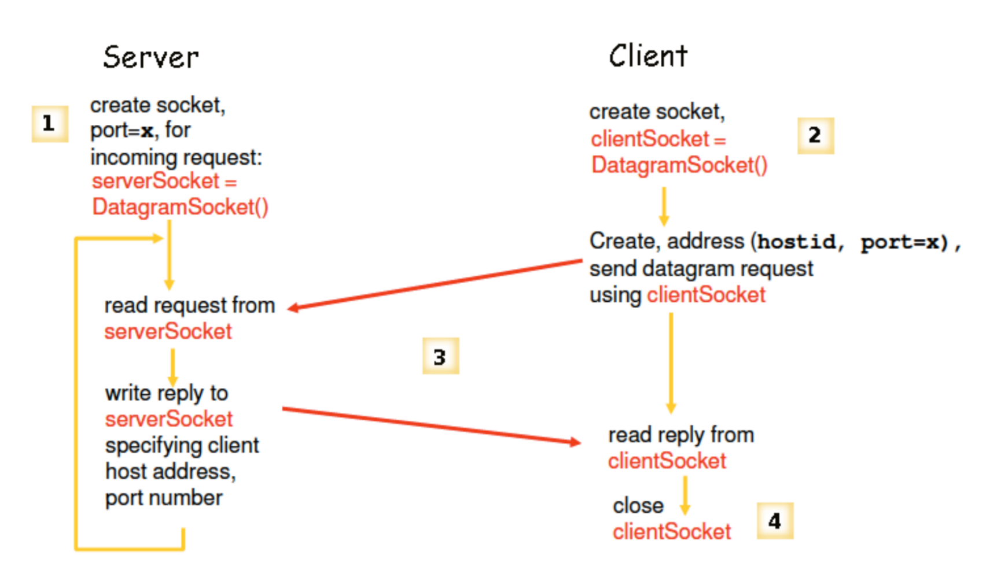
TCP & UDP

Slide 3
Json

Slide 4

Step 1: Importing Libraries

Slide 5


Client

Slide 6
Server

Slide 7
Time permits?

Slide 8
Sockets with MVC

Slide 9
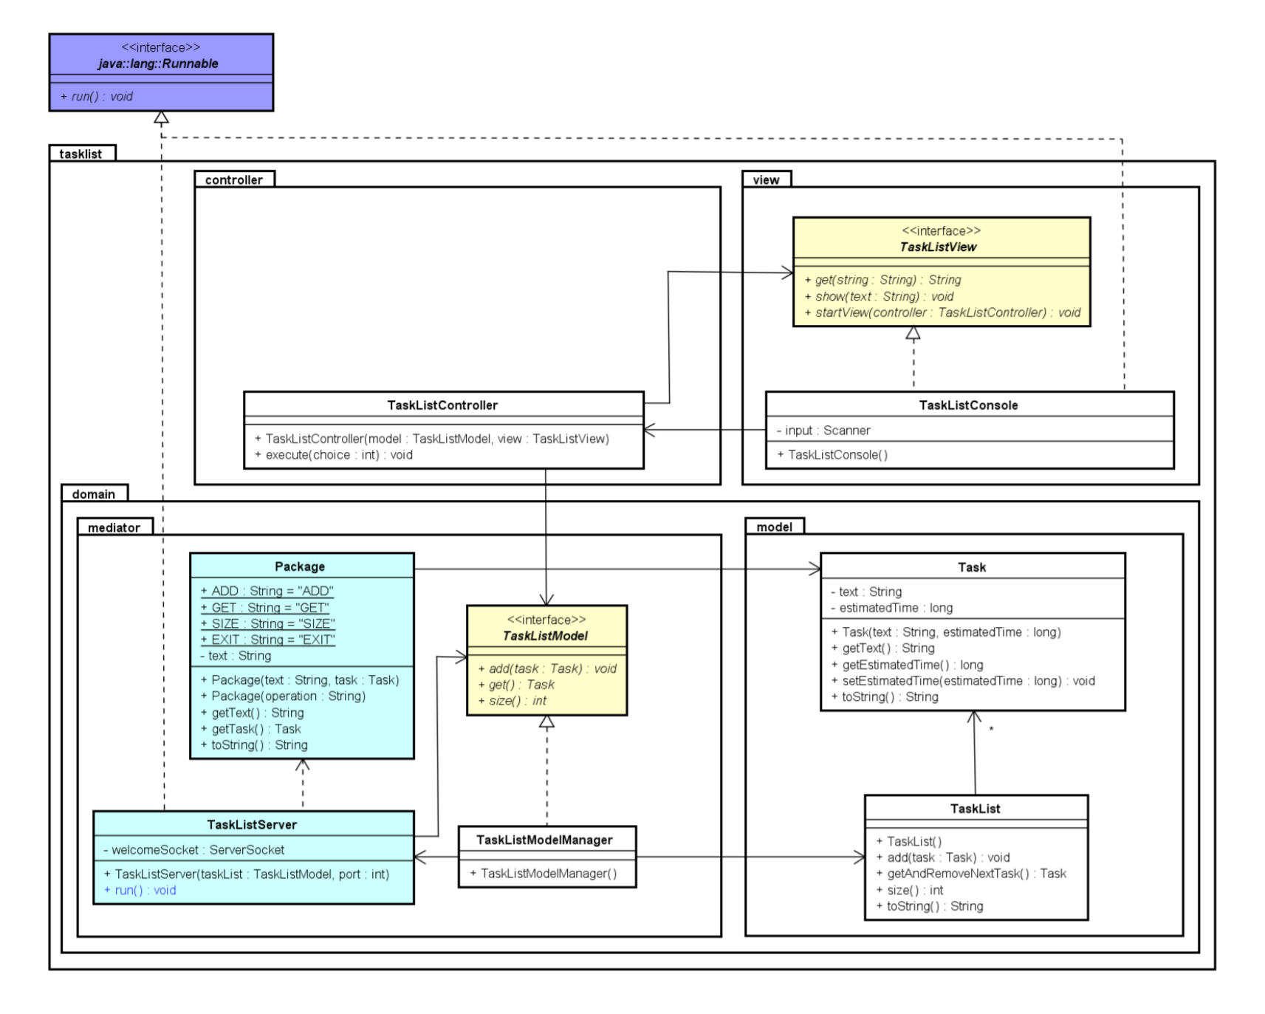
Server

Slide 10
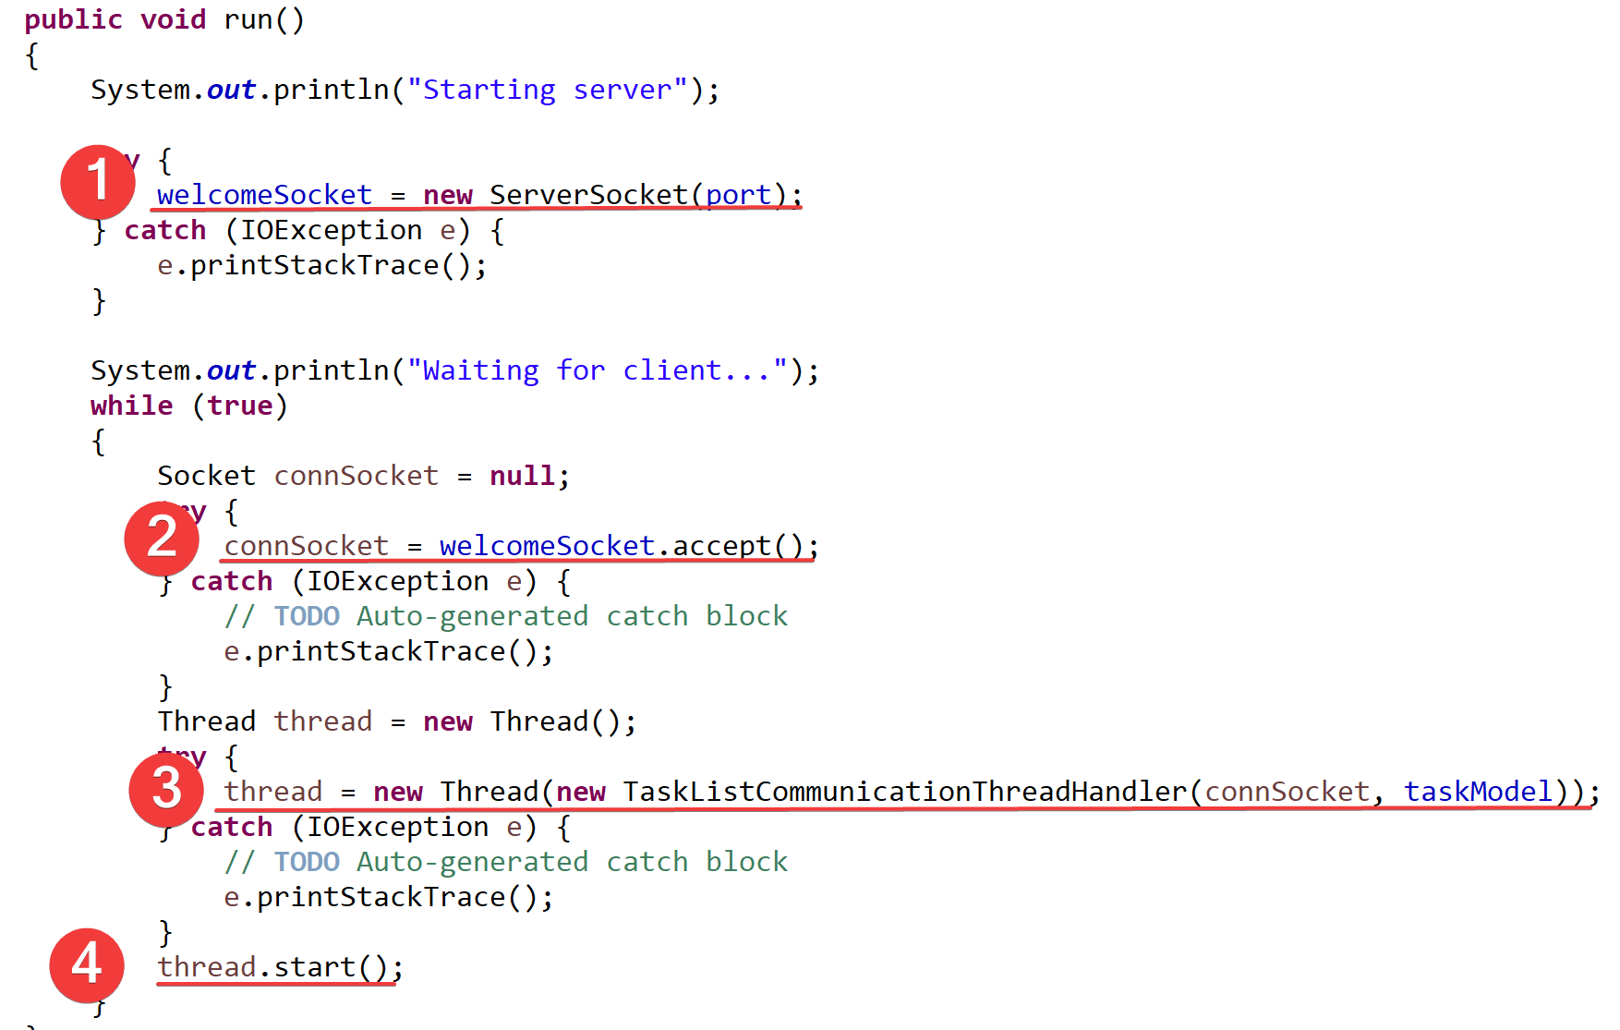
TaskListServer

Slide 11
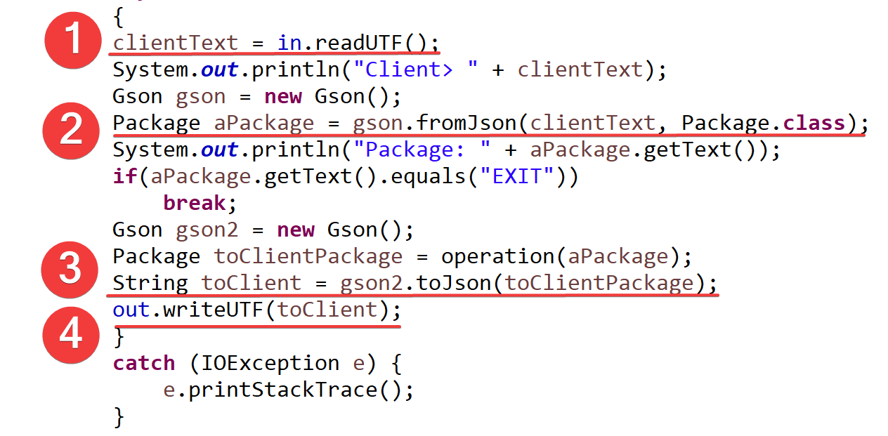
TaskListCommunicationThreadHandler

Slide 12
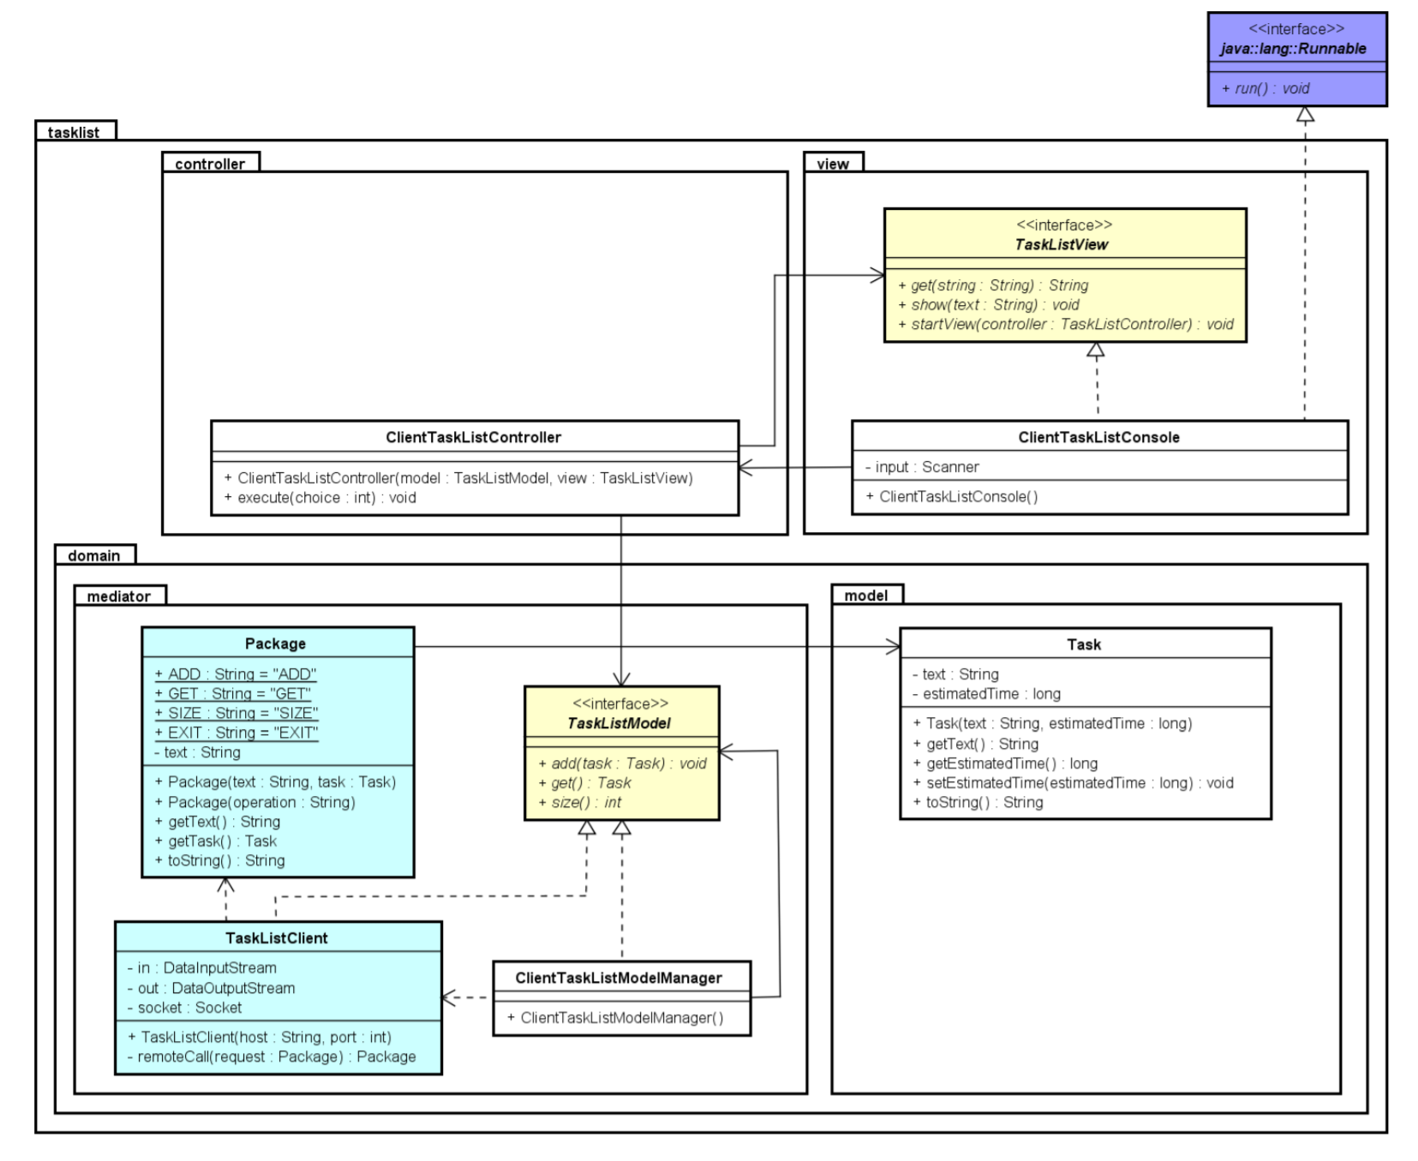
Client

Slide 13
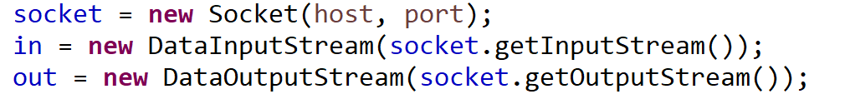
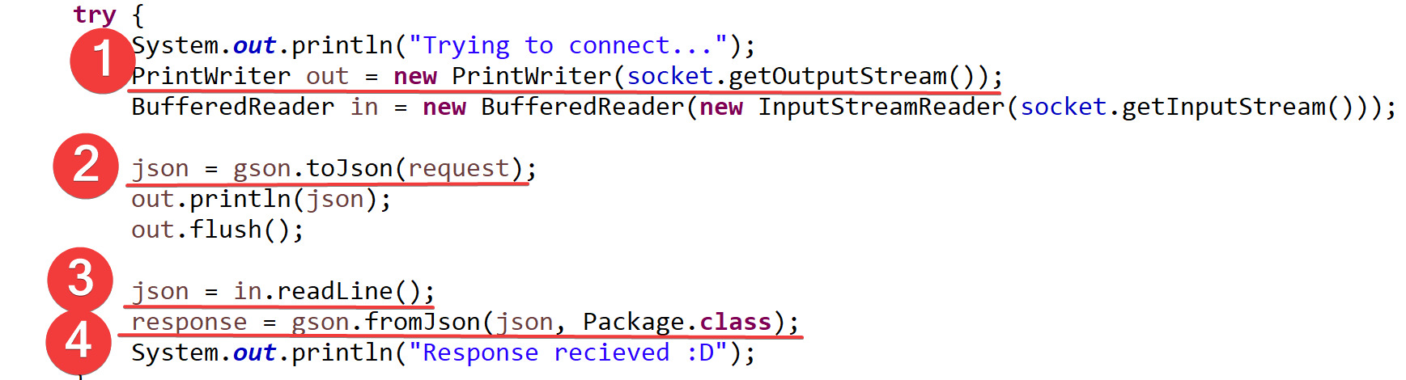
TaskListClient

