Slide 1
Testing
ICT 2nd semester

Slide 2
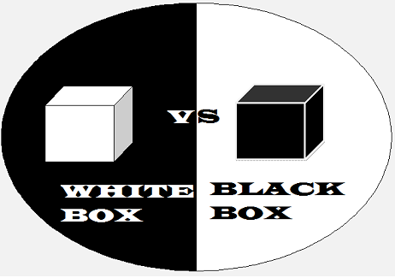
Whitebox and blackbox testing

Slide 3
Testing the method enqueue() dequeue()
Equivalence partioning
Boundary value analysis

Slide 4
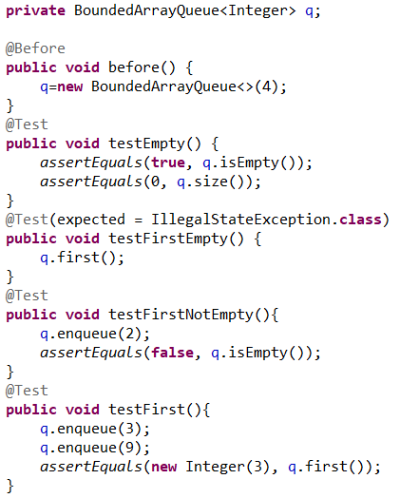
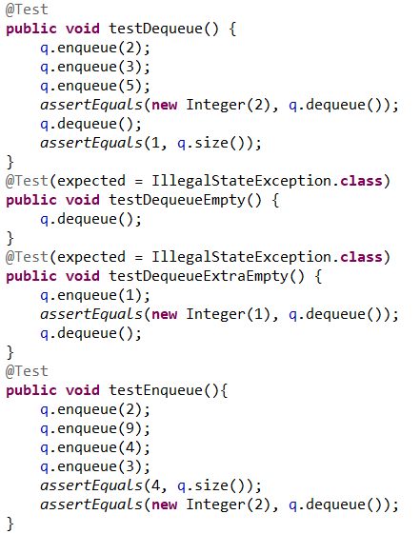
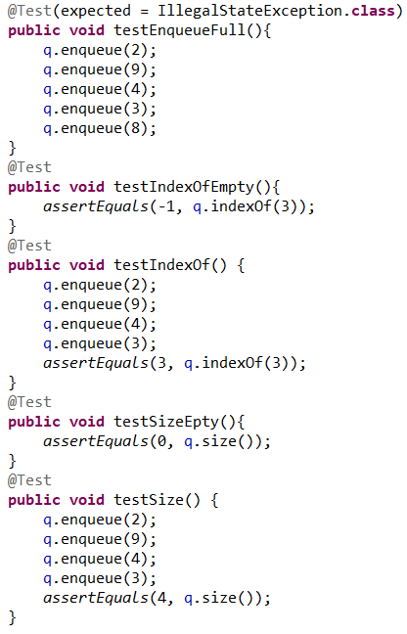
JUnit test in code

Slide 5
Other types of testing
Requirement test descriptions
Debugging with print statements
Destructive testing
Path testing

