Slide 1
Threads
ICT Semester 2

Slide 2
Why multithreaded programs?

Slide 3
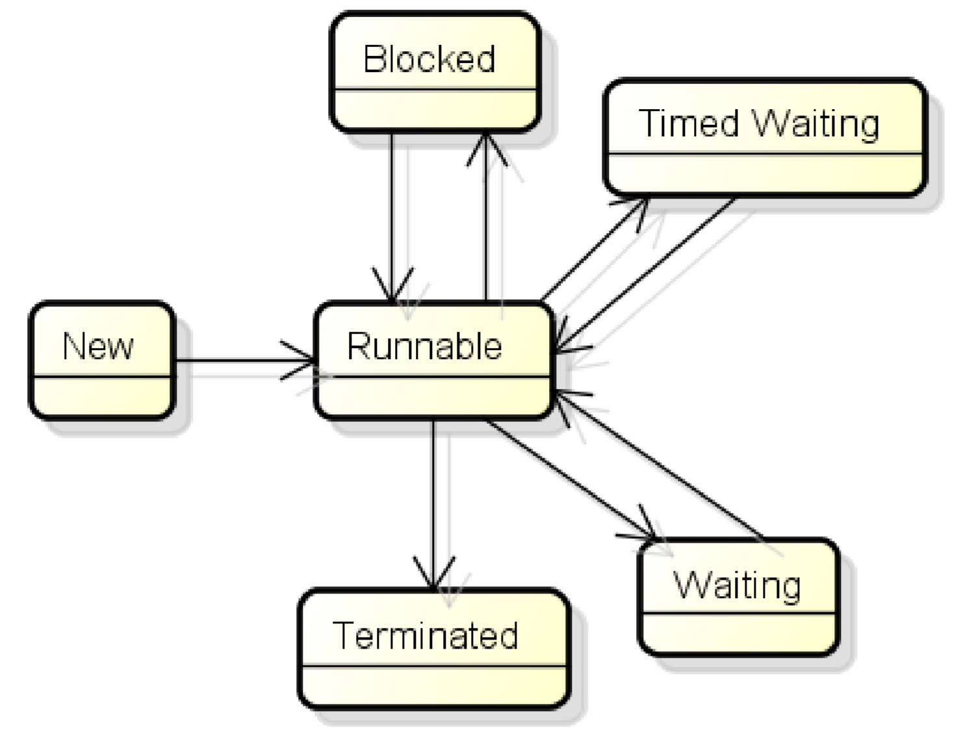
States

Slide 4
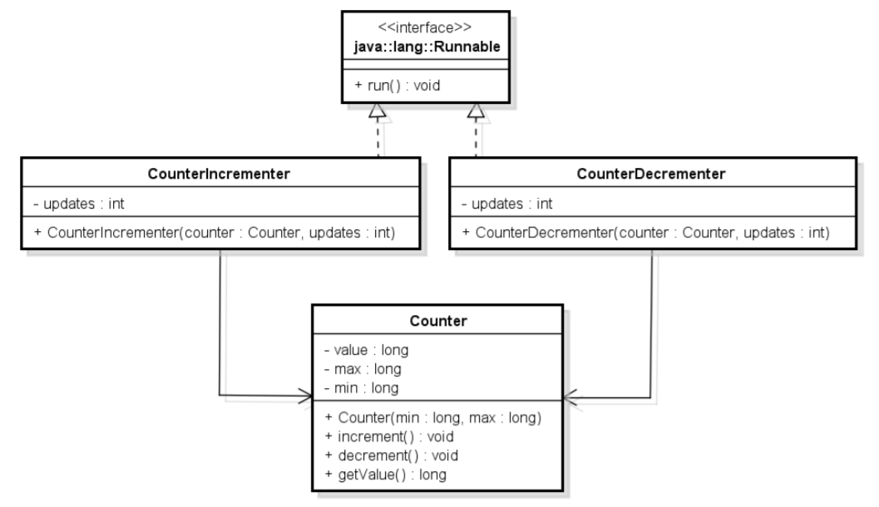
Thread safe class & monitor

Slide 5
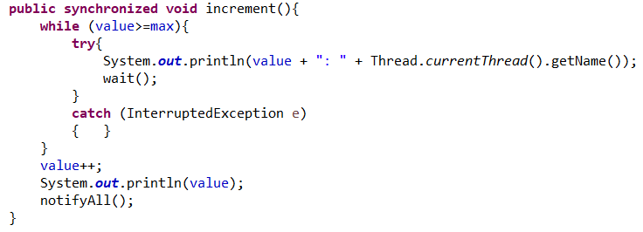
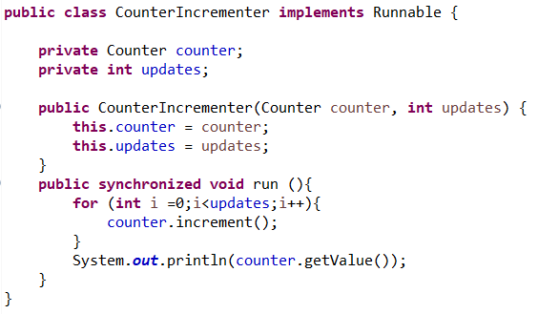
Thread safe class & monitor

Slide 6
Time permits?

Slide 7

Starvation

Slide 8
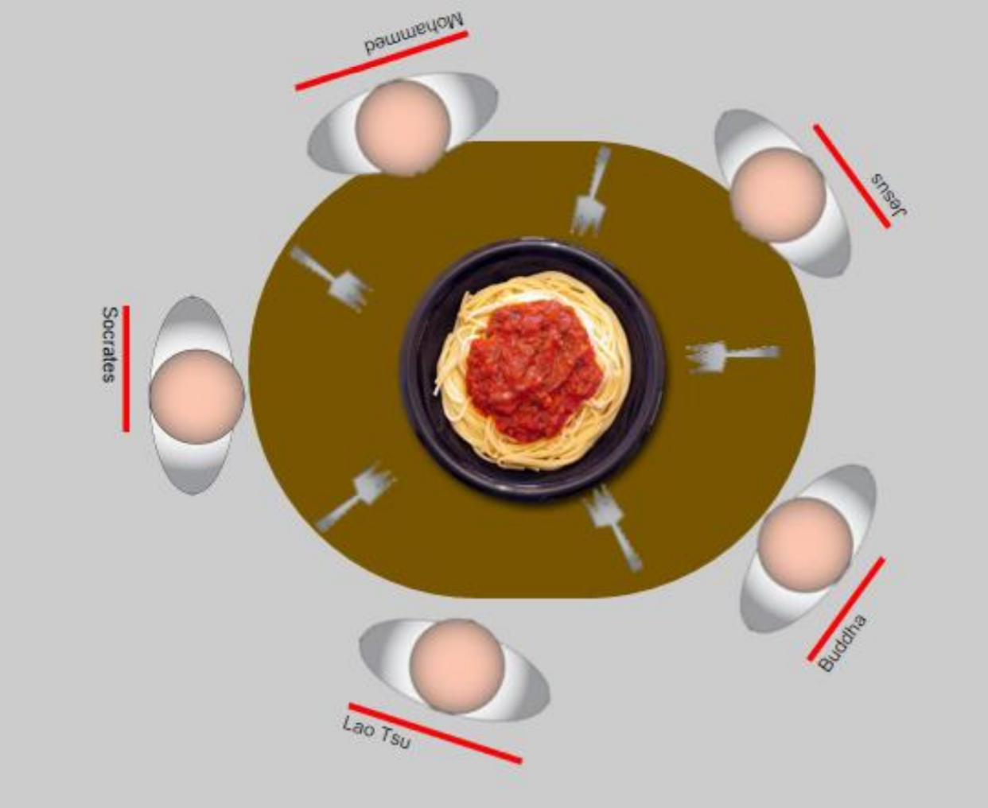
Deadlock

