Slide 1
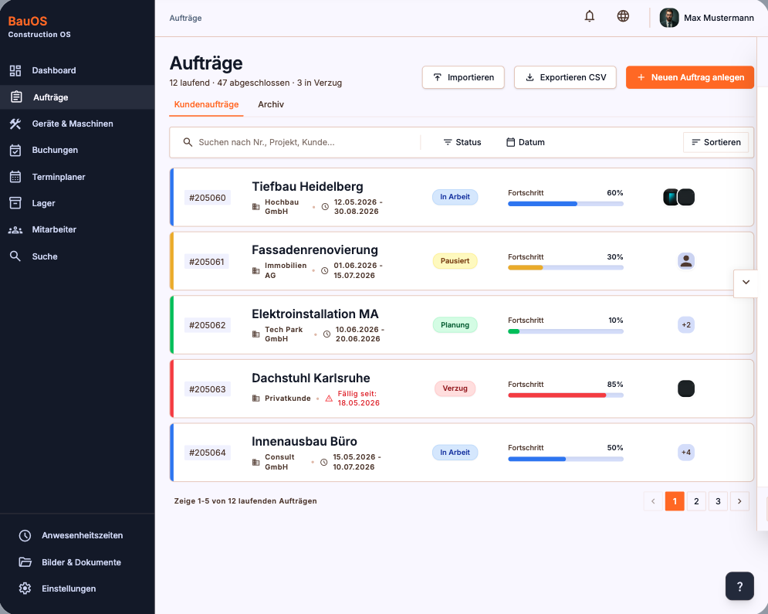
JPanel
JButton
JLabel
JLabel
JLabel
JLabel
JTabbedPane
JTextField
JPanel
JToggleButton
JProgressBar
JButton
JPanel
JFrame

