Slide 1


T5 capstone project
Our voice
Saudi sign language recognition

Slide 2


Field | Description
Title | Saudi Sign Language Recognition (SSLR) In ER
Abstract | This project develops an AI model to translate sign language into spoken words, improving communication between People with Hearing Disabilities (PWHD) and medical staff.
Introduction | "OUR VOICE: SSLR (Saudi Sign Language Recognition)" addresses the effective recognition and understanding of Saudi Sign Language (SSL) using AI and Data Science techniques to bridge the communication gap with the hearing-impaired community, aligning with the goals of the Saudi 2030 Vision for inclusivity and empowerment.
Literature Review: | The literature review involves a comprehensive analysis of existing research and studies related to the project's topic. It examines the current state of knowledge, identifies gaps or limitations in previous work, and highlights relevant theories, methodologies, or frameworks that inform the project's approach.
Data Description and Structure: | The data collection process for SSL gestures involved capturing diverse video recordings of SSL expressions, organizing them into labeled sequences of frames, and ensuring a suitable dataset for training an accurate and reliable SSL recognition model.
Methodology | The methodology involved data collection by recording sign gestures multiple times, extracting features using MediaPipe algorithm, and developing a model with CNNs for spatial features and RNNs for temporal dependencies. The training process included epochs, loss calculation, and weight updates, followed by evaluation on separate test data. Real-time testing involved capturing frames from a webcam, preprocessing, and feeding into the trained model for inference.
Discussion and Results: | Initially, an RNN model for video classification yielded unsatisfactory results (accuracy 0.05), prompting a shift to landmark extraction and an RNN model with GRU layers, resulting in improved accuracy (0.53). Further refinements, including LSTM layers and a landmark dataset, led to a significantly enhanced accuracy of 0.73, highlighting the effectiveness of the refined approach.
Conclusion and Future Work | To enhance our model's quality and real-life implementation, we plan to enrich our dataset by recording additional words and incorporating diverse individuals. We also aim to explore synergies with emerging technologies and user feedback mechanisms, drawing inspiration from successful platforms like Tawakkalna and My Health to improve user engagement and gather valuable insights.
Team | Mais Alshahri ,Dania Fallata, Hessah Albarrit , Atheer Alzhrani and Shahad Wadani

Slide 3

Saudi Sign Language Recognition (SSLR) In ER

Slide 4
Abstract
This project addresses the pervasive communication challenges faced by People with Hearing Disabilities (PWHD) within healthcare sector. The project's purpose is to develop an innovative AI model that translates sign language into words, serving as a pivotal solution to bridge the communication gap between PWHD and medical staff. Leveraging a dataset comprised of videos recorded by the project team, Despite encountering challenges related to data availability, limitations, and time constraints, the project aims to pave the way for future improvements. The envisioned future work includes enhancing accuracy through advanced machine learning models, optimizing real-time performance, building a more extensive dataset library encompassing diverse sign language vocabularies, and exploring integrations with emerging technologies and user feedback mechanisms for continuous enhancement.

Slide 5
Introduction
"OUR VOICE: SSLR (Saudi Sign Language Recognition)" delivered during the AI & Data Science Bootcamp T5. The presentation focused on addressing the problem of effectively recognizing and understanding Saudi Sign Language (SSL) for communication with the hearing-impaired community. The recognition system developed using AI and Data Science techniques aims to bridge the communication gap and contribute to the goals of the Saudi 2030 Vision, which emphasizes inclusivity and empowerment of all members of society. This introduction provides an overview of the presentation's key themes, including the problem statement, the proposed solution, and the significance of SSL recognition in the context of the Saudi 2030 Vision. It sets the stage for further exploration of the presentation's content and its implications in building a more inclusive and accessible society.

Slide 6
Literature Review:
How2Sign: A Large-Scale Multimodal Dataset for Continuous American Sign Language
Amanda Duarte, Shruti Palaskar, Lucas Ventura, Deepti Ghadiyaram, Kenneth DeHaan, Florian Metze, Jordi Torres, Xavier Giro-i-Nieto; Proceedings of the IEEE/CVF Conference on Computer Vision and Pattern Recognition (CVPR), 2021, pp. 2735-2744
Abstract One of the factors that have hindered progress in the areas of sign language recognition, translation, and production is the absence of large annotated datasets. Towards this end, we introduce How2Sign, a multimodal and Multiview continuous American Sign Language (ASL) dataset, consisting of a parallel corpus of more than 80 hours of sign language videos and a set of corresponding modalities including speech, English transcripts, and depth. A three-hour subset was further recorded in the Panoptic studio enabling detailed 3D pose estimation. To evaluate the potential of How2Sign for real-world impact, we conduct a study with ASL signers and show that synthesized videos using our dataset can indeed be understood. The study further gives insights on challenges that computer vision should address in order to make progress in this field.
Summary:
The paper introduces the How2Sign dataset, which is a large-scale multimodal and Multiview dataset for American Sign Language (ASL). The dataset consists of over 80 hours of sign language videos with aligned modalities, including speech, English transcripts, and depth information. A subset of the dataset was recorded in the Panoptic studio, enabling detailed 3D pose estimation.
The authors highlight the importance of large annotated datasets for sign language recognition, translation, and production tasks. They discuss the challenges faced by sign language users due to the lack of support from communication technologies designed primarily for spoken or written language. The How2Sign dataset aims to address this gap and facilitate research in sign language processing.
The contributions of the paper include the introduction of the How2Sign dataset, which contains a large amount of ASL videos with sentence-level alignment, a vocabulary of 16k English words, and a rich set of annotations. The dataset also includes 2D keypoints and 3D pose estimation for a subset of videos recorded in the Panoptic studio.
The authors conducted a study with ASL signers to evaluate the potential of the How2Sign dataset for real-world impact. The study showed that videos generated using the dataset can be understood to a certain extent. The study also provided insights into the challenges that the research community can address in the field of sign language processing.
In the background and related work section, the paper discusses the challenges of sign language processing and provides an overview of existing sign language datasets. It emphasizes the need for large-scale annotated datasets for training models in this domain.
Overall, the paper presents the How2Sign dataset as a valuable resource for advancing research in sign language processing. It addresses the limitations of existing datasets and provides a comprehensive collection of multimodal and Multiview ASL videos.
Dataset website: http://how2sign.github.io/

Slide 7
Data Description and Structure:
The data collection process for SSL gestures involved capturing video recordings of a team member performing the gestures. The team member referred to the Saudi sign language dictionary to ensure a diverse range of gestures and expressions commonly used in SSL communication were included. To prepare the data for training the recognition model, it was organized into a suitable format. This likely involved structuring the data as sequences of frames, where each frame represents a specific SSL gesture from the video recordings. The gestures were categorized and labeled based on their meanings, providing the necessary annotations for training the model. The quality and diversity of the SSL dataset play a crucial role in training an effective SSL recognition model. Therefore, the data collection process, annotations, preprocessing steps, and the chosen data structure all contribute to ensuring the dataset is suitable for training the model accurately and reliably.

Slide 8
Methodology:
The methodology involved several key steps, including:
Data Collection: due to the time and computational power limitation we collected data by recording sign gestures words by video and every word recorded 30 times and each video splitted into 30 frames for further processing
Data preparation: after splitting each video into frames we used MediaPipe algorithm to extract features from the recorded videos by collecting key points or landmarks of hands, pose and face then we save each frame as NumPy array.
Model Development: The presenters elaborated on the architecture of the SSL recognition model. They explained the design choices, such as the use of CNNs for spatial feature extraction from SSL gesture images and RNNs for capturing temporal dependencies in sequential gesture data.
The training process begins, where the model is trained using the provided training data for a specified number of epochs (180). During each epoch, the model makes predictions on the training data, calculates the loss, and updates the weights and biases using the optimizer's algorithm. Additional operations, such as monitoring the progress with TensorBoard, can be included using the callbacks argument.
After the training is completed, the model's performance is assessed by evaluating its predictions on separate test data. This evaluation step calculates the loss and metrics on the test data, providing evaluation results that can be stored or further analyzed.
To test the model in real-time using a webcam, the code captures frames from the webcam and preprocesses them if necessary (e.g., resizing, normalization). The preprocessed frames are then fed into the trained model for inference. The model makes predictions based on the extracted features, and the prediction results can be further processed or displayed as desired.

Slide 9
Discussion and Results:
In our initial approach, we employed an RNN model for video classification. The training dataset consisted of videos recorded by our team members. To prepare the data for training, we segmented each video into frames, converting them into NumPy arrays before inputting them into the model. Unfortunately, this initial model yielded unsatisfactory results, displaying a notably low accuracy score of 0.05, indicating a need for improvement in both the model architecture and the training data quality. Following our initial setback, we pivoted our strategy by adopting a more nuanced approach. Shifting from video classification, we transitioned to extracting key landmarks for hands and face using the Mediapipe pretrained model. These landmarks were then transformed into NumPy arrays and fed into an RNN model, leveraging GRU layers for improved temporal understanding. After shifting to landmark extraction and utilizing GRU layers in our RNN model, accuracy improved to 0.53, a substantial enhancement over the initial video classification attempt. Acknowledging this progress, we are committed to refining the model architecture further. Our ongoing efforts involve meticulous scrutiny and optimization to achieve a more robust and effective solution. Our final model, incorporating LSTM layers and leveraging a landmark dataset, achieved a significantly improved accuracy of 0.73 during testing. This enhanced performance underscores the effectiveness of our refined approach, and trained model weights were saved as h5 file

Slide 10
Conclusion and Future Work
While our model currently demonstrates good accuracy, there exists ample room for enhancement to elevate both its quality and real-life implementation. Key areas for improvement encompass: Data Enrichment: To enhance the robustness of our model, we aim to expand and diversify our dataset. This involves recording additional words to encompass a more comprehensive sign language dictionary. Our focus extends to inclusivity, incorporating a variety of individuals, including children, men, and the elderly. This diversified dataset aims to significantly improve the model's accuracy across a broader spectrum of real-world scenarios. Exploring Synergies with Emerging Technologies: In our quest for continuous improvement, we are actively considering integrations with cutting-edge technologies and user feedback mechanisms, drawing inspiration from successful models such as Tawakkalna and My Health. By aligning with these platforms, we aim to enhance user engagement and gather valuable insights for refining our sign language translation system.

Slide 11
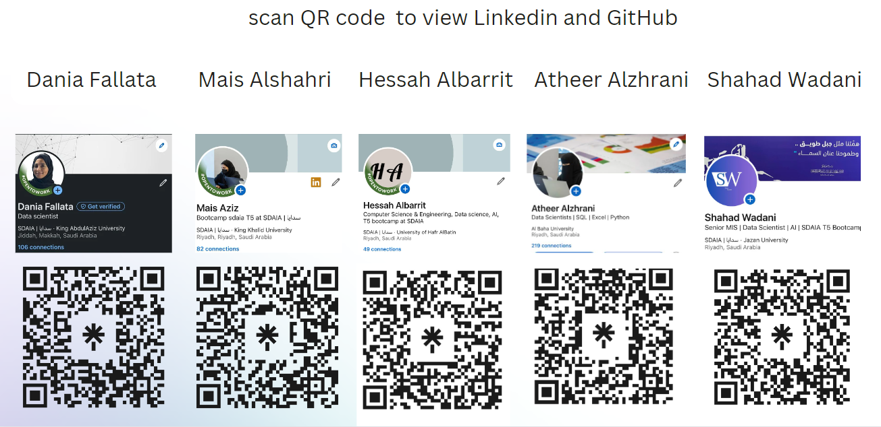
Team

