Slide 1
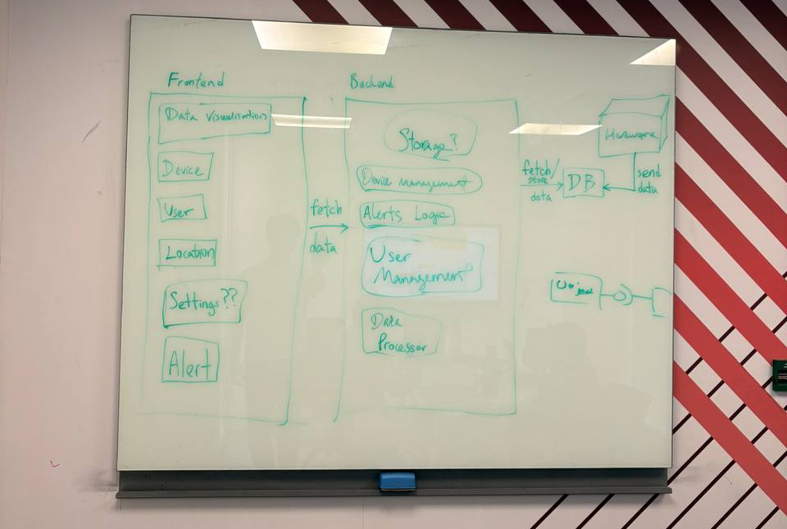
Hardware Device
Sensor Data Parsing
Frontend
API Client Module
API Client Module
Data Visualisation Module
Charts and Graphs
Table View
Export Data
Backend
API Server
Module
User Authentication Module
Data Retrieval Processor
Alert Notification Module
PosgreSQL Database
Maps (Device Management)
Device Information
Data Analytics Module
Animal Analysis
Alert
Management
View Alerts
Configure Alerts
Data Lake
Data Ingest Processor
Data Processing
Metadata Extraction
User Authentication Module
Map Module
Generates map
External Maps API

