Slide 1
Who earns what in KP rural?
The distribution of annual earnings and how it changes with age (PSLM 2019-20)
My variant
Reg. no. last digits 20 = 2 x 8 + 4 -> variant 4: KP rural
My sample
3,396 earners aged 15-64 (earn_annual > 0), every statistic weighted by hhweight
My tools
R (ggplot2, svglite) for the figures; Python (pandas, matplotlib) to reproduce the band means
Danial | FA24-BEDS-020 | ECO346 Section A
Notes:
(about 40 seconds) Introduce yourself. My registration number ends in a number that gives variant 4: KP rural. I use the PSLM 2019-20 person file joined to the household file by hhid, keep 3,396 earners aged 15-64, and weight everything by hhweight because the survey deliberately oversamples small districts. Figures are drawn in R; Python reproduces the band means.

Slide 2
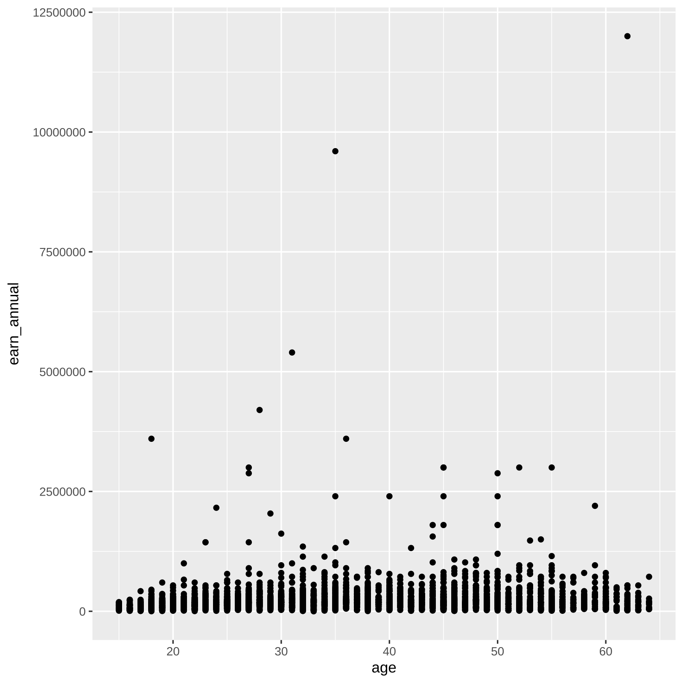
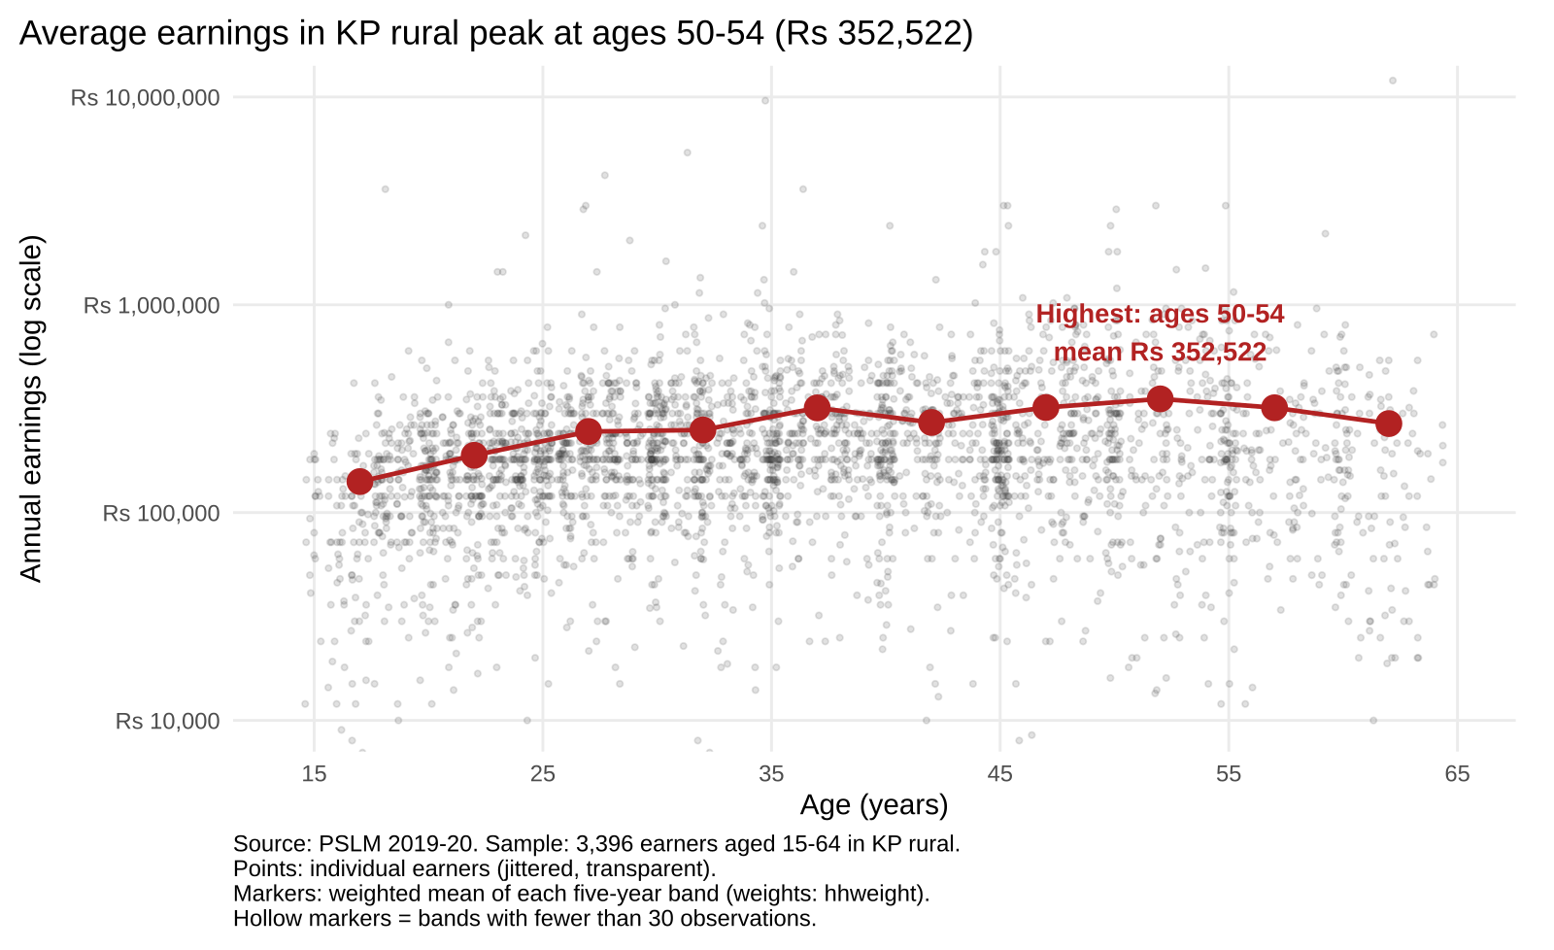
Makeover: from an unreadable cloud to an age profile
R default
Redesign
Log axis (skew) Alpha + jitter (overplotting) Band means + annotation (conditional means, position on a common scale)
ECO346 Assignment 1 | FA24-BEDS-020 | Source: PSLM 2019-20, weighted by hhweight
2
Notes:
(about 100 seconds) Left: R's default, ggplot(data, aes(x, y)) + geom_point(). Right: my redesign. Three changes. One: a log vertical axis, because earnings are right-skewed and on a linear axis most people are squashed at the bottom. Two: transparency 0.15 and horizontal jitter of at most 0.4 years, because ages are whole numbers and thousands of points overplot into columns. Three: weighted means for each five-year band, joined by a line and annotated, because position on a common scale is the most accurate visual channel and the conditional mean shows the age pattern. The default does show one thing the redesign hides: the single largest earner, Rs 12,000,000, far above everyone, which shows how extreme the right tail is.

Slide 3
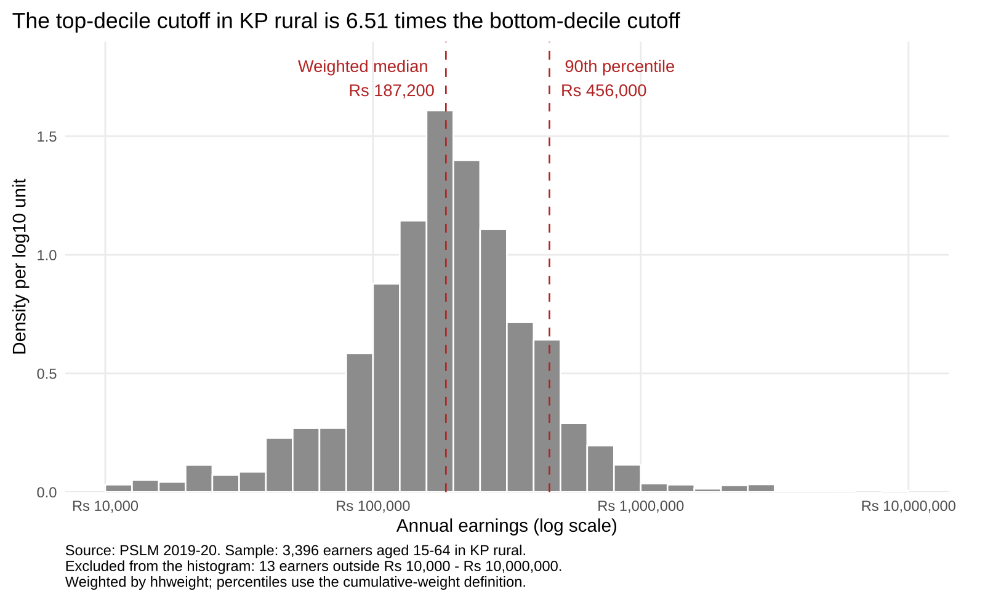
Top-decile cutoff is 6.51 times the bottom-decile cutoff
Earners
3,396
Weighted median
Rs 187,200
Unweighted median
Rs 180,000
10th percentile
Rs 70,000
90th percentile
Rs 456,000
p90 / p10
6.51
Excluded from histogram
13
ECO346 Assignment 1 | FA24-BEDS-020 | Source: PSLM 2019-20, weighted by hhweight
3
Notes:
(about 70 seconds) Weighted histogram on a log scale with bins 0.1 wide. The weighted median is Rs 187,200; the unweighted median is Rs 180,000. The 10th percentile is Rs 70,000 and the 90th is Rs 456,000, a ratio of 6.51. 13 earners fall outside Rs 10,000 to Rs 10,000,000 and are excluded from the histogram only. Percentiles use the cumulative-weight definition, not R's quantile().

Slide 4
Earnings peak at ages 50-54; same-age gaps are larger
Mean rises from Rs 141,017 (15-19) to Rs 352,522 (50-54).
Age gain is 2.5x; the p90/p10 gap is 6.51x.
Cannot tell: one cross-section, so age is mixed with cohort.
Python reproduces the bands to the rupee (25-29: Rs 245,584).
ECO346 Assignment 1 | FA24-BEDS-020 | Source: PSLM 2019-20, weighted by hhweight
4
Notes:
(about 90 seconds) The finding I consider most important: mean earnings rise from Rs 141,017 at 15-19 to Rs 352,522 at 50-54, but the gap between the 90th and 10th percentile (6.51x) is bigger than the age gain (2.5x), so differences between people of the same age matter more than age itself. Limitation: this is one cross-section, so age is mixed with cohort effects and selection into work. Python reproduces every band mean to the rupee; the 25-29 band is Rs 245,584 in both languages.

