Slide 1
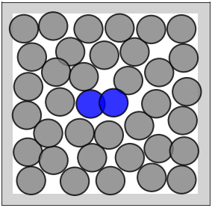
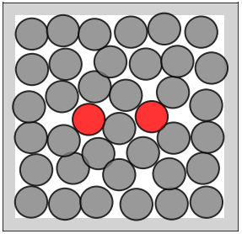
Adaptive MCMC
Latent MC
Aim: Learn proposal scheme P
to achieve efficient MCMC
Aim: Learn transformation Txz of data to latent space such that direct MC is efficient
sample z
p_{Z}(z)
μ
z
sample
x_{t}
P
x_{t+1} ~ N(μ, Σ)
T_{zx}
T_{xz}
Σ
transform
to x
x
sample z
p_{X}(x)

