Slide 1
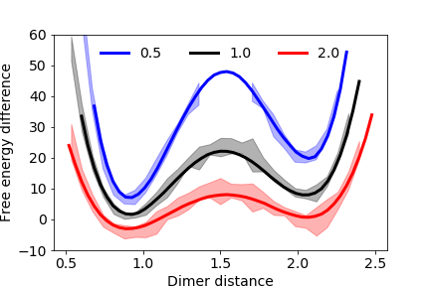
a
c
b
d
f
T_{xz}
e
g
T_{zx}
i
h

