Slide 1
Draft JS

Slide 2
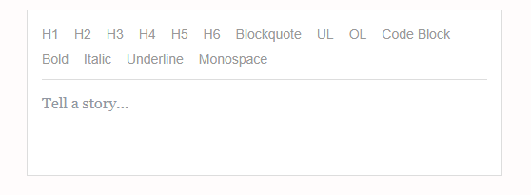
What
Build rich text editor in react
Leverages immutable model
DOM is wrapped around a controlled input,
Abstract cross-browser differences of content-editable

Slide 3
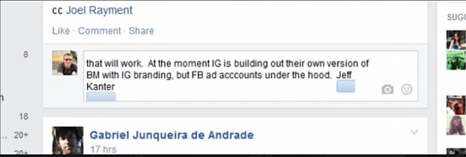
Why
Replaces content editable and makes it consistent
Richer Content Editor
Robust Cursor and selection control
No DOM hacks
Fits nicely with React

Slide 4
Catch
Only works with react
Issues with mobile browsers
Lack of documentation

Slide 5
Examples
https://draftjs.org/
https://draft-wysiwyg.herokuapp.com/
https://www.draft-js-plugins.com
http://bitwiser.in/medium-draft/

Slide 6
EditorState
ContentState
ContentBlock
Entity
Decorator
Inline styles
SelectionState
cursor

Slide 7
Editor State
React Controlled Component and Inputs

Slide 8
Basic
Controlled component
No text
Log
How to set/get the content state
Create non empty content

Slide 9
Content State
Text in an array of blocks
Entities (metadata that accompanies text)
Immutable – we never change..

Slide 10
Entities and custom block components
Annotating text ranges with metadata
Rich Text Editing
Autocomplete for Authors, Hashtags, Commands (Slack)
Emoji Rendering
Image Repositioning with Drag & Drop
Image Upload via File Drop
Rich Media
Regex styling

Slide 11
Tex
https://efloti.github.io/draft-js-mathjax-plugin/
\begin{eqnarray*}
\frac{1}{n}\sin x & = & \mathrm{?} \\
\frac{1}{\cancel{n}} \mathrm{si}\cancel{\mathrm{n}} ~x & = & \mathrm{?} \\
\mathrm{six} & = & 6
\end{eqnarray*}

Slide 12
Decorators
Strategy
Component
Composite

Slide 13
Editor Props
blockRenderMap (block type > html tag)
blockRendererFn (render custom block: emoji, tex, youtube)
blockStyleFn (apply className to a block)
Decorators (wrap text with a Component)
customStyleMap (type > style

Slide 14
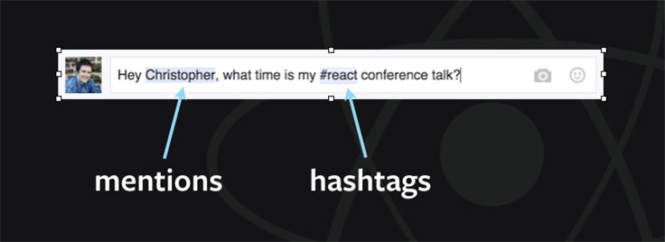
Where
Facebook – Comments/Status, Notes
FlexIT
WeCare Training Module

Slide 15
More Decorators
Hash tag

Slide 16
Even more decorators
https://github.com/Mair/react-meetup-draftjs

Slide 17
Production
Dooly – ‘smart’ notetaker for CRM/Sales
https://www.dooly.ai/
Cloud collaboration note taker that integrates with Salesforce
https://github.com/nikgraf/awesome-draft-js
https://read.douban.com/editor_ng

Slide 18
What now?
Quote
eCos/contract documents

Slide 19
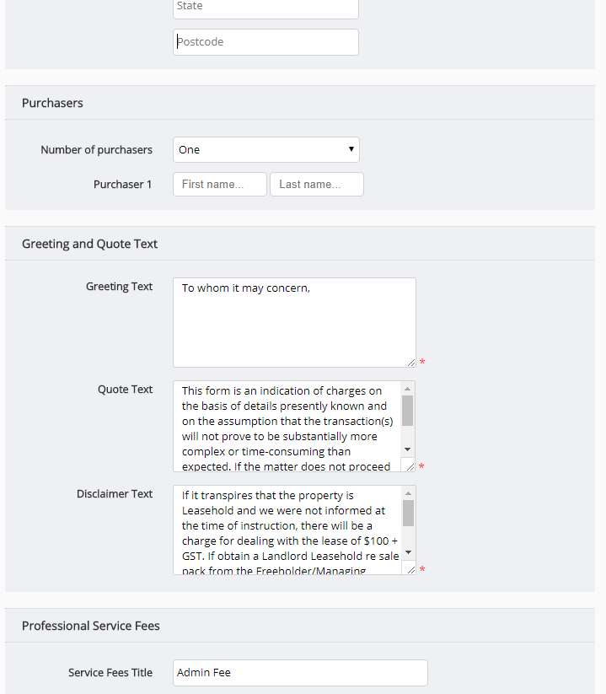

Slide 20
Interested?
https://github.com/nikgraf/awesome-draft-js

