Slide 1
Draft JS
Adventures 11/17-01/18

Slide 2
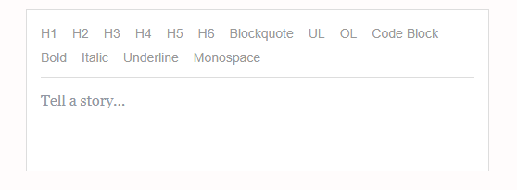
What
Build rich text editor in react
Leverages immutable model
DOM is wrapped around a controlled input,
Abstract cross-browser differences of content-editable

Slide 3
Why
Replaces content editable and makes it consistent
Richer Content Editor
Robust Cursor and selection control
No DOM hacks
Fits nicely with React

Slide 4
Examples
https://build-sftaykknun.now.sh/Home
https://www.draft-js-plugins.com
https://draft-wysiwyg.herokuapp.com/
http://bitwiser.in/medium-draft/

Slide 5
EditorState
Everything
ContentState
What you see
ContentBlock
Array of text
Entity
Text with metadat
Decorator
Inline styles
SelectionState
cursor

Slide 6
Editor Props
blockRenderMap (block type > html tag)
blockRendererFn (render custom block: emoji, tex, youtube)
blockStyleFn (apply className to a block)
Decorators (wrap text with a Component)
customStyleMap (type > style

Slide 7
Basic
See code
Controlled component
No text
Log
How to set/get the content state
Create non empty content

Slide 8
Entities and custom block components
Annotating text ranges with metadata
Rich Text Editing
Autocomplete for Authors, Hashtags, Commands (Slack)
Emoji Rendering
Image Repositioning with Drag & Drop
Image Upload via File Drop
Rich Media
Regex styling

Slide 9
Catch
Only works with react
Issues with mobile browsers
Lack of documentation

Slide 10
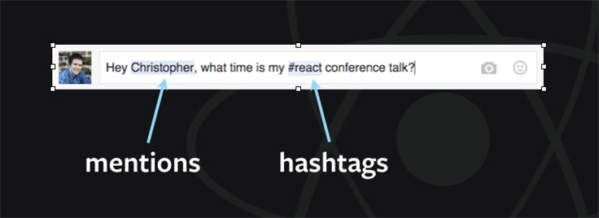
Where
Facebook – Comments/Status, Notes
FlexIT
WeCare Training Module

Slide 11
Demo
https://efloti.github.io/draft-js-mathjax-plugin/
\begin{eqnarray*}
\frac{1}{n}\sin x & = & \mathrm{?} \\
\frac{1}{\cancel{n}} \mathrm{si}\cancel{\mathrm{n}} ~x & = & \mathrm{?} \\
\mathrm{six} & = & 6
\end{eqnarray*}

Slide 12
Decorators

Slide 13
Production
Dooly – ‘smart’ notetaker for CRM/Sales
https://www.dooly.ai/

Slide 14
What now?
Quote
eCos/contract documents

Slide 15
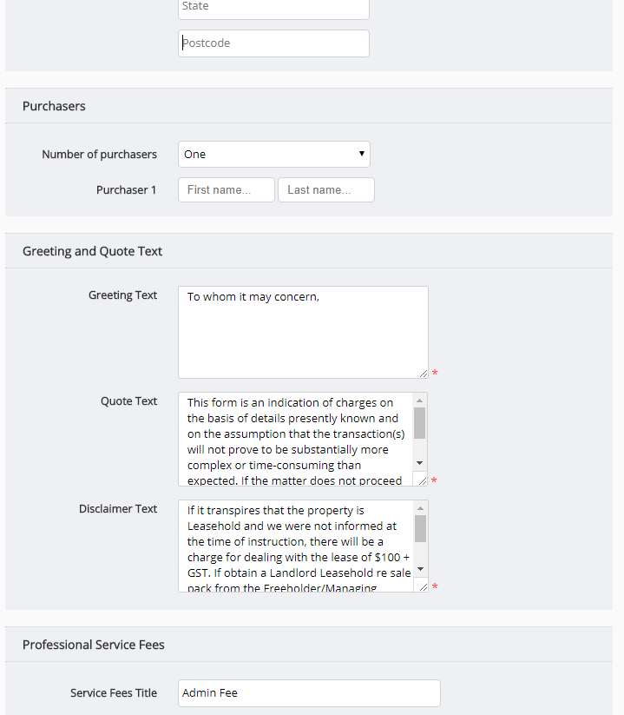

Slide 16
Interested?
https://bigbitecreative.com/building-editor-draft-js-react/

