Slide 1


[SWEG2108]
College of [Engineering]Department of [Software Engineering]
[DatabaseSystems]
PROJECT TITLE: YISAKAL SAVING AND CREDIT COOPERATIVE ORGANIZATION DB SYSTEMS.
(YISAKAL SACCO)
21/05/2026

Slide 2



INTRODUCTION
Background
Yisakal SACCO is a financial cooperative established in Addis Ababa in 2026. It provides savings, loans, and micro-finance services to members. Due to increasing transactions and members, the organization needs a modern database system.
Problem Statement
The current system uses manual records and spreadsheets, causing:
Data duplication
Inconsistency
Slow reporting
Poor loan tracking
Limited scalability
Objectives
General Objective
To design and implement an integrated database system using MySQL and MongoDB.
Specific Objectives
Improve data management
Reduce redundancy
Support reporting
Enhance security and efficiency

Slide 3
Objectives of Yisakal SACCO
General Objective
To design and implement an integrated database system using MySQL and MongoDB.
Specific Objectives
Improve data management
Reduce redundancy
Support reporting
Enhance security and efficiency
Main Services of Yisakal SACCO
Savings management
Loan processing
Repayment tracking
Member registration
Financial reporting
Stages of Loan Processing at Yisakal SACCO
Member registration
Loan application
Loan approval
Loan disbursement
Repayment monitoring
Current Challenges
Manual data handling
Duplicate records
Slow report generation
Weak security
Difficulty tracking loans

Slide 4









Proposed System Solution
Scope of the System
Role modeling
The project integrates both Relational and NoSQL database technologies to overcome the limitations of traditional database systems.
We have applied the proposed database into both Relational and NoSQL databases, which are corresponding/analogous to each other.
Use MySQL for structured data
Use MongoDB for semi-structured data
Centralized and secure database system
Real-time reporting and tracking
Member Management
Savings Management
Loan Management
Transaction Management
Report Generation
Audit Record Management

Slide 5
Tools and Technologies Used
MySQL – Relational database management
MongoDB – NoSQL database management
MySQL Workbench – Database design and query execution
MongoDB Compass – MongoDB administration tool
Lucidchart and draw.io – ER diagram and system design
GitHub – Project documentation and collaboration

Slide 6
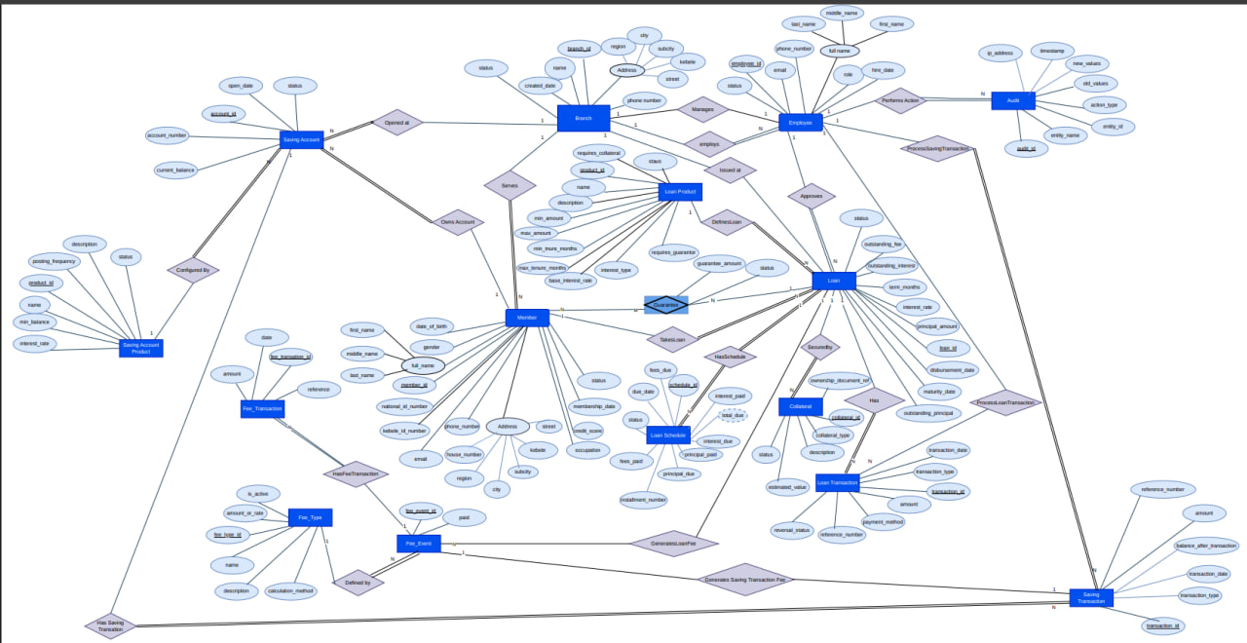
The conceptual ER diagram

Slide 7
Entity Identification and Classification
Branch – Stores information about SACCO branches.
Employee – Stores information about SACCO employees.
Member – Stores information about SACCO members.
Loan Product – Stores different types of loan services offered.
Saving Account Product – Stores different saving account types.
Saving Account – Stores member saving account information.
Loan – Stores loan details issued to members.
Guarantor – Stores members who guarantee loans for other members.
Collateral – Stores assets pledged as loan security.
Loan Schedule – Stores loan repayment installment schedules.
Loan Transaction – Stores loan payment and disbursement transactions.
Saving Transaction – Stores savings deposit and withdrawal transactions.
Audit – Stores system activity and change records.
Fee Type – Stores different categories of fees.
Fee Event – Stores generated fee occurrences related to loans or savings.
Fee Transaction – Stores payment transactions for generated fees.

Slide 8
Relationship Specifications & Cardinalities
Defines how entities in the SACCO system are connected.
Branch employs many Employees (1:N)
Branch serves many Members (1:N)
Member owns many Saving Accounts (1:N)
Member takes many Loans (1:N)
Loan has many Loan Schedules (1:N)
Loan records many Loan Transactions (1:N)
Saving Account records many Saving Transactions (1:N)
Loan may have multiple Collaterals (1:N)
Members and Loans are connected through Guarantor (M:N)
Fee Types generate many Fee Events (1:N)

Slide 9
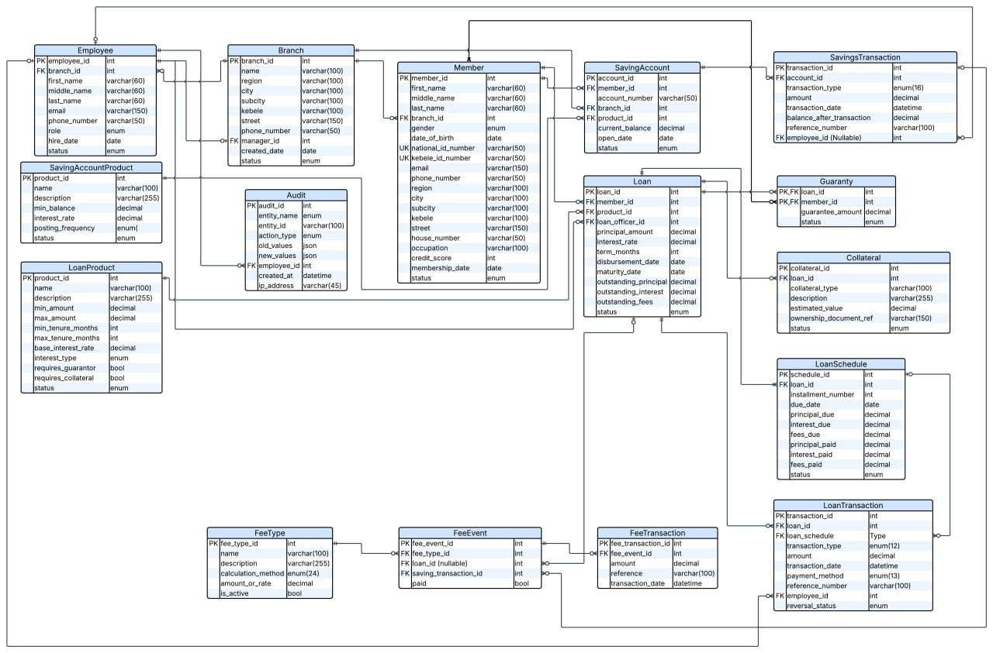
Relational ER diagram

Slide 10
YISAKAL SACCO DATABASE NORMALIZATION ANALYSIS
In this PPT, some table samples are inserted to illustrate how the
normalization process was performed from UNF up to BCNF.
The tables demonstrate the step-by-step decomposition of data to remove redundancy and improve database consistency.

Slide 11
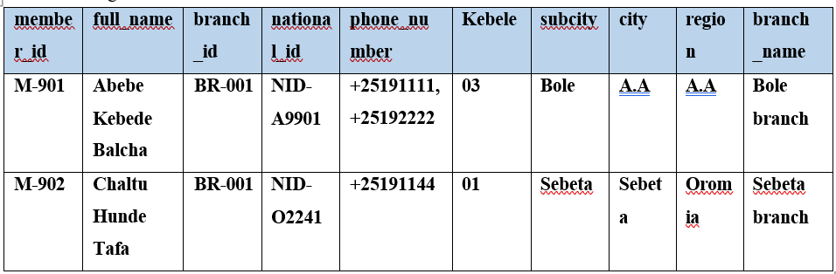
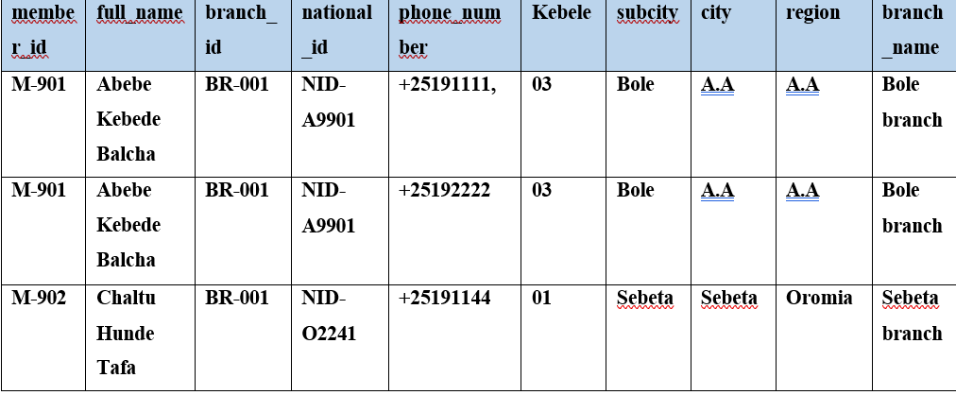
YISAKAL SACCO DATABASE NORMALIZATION ANALYSIS
In this PPT, some table samples are inserted to illustrate how the
normalization process was performed from UNF up to BCNF.
The tables demonstrate the step-by-step decomposition of data to remove redundancy and improve database consistency.
Administrative location,Branch and MemberSubsystem
Step 1: Create unnormalized data
Convert to 1NF:-

Slide 12
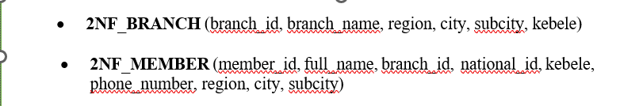
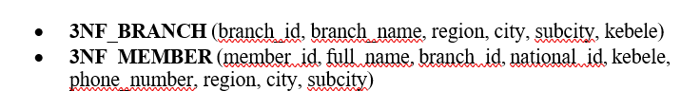
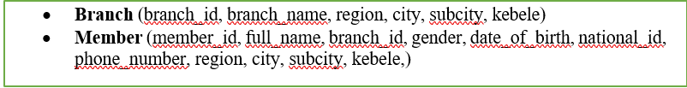
YISAKAL SACCO DATABASE NORMALIZATION ANALYSIS
Step 3:- Convert to 2NF
STEP 4 — Convert to 3NF
Step 5 — Convert to BCNF

Slide 13
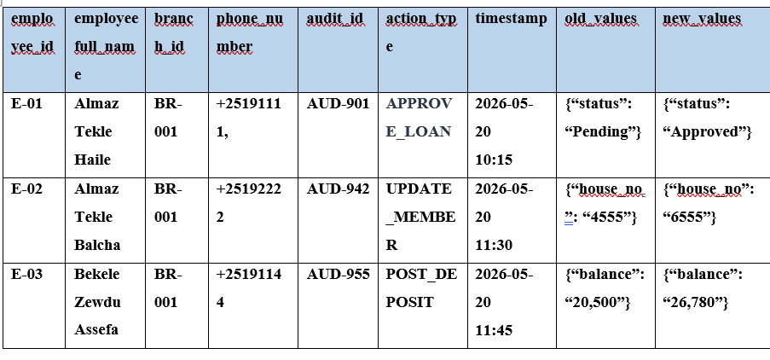
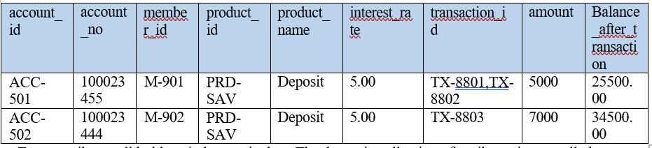

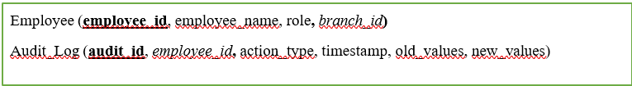
YISAKAL SACCO DATABASE NORMALIZATION ANALYSIS

Slide 14
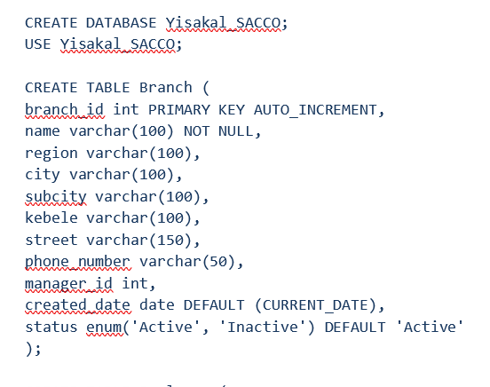
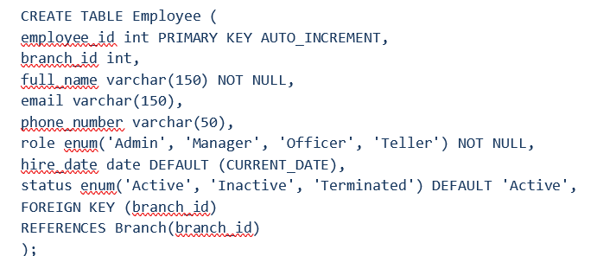
This section shows sample SQL queries for creating tables such as Branch and Employee. The same structure and approach were applied to all other tables in the database, ensuring consistency, proper relationships, and data integrity across the entire SACCO system.

Slide 15
The MySQL system was implemented using relational tables
for SACCO entities, with primary and foreign keys, constraints, and sample data inserted to simulate real SACCO
operations such as members, loans, savings, transactions, and auditing.
The system database was created in MySQL Workbench (Yisakal_SACCO).
Tables were designed for key entities such as Branch, Member, Employee, Loan, Savings, Transactions, Collateral, and Fees.
Primary keys and foreign keys were used to maintain relationships and data integrity.
Sample data was inserted to simulate real SACCO operations (loans, savings, payments, and fees).
The system was tested using SQL insert and query operations to verify functionality.
The following SQL examples demonstrate basic database
operations such as retrieving, updating, modifying, and deleting data within the SACCO system.
1. Retrieve all members
SELECT * FROM Member;
2. Get members from a specific branch
SELECT * FROM Member WHERE branch_id = 1;
3. Update member phone number
UPDATE Member
SET phone_number = '0912345678'
WHERE member_id = 201;
4. Update savings account balance
UPDATE SavingAccount
SET current_balance = 30000
WHERE account_id = 501;
5. Delete a member
DELETE FROM Member
WHERE member_id = 205;
Add a new column to Member table
ALTER TABLE Member
ADD marital_status VARCHAR(20);

Slide 16
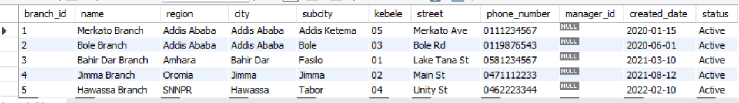
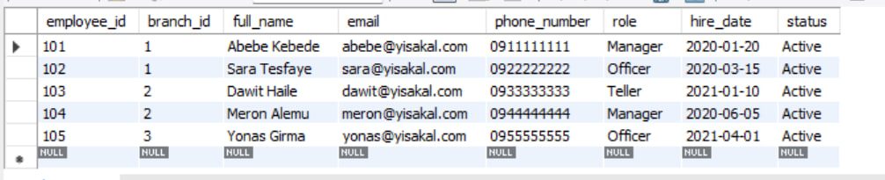
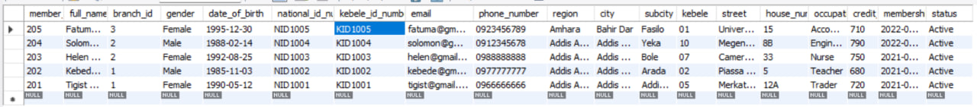
The following section presents the MySQL query tables created in MySQL Workbench, showing
the implemented database structure and relationships used in the SACCO system.
Branch table
employee table
member table
The following section presents the MySQL query tables created in MySQL Workbench, showing
the implemented database structure and relationships used in the SACCO system.

Slide 17
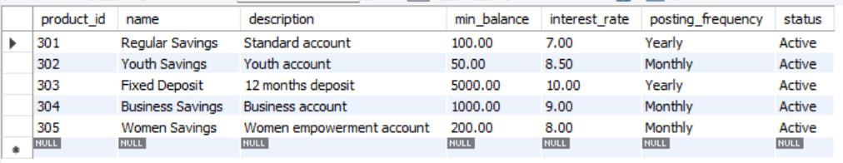
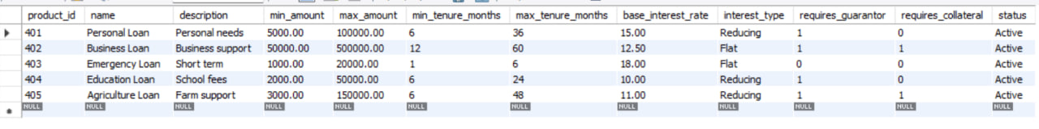
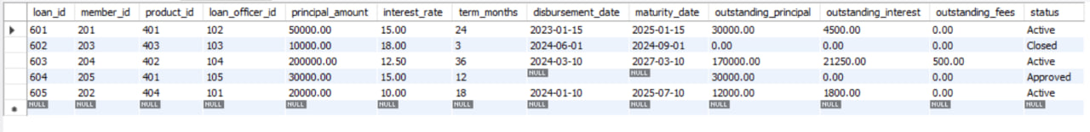
saving accounts table
Scope of the System
loan product table
loan

Slide 18
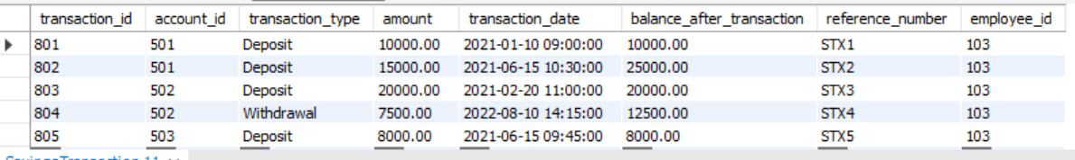
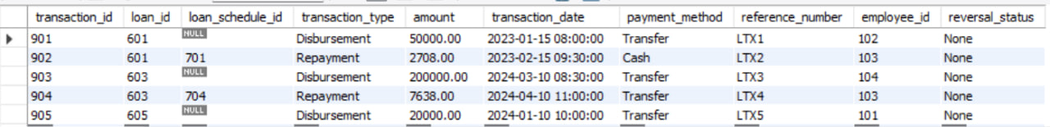
saving account product table
Scope of the System
saving transaction
loan transaction

Slide 19
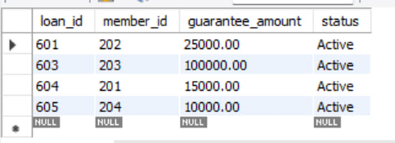
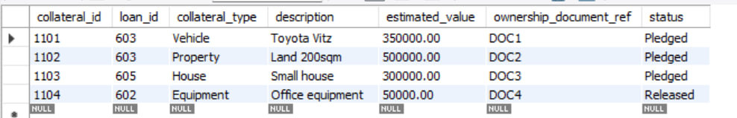
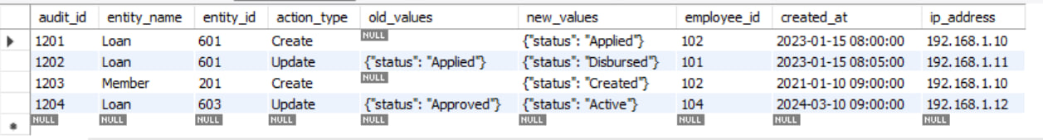
Guaranty table
Collaterial table
Audit table

Slide 20
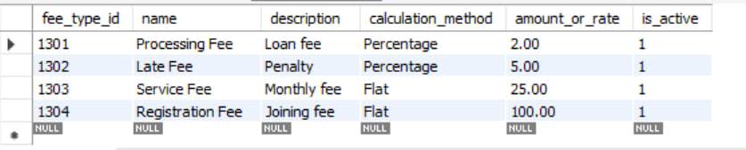
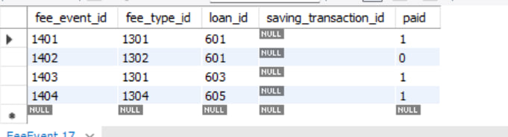
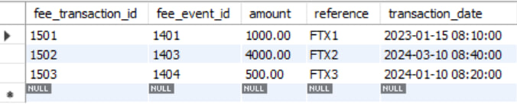
feetype table
fee event table
fee transaction table

Slide 21
MongoDB Implementation for Yisakal SACCO
MongoDB is used to store SACCO data in a flexible, document-based structure that allows easy handling of complex and evolving financial data.
Collections are used instead of tables to represent real-world SACCO entities such as members, loans, accounts, and transactions.
Embedded documents are used to group related data (e.g., address, identity, and balance) within a single record to improve readability and reduce joins.
References (using IDs) are used to connect related collections such as Member–Loan and Loan–Transaction relationships.
Schema validation is applied to ensure data integrity by enforcing rules on the structure and type of stored data.
Indexing is used to improve query performance and make data retrieval faster, especially for large datasets.
Sample data (seed data) is inserted to simulate real SACCO operations like deposits, loans, repayments, and fee processing.

Slide 22
These examples show how MongoDB queries are used to retrieve, filter, and analyze SACCO data for operational and reporting purposes.
Retrieve all active members
db.Member.find({ status: "Active" })
Find loans for a specific member
db.Loan.find({ member_id: "Member-201" })
Get saving account balance
db.SavingAccount.find(
{ account_number: "SAV-2021-0001" },
{ current_balance: 1, _id: 0 }
)
Check overdue loan schedules
db.LoanSchedule.find({ status: "Overdue" })
Calculate total deposits per account
db.SavingsTransaction.aggregate([
{ $match: { transaction_type: "Deposit" } },
{
$group: {
_id: "$account_id",
total_deposits: { $sum: "$amount" }
}
}
])

Slide 23
In conclusion, the Yisakal SACCO system was successfully designed and implemented using both MySQL and MongoDB. The system effectively manages key SACCO operations such as member registration, savings, loans, transactions, fees, and reporting. MySQL ensures structured data with strong relationships and integrity, while MongoDB provides flexibility for handling complex and dynamic data. Overall, the project delivers an efficient, reliable, and practical database solution for SACCO management.

Slide 24
5.REFERENCES
[1] MySQL Workbench, Oracle Corporation, Austin, TX, USA, 2026.
[2] MongoDB Compass, MongoDB, Inc., New York, NY, USA, 2026.
[3] Lucidchart, Lucid Software Inc., South Jordan, UT, USA, 2026.
[4] draw.io, JGraph Ltd., Northampton, UK, 2026.
[5] A. Silberschatz, H. F. Korth, and S. Sudarshan, Database System Concepts, 7th ed. New York, NY, USA: McGrawHill, 2019.
[6] R. Elmasri and S. B. Navathe, Fundamentals of Database Systems, 7th ed. Boston, MA, USA: Pearson, 2016.

Slide 25
Thank You!

