Slide 1
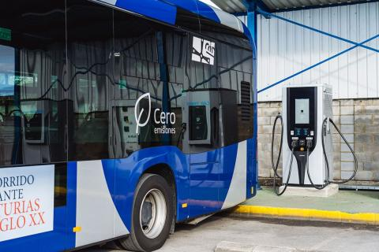


Datathon solution
Daniel Castaño Rodriguez

Slide 2
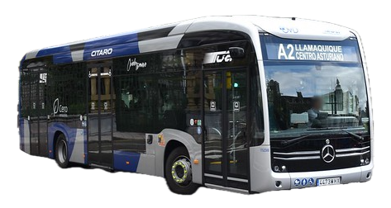
A datathon without data?
Configuration:
Charging point
Battery capacity
Min battery charge
Max battery charge
Simulator

Slide 3
A datathon without data?
Configuration:
Charging point
Battery capacity
Min battery charge
Max battery charge
Simulator

Slide 4
A datathon without data?
Results:
Bus cost
Consumption cost
Battery degradation
Emissions
Number of buses
…
Simulator

Slide 5
Multiobjective optimization
Results:
Bus cost
Consumption cost
Battery degradation
Emissions
Number of buses
…
Simulator
Optimize

Slide 6
Genetic Algorithm
Evaluation

Slide 7
Genetic Algorithm
Evaluation
Selection

Slide 8
Genetic Algorithm
Evaluation
Selection
Mutation
Crossover

Slide 9
Trade-Off
Economic cost VS Battery degradation
Bus cost + Consumption cost

Slide 10
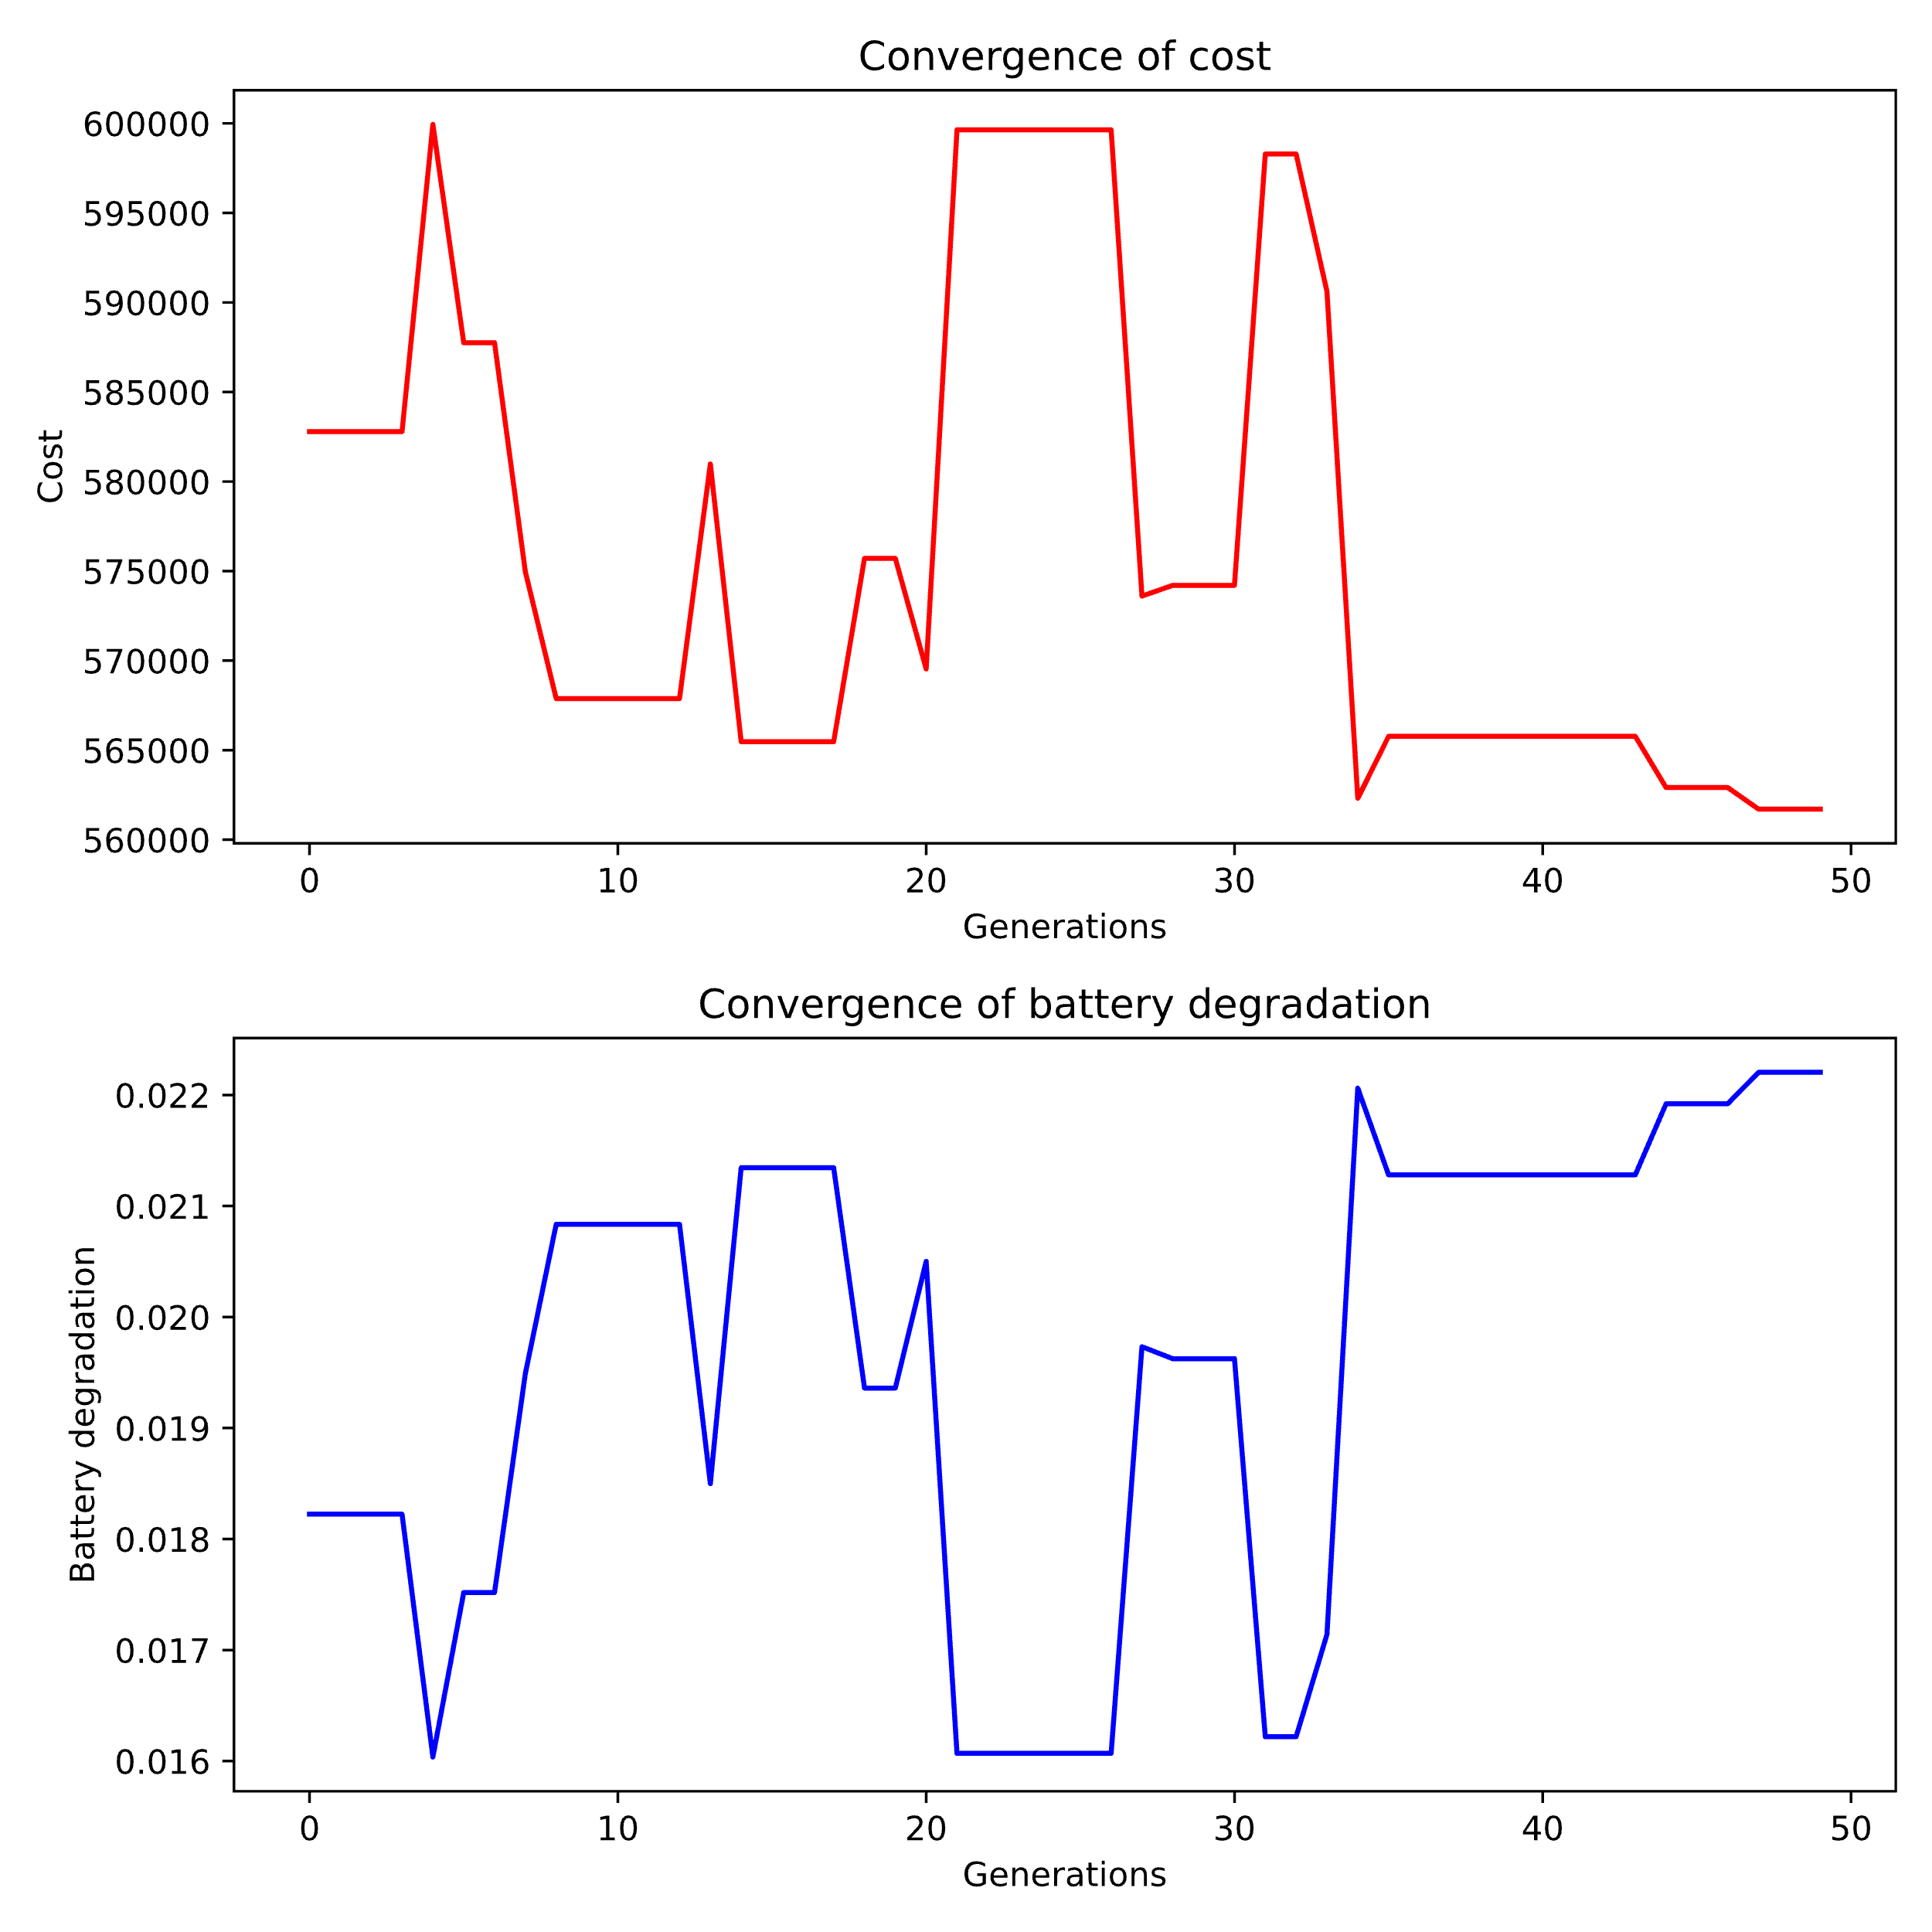
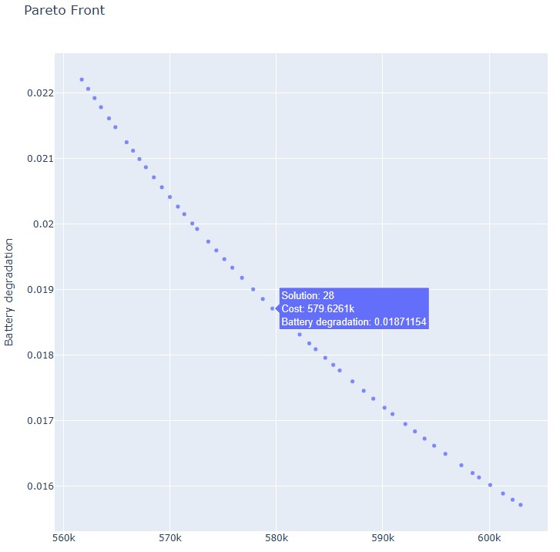
Solution

Slide 11
Charging point: 3
Battery capacity: 645
Battery range: 10-69%

Slide 12
Results
Lower consumption
Lower battery degradation
Only one bus needed
Battery is always higher than the minimum
Higher bus cost

Slide 13
Comparison
Vehicle | NOx (g) | CO (g) | HC (g) | PM (g) | CO₂(g)
Combustion | 129.74 | 486.51 | 42.16 | 3.24 | 86103.84
Electric | 131.09 | 26.22 | 13.11 | 5.24 | 65543.55

