Slide 1
2Body

Slide 2
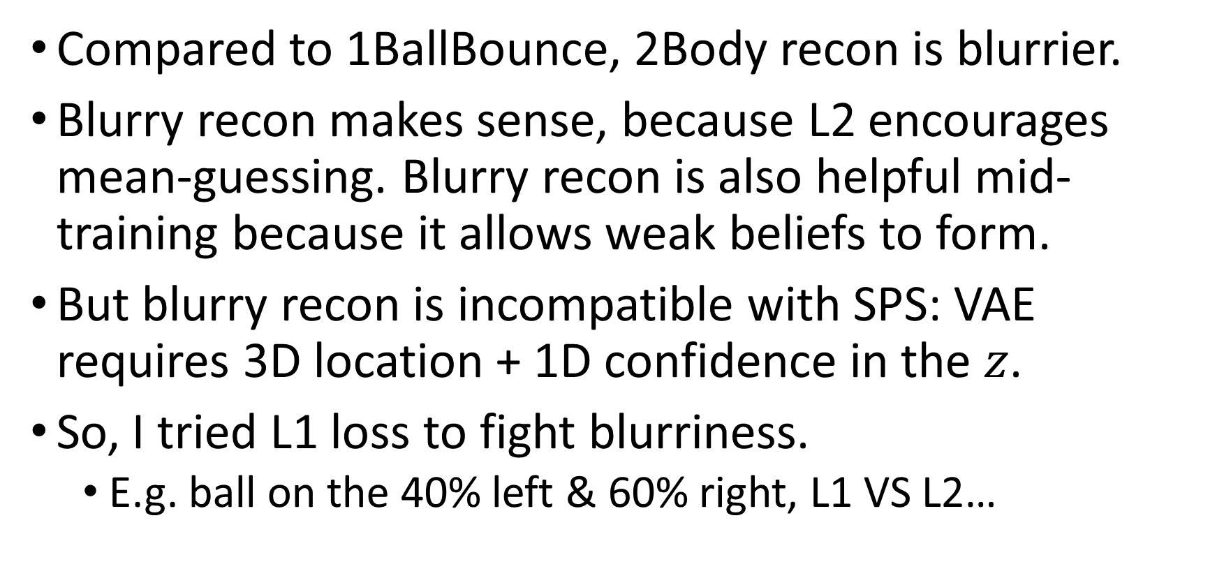
2Body L1 loss
Compared to 1BallBounce, 2Body recon is blurrier.
Blurry recon makes sense, because L2 encourages mean-guessing. Blurry recon is also helpful mid-training because it allows weak beliefs to form.
But blurry recon is incompatible with SPS: VAE requires 3D location + 1D confidence in the $z$.
So, I tried L1 loss to fight blurriness.
E.g. ball on the 40% left & 60% right, L1 VS L2…

Slide 3
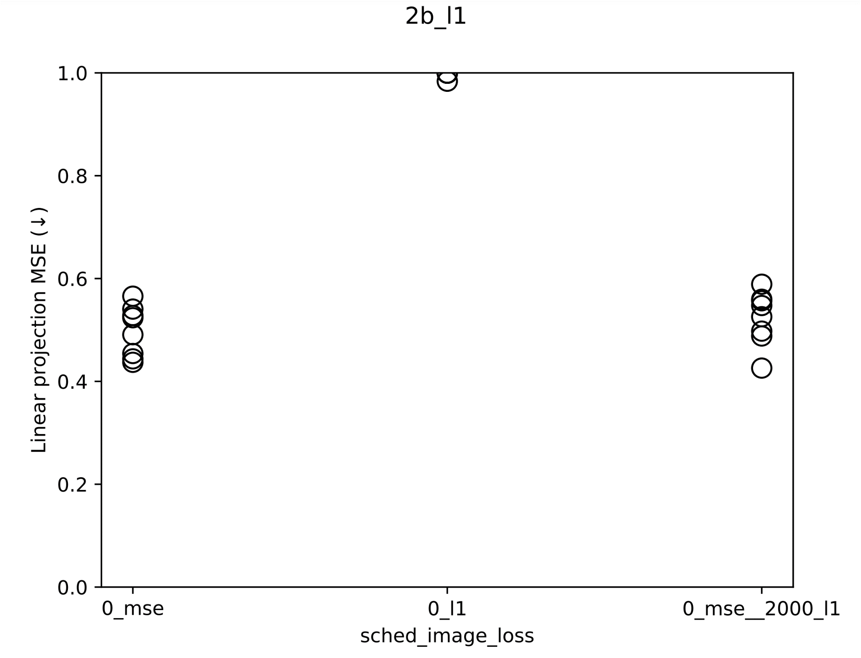

Slide 4
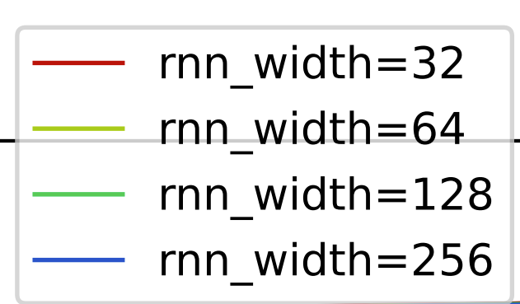
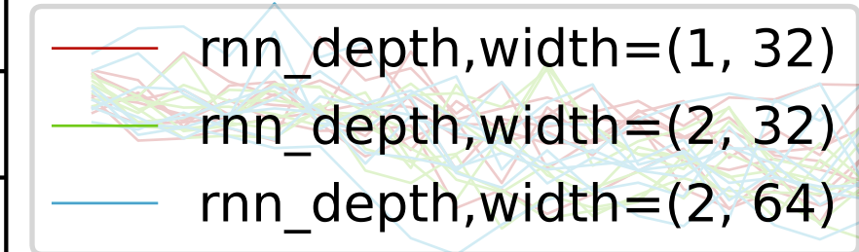
2Body: prediction is hard
2023_m01_d20@06_35_01_2b_rnn_width\rnn_width=128_rand_0\visualize_train_epoch_1000.mp4
And this is on the train set!
We tried but nothing helped. Image prediction loss is always high.

Slide 5
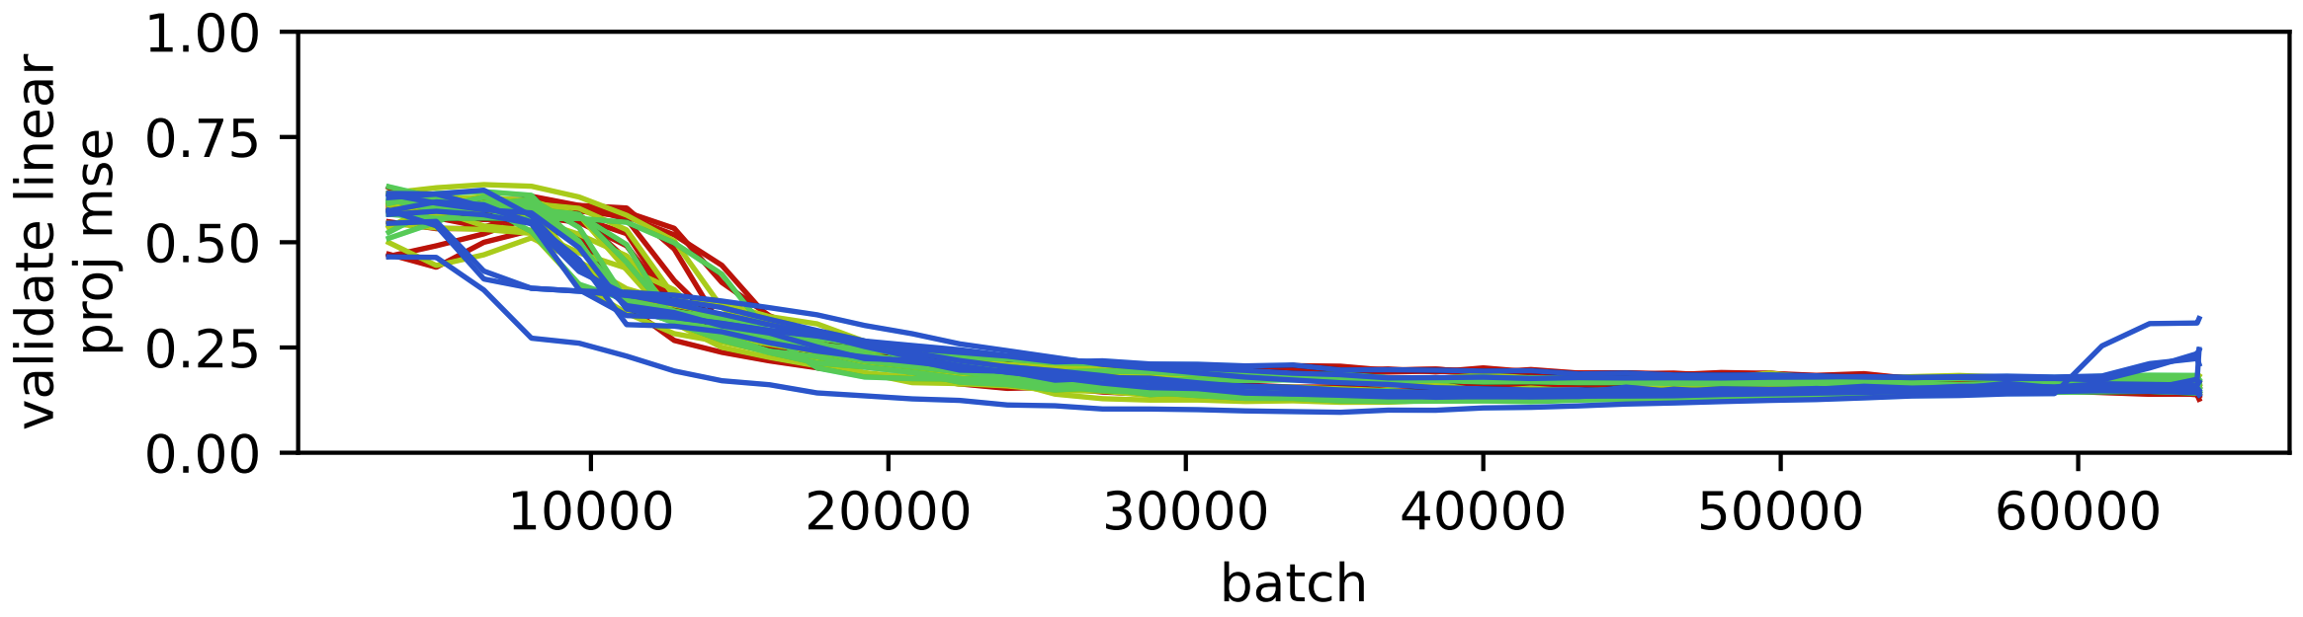
The linear proj. MSE went up after epoch 35K.
My theory:
When teacher forcing is high, clear images can be predicted.
When teacher forcing is low, a blurry image minimizes MSE, so VAE is forced to encode confidence into the 3D z, hurting interpretability.

Slide 6
Is the task too hard?
[take notes here]
Xuanjie recommended: try GRU.

Slide 7
有没有可能…
Judging form the video eval, I say the RNN 已经学会了规律，只是长程预测不准。
Its predictions look physically realistic to the eyes.
不如我们显式地建模 confidence, 把它从 z 里拿出来？

Slide 8
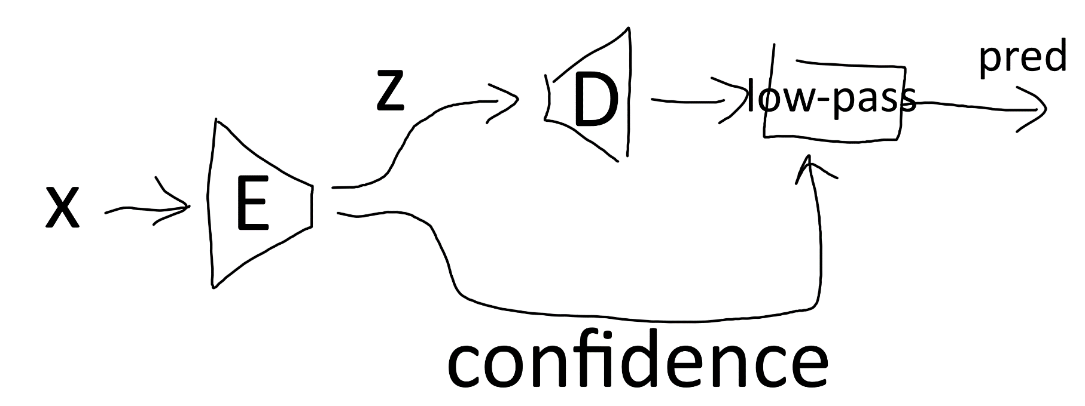
有没有可能…
Judging form the video eval, I say the RNN 已经学会了规律，只是长程预测不准。
Its predictions look physically realistic to the eyes.
不如我们显式地建模 confidence, 把它从 z 里拿出来？

Slide 9
New eval method: supervised calibration
SPICE and Junyan’s metrical structure extractor both use 1 or 2 labeled samples to calibrate their unsupervised result.
Here we use 4 labeled trajectories to calibrate.
Demos:
2023_m01_d04@01_22_50_sps
return groups[-2:]
2023_m01_d24@08_38_49_2b_sps
4-shot calibration is enough. 64-shot is better at reducing confounding / surface feature in 2Body.

Slide 10
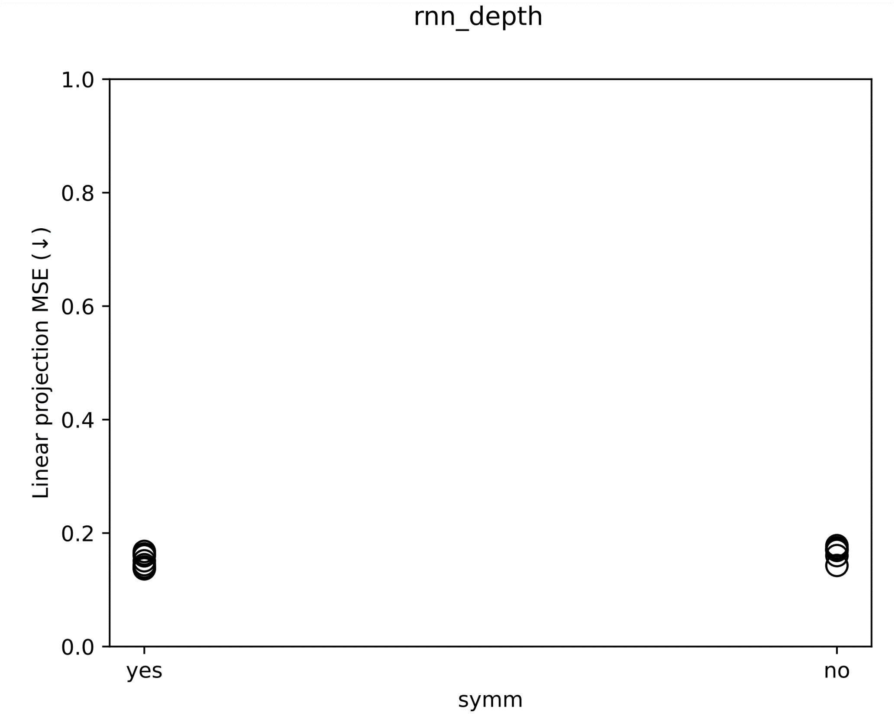

Slide 11
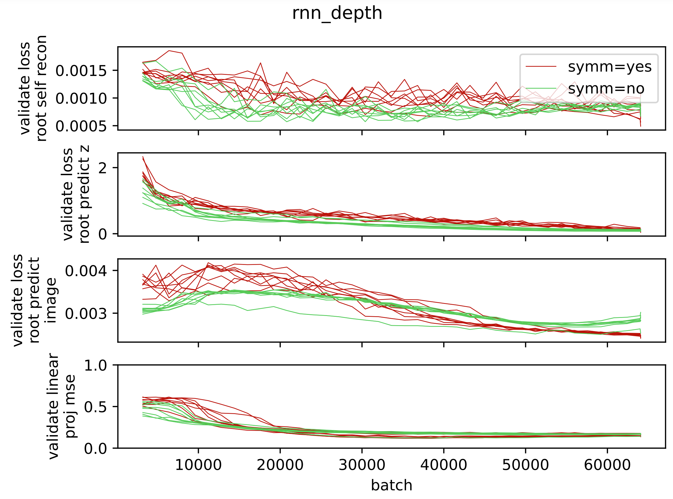
SPS 倒是显著降低了 validate image pred loss...

