Slide 1
next

Slide 2
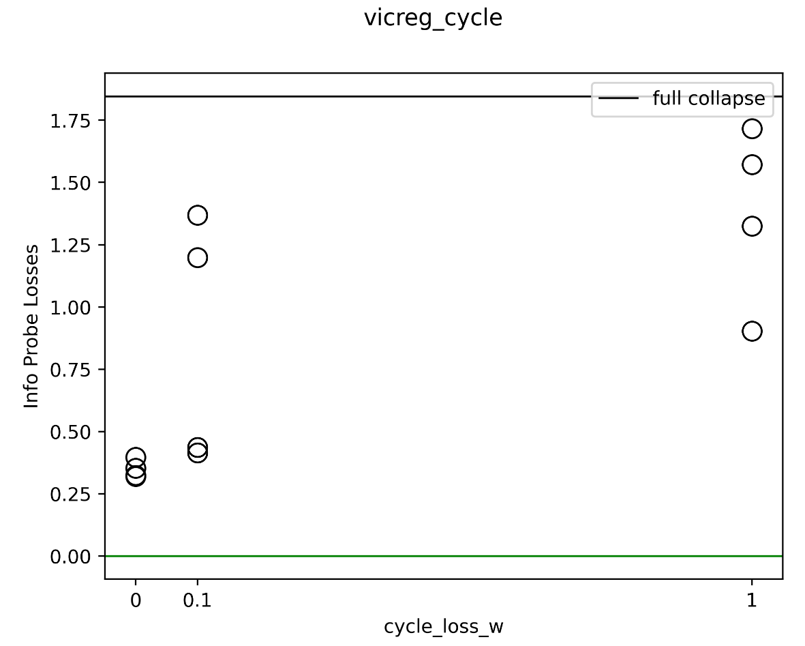
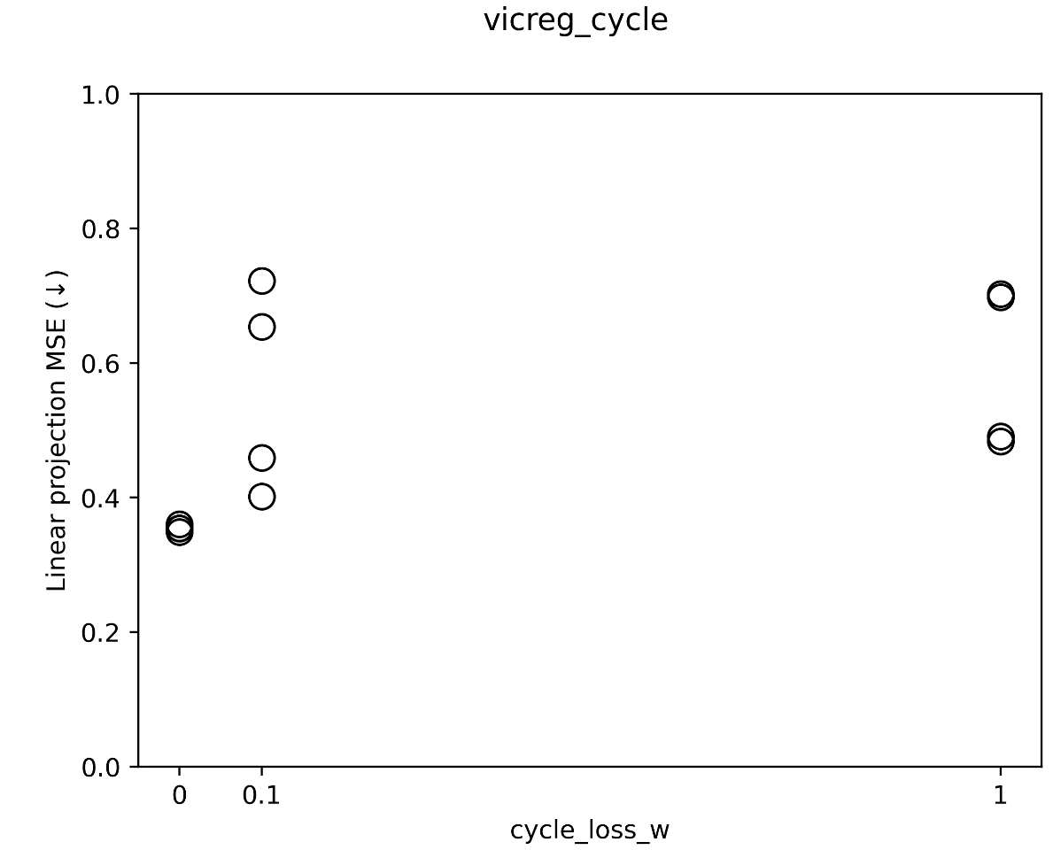
VICReg + cycle consistency (②)
2023_m01_d25@06_07_15_vicreg_cycle
Check evalDecoder: 隐写些啥

Slide 3
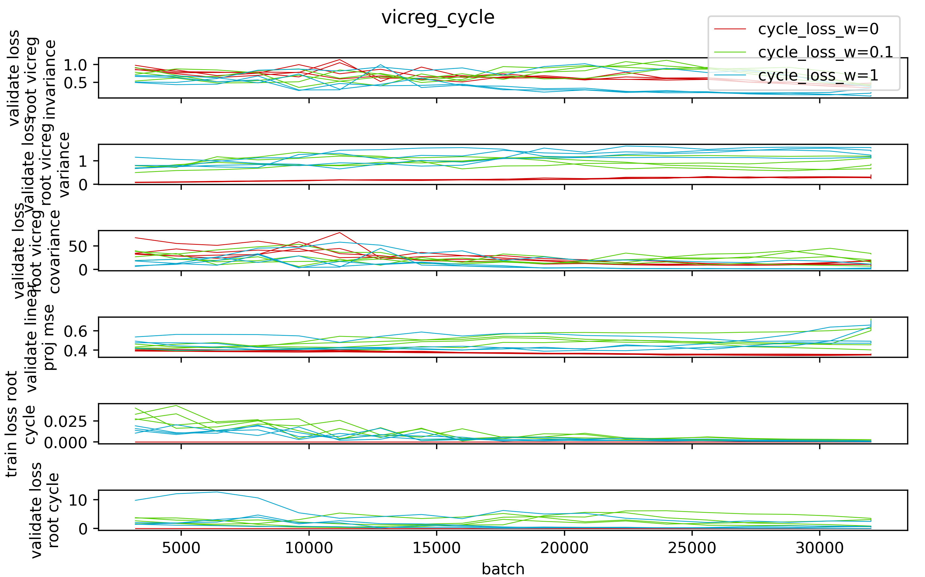

Slide 4
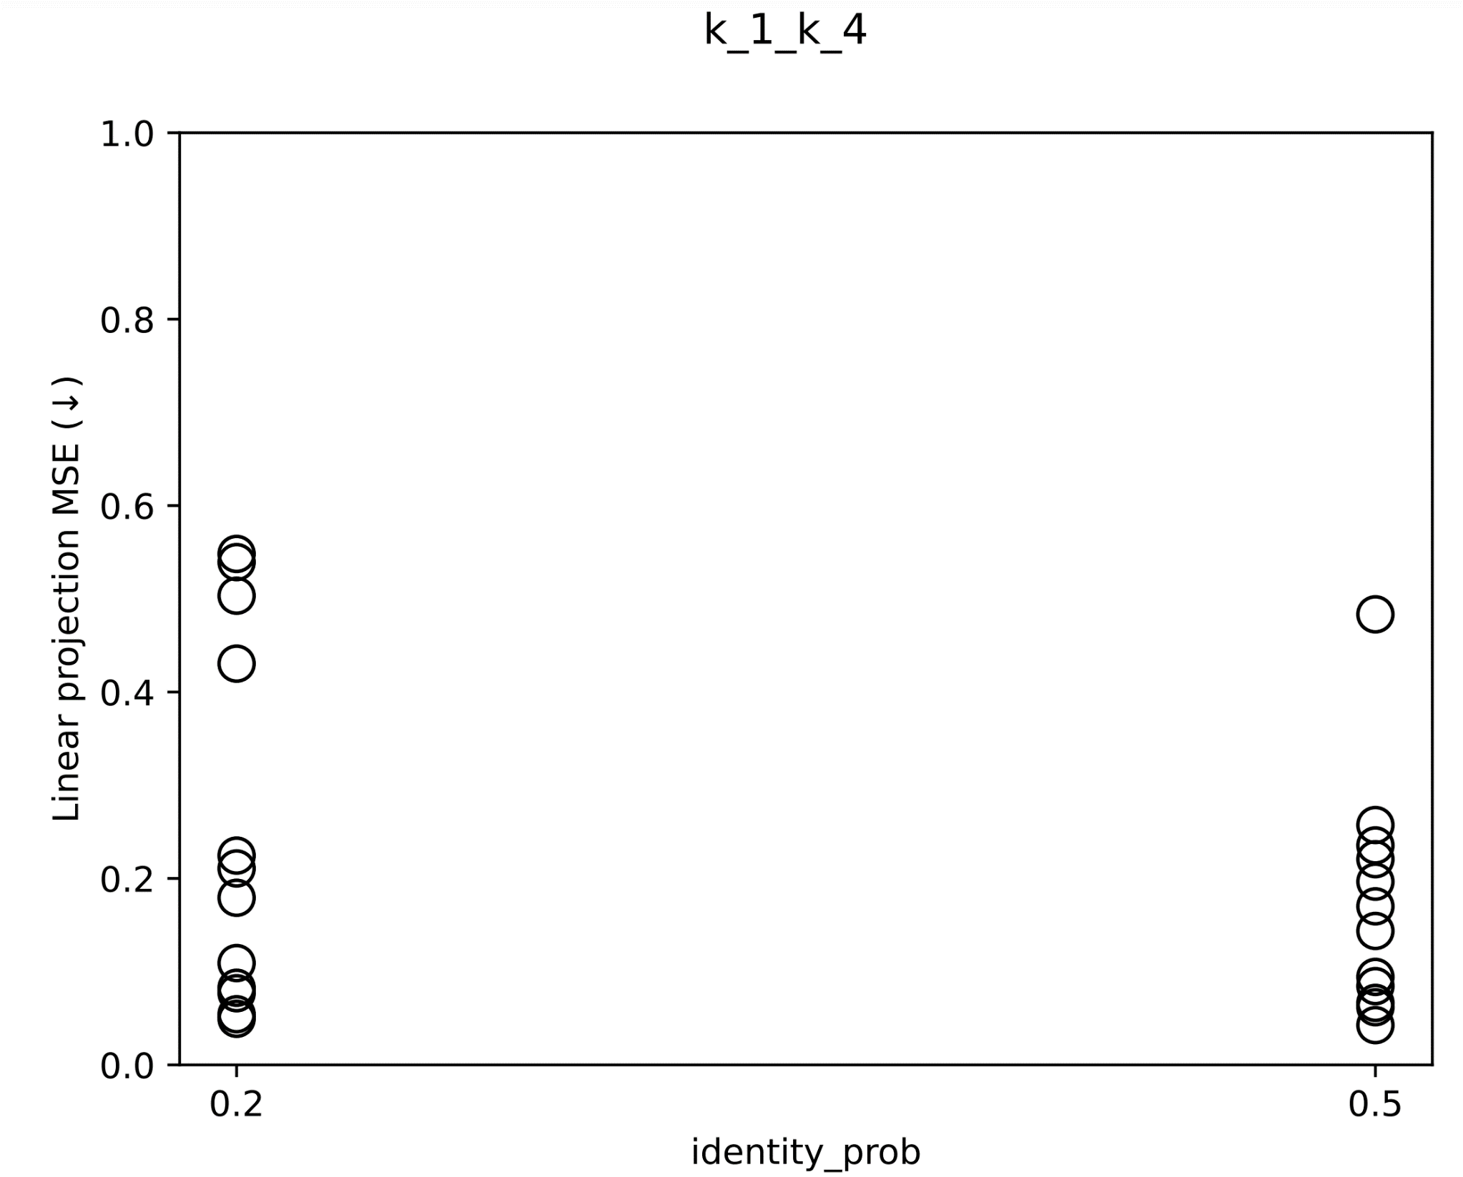
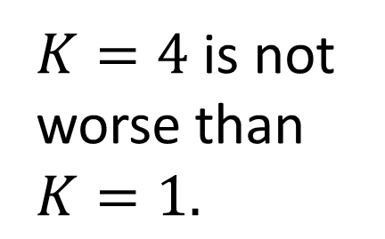
$K=4$ is not worse than $K=1.$

Slide 5
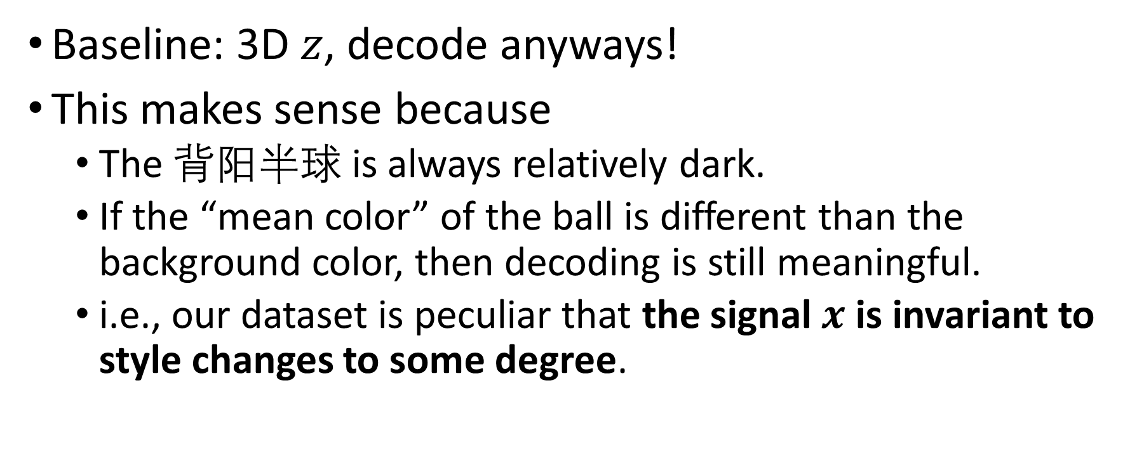
Bouncing ball with flashing colors
Baseline: 3D $z$, decode anyways!
This makes sense because
The 背阳半球 is always relatively dark.
If the “mean color” of the ball is different than the background color, then decoding is still meaningful.
i.e., our dataset is peculiar that the signal $x$ is invariant to style changes to some degree.

Slide 6
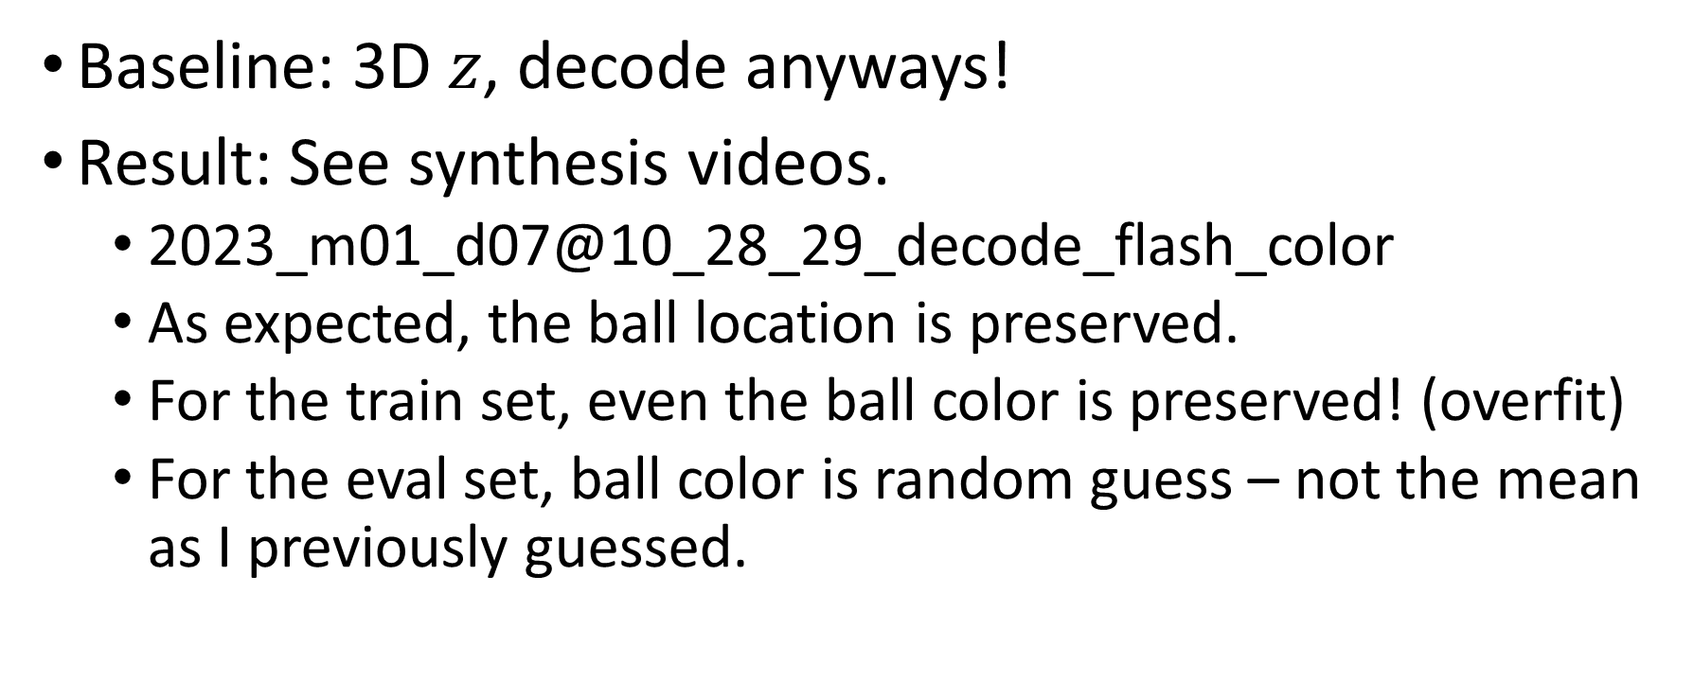
Bouncing ball with flashing colors
Baseline: 3D $z$, decode anyways!
Result: See synthesis videos.
2023_m01_d07@10_28_29_decode_flash_color
As expected, the ball location is preserved.
For the train set, even the ball color is preserved! (overfit)
For the eval set, ball color is random guess – not the mean as I previously guessed.

Slide 7
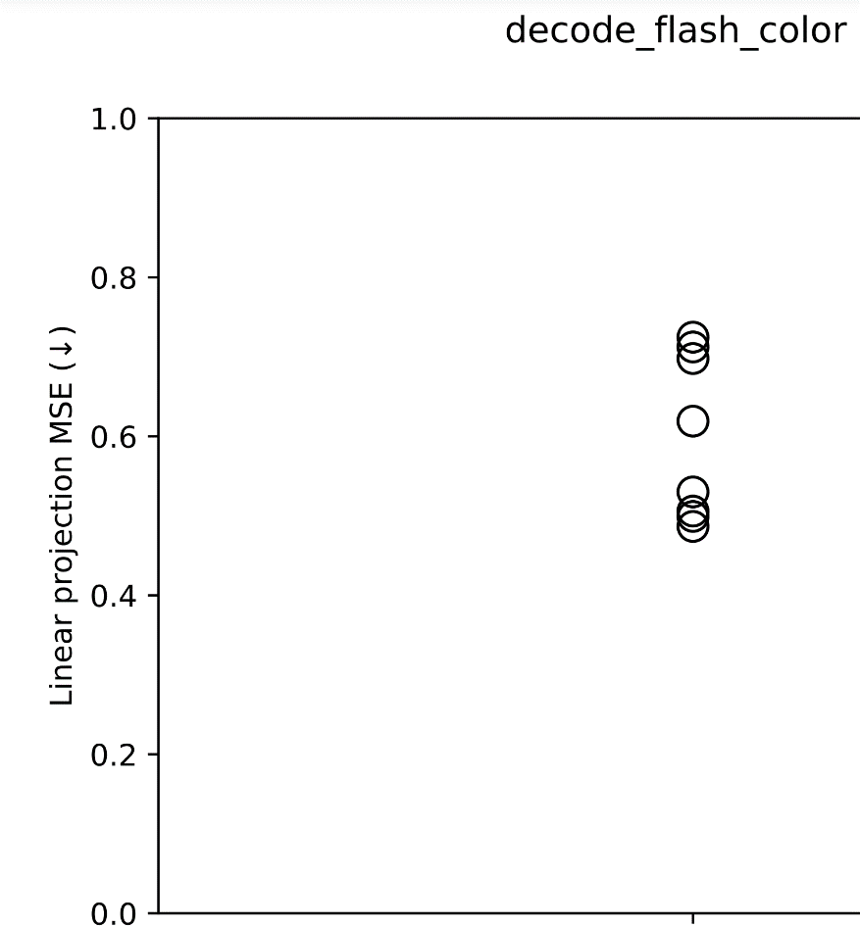
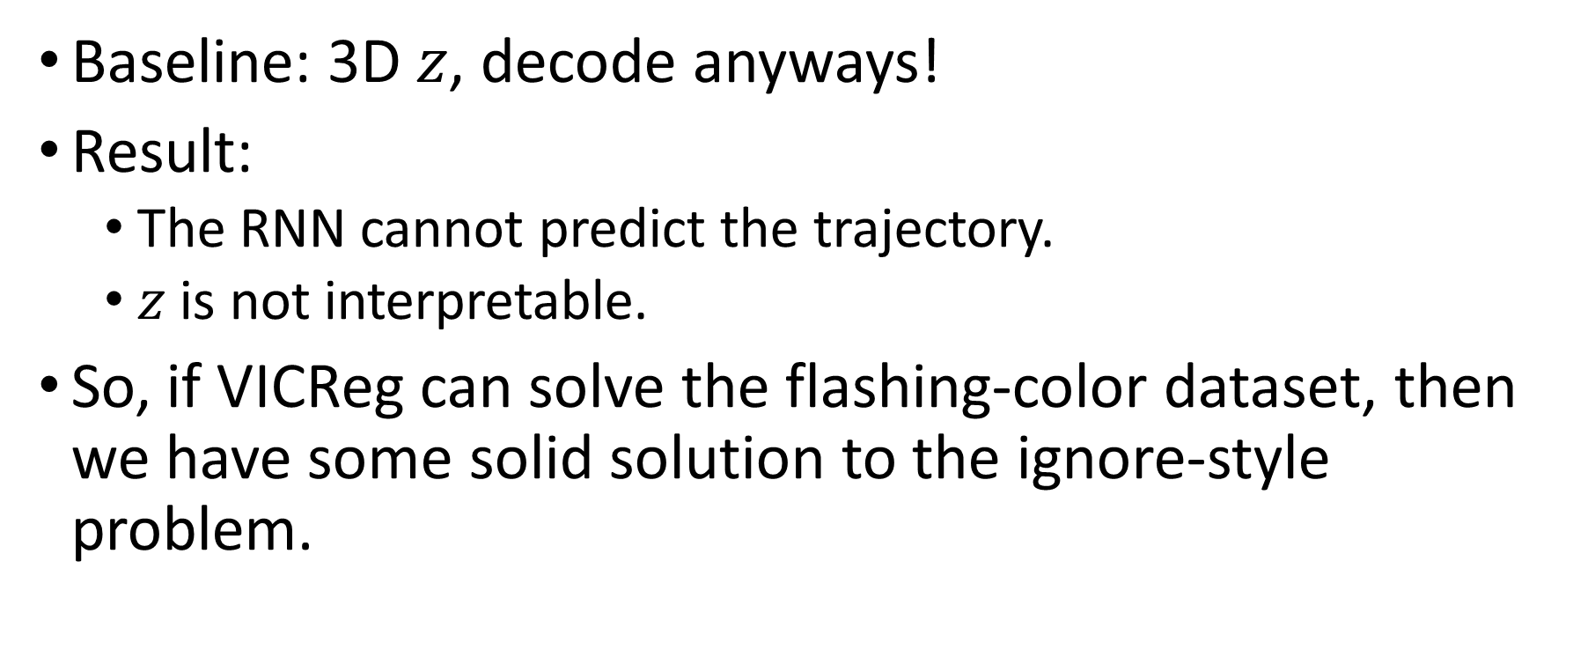
Bouncing ball with flashing colors
Baseline: 3D $z$, decode anyways!
Result:
The RNN cannot predict the trajectory.
$z$ is not interpretable.
So, if VICReg can solve the flashing-color dataset, then we have some solid solution to the ignore-style problem.

Slide 8
SPS effectiveness on bouncing ball

Slide 9
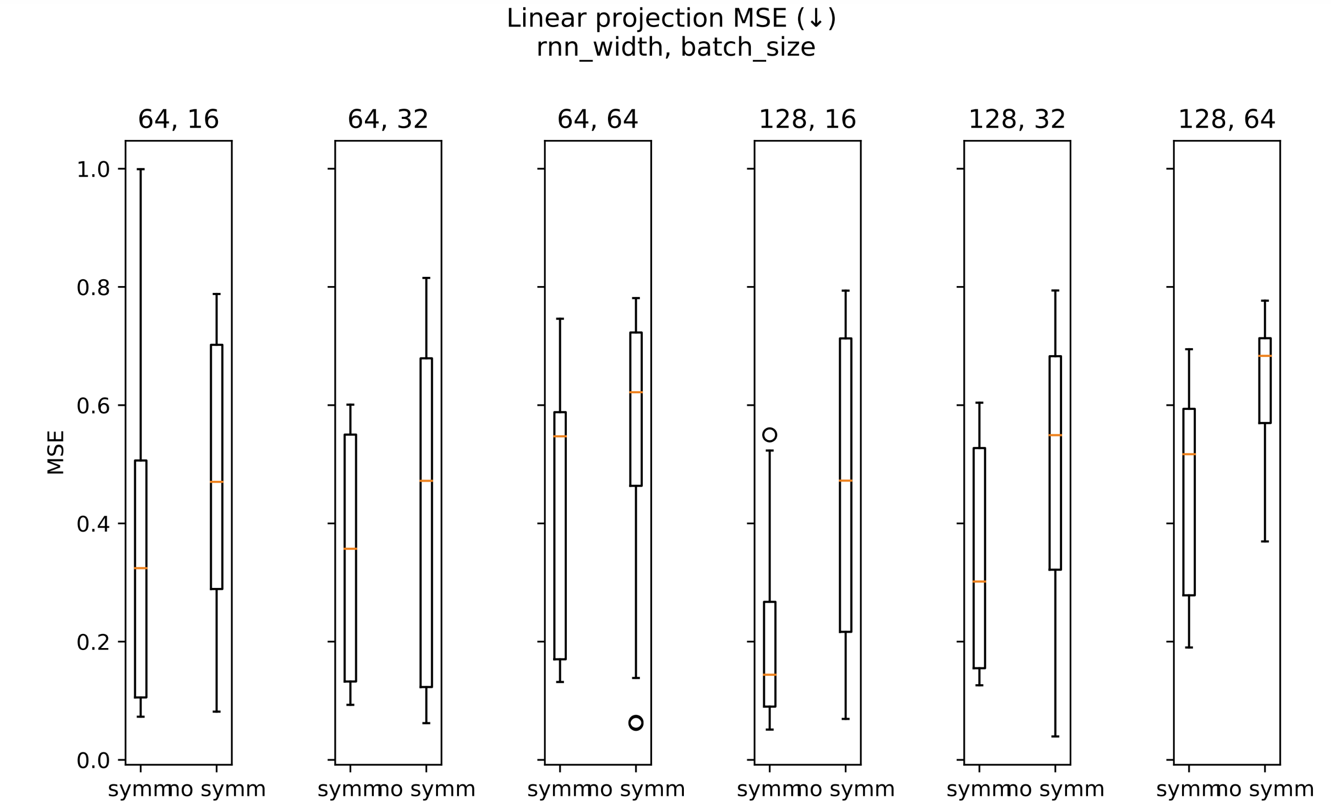
Notes:
2023_m01_d04@01_22_50_sps

Slide 10
SPS effectiveness on bouncing ball
Is SPS effective?
yes.
Is the baseline strong enough?
no.
SPS's effect is more pronounced as RNN size increases.
Note: even when comparing RNN(64) VS RNN(128)+symm, symm still wins.
SPS allows you to over-parametrize by at least 4x # of parameters.

Slide 11
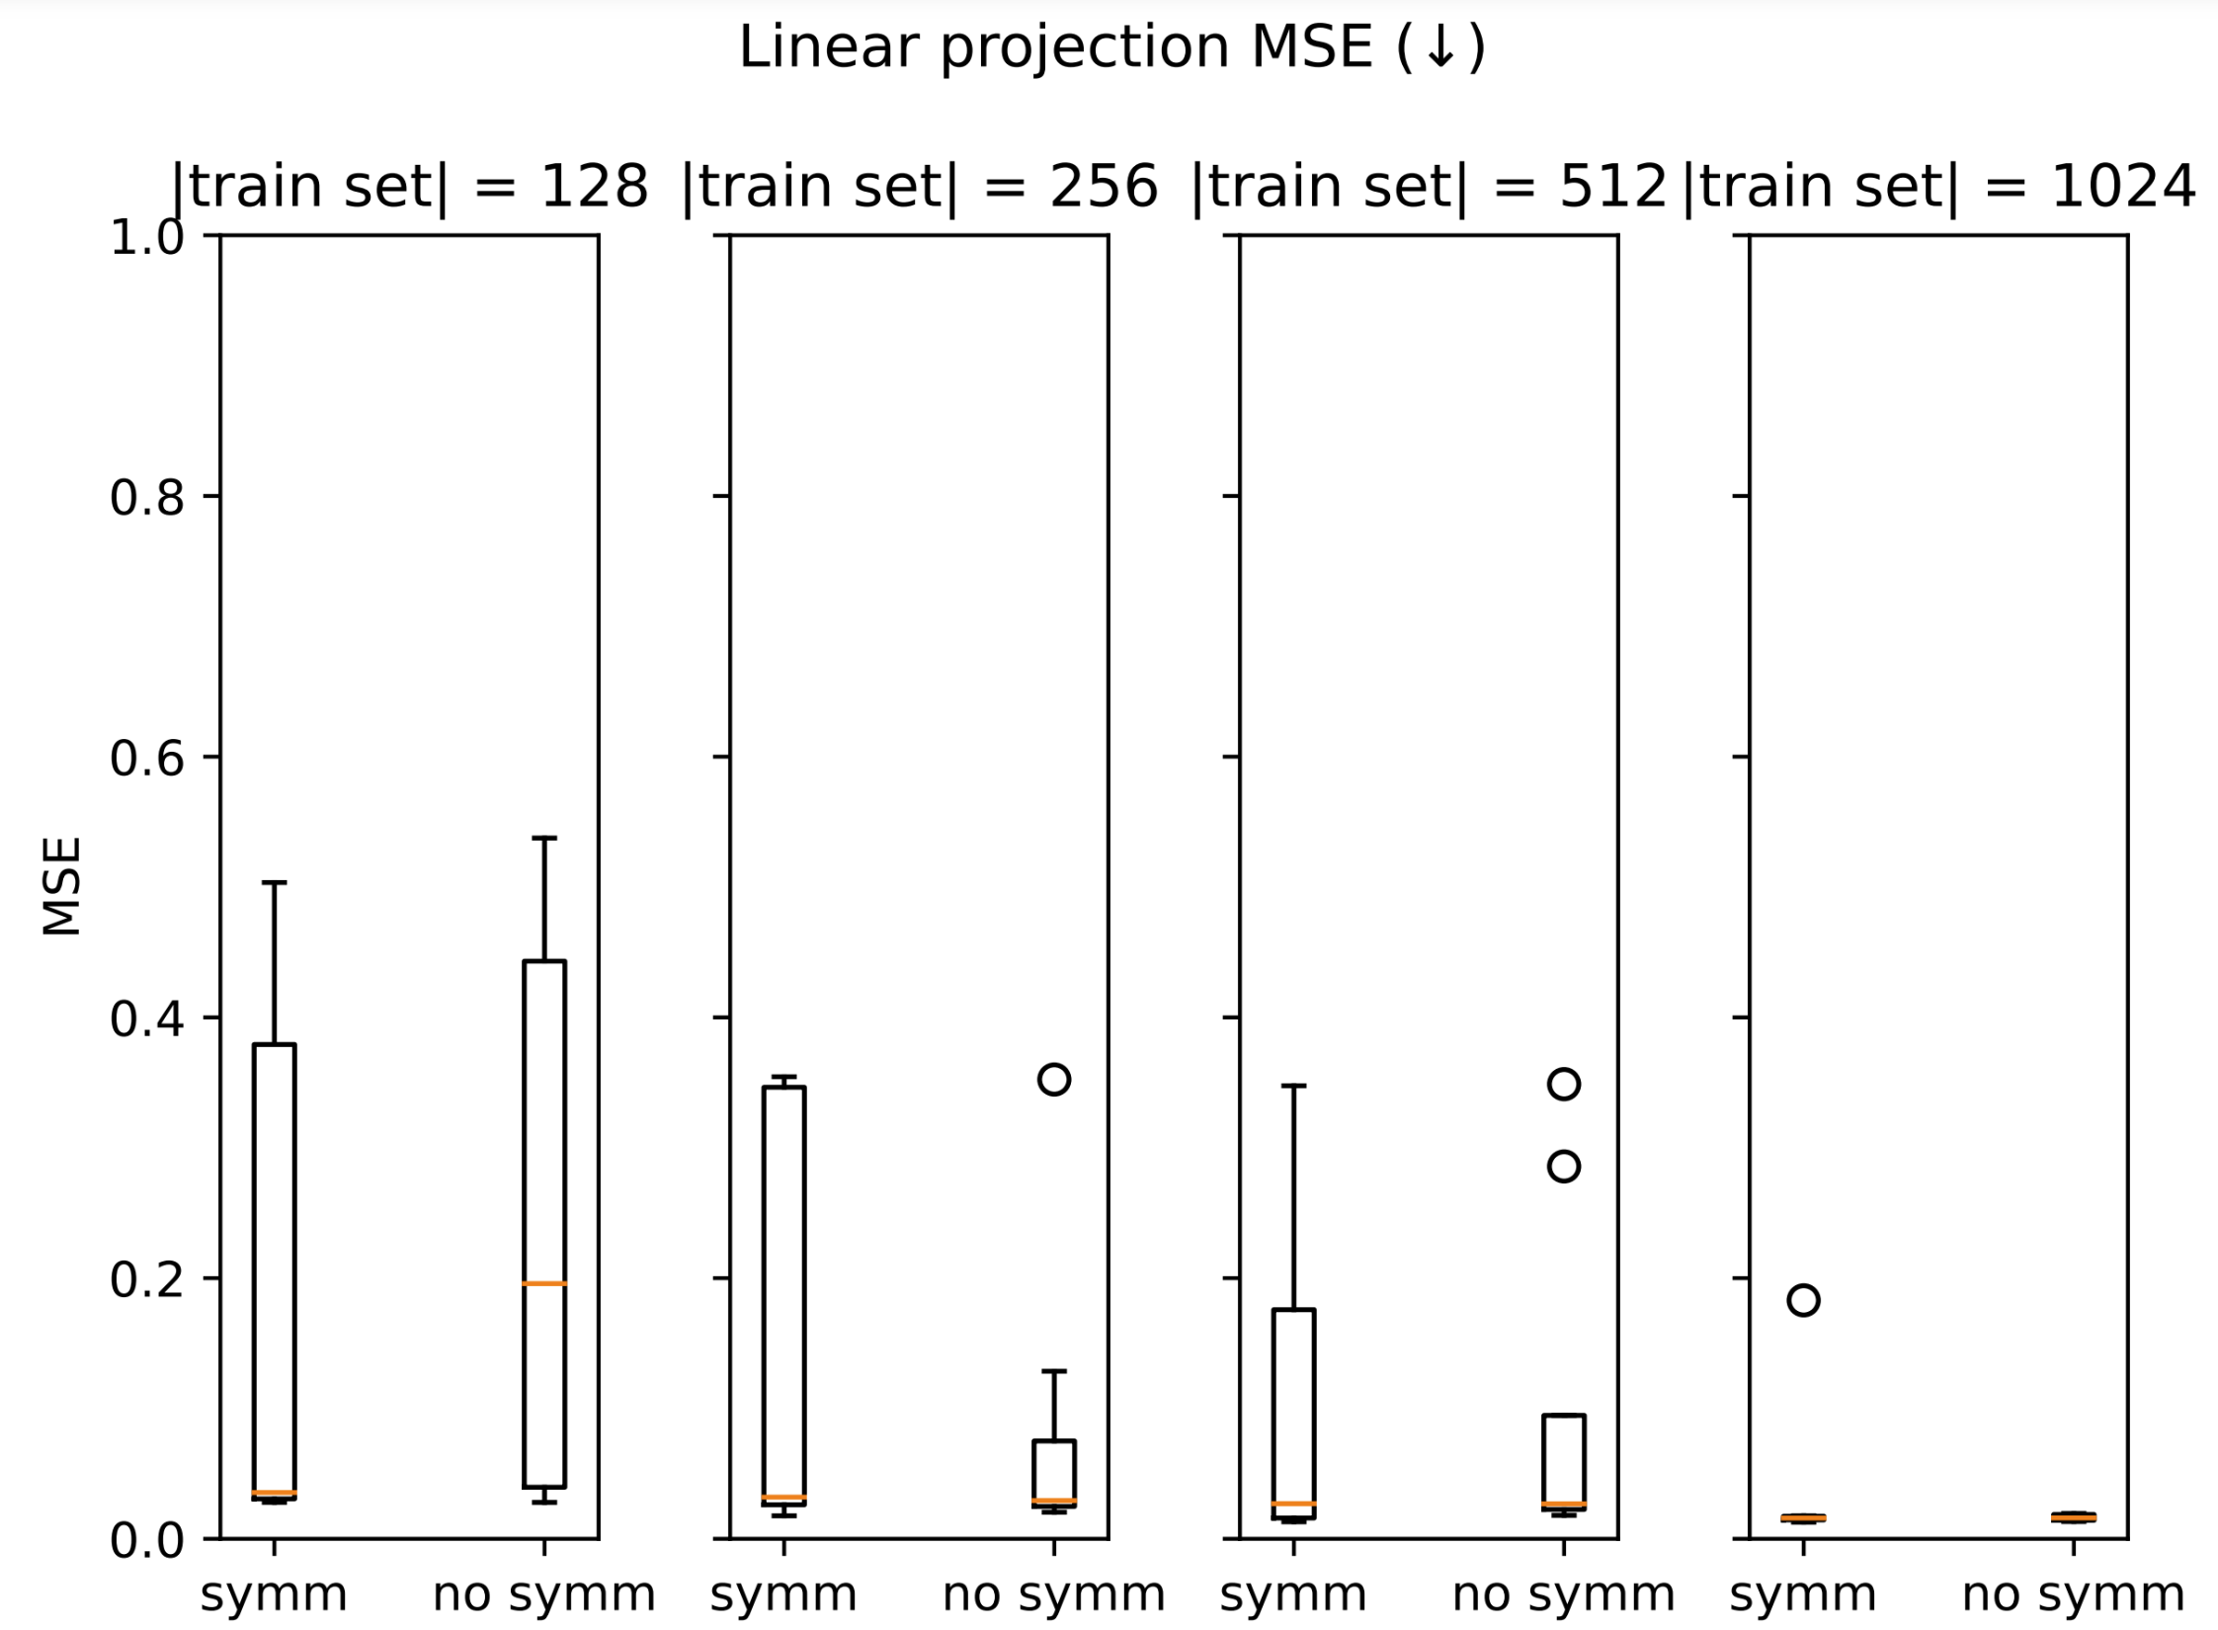
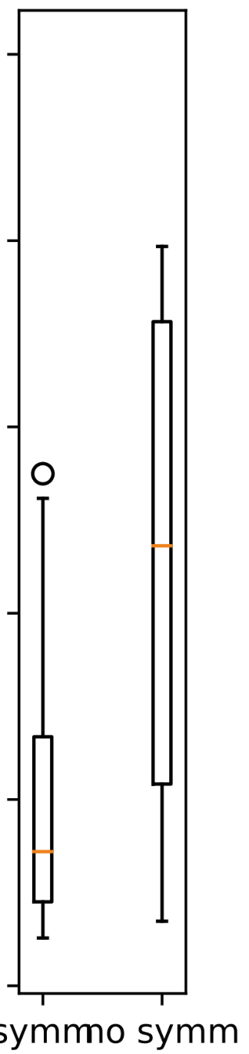
=64

