Slide 1
Notes_1_27_2023

Slide 2
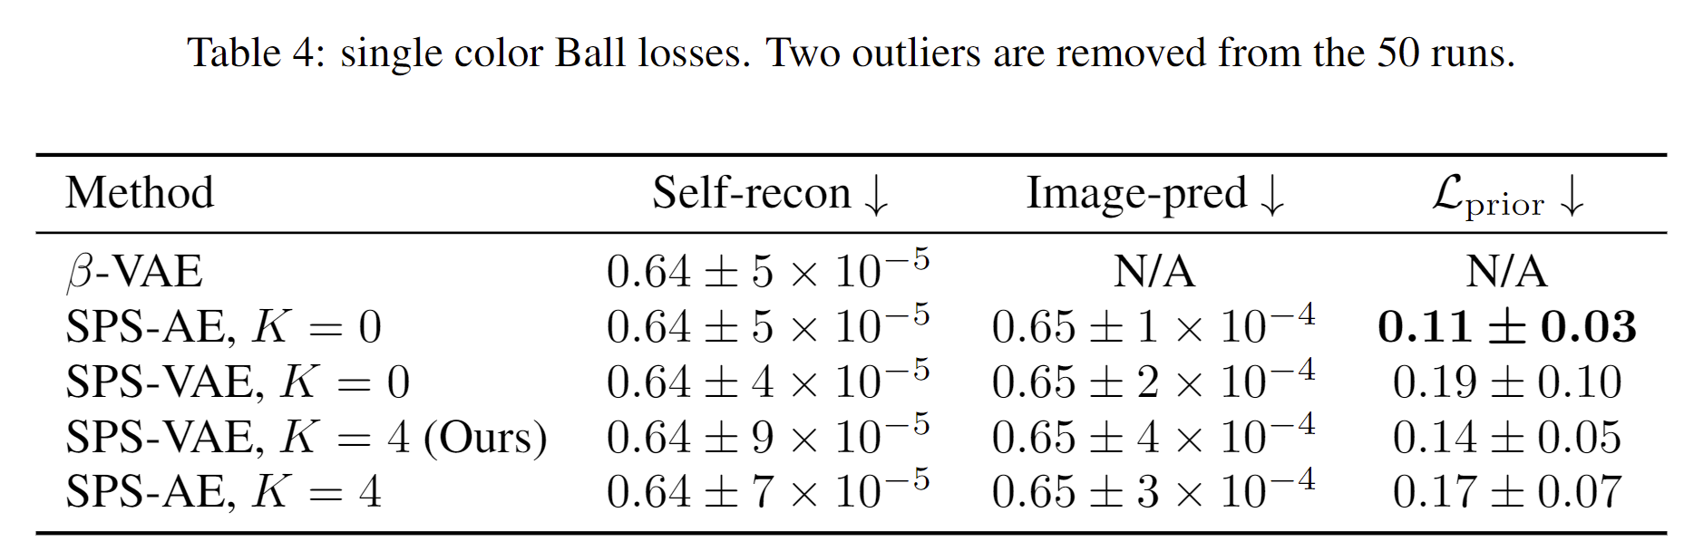
SPS hurts losses (unlike in music)

Slide 3
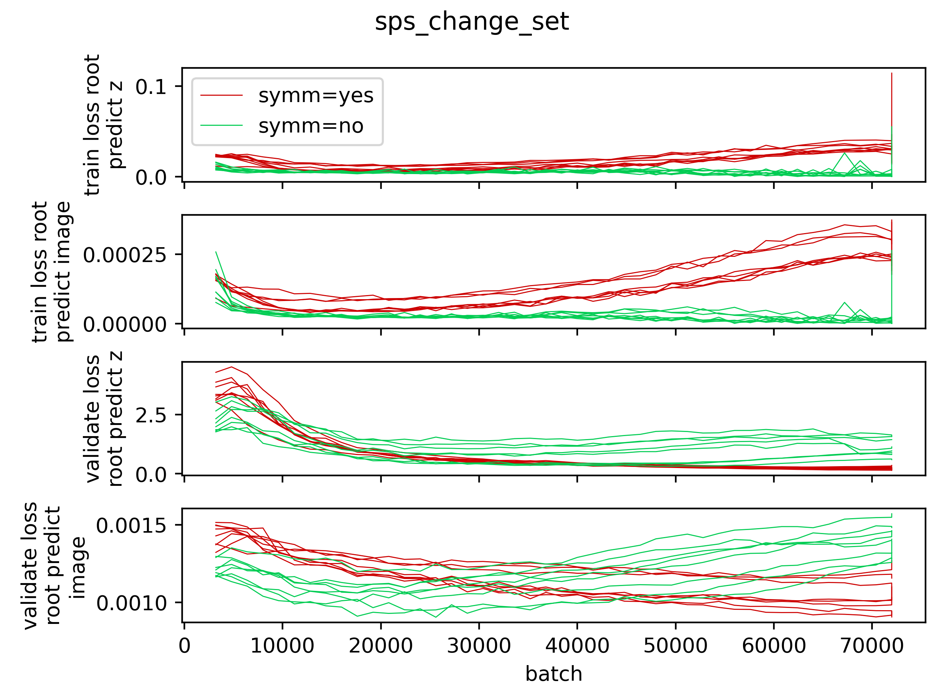
In my repo, SPS fights overfitting.
z
Train
image
z
Validate
image

Slide 4
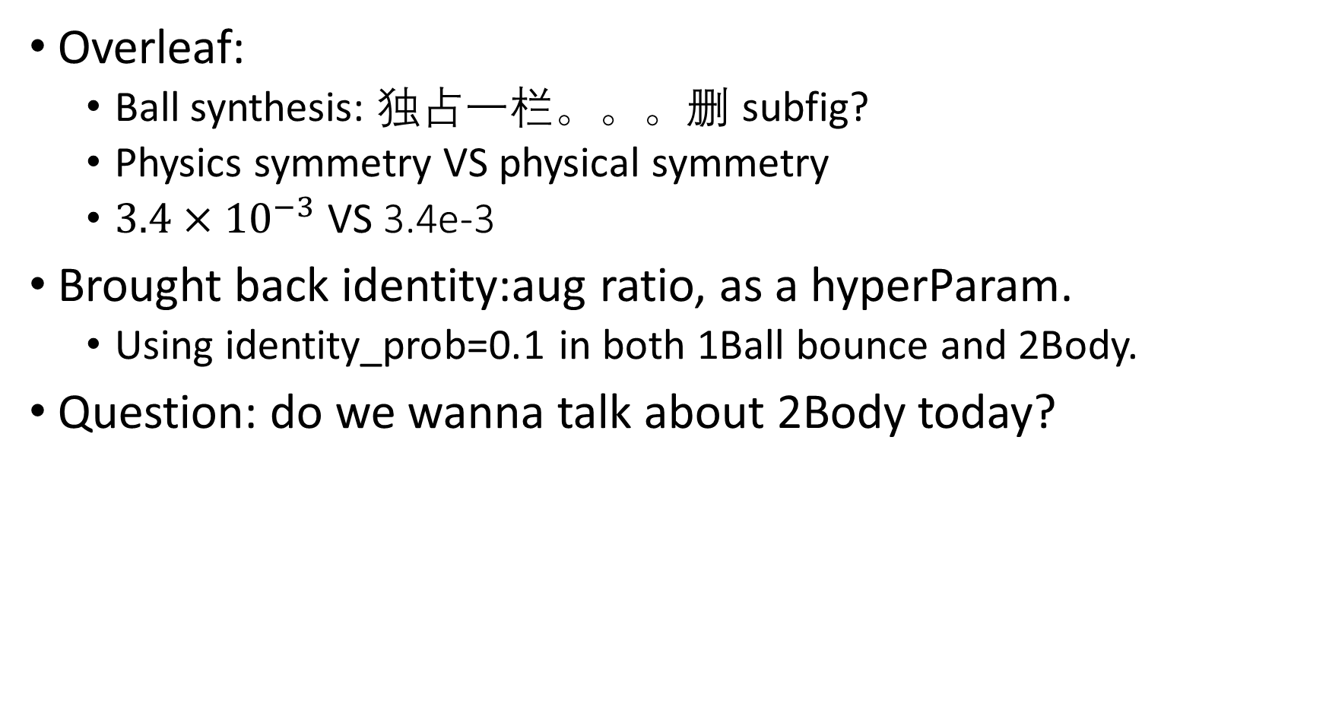
Overleaf:
Ball synthesis: 独占一栏。。。删 subfig?
Physics symmetry VS physical symmetry
$3.4×{10}^{−3}$ VS 3.4e-3
Brought back identity:aug ratio, as a hyperParam.
Using identity_prob=0.1 in both 1Ball bounce and 2Body.
Question: do we wanna talk about 2Body today?

