Slide 1
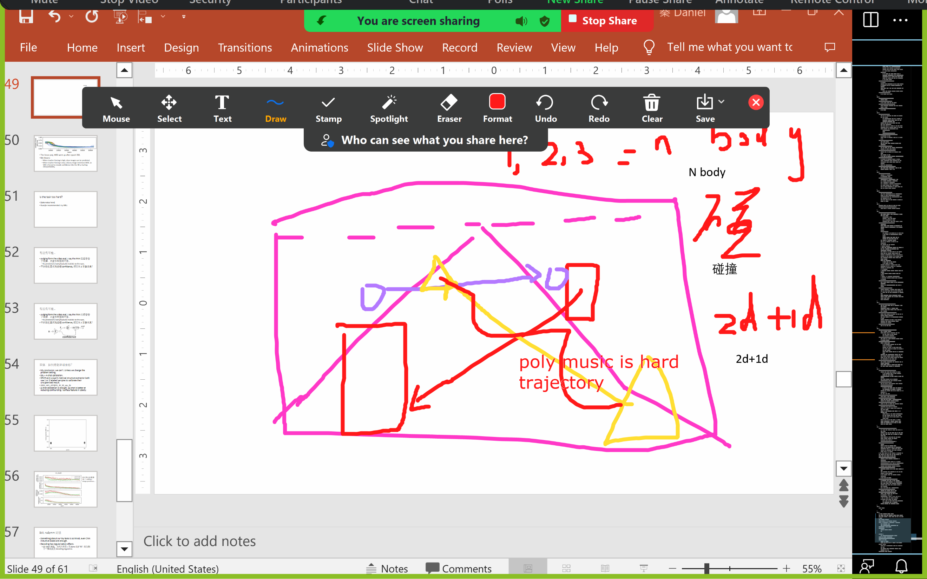

Slide 2
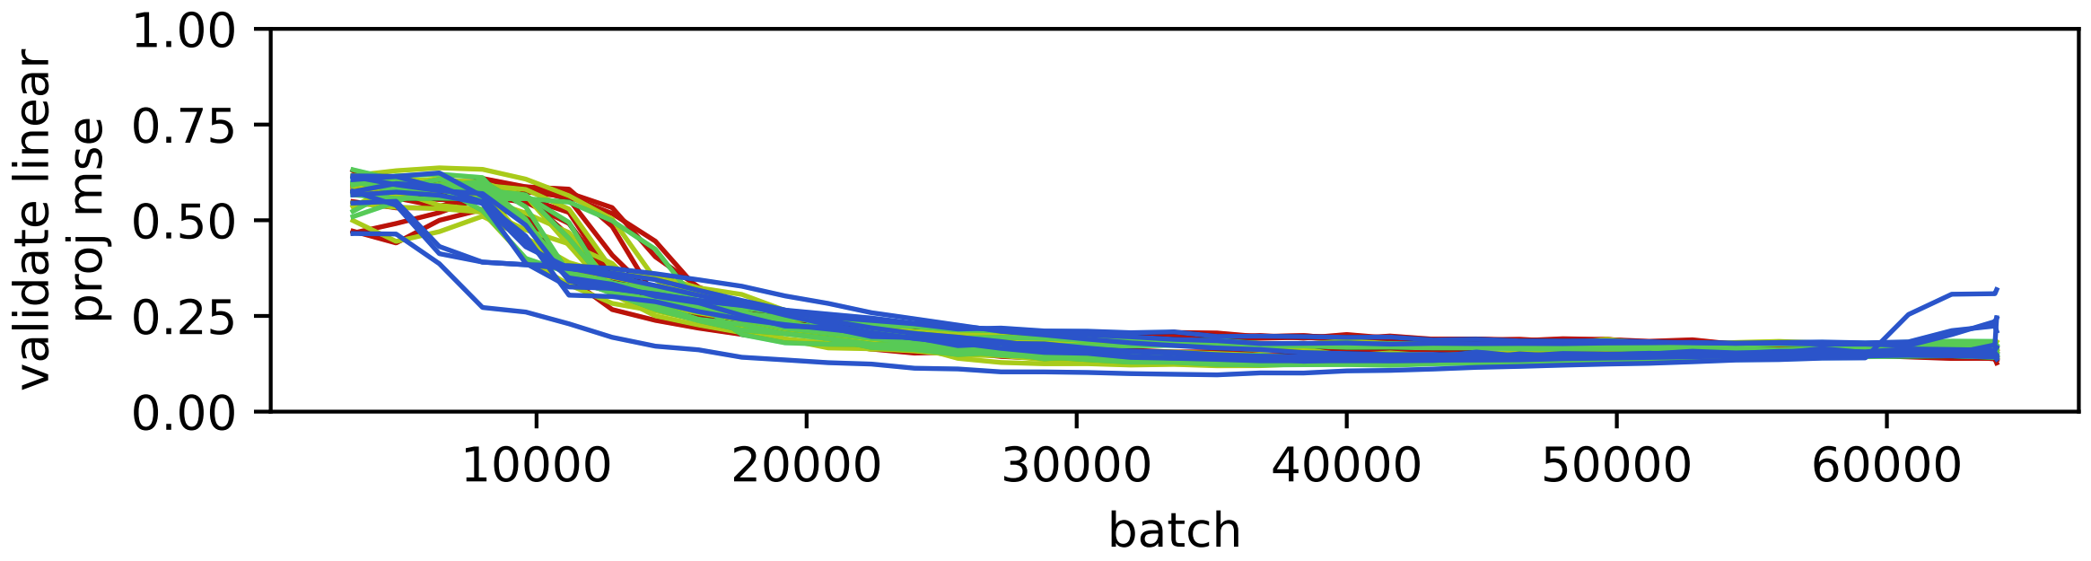
The linear proj. MSE went up after epoch 35K.
My theory:
When teacher forcing is high, clear images can be predicted.
When teacher forcing is low, a blurry image minimizes MSE, so VAE is forced to encode confidence into the 3D z, hurting interpretability.

Slide 3
Is the task too hard?
[take notes here]
Xuanjie recommended: try GRU.

Slide 4
有没有可能…
Judging form the video eval, I say the RNN 已经学会了规律，只是长程预测不准。
Its predictions look physically realistic to the eyes.
不如我们显式地建模 confidence, 把它从 z 里拿出来？

Slide 5
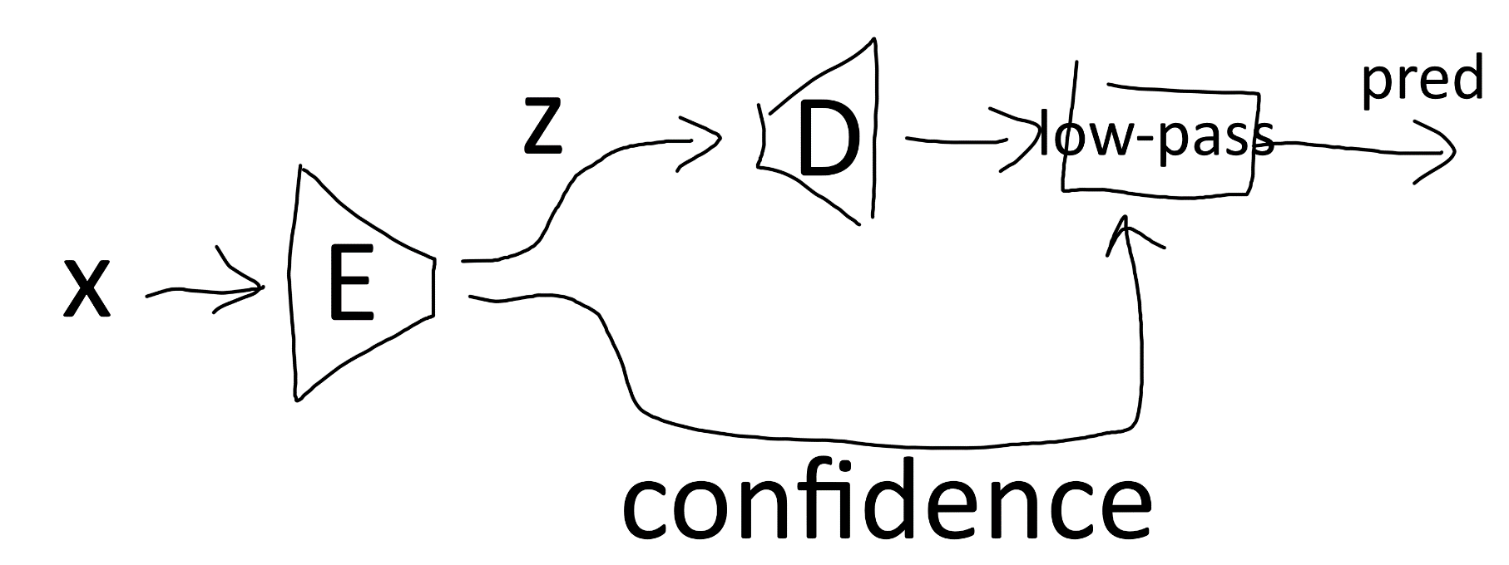
有没有可能…
Judging form the video eval, I say the RNN 已经学会了规律，只是长程预测不准。
Its predictions look physically realistic to the eyes.
不如我们显式地建模 confidence, 把它从 z 里拿出来？

Slide 6
双体：如何得到单球坐标？
My conclusion: we can’t. Unless we change the problem setting.
SSL + 4-shot calibration.
SPICE and Junyan’s metrical structure extractor both use 1 or 2 labeled samples to calibrate their unsupervised result.
2023_m01_d27@21_45_50_sps_2b
4-shot calibration is enough. 64-shot is better at reducing confounding / surface feature in 2Body.

Slide 7
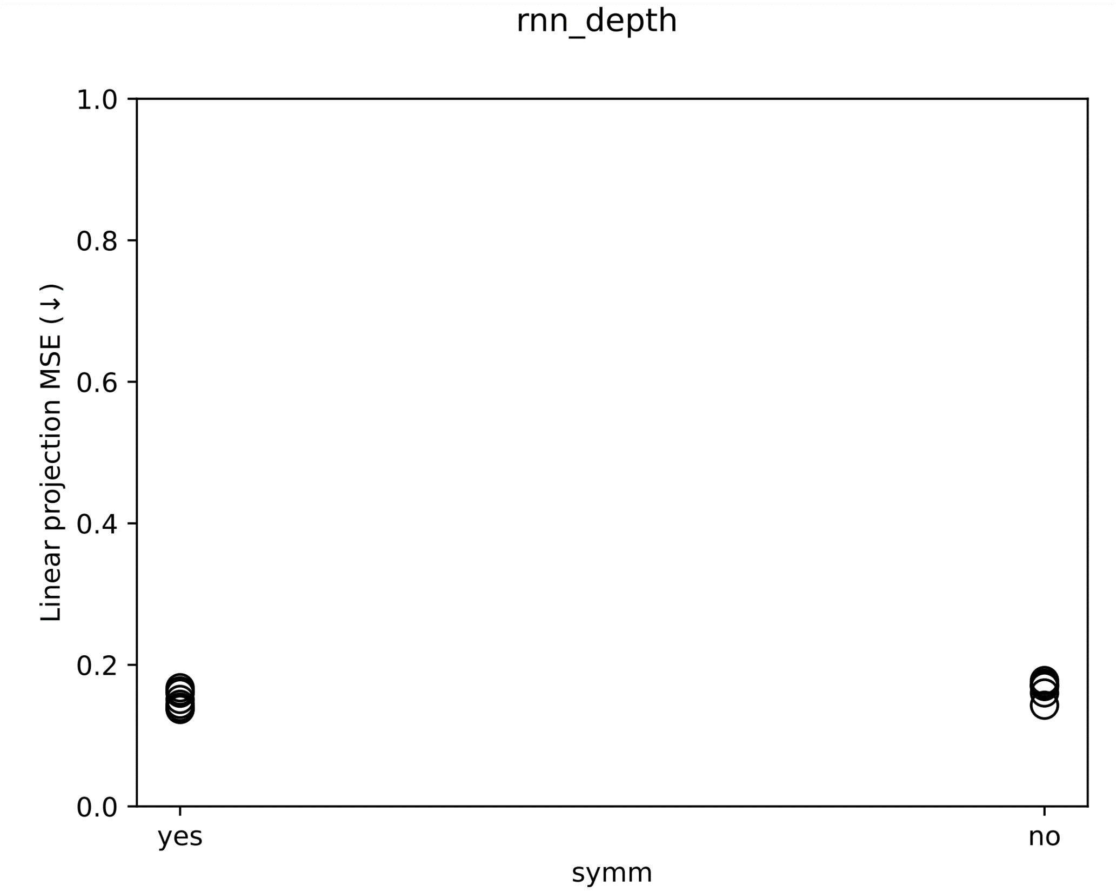

Slide 8
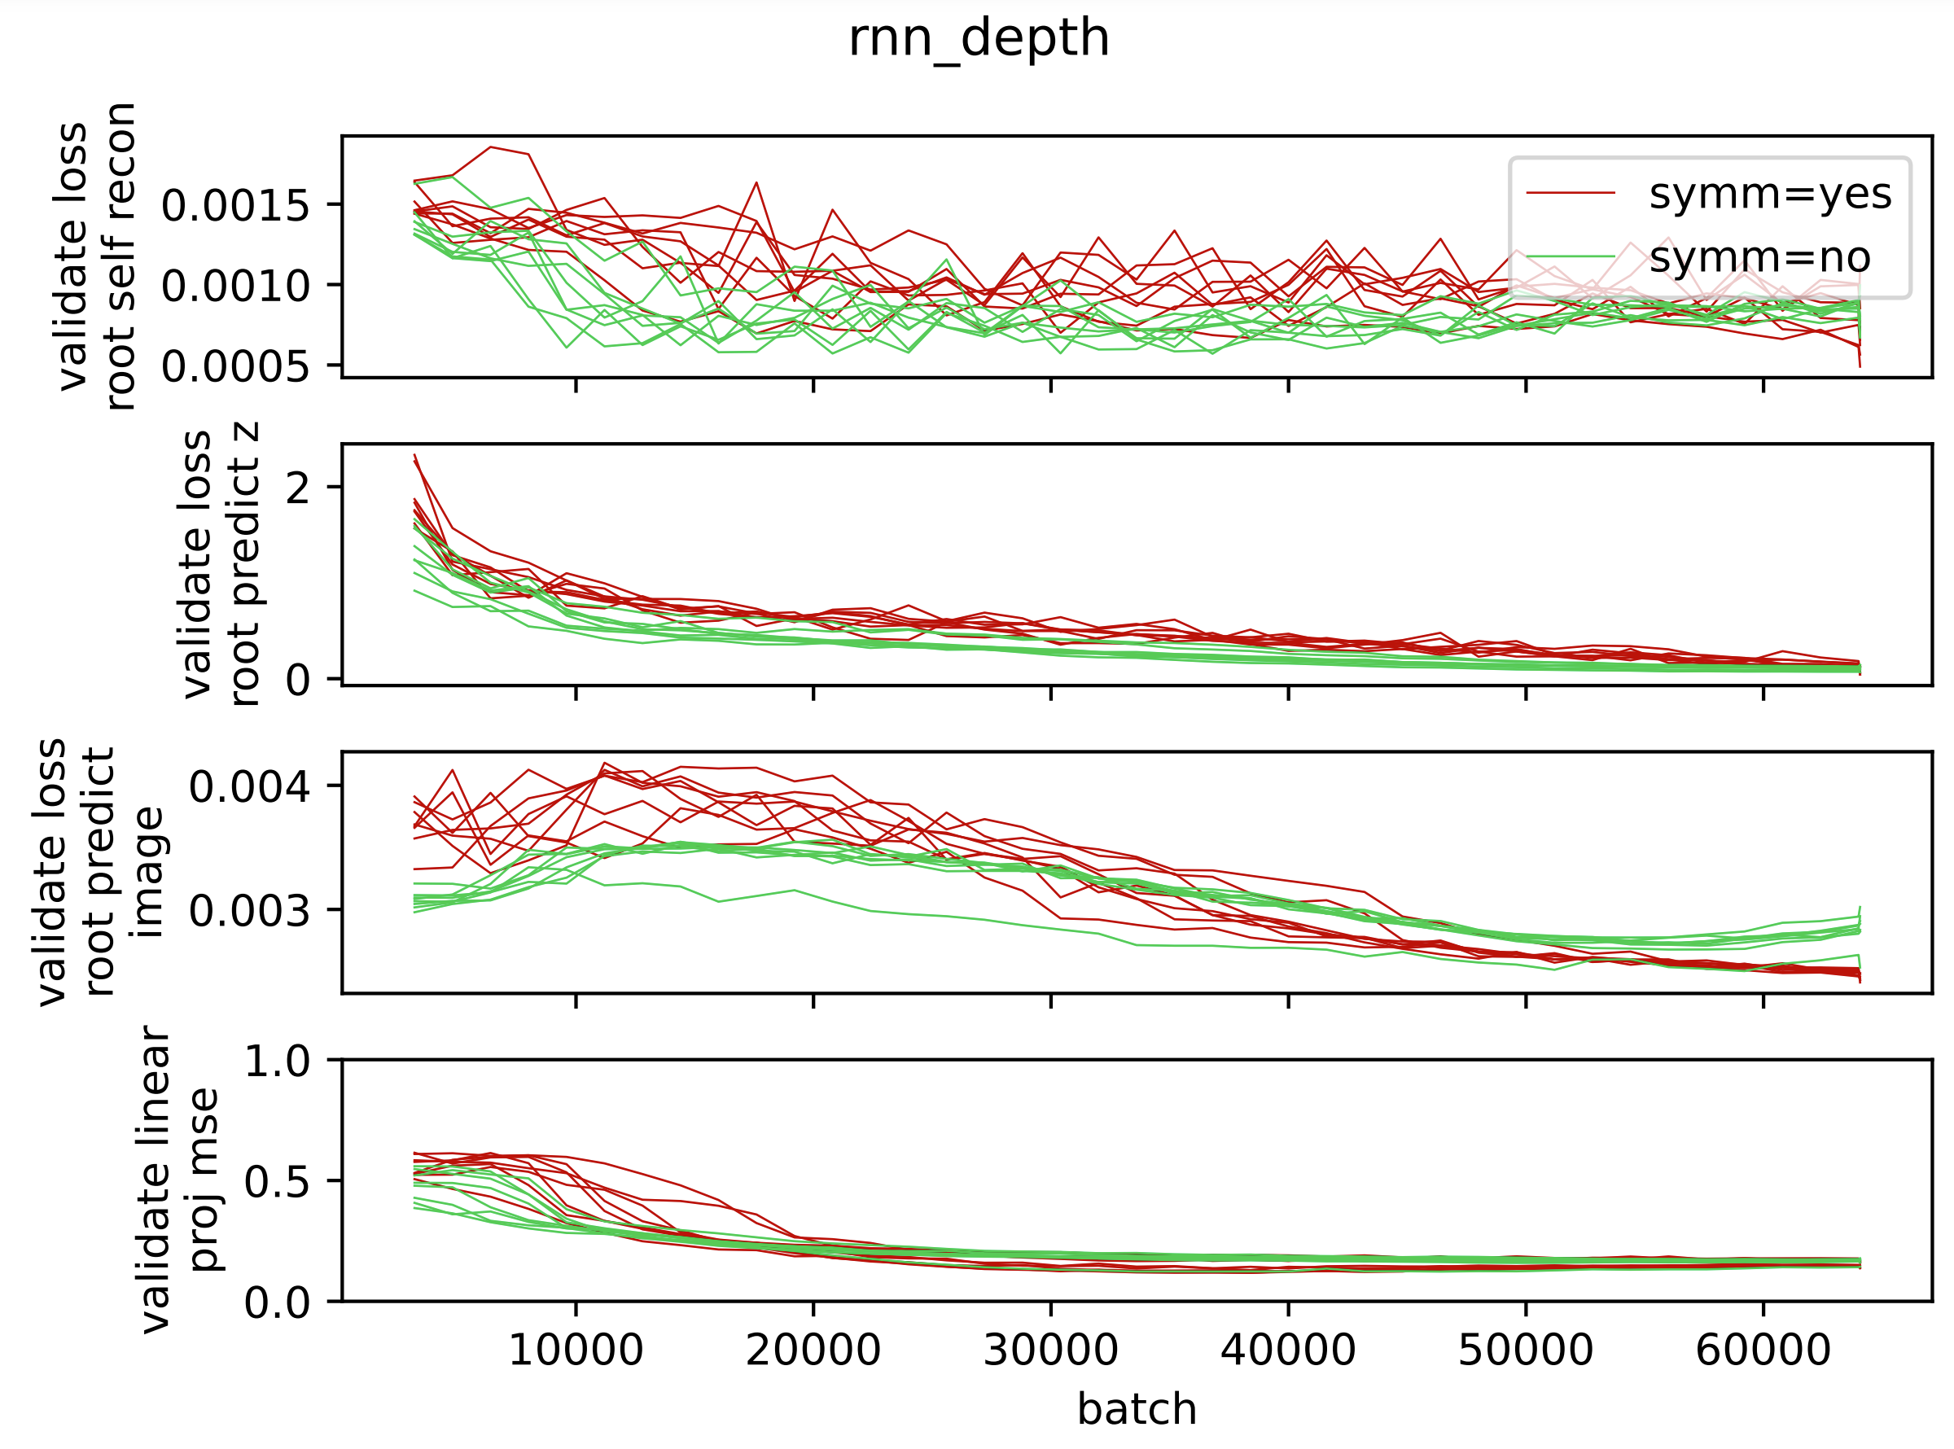
SPS 倒是显著降低了 validate image pred loss...

Slide 9
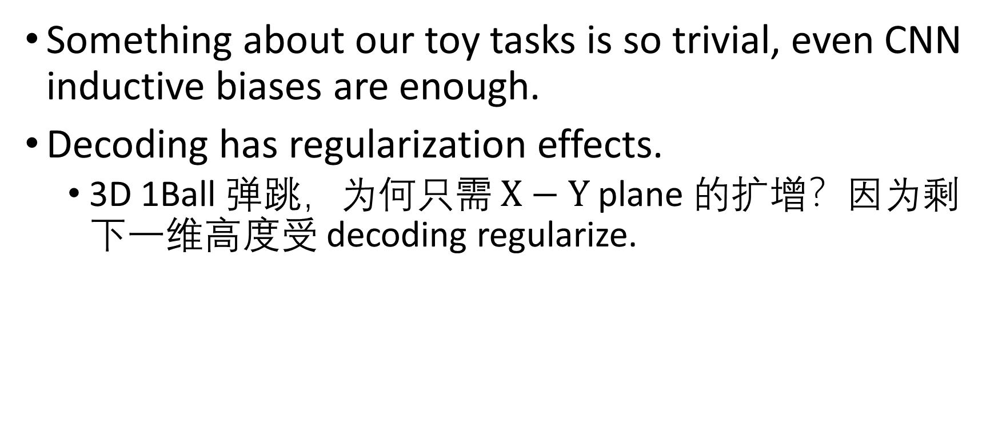
Still, noSymm 好强
Something about our toy tasks is so trivial, even CNN inductive biases are enough.
Decoding has regularization effects.
3D 1Ball 弹跳，为何只需 $X−Y$ plane 的扩增？因为剩下一维高度受 decoding regularize.

Slide 10
Refactor: any-modal SPS
现在 video 和 music 共享 SPS 代码，只有 dataset 及其 metadata 不一样，作为参数传入。

Slide 11
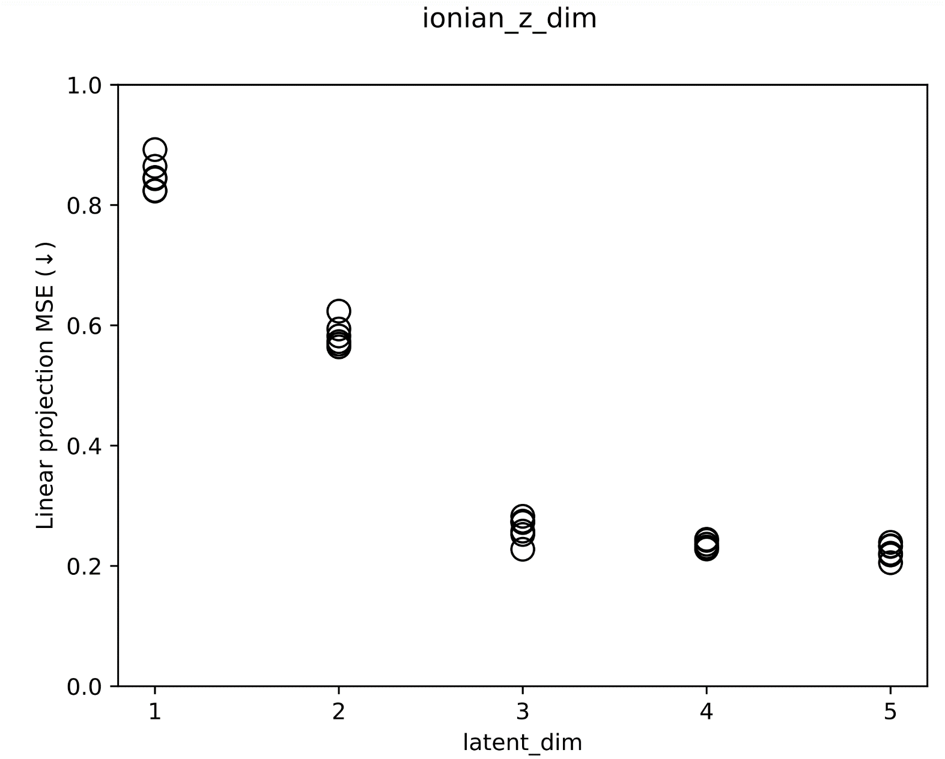
SPS (w/ decode) on Ionian scales
All dims have translate aug.
Also, we see that z_dim = 1 cannot recon. Previously, I thought because the pitch aligns all partials the VAE would at least learn the pitch. Wrong.
Notes:
2023_m02_d04@21_07_57_ionian_z_dim

Slide 12
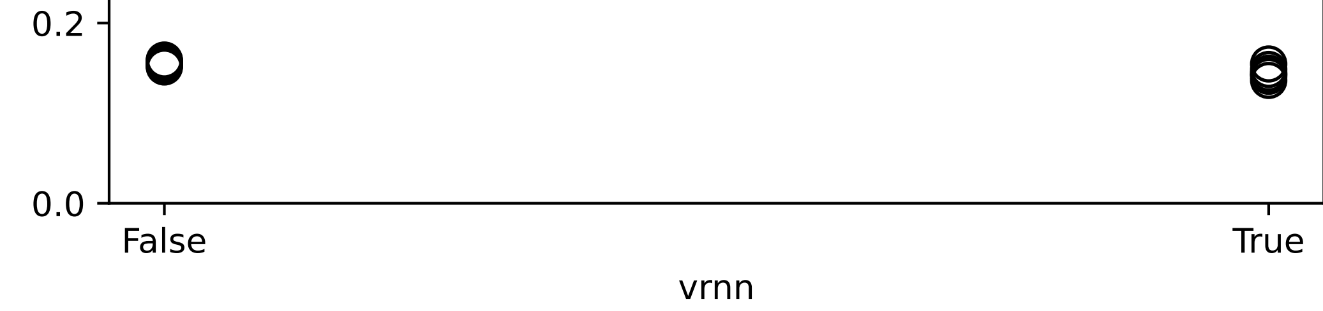
VRNN
No-VRNN: RNN models the VAE posterior mean.
VRNN: RNN models the VAE posterior sample.
The idea: 惩罚 RNN 关于输入的高频分量。
Notes:
2023_m01_d26@19_31_47_2b_vrnn

Slide 13
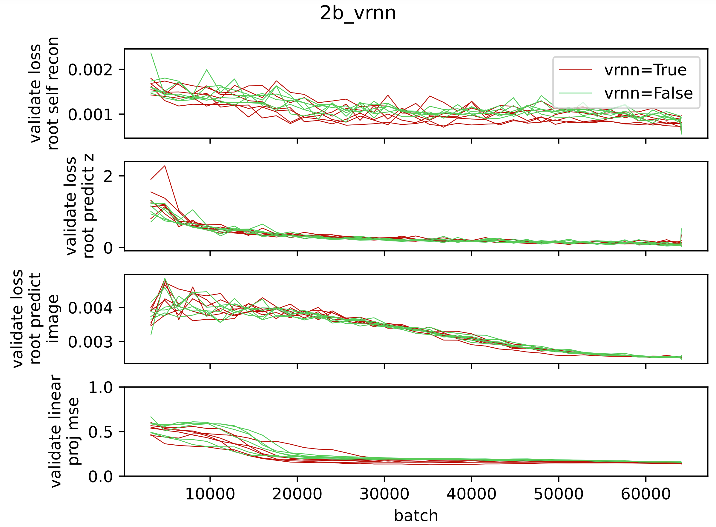
VRNN image pred 不牺牲？？

