Slide 1
notes_1_20_2023

Slide 2
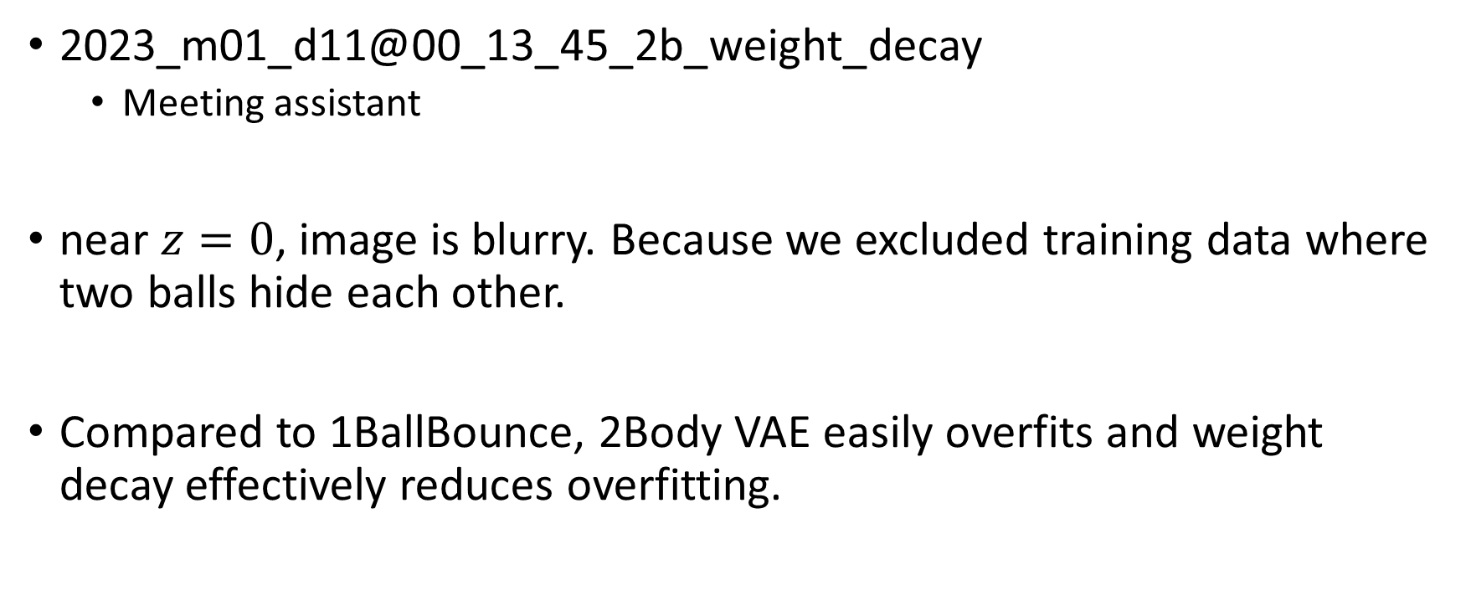
Two body
2023_m01_d11@00_13_45_2b_weight_decay
Meeting assistant
near $z=0$, image is blurry. Because we excluded training data where two balls hide each other.
Compared to 1BallBounce, 2Body VAE easily overfits and weight decay effectively reduces overfitting.

Slide 3
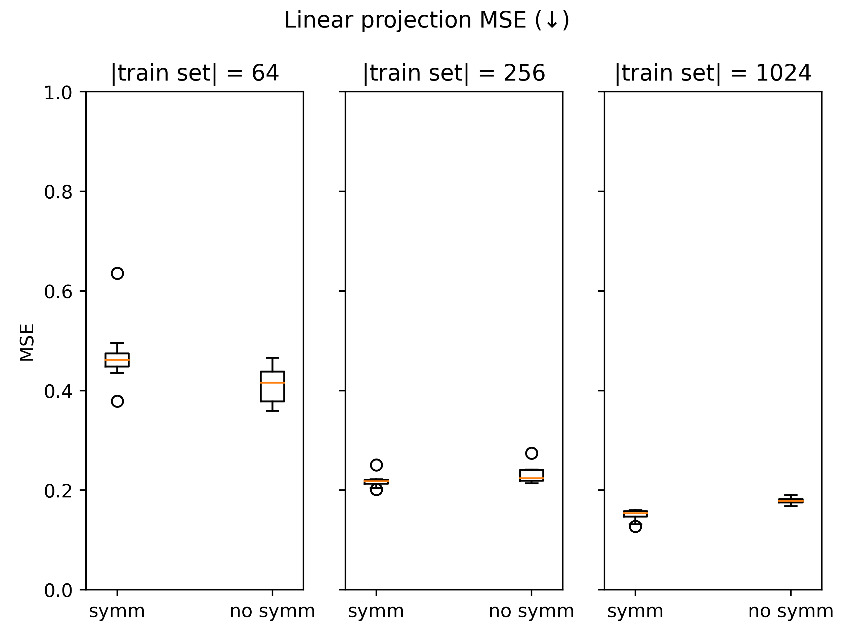
2Body
Notes:
2023_m01_d14@21_00_35_2b_sps

Slide 4
2023_m01_d14@21_00_35_2b_sps\symm,train_set_size=('yes',1024)_rand_6\visualize_validate_epoch_1000.mp4

Slide 5
Plot losses

Slide 6
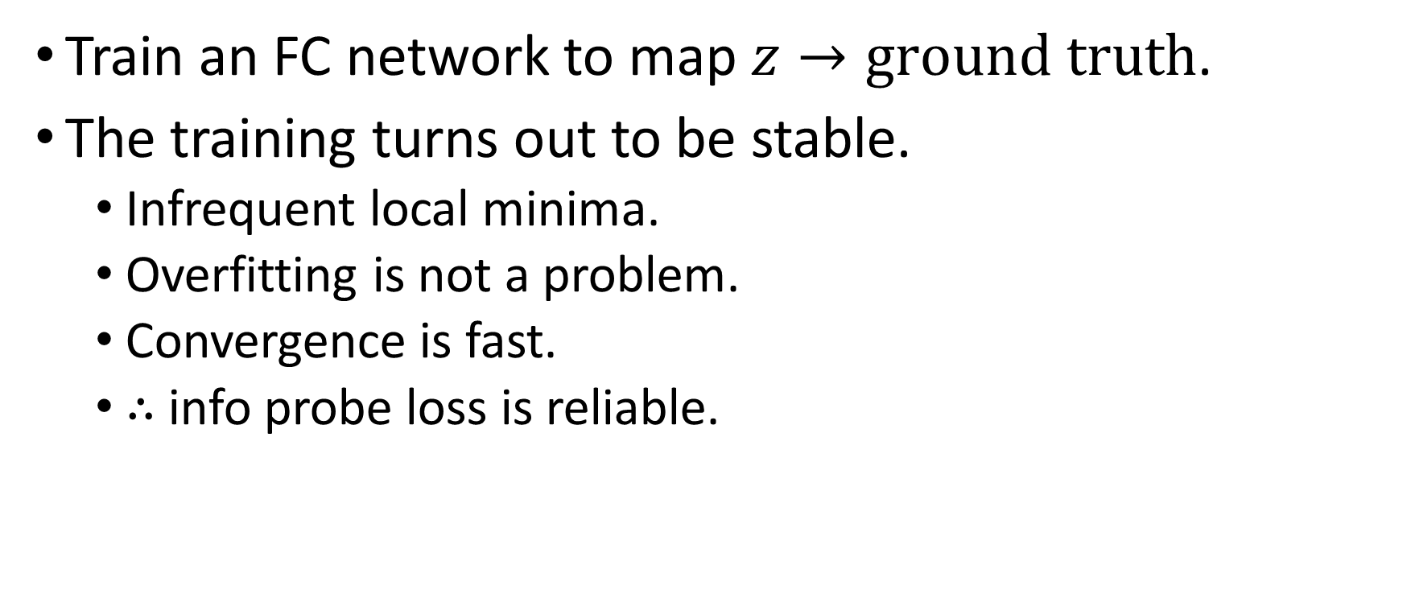
Info probe
Train an FC network to map $z→ground truth$.
The training turns out to be stable.
Infrequent local minima.
Overfitting is not a problem.
Convergence is fast.
$∴$ info probe loss is reliable.

Slide 7
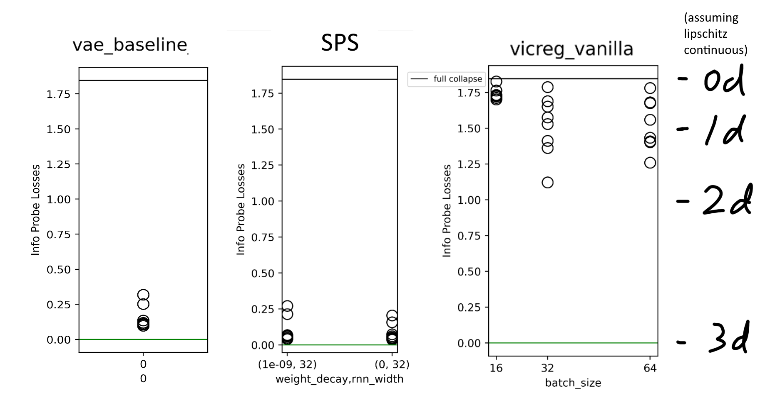
VICReg
Notes:
2023_m01_d14@02_49_46_vae_baseline_for_info_probe
2023_m01_d06@00_49_15_weight_decay
2023_m01_d06@23_30_40_vicreg_vanilla

Slide 8
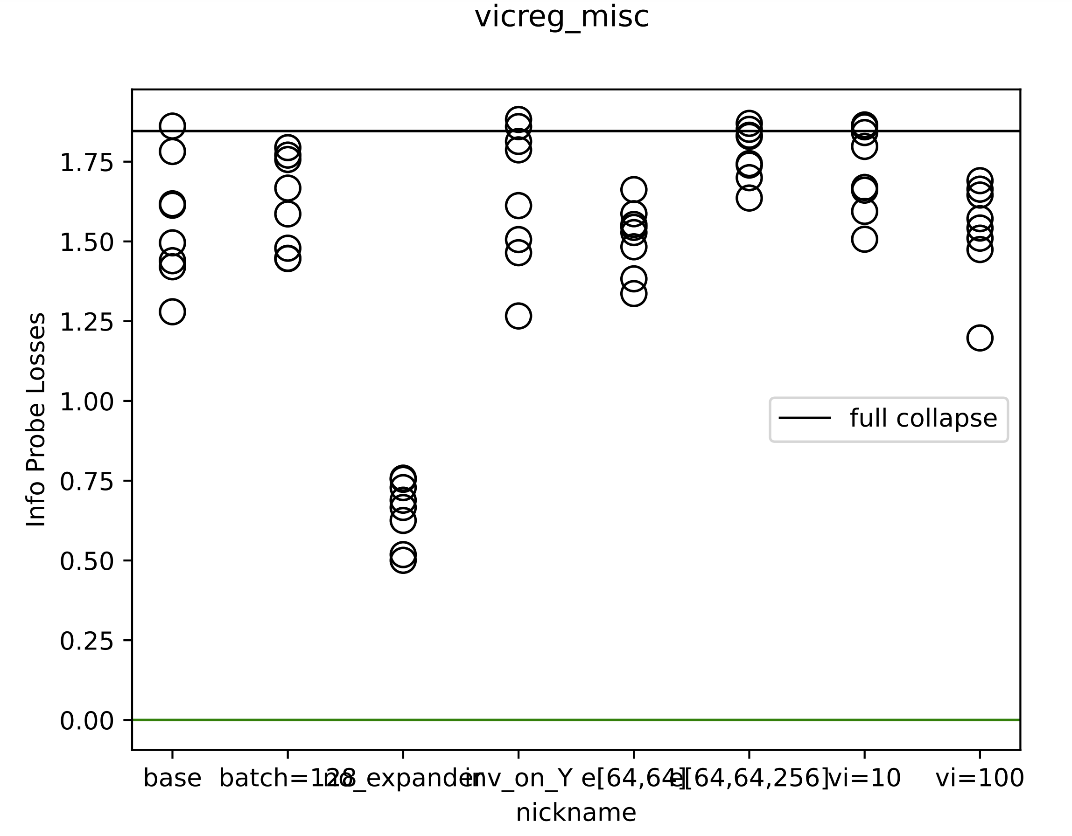
Info probe
Notes:
2023_m01_d14@21_07_39_vicreg_misc

Slide 9
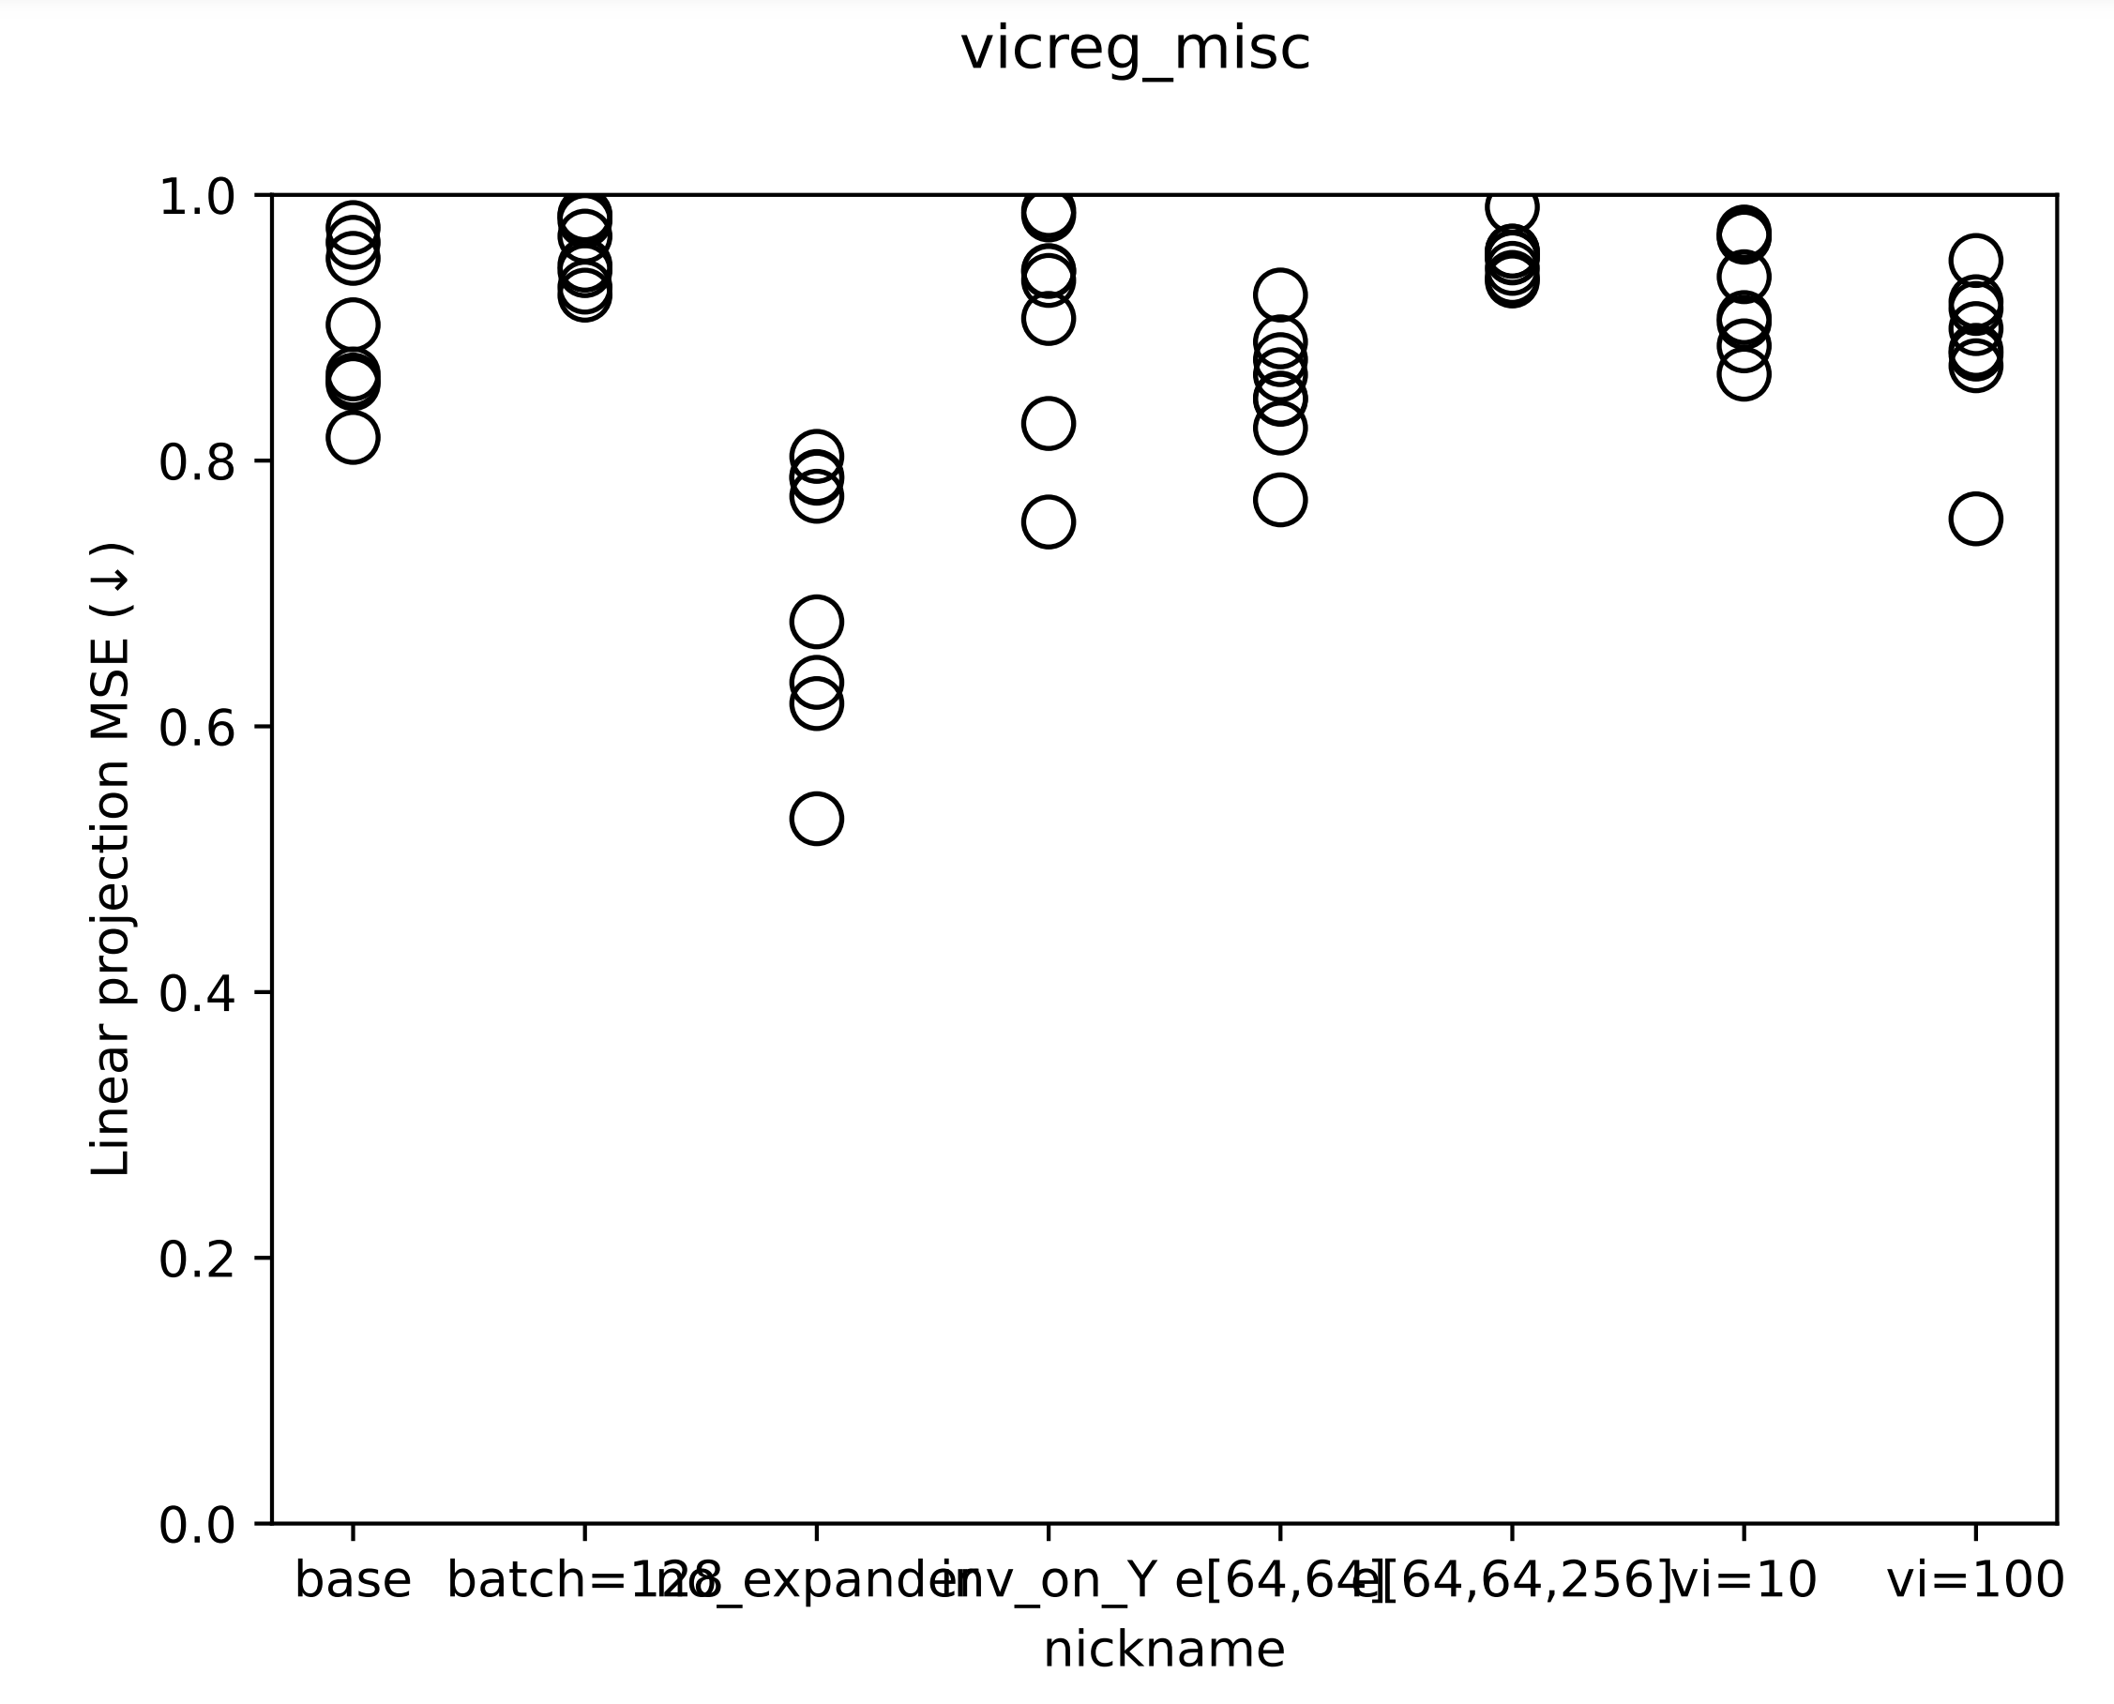
Linearity

Slide 10
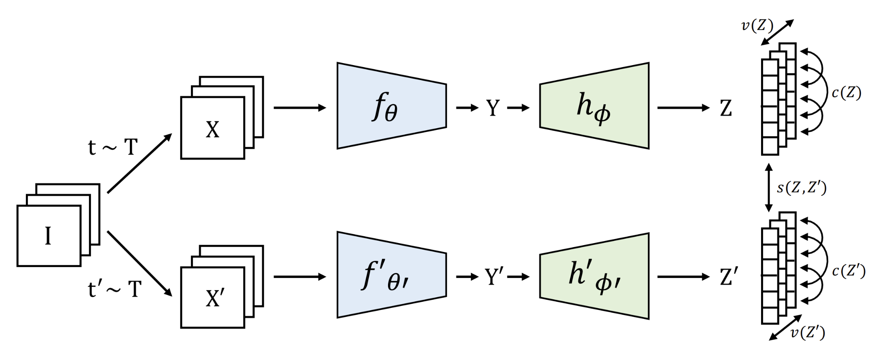
Remove the expander!

Slide 11
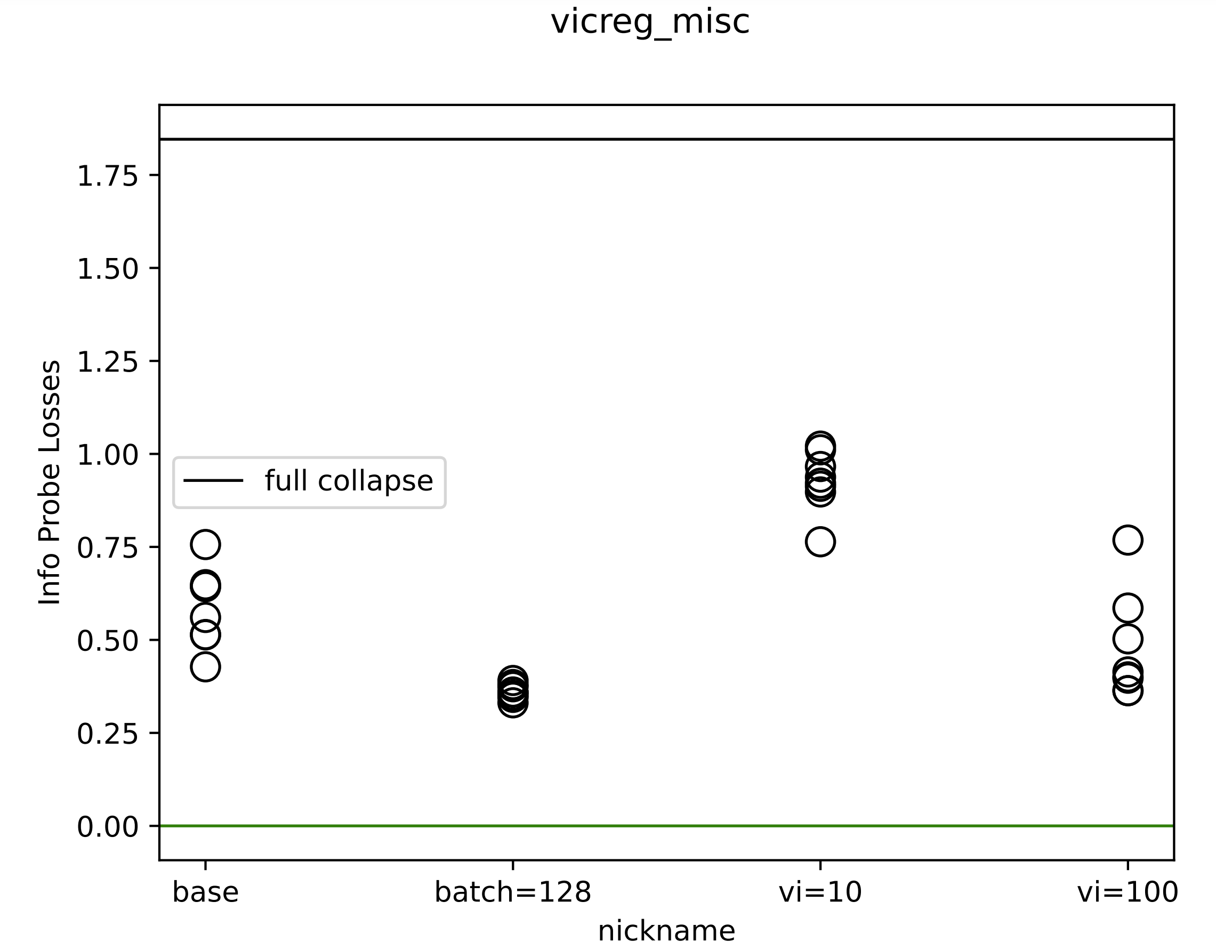
Info probe
Notes:
2023_m01_d16@03_51_16_vicreg_misc

Slide 12
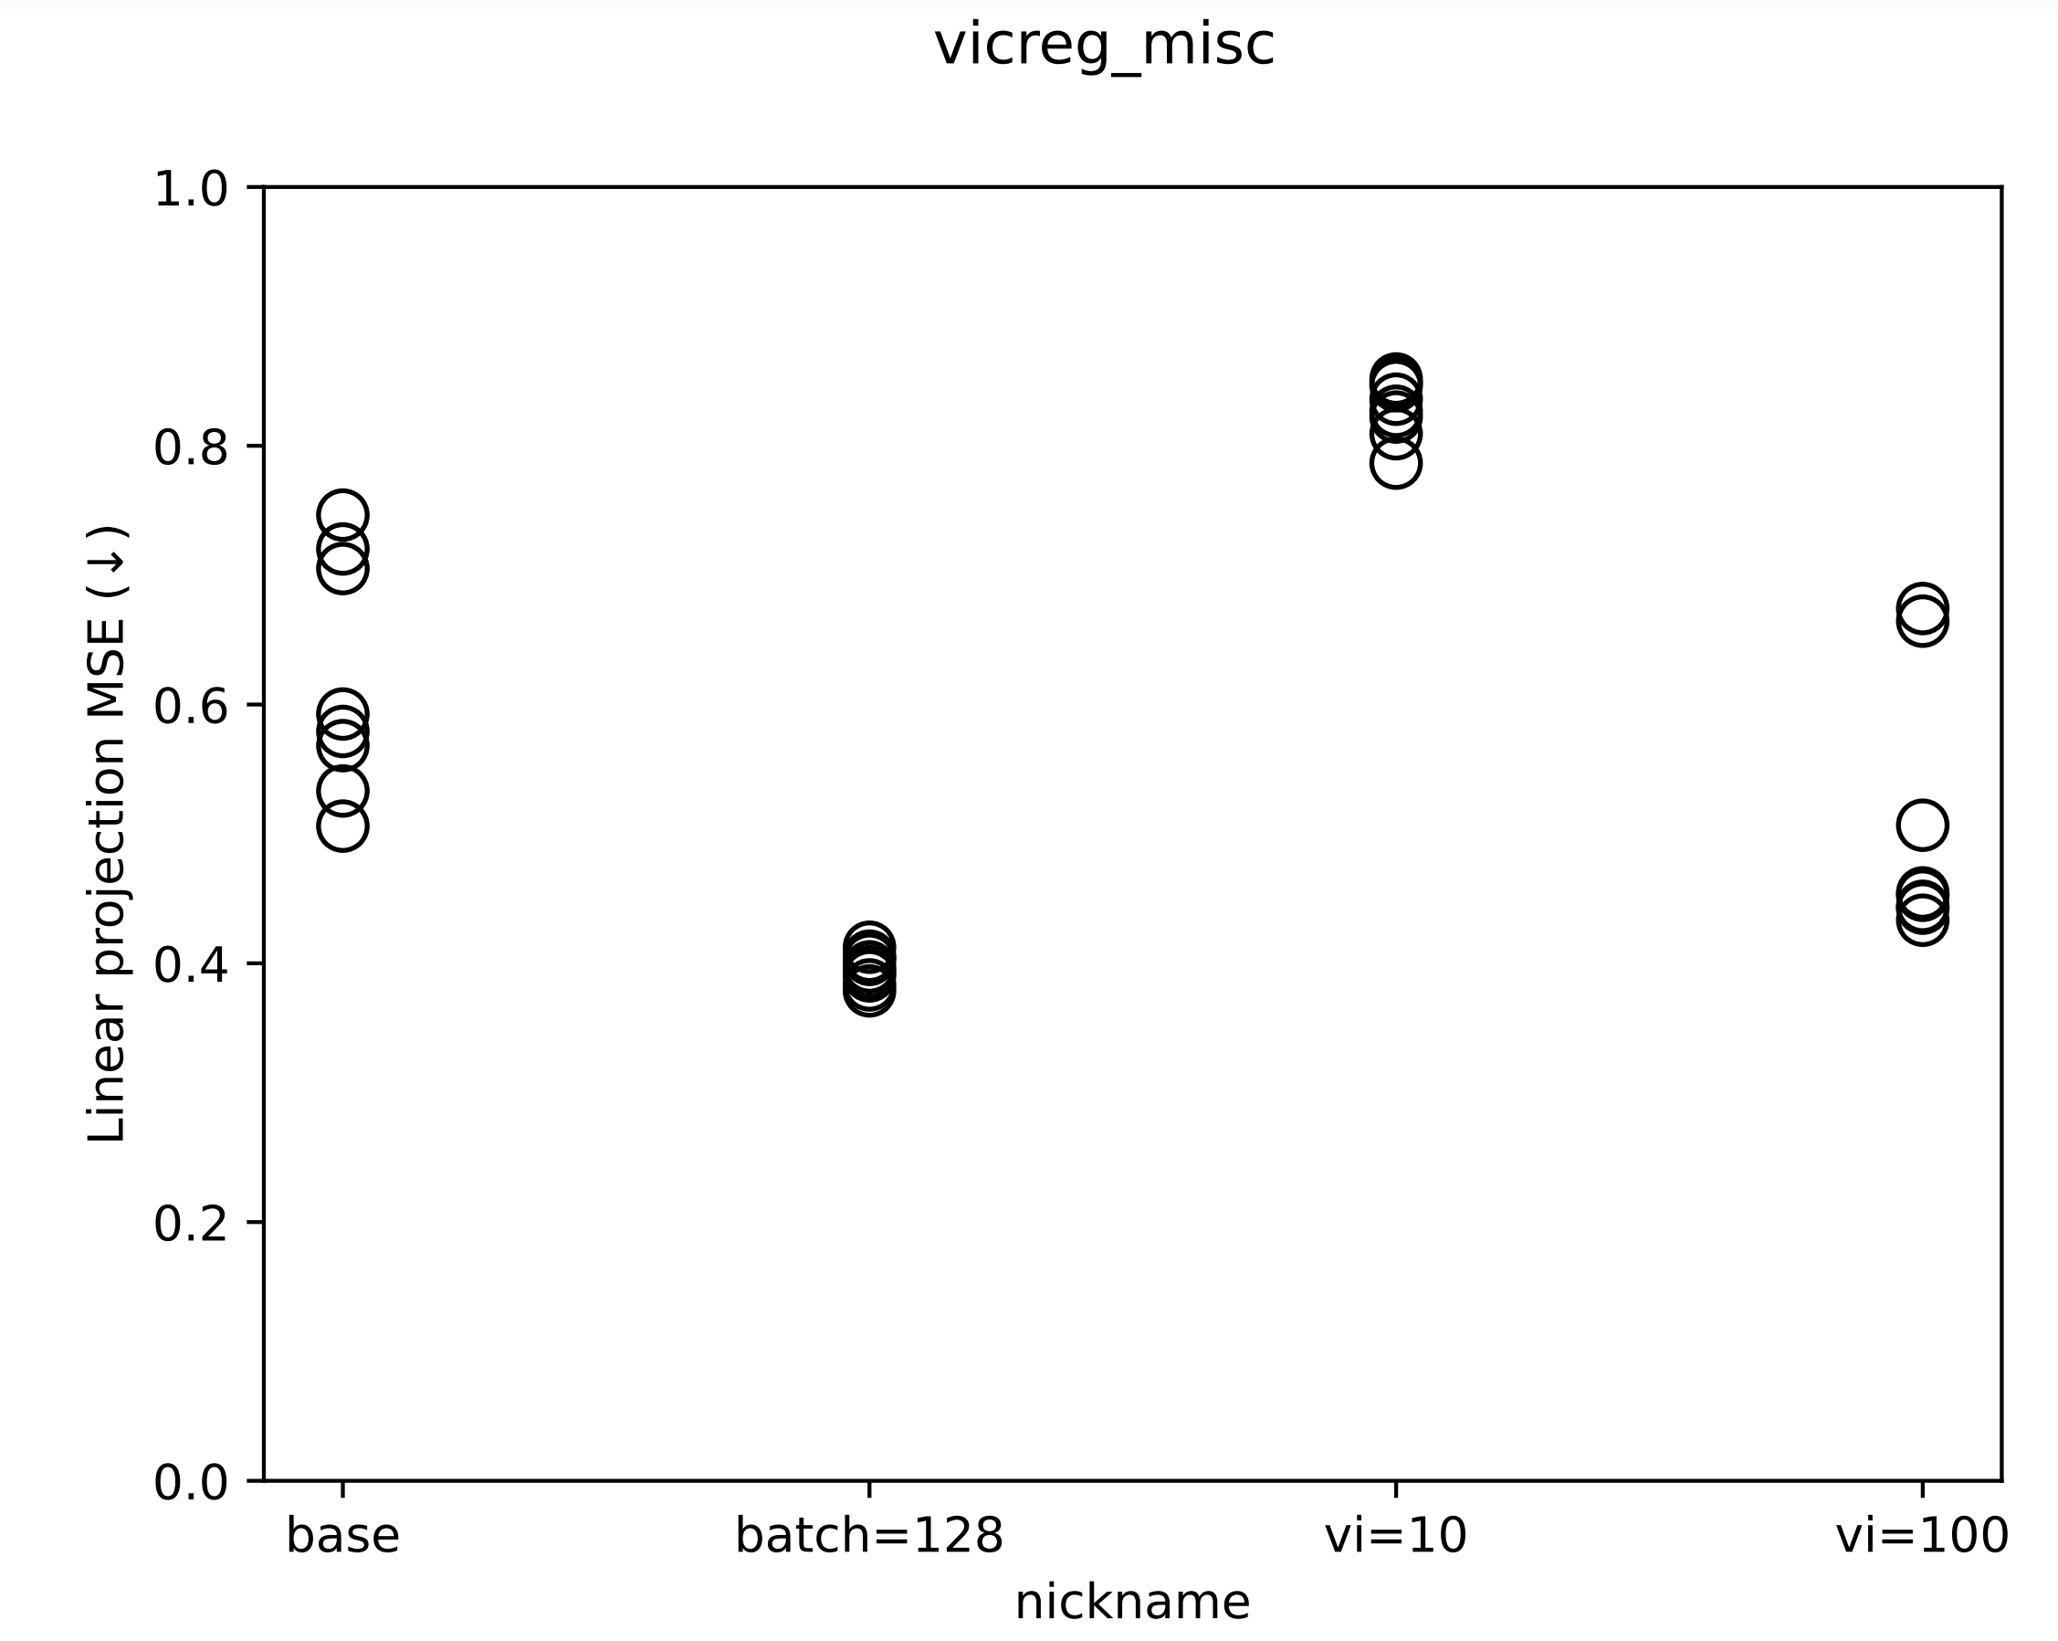
Linearity

Slide 13

VICReg next step:
Force even more info content into $z$.

Slide 14
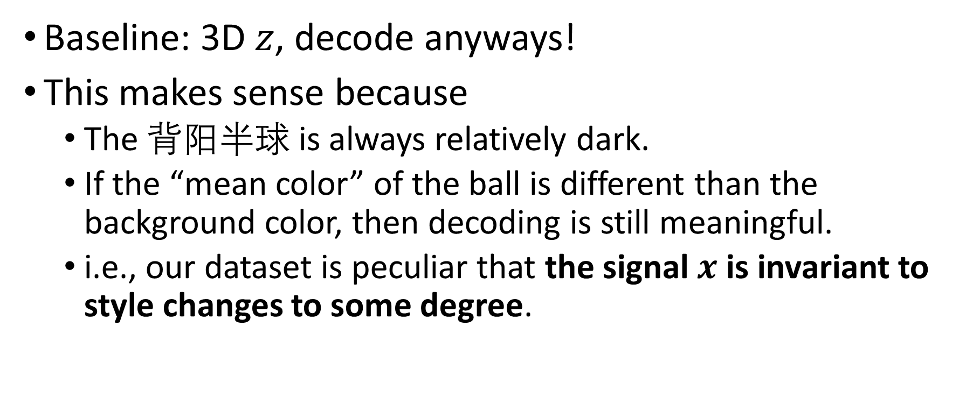
Bouncing ball with flashing colors
Baseline: 3D $z$, decode anyways!
This makes sense because
The 背阳半球 is always relatively dark.
If the “mean color” of the ball is different than the background color, then decoding is still meaningful.
i.e., our dataset is peculiar that the signal $x$ is invariant to style changes to some degree.

Slide 15
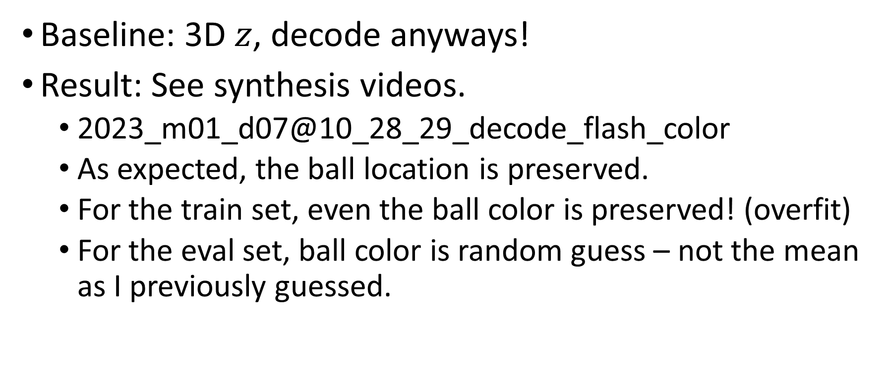
Bouncing ball with flashing colors
Baseline: 3D $z$, decode anyways!
Result: See synthesis videos.
2023_m01_d07@10_28_29_decode_flash_color
As expected, the ball location is preserved.
For the train set, even the ball color is preserved! (overfit)
For the eval set, ball color is random guess – not the mean as I previously guessed.

Slide 16
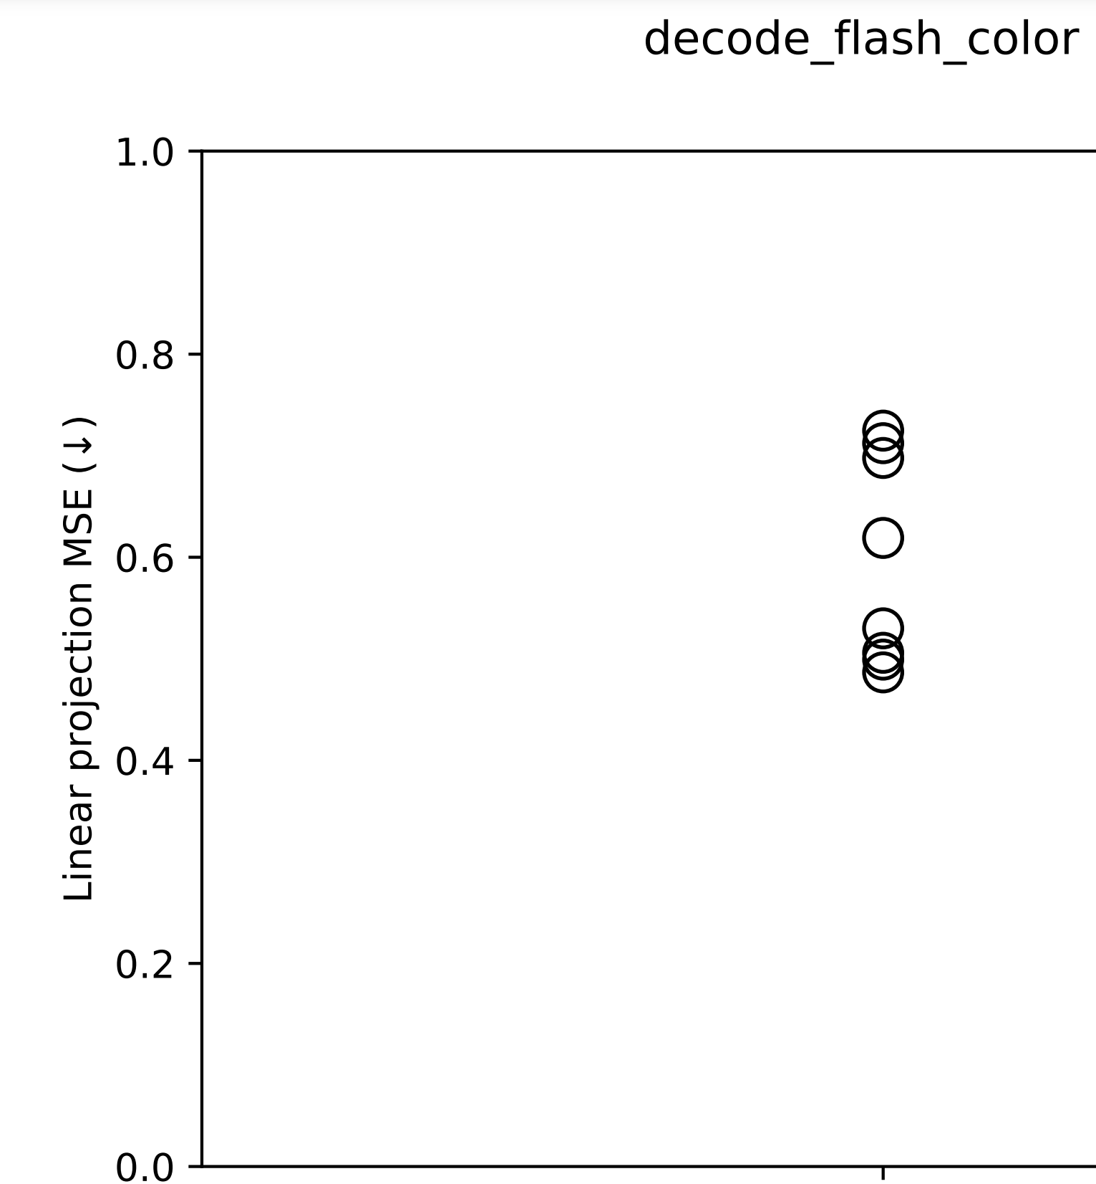
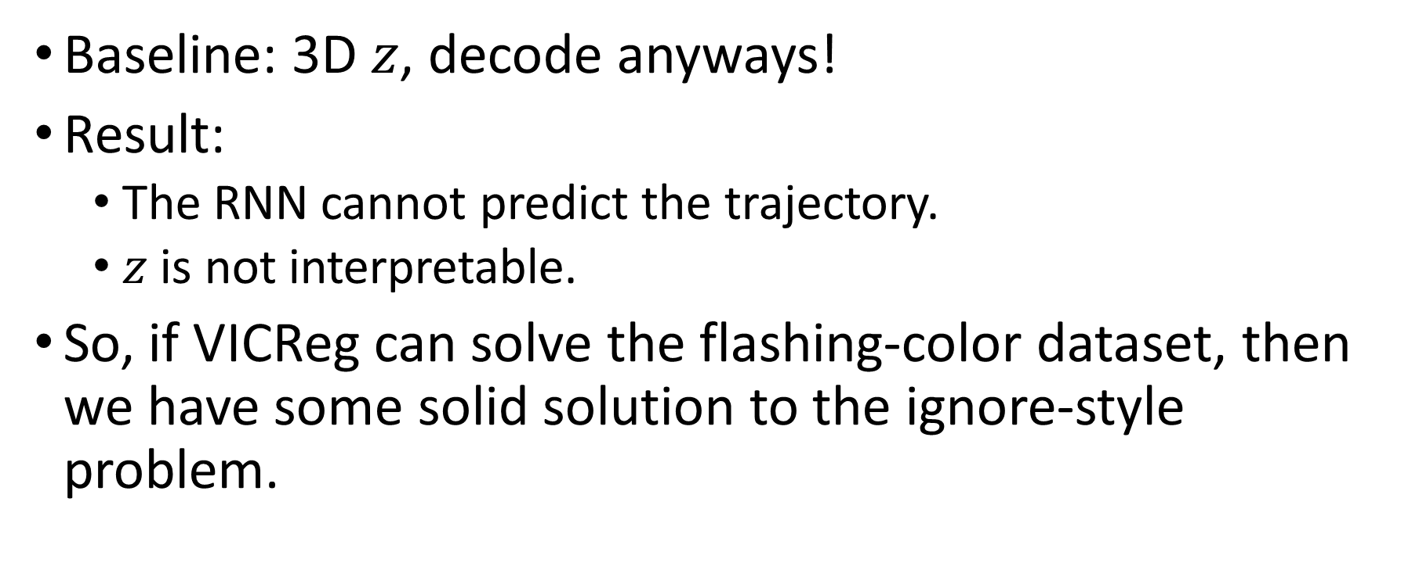
Bouncing ball with flashing colors
Baseline: 3D $z$, decode anyways!
Result:
The RNN cannot predict the trajectory.
$z$ is not interpretable.
So, if VICReg can solve the flashing-color dataset, then we have some solid solution to the ignore-style problem.

Slide 17
SPS effectiveness on bouncing ball

Slide 18
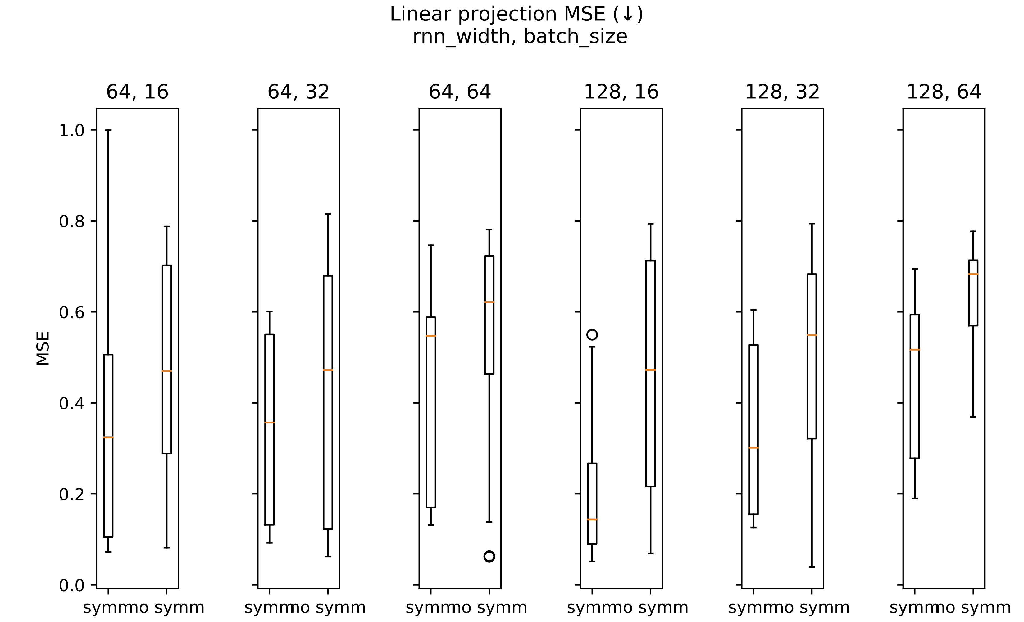
Notes:
2023_m01_d04@01_22_50_sps

Slide 19
SPS effectiveness on bouncing ball
Is SPS effective?
yes.
Is the baseline strong enough?
no.
SPS's effect is more pronounced as RNN size increases.
Note: even when comparing RNN(64) VS RNN(128)+symm, symm still wins.
SPS allows you to over-parametrize by at least 4x # of parameters.

Slide 20
快速过一下 other results

Slide 21
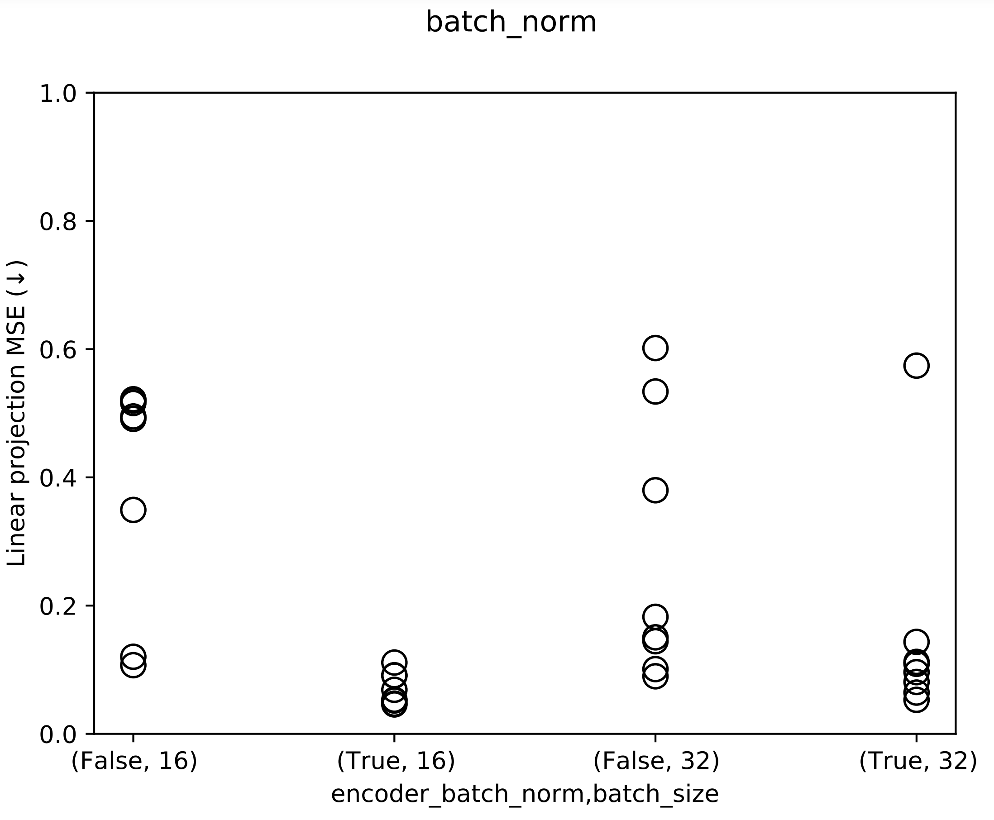
Batch norm: super effective!
❌
✔
❌
✔
Notes:
2023_m01_d03@05_51_38_batch_norm

Slide 22
RNN ensemble
Motivation: as long as one RNN doesn’t collapse, we can disentangle!
Collapsed RNN doesn’t pass gradients to the VAE, just as if they didn’t exist.

Slide 23
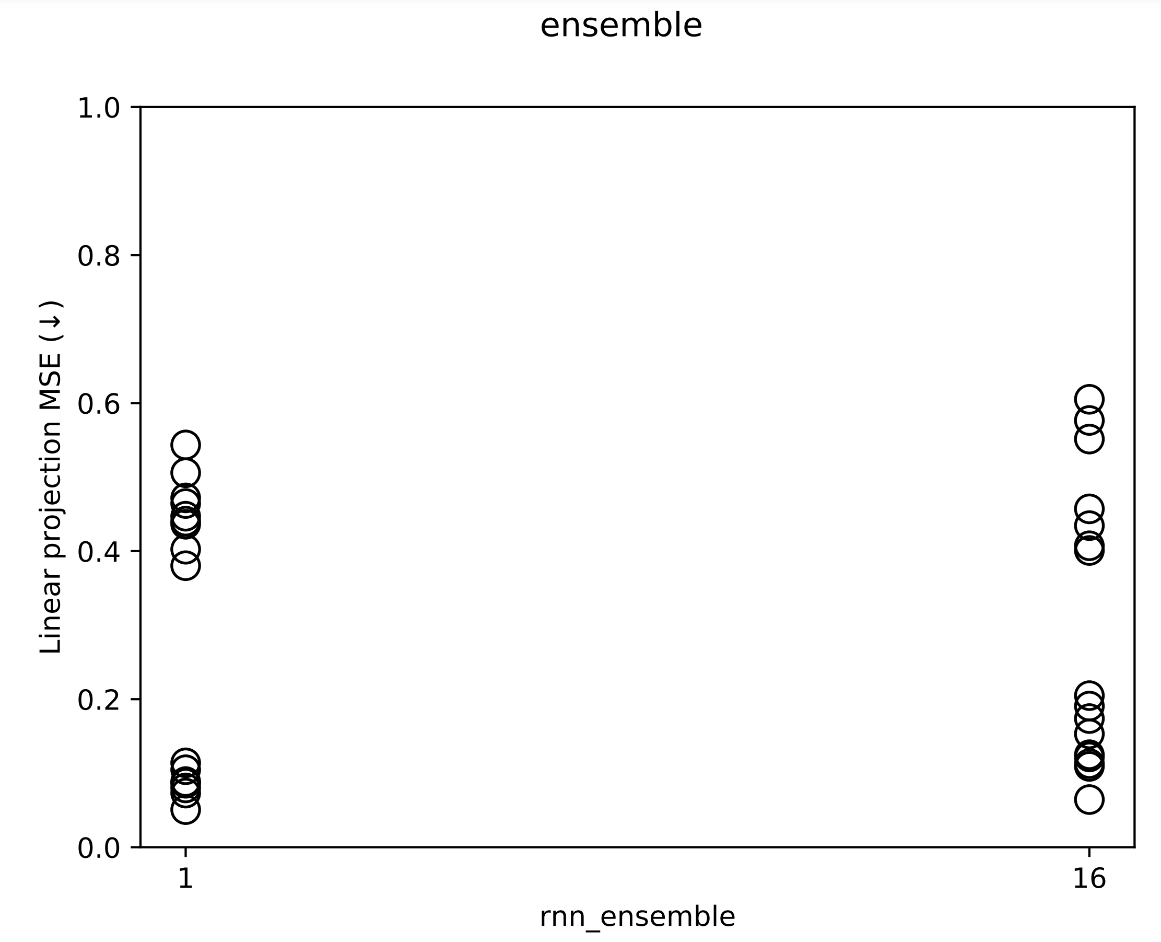
Notes:
2023_m01_d06@00_49_15_ensemble

Slide 24
RNN ensemble
Result:
For some reason, it doesn't help at all.
Ensemble looks consistently weaker, in terms of all losses.
The reason is not clear.
Still, we should try ensemble with VICReg.

Slide 25
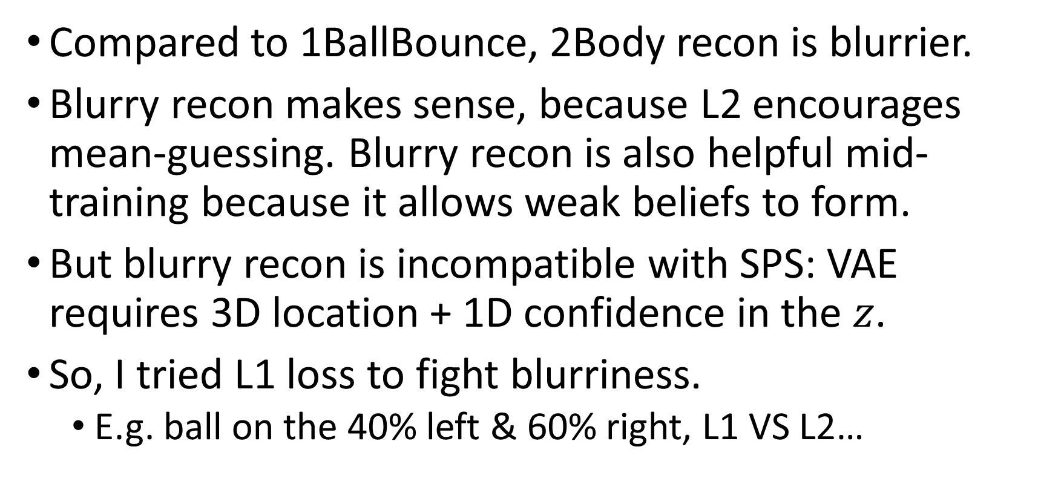
2Body L1 loss
Compared to 1BallBounce, 2Body recon is blurrier.
Blurry recon makes sense, because L2 encourages mean-guessing. Blurry recon is also helpful mid-training because it allows weak beliefs to form.
But blurry recon is incompatible with SPS: VAE requires 3D location + 1D confidence in the $z$.
So, I tried L1 loss to fight blurriness.
E.g. ball on the 40% left & 60% right, L1 VS L2…

Slide 26
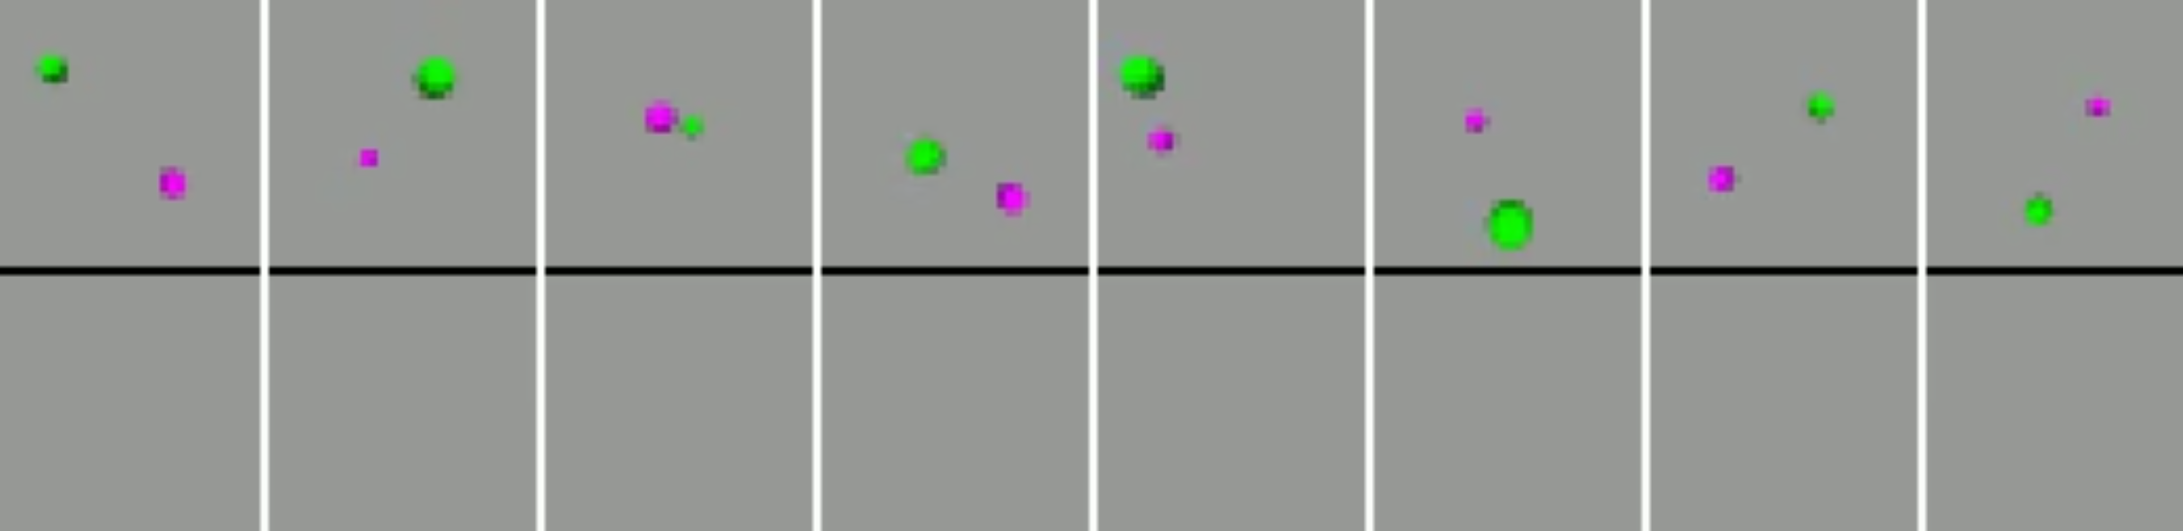
2Body L1 loss
First exp:
上 L1 会直接 collapse, all the way.
Notes:
2023_m01_d01@08_47_02_2b_l1
2023_m01_d03@13_21_44_2b_l1

Slide 27
2Body L1 loss
Second exp:
Epoch 0: L2 … … Epoch 2000: L1.
Result: doesn’t collapse!
However,
Notes:
2023_m01_d01@08_47_02_2b_l1
2023_m01_d03@13_21_44_2b_l1

Slide 28
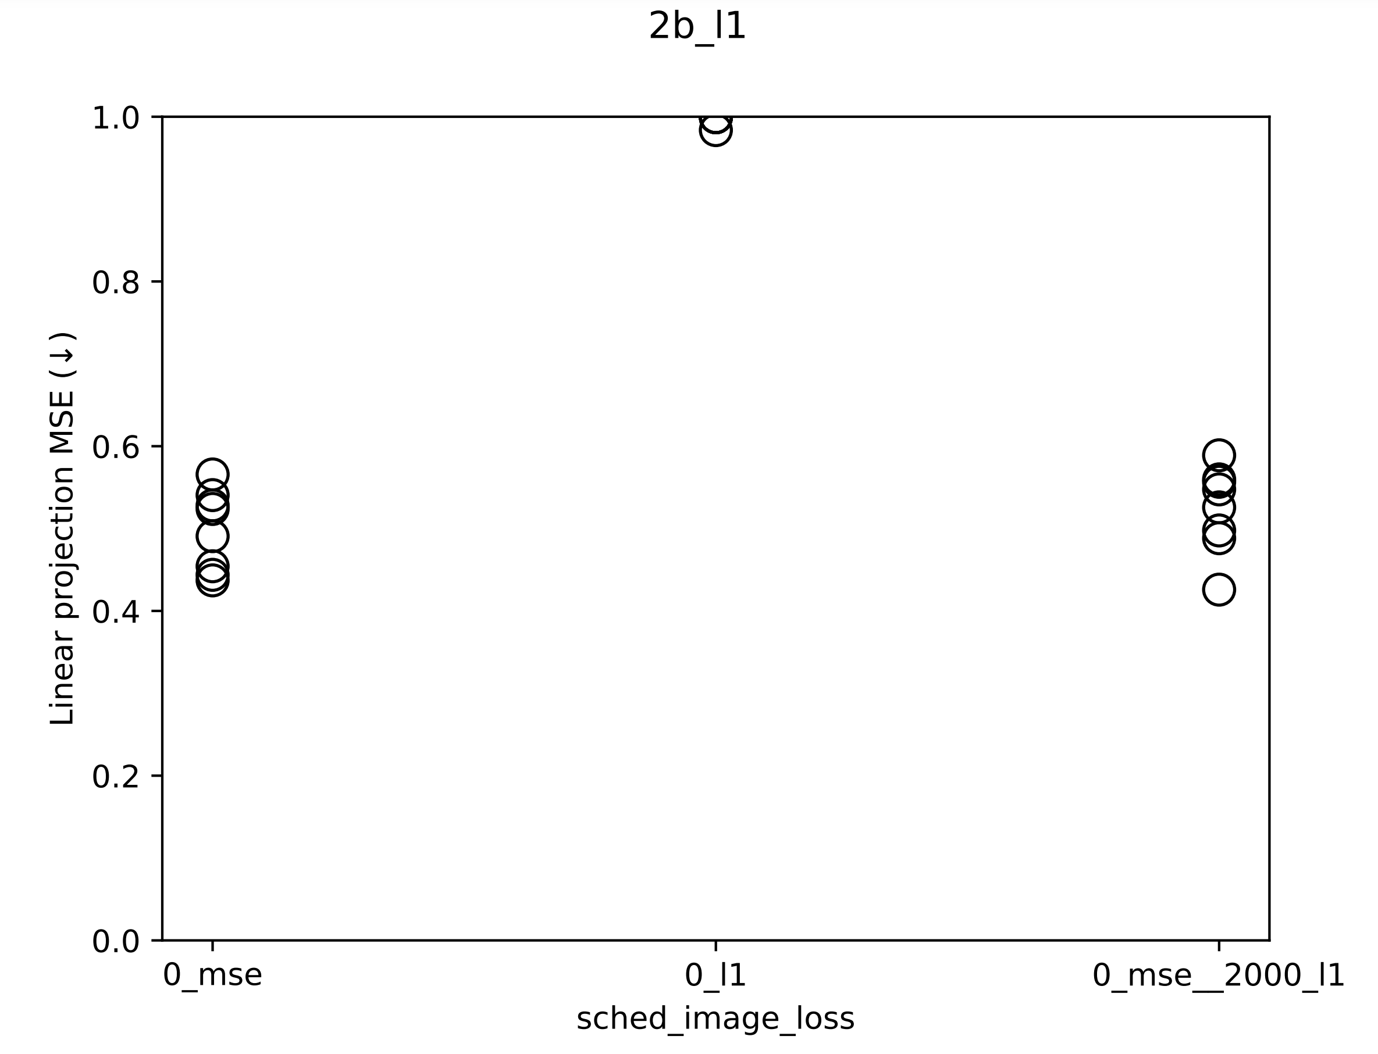

Slide 29
VVRNN: ablated
SKIP during meeting
Notes:
2023_m01_d04@01_32_48_vvrnn_static

