Slide 1
AuthedIP Overview
Daniel Chin. 3/15/2022.

Slide 2
Background: Transport/Application-layer vs Network-layer security
App-layer threats:
Eavesdropping on communication.
Intercepting and changing packet content.
App-layer solution: Encrypt your traffic!
This is necessary, but not enough.
Net-layer threats:
Resource depletion attacks: DoS.
Eavesdropping on traffic volume over time about each (source, dest) pair.

Slide 3
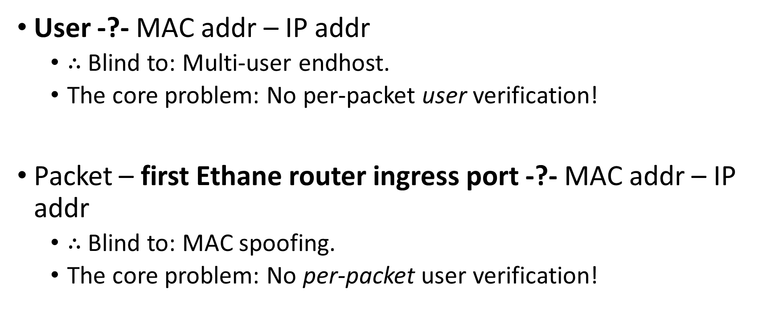
A security problem with Ethane
User -?- MAC addr – IP addr
$∴$Blind to: Multi-user endhost.
The core problem: No per-packet user verification!
Packet – first Ethane router ingress port -?- MAC addr – IP addr
$∴$Blind to: MAC spoofing.
The core problem: No per-packet user verification!

Slide 4
AuthedIP
Do per-packet user verification!
Goal: only authenticated packets are allowed in the network.
If you are not a registered user, you can’t send anything.
If you are a registered user, you can’t send anonymous packets.
Putting the check inside the network prevents DoS.
Compare: check at receiver.
No anonymity: anomalies can be traced back to registered users.

Slide 5
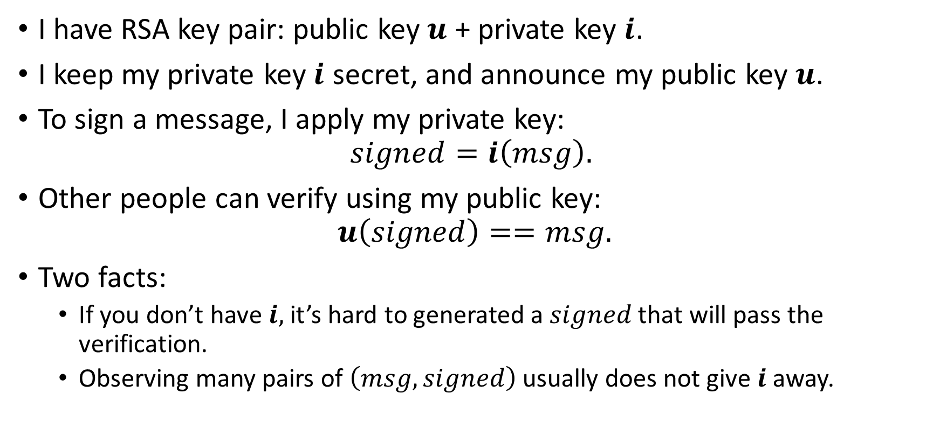
Background: RSA signature
I have RSA key pair: public key $u$ + private key $i$.
I keep my private key $i$ secret, and announce my public key $u$.
To sign a message, I apply my private key:
$$signed=i\left(msg\right).$$
Other people can verify using my public key:
$$u\left(signed\right)==msg.$$
Two facts:
If you don’t have $i,$it’s hard to generated a $signed$ that will pass the verification.
Observing many pairs of $\left(msg, signed\right)$ usually does not give $i$ away.

Slide 6
AuthedIP: The idea
Each user is registered with Controller.
i.e. Controller has a list of public keys of all users.
Each IP packet is signed by a user.
Routers reject packets that fail verification.
Simple!!! Right?

Slide 7
Attack 1: steal verified packet and change dest
I listen on the Ethernet and record a packet sent by someone else.
I can change the destination address. Send it.
The packet will not be rejected.
Imagine:
Jessica sent “clear database” to the test database. I send her packet to the production database.
Solution: Sign not only the payload, but also source-destination addresses.

Slide 8
Attack 2: record and playback
I record a packet, do not modify it, and send it back into the net.
Solution: Have a timestamp in each packet, and sign the timestamp too.

Slide 9
AuthedIP packet
h = hash(source, dest, content)
t = timestamp()
s = sign(concat(t, h))
Verify:
The hash is correct.
The signature is correct.
The timestamp is fresh.
The public key is registered.

Slide 10
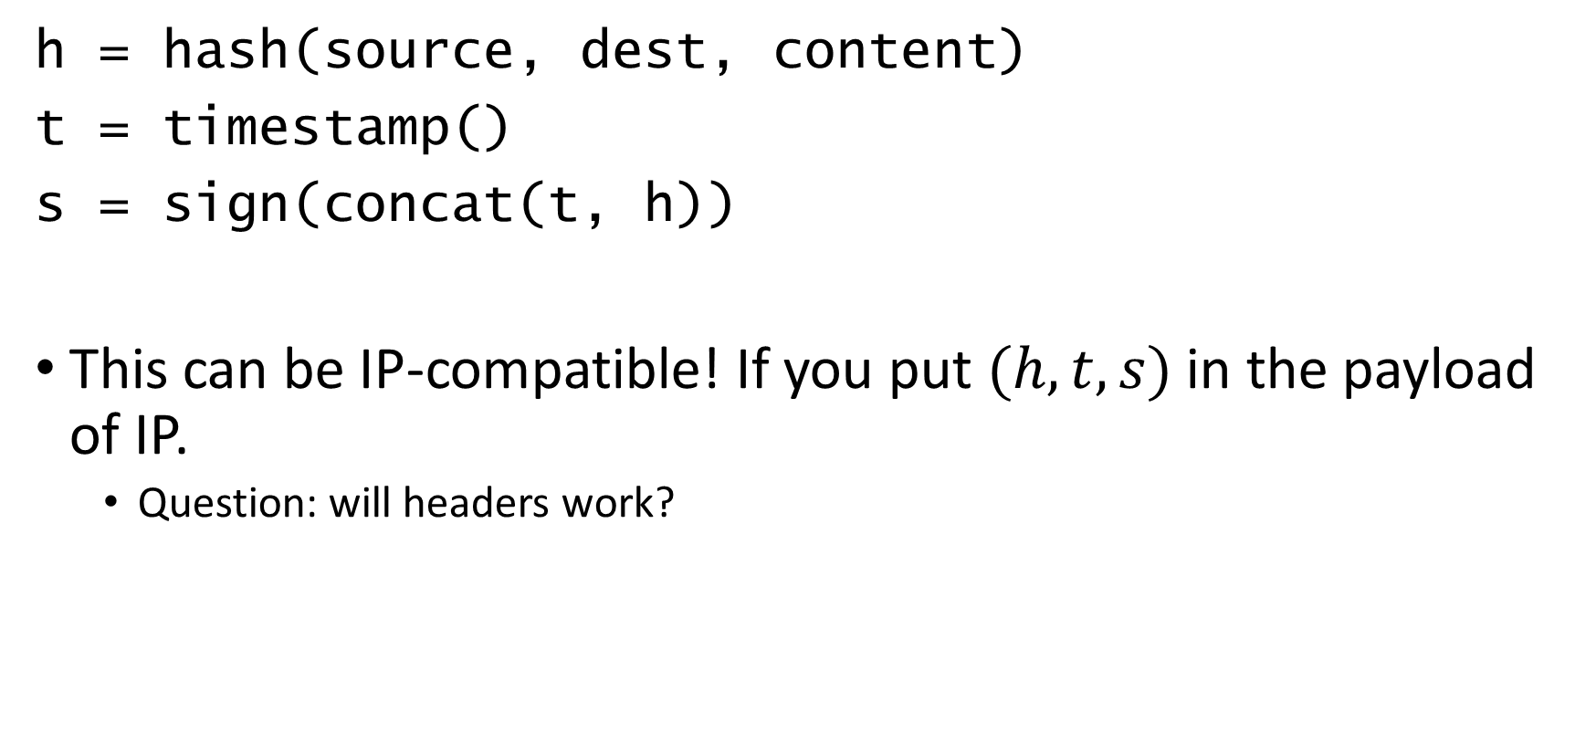
AuthedIP packet
h = hash(source, dest, content)
t = timestamp()
s = sign(concat(t, h))
This can be IP-compatible! If you put $(h,t,s)$ in the payload of IP.
Question: will headers work?

Slide 11
Attack 3: duplicate recent packets to DoS
Stays within the freshness constraint.
I can’t think of a solution yet…

Slide 12
Performance!
Verify
Forward
Time

Slide 13
Performance!
Forward
Verify
Time

Slide 14
Performance!
Wait.. So why should the routers do the verifications?
Just duplicate the packets to verifier servers.

Slide 15
General design
Controller
Verifier server

Slide 16
Project Repo
https://github.com/Daniel-Chin/AuthedIP
Aims at defining the complete behaviors with Python code.

