Slide 1
AuthedIP protocol
Daniel Chin, 3/23/2022.

Slide 2
Threat model
Setting?
Enterprise network.
What threat?
DoS.
From who?
Registered but misaligned employees.
Malwares on registered hosts.
Unregistered hosts in your building.

Slide 3
Threat model
Assumptions:
You have full control on a subset of routers and links.
From physical security.

Slide 4
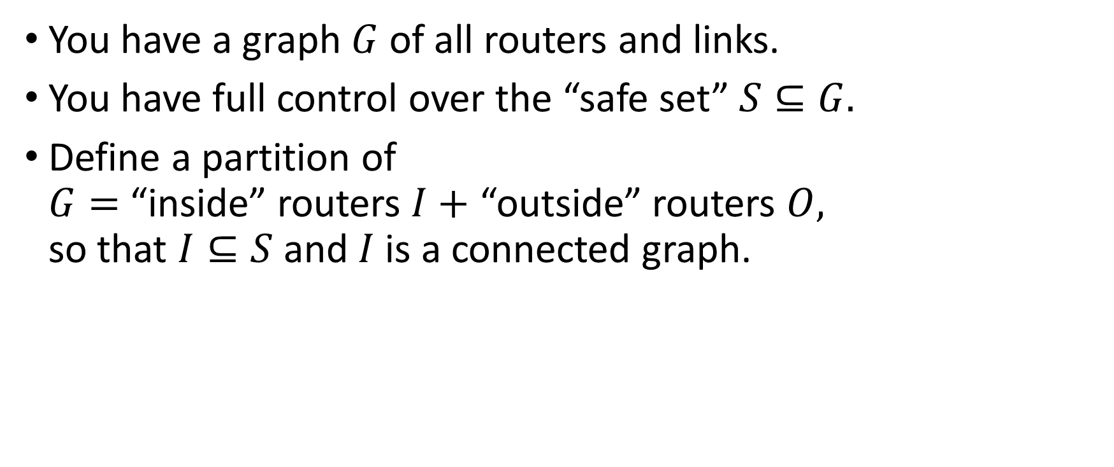
Inside and outside
You have a graph $G$ of all routers and links.
You have full control over the “safe set” $S⊆G.$
Define a partition of $G=$ “inside” routers $I+$ “outside” routers $O,$ so that $I⊆S$ and $I$ is a connected graph.

Slide 5
Inside and outside
Safe
Safe
Unsafe
Only one of the “safe” subgraph can be “inside”.

Slide 6

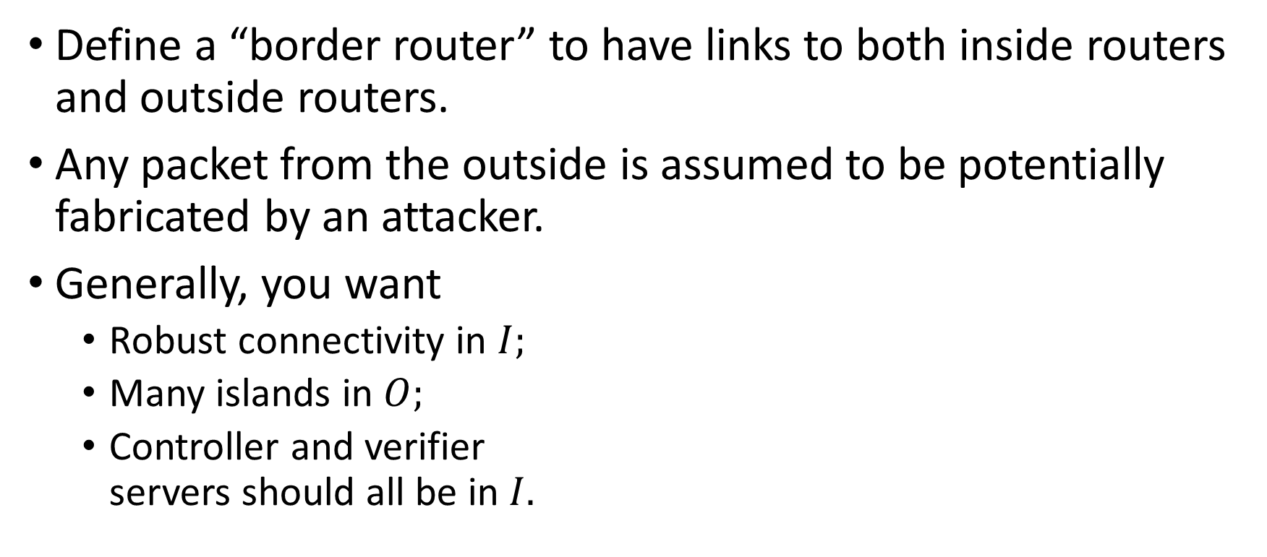
Inside and outside
Define a “border router” to have links to both inside routers and outside routers.
Any packet from the outside is assumed to be potentially fabricated by an attacker.
Generally, you want
Robust connectivity in $I;$
Many islands in $O;$
Controller and verifier servers should all be in $I.$
$$I$$

Slide 7
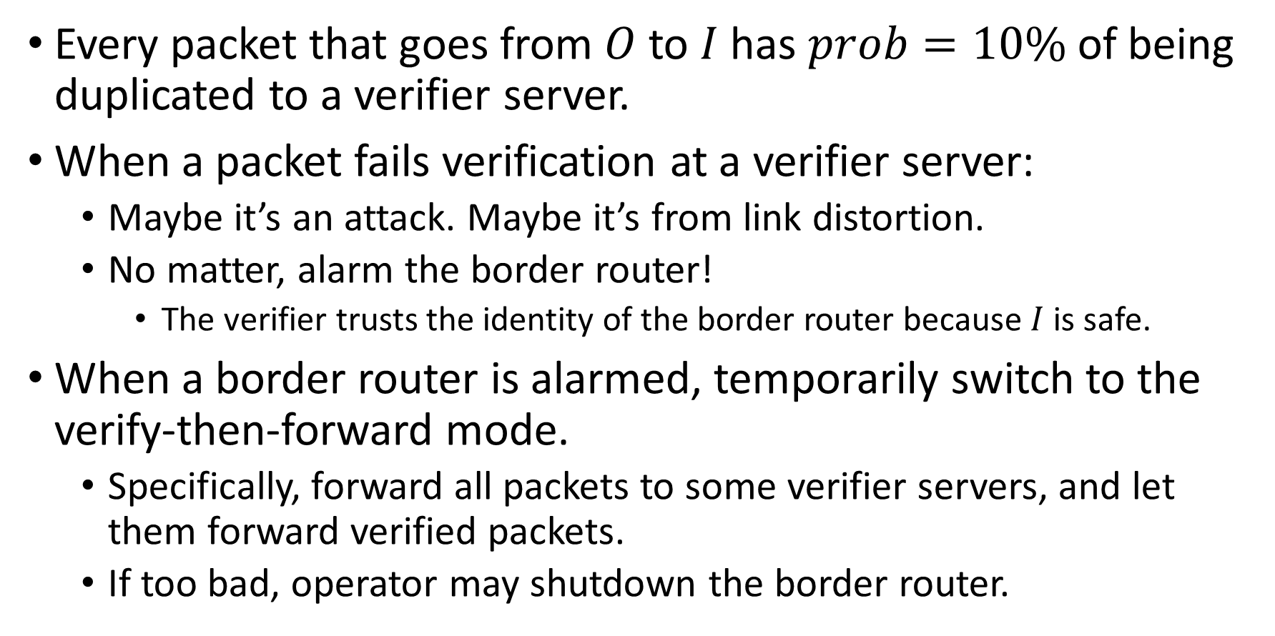
Policing
Every packet that goes from $O$ to $I$ has $prob=10\%$ of being duplicated to a verifier server.
When a packet fails verification at a verifier server:
Maybe it’s an attack. Maybe it’s from link distortion.
No matter, alarm the border router!
The verifier trusts the identity of the border router because $I$ is safe.
When a border router is alarmed, temporarily switch to the verify-then-forward mode.
Specifically, forward all packets to some verifier servers, and let them forward verified packets.
If too bad, operator may shutdown the border router.

Slide 8
Policing
After an attack with unverified packets,
we know which border router the attack originated from.
Either investigate that outside subnet.
Or turn that outside subnet into a safe subnet, essentially making them inside. This will pinpoint the attacker’s host in future.
After an attack with verified packets,
We know which registered user signed the packets.
Investigate that user, or check their machine for malware.

Slide 9
What if
DoS?
During the time it takes to verify the first invalid packet, the attacker can send as much traffic as possible towards the victim.
But after that, all packets will be rejected by the closest verifier server, localizing the damage.
Attack sporadically, waiting for the alarm to reset?
This attack disguises as random link distortion.
Therefore, its effect is at most as bad as random link distortion, up to a constant multiplier.

Slide 10
Policing: extra idea
Servers may scream for help when they suspect a DoS on them.
The server notifies Controller. Controller will then alarm some border routers.

Slide 11
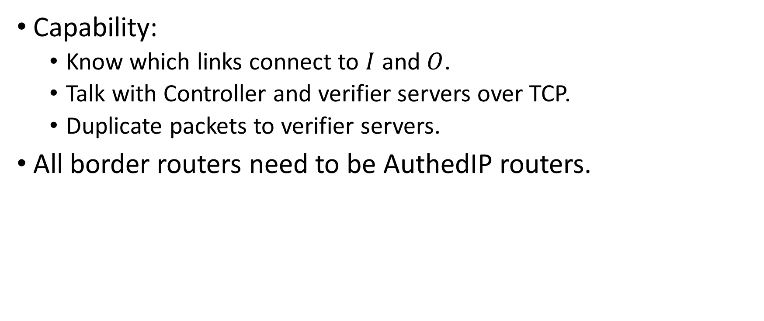
AuthedIP routers
Capability:
Know which links connect to $I$ and $O$.
Talk with Controller and verifier servers over TCP.
Duplicate packets to verifier servers.
All border routers need to be AuthedIP routers.

Slide 12
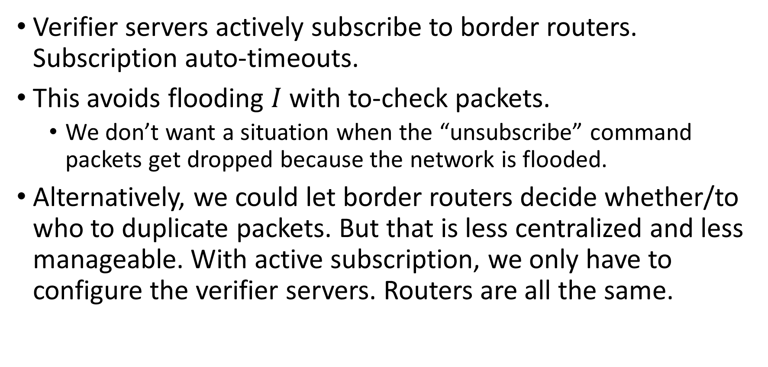
Verifier actively subscribes to border routers
Verifier servers actively subscribe to border routers. Subscription auto-timeouts.
This avoids flooding $I$ with to-check packets.
We don’t want a situation when the “unsubscribe” command packets get dropped because the network is flooded.
Alternatively, we could let border routers decide whether/to who to duplicate packets. But that is less centralized and less manageable. With active subscription, we only have to configure the verifier servers. Routers are all the same.

Slide 13
Recap
Threats from…
Registered but misaligned employees?
They are not anonymous.
Malware on registered hosts.
Stealing the private key is harder than infiltrating a host.
We know which user/host is problematic.
Unregistered hosts in your building.
We know which border router they connected to, and by extension, which outside subnet they are in.

Slide 14
Open questions
Attack: duplicate recent packets to DoS.
May need salting to prevent slow brute force of RSA signature. Controller should declare “salt of the day”.
Maybe the routers check the signature and servers check the hash?
No use

