Slide 1
AuthedIP: Authenticated IP Layer
Daniel Chin. 5/9/2022.

Slide 2
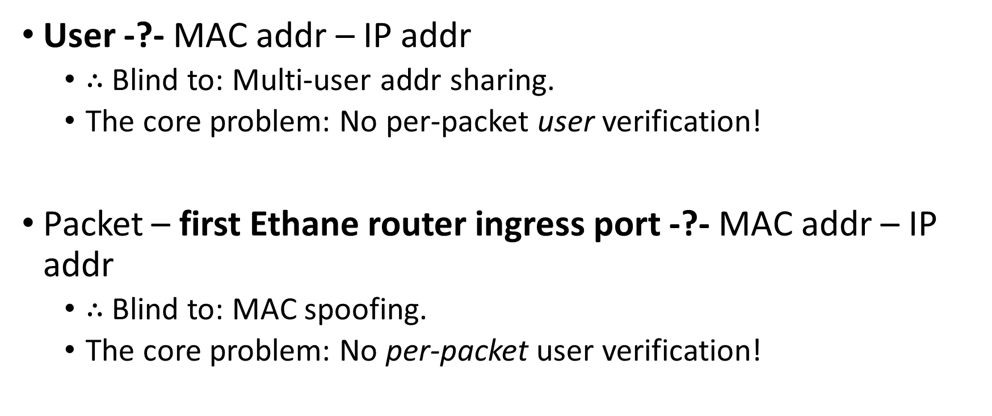
A security problem with Ethane
User -?- MAC addr – IP addr
$∴$Blind to: Multi-user addr sharing.
The core problem: No per-packet user verification!
Packet – first Ethane router ingress port -?- MAC addr – IP addr
$∴$Blind to: MAC spoofing.
The core problem: No per-packet user verification!
Notes:
The first problem is with Ethane’s binding between the user, the MAC address, and the IP address. When a user appears in the network, they first authenticate with the Controller with their credentials. This endorses their IP and MAC addresses. However, multiple users may share the same addresses, and Ethane is blind to that. The binding between the user and the addresses is therefore weak. The fundamental cause is that IP has no per-packet user identity.
The second problem is with Ethane’s binding between the packet, its first Ethane router ingress port, and its source addresses. Via MAC spoofing, a packet can easily lie about its source addresses, so the only secure information is which Ethan router ingress port the packet first went through. That is insufficient to hold packets accountable, unless the enterprise has deployed Ethane routers to all edges and each end host is connected directly to a different port on an Ethane router. Therefore, the second binding is also weak. An attacker, sharing the same ingress port with a valid user, can steal that user’s MAC address and send packets in their name. From Ethane’s perspective, a stream of packets with the same source address arrives at one ingress port after the user authenticated successfully with the Controller. No anomaly is noticeable. More generally, a user’s authentication only proves “such a user is behind such an ingress port” and nothing else. The user endorses the ingress port, and not their packets. In other words, the core problem is that Ethane has no per-packet user verification.

Slide 3
Thread model
DoS attack:
From within the enterprise network / outside the network?
From user / non-user?
The Inside vs. the Outside.
The Inside is physically secure.
Notes:
in this project, I only focus on the Denial of Service (DoS) attack originating from within the network.
A non-user may connect to the enterprise network and perform a DoS. A corrupted end host may perform a DoS against its user’s will. A misaligned employee may willingly perform a DoS. Those cases should all be addressed.

Slide 4
Overall design of AuthedIP
Each user’s RSA public key is registered with the Controller.
Each IP packet is signed by a user.
Routers forward packets, but duplicate some of them to the nearest verifier server.
Verifier servers check the packets’ signature. If verification fails, alert the responsible router.
When sufficiently alerted, routers enter the verify-then-forward mode to reject unverified packets.

Slide 5
User registration
Public key: 512-bit.
Public key ID: 64-bit.
The Controller stores a hash table that maps public key IDs to public keys.

Slide 6
Packet
In addition to an IP packet, an AuthedIP packet has three extra fields:
timestamp (16 bytes),
public key ID (8 bytes),
signature (64 bytes).
The signature is an RSA signature of the SHA-256 hash of the packet’s identity. The packet’s identity is the 24-byte concatenation of its timestamp, its source address, and its destination address.

Slide 7
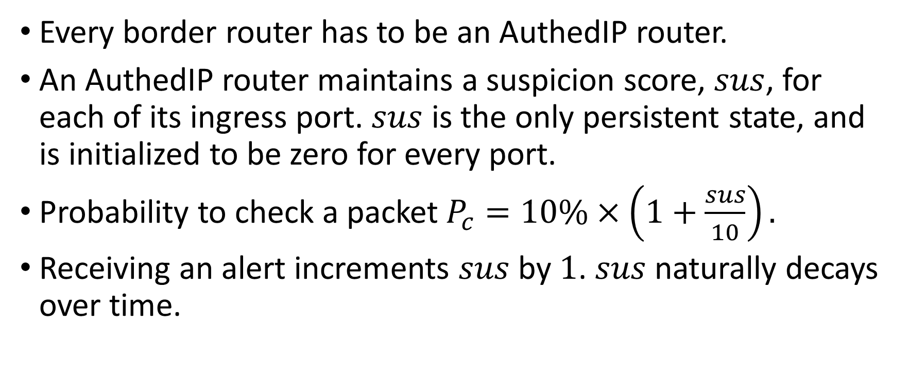
Router
Every border router has to be an AuthedIP router.
An AuthedIP router maintains a suspicion score, $sus$, for each of its ingress port. $sus$ is the only persistent state, and is initialized to be zero for every port.
Probability to check a packet $P_{c}=10\%×\left(1+\frac{sus}{10}\right).$
Receiving an alert increments $sus$ by $1$. $sus$ naturally decays over time.
Notes:
A DoS will increase $sus$ quickly, while sporadic verification failures due to link distortion will decay spontaneously.

Slide 8
Router (cont’d)
Wrap to-check packet and send to the nearest verifier server.
The wrapper packet contains two extra fields:
a 5-byte field that identifies the ingress port;
a 1-byte flag: whether the verifier server should forward this packet to its original destination.
Notes:
Conceptually redirected to go thru a verifier as a middlebox.

Slide 9
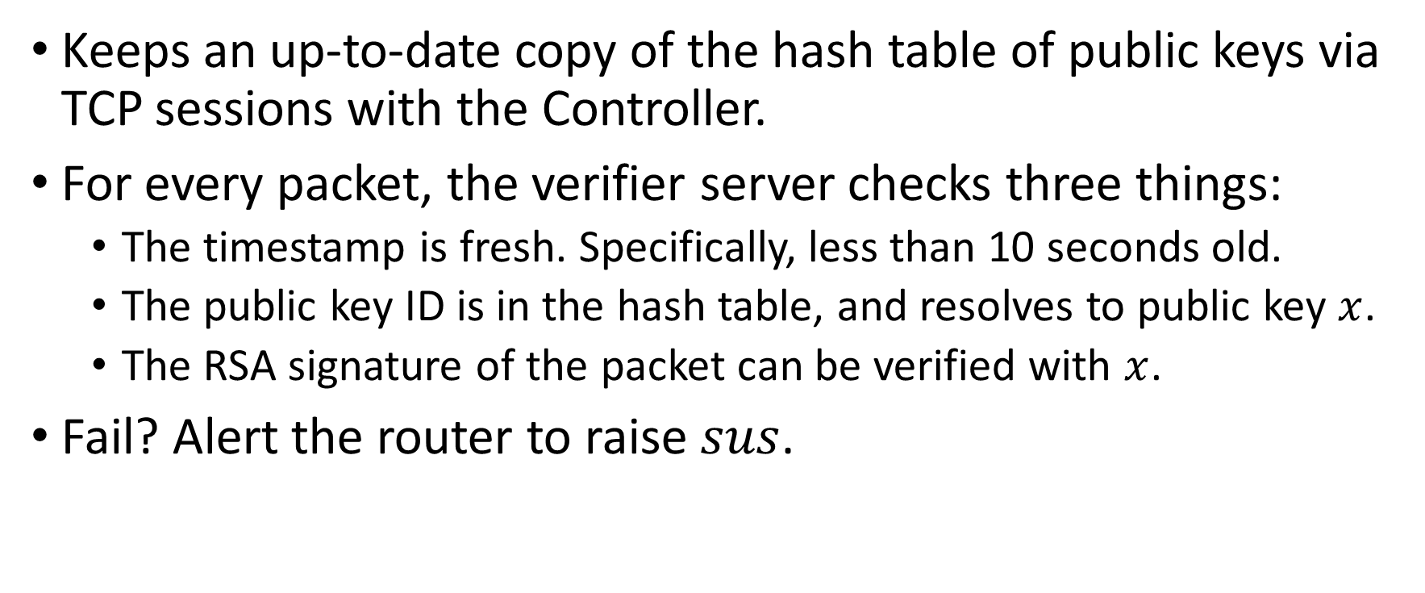
Verifier server
Keeps an up-to-date copy of the hash table of public keys via TCP sessions with the Controller.
For every packet, the verifier server checks three things:
The timestamp is fresh. Specifically, less than 10 seconds old.
The public key ID is in the hash table, and resolves to public key $x$.
The RSA signature of the packet can be verified with $x$.
Fail? Alert the router to raise $sus$.

Slide 10
Controller
In addition to doing Ethan things, maintain a hash table that maps public key IDs into public keys.

Slide 11
End host
When sending an IP packet, prepend the 88-byte AuthedIP fields.
This includes signing.
When receiving an IP packet, know that the “real payload” is offset by 88 bytes.
The receiver has no reason to verify the signature.

Slide 12
Active subscription?
Check out the report?

Slide 13
How to DoS AuthedIP
Using unverified packets?
Rapid? Rejected within one second.
Sporadic? As bad as link distortion.
Using verified packets?
Brute-force signature? No.
Steal key / trick signing? Hard.
Replay recent packets? DoS succeeds!
Notes:
First, consider using unverified packets to attack.
Suppose an attacker sends a stream of unverified packets. It takes time for the first packet to be duplicated, arrive at a verifier server, get rejected, and lead to an alert. It also takes time for $sus$ to accumulate. During this time window, unverified packets can freely flow into the network. However, such a time window is short. In my simulation (section 6.4) such a time window is shorter than one second.
The $sus$ levels decay over time. An attacker can send unverified packets sporadically, waiting for $sus$ to reach zero before sending another one. This attack disguises as random link distortions. Therefore, it must not send unverified packets at a significantly higher rate than random link distortions. That means, this attack’s damage is at most as bad as random link distortions, up to a constant multiplier.
Then, consider using verified packets to attack.
An attacker can try to brute force the signature, but as long as we use up-to-date cryptography standards, brute forcing should take a very long time. Timestamps expire in 10 seconds, so the attacker must brute force signatures for timestamps for a planned, future attack. Every successful cracking of signature grants the attacker 10 seconds of DoS time. So, good luck.
A malware on a valid user’s machine may try to steal the private key, but key files are protected in the OS. The malware may try to trick the user’s programs into signing some DoS packets. Programming-wise, signing with a private key has much more salient semantics than shipping packets, which hopefully makes it harder to inadvertently sign packets.
An attacker can replay recent packets sniffed from the network. For a sustained DoS attack, this requires a valid user in the same Outside subnet to be talking with the victim at least once every 10 seconds. That is possible. To make things worse, the signed (!) DoS packets all share the same border router with the valid conversation. It is not even clear that an attack is happening at all. AuthedIP fails to defend against such an attack. However, note that this attack requires specific circumstances.

Slide 14
After an Attack
After an attack with unverified packets, we know which border router the attack originated from. Either investigate that subnet on the Outside, or install more AuthedIP routers with physical security to push the frontier of the Inside. That will pinpoint the attacker’s host in the future.
After an attack with verified packets, we know which registered user signed the packets. Either investigate that user, or check their machine for malware.

Slide 15
Simulation Results
IP-over-socket on a localhost.
Each machine is a thread.
Routes are pre-installed.

Slide 16
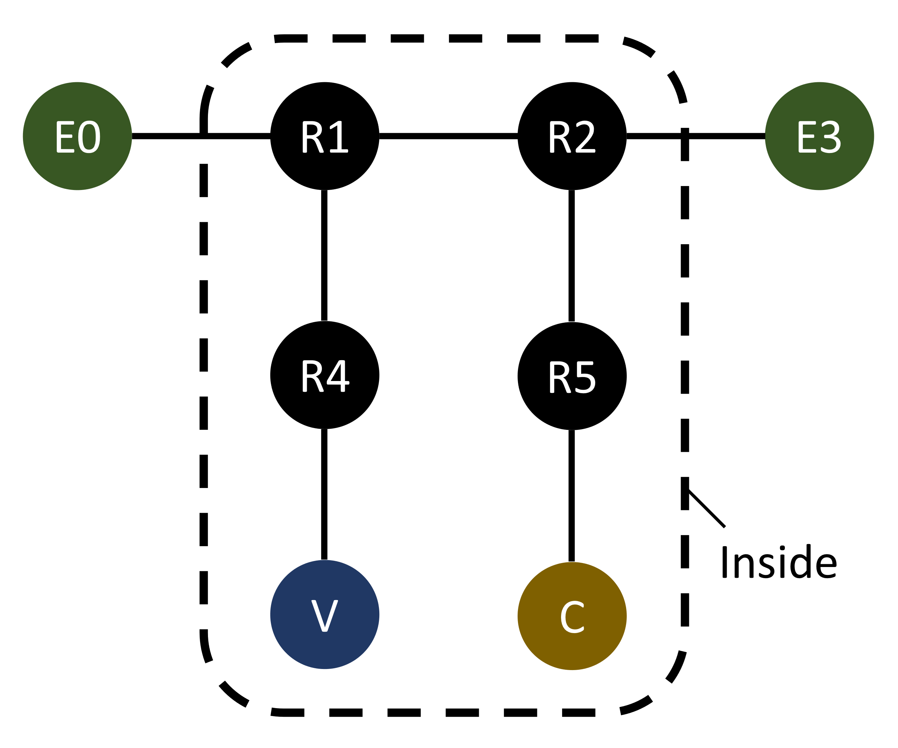
The simulated network

Slide 17
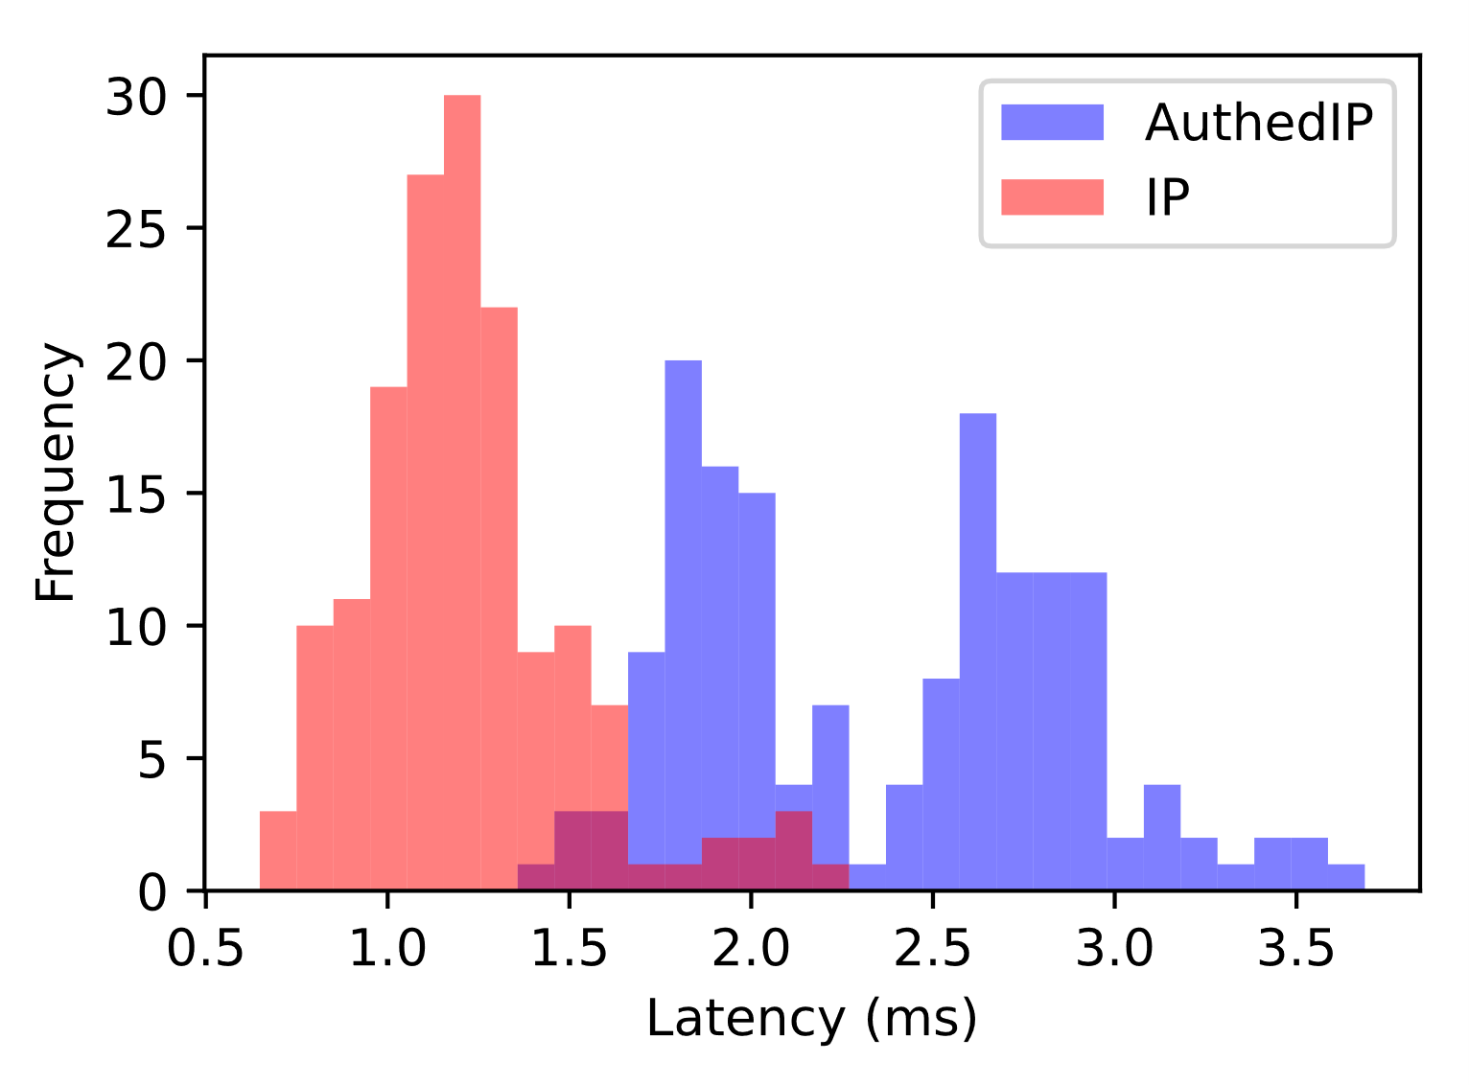
Latency
The end-to-end latency viewed from the transport layer.
so it includes
packet signing,
network flight (which includes router computations),
receiver parsing.

Slide 18
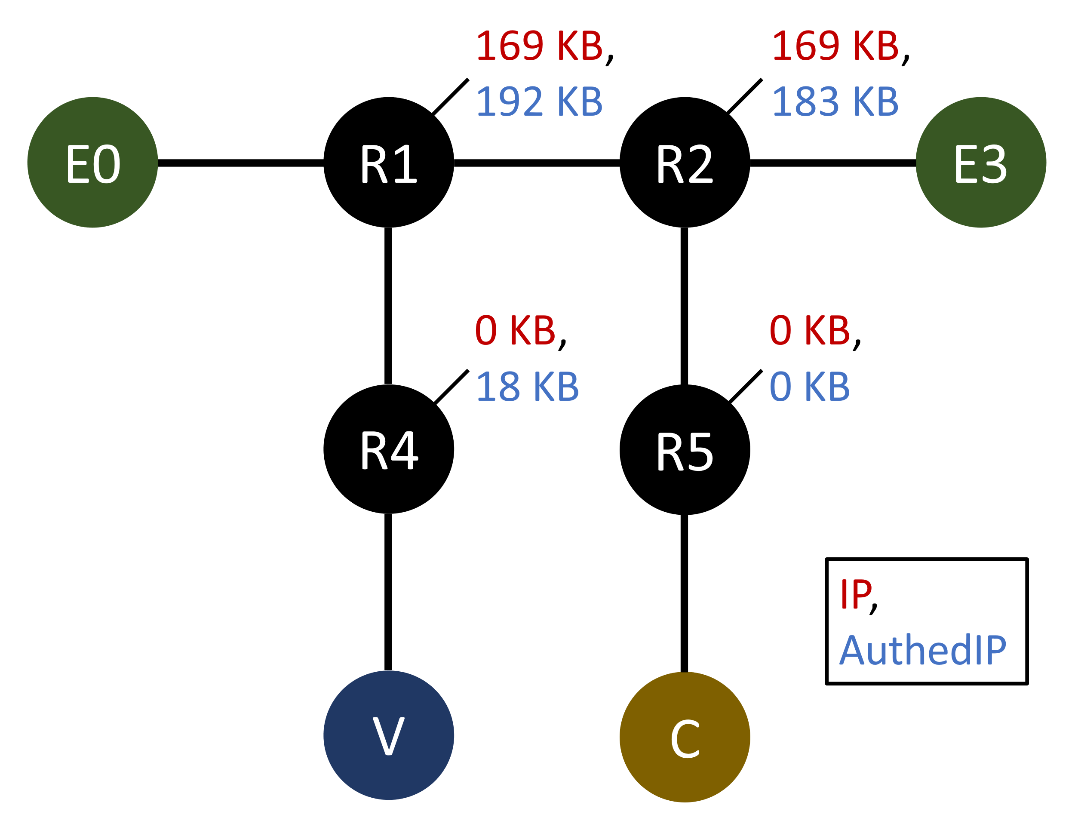

Traffic load over 5 seconds
The aggregate traffic load over all routers, for AuthedIP, is $17\%$ higher than IP.

Slide 19
Verification Power Puts a Bound on Throughput
One verifier server grants 15.1 GB/s of flux to enter the Inside.
This efficiency is achieved with a single-thread Python implementation on my laptop.

Slide 20
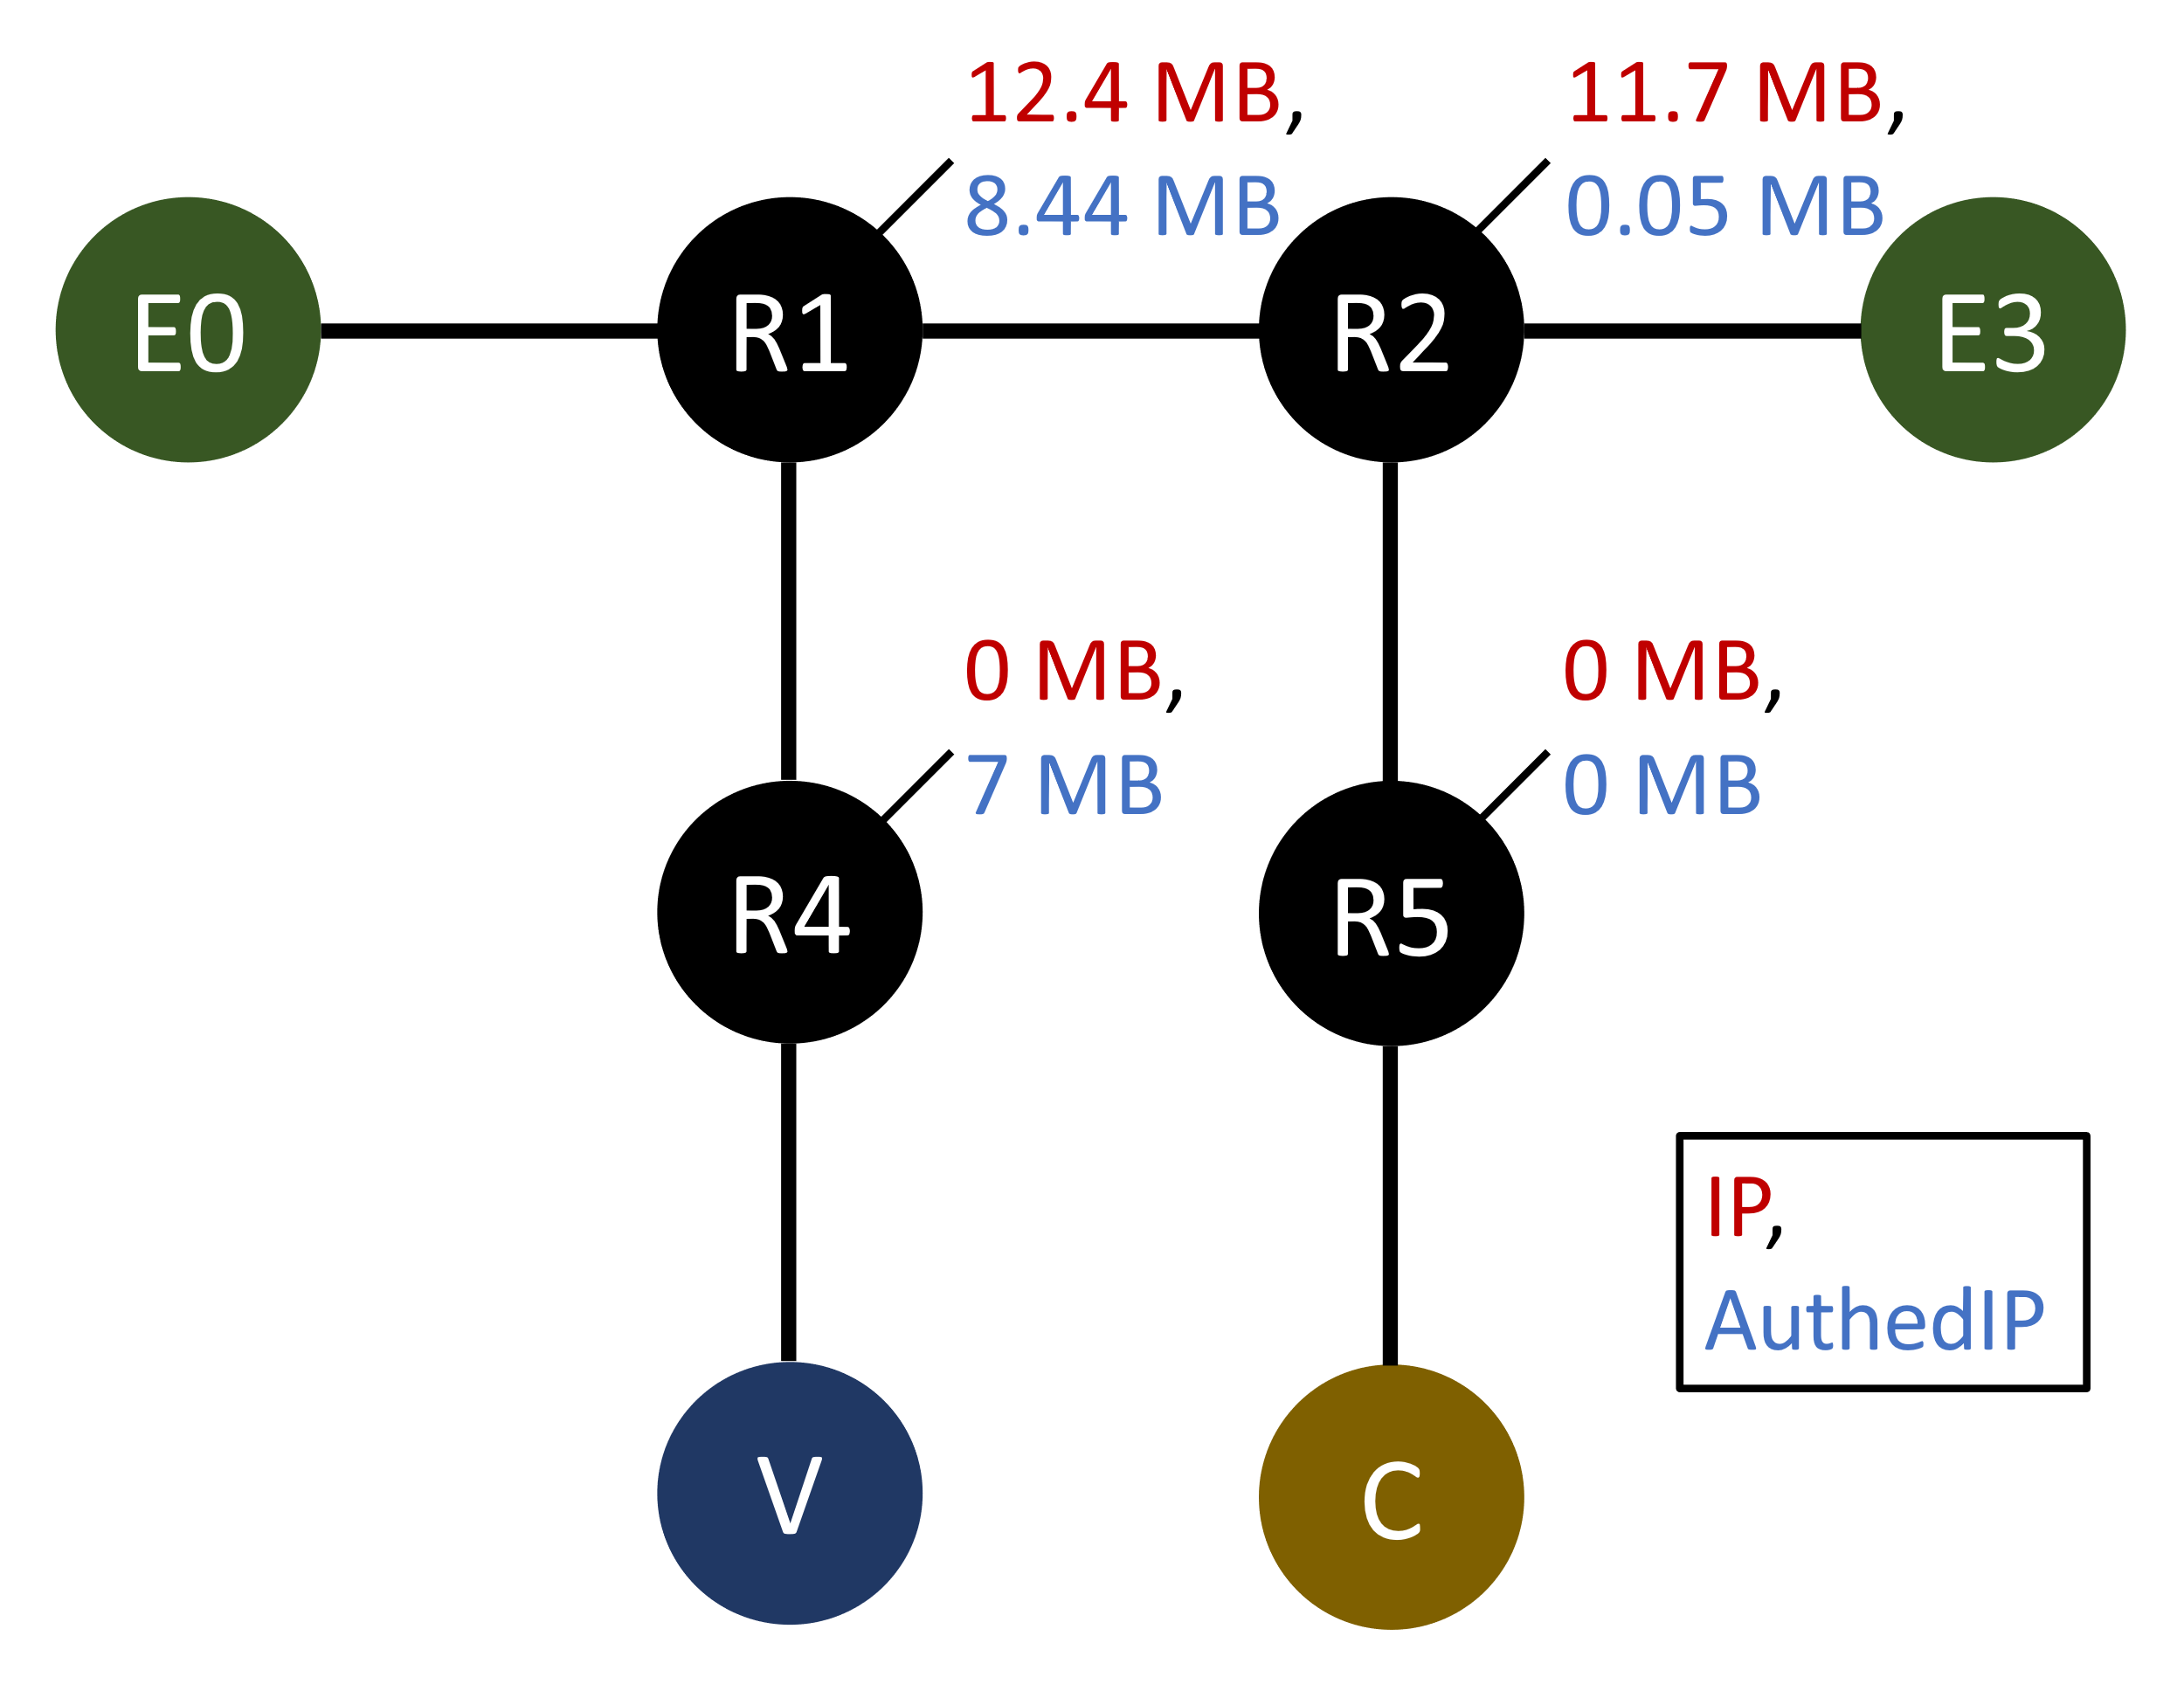
Defending DoS
Within <1 sec, R1 enters the verify-then-forward mode.
R2 and E3 have only received 0.05 MB of DoS traffic.
Afterwards, all DoS traffic is redirected to V and gets dropped.
Total traffic load for AuthedIP is 36% lower than IP. Importantly, R2 and E3 are almost unaffected.

Slide 21
Defending DoS (cont’d)
Surprisingly, even R1 experiences lower traffic load in AuthedIP than in IP!
That happens because V is CPU-bound, which makes R1’s output queue towards V full, which makes R1 forward less packets than in IP.
This is related to something I skipped in this presentation. Check out the report.

Slide 22
Limitations
Attacker can predict the timestamp.
Maybe: Controller announces a random salt every day, to be xor-ed with the timestamp.
Conversations between routers, verifier servers, and the Controller are insecure.
An attacker can send fake “duplicated packets” to verifier servers, or send fake alerts to border routers, essentially playing AuthedIP against itself.
Maybe: encrypt.
Maybe: physical security.

Slide 23
Conclusion
In this project I design and study AuthedIP, an augmentation to the Internet Protocol for the enterprise network. In an AuthedIP network, each packet is signed by a user. Non-users can be rejected within seconds. Anomalies can be traced back to its endorsing user.
Repo : github.com/Daniel-Chin/AuthedIP
Report: github.com/Daniel-Chin/AuthedIP/blob/main/report.pdf

