Slide 1
Dice Simulation
Daniel Chin | Michael Li

Slide 2
Table of Content
Intro
Investigation results
Model implementation
Loose ends (if we have time)

Slide 3
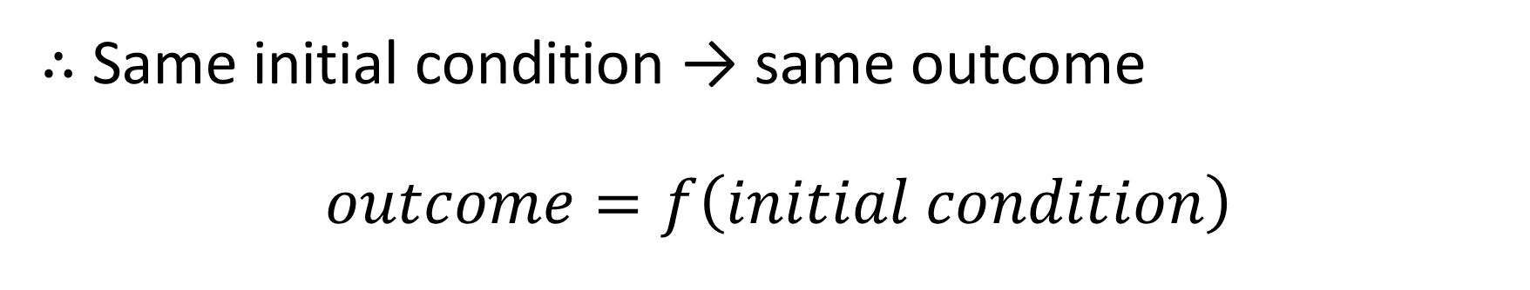
Simulation is deterministic
∴ Same initial condition → same outcome
$$outcome=f\left(initial condition\right)$$
{
{
1 2 3 4 5 6
Linear velocity
Angular momentum

Slide 4

Human has error $(ε)$
$$f\left(initial condition+ε\right)$$

Slide 5

Human has error $(ε)$
$$f\left(initial condition+ε\right)$$
=
$$f\left(initial condition\right)$$
When $ε$ is sufficiently small

Slide 6

$$outcome=f\left(initial condition\right)$$

Slide 7
Cheating strategies
Find a large cell. Or,
Find a group of cells of the same color/number

Slide 8
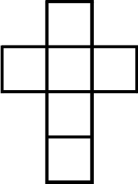
Can there be adjacent cells pointing to opposite faces on the cube?
3
1
2
6
5
4

Slide 9
What is a border?
3
1

Slide 10
Standing on the edge
Exact solution? Or just a “limit” situation?
Will return to this in the “loose ends” section.

Slide 11
6
1
3
What about vertices that connect 3 cells?

Slide 12
What about vertices that connect 7 cells?
That’s just the norm in a 6D space.

Slide 13
What about vertices that connect 7 cells?
That’s just the norm in a 6D space.
Wait a sec… There’s only 6 faces on a dice!

Slide 14
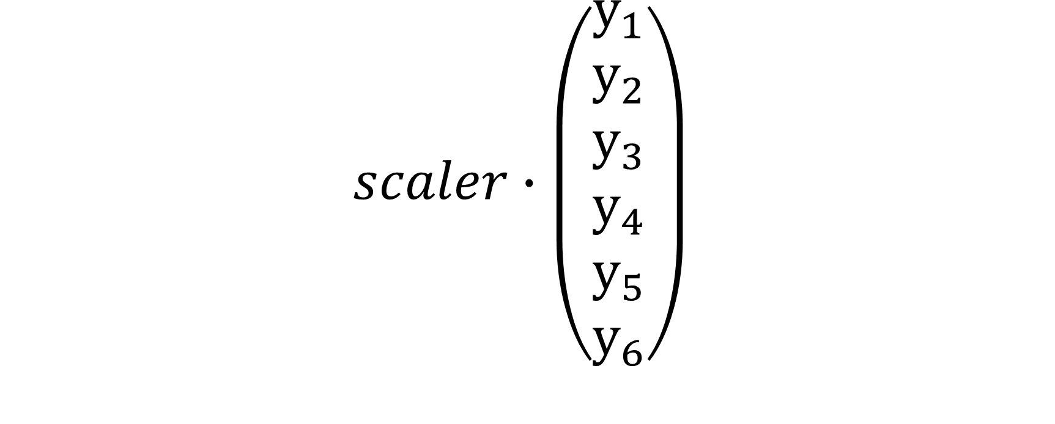
Take a line in the 6D space
$$scaler∙\left(\begin{matrix}y_{1} \\ y_{2} \\ y_{3} \\ y_{4} \\ y_{5} \\ y_{6}\end{matrix}\right)$$

Slide 15
1D investigation
Initial condition

Slide 16
1D investigation: naïve sampling
Initial condition

Slide 17
1D investigation: dynamic sampling
Initial condition

Slide 18
1D dynamic sampling algorithm
Binary search mode
Marching mode
* Found 3rd color during searching? Recursion.

Slide 19
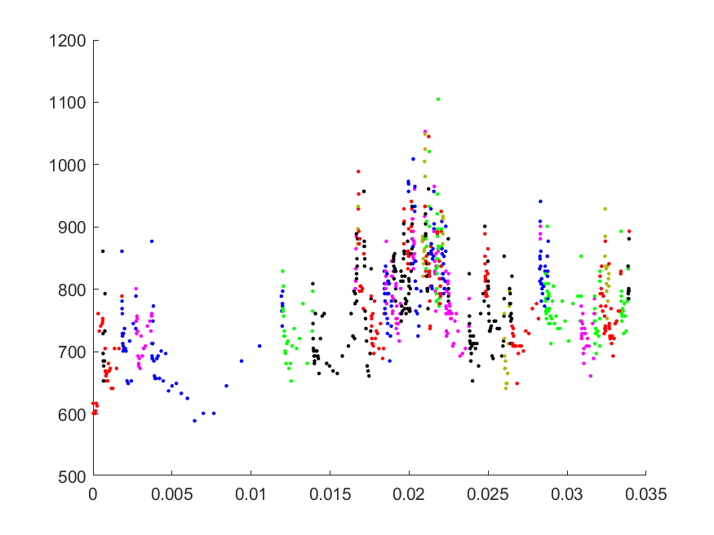
Dynamic (cheating) sampling

Slide 20
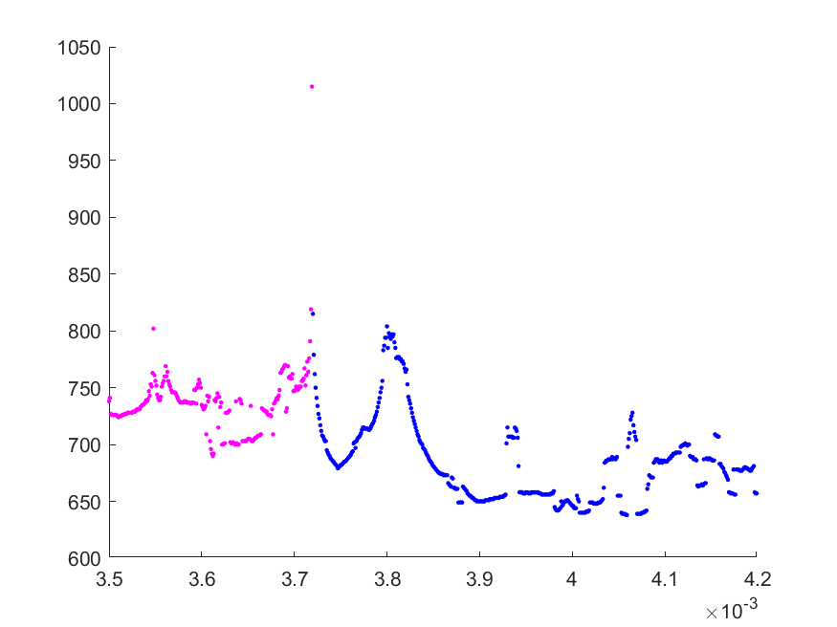

Slide 21
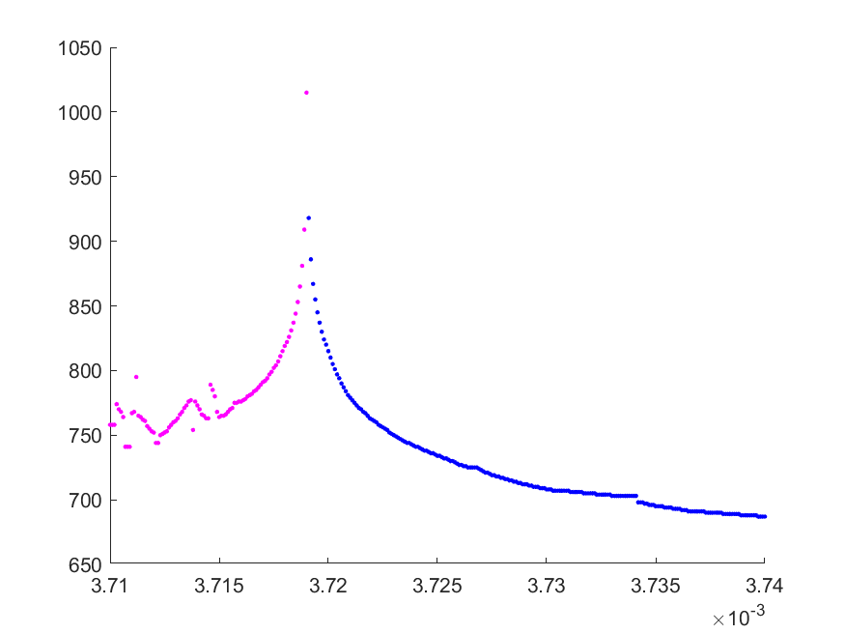

Slide 22
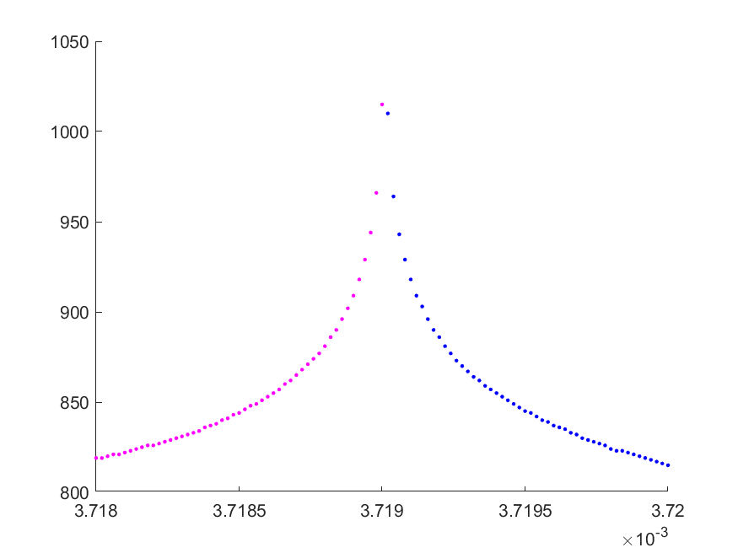

Slide 23
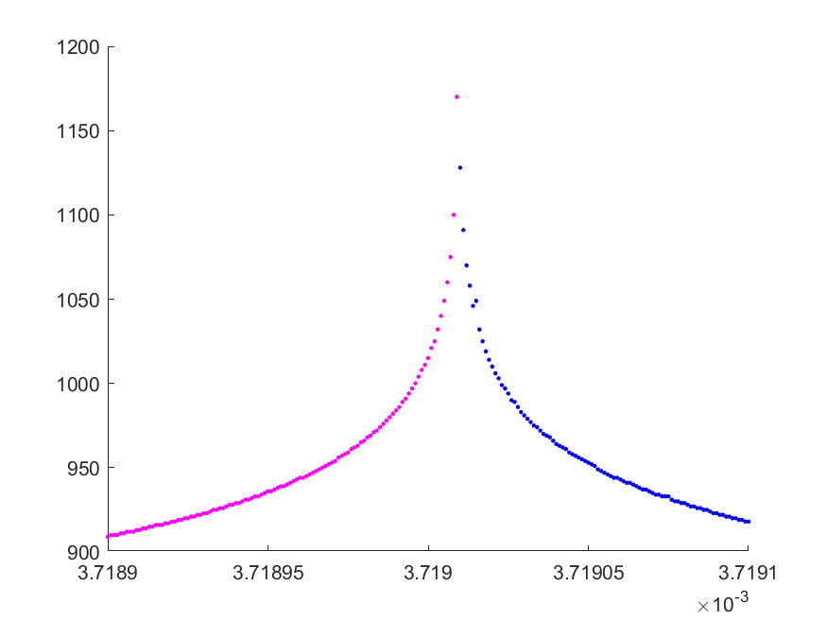

Slide 24
Michael: Video here

Slide 25
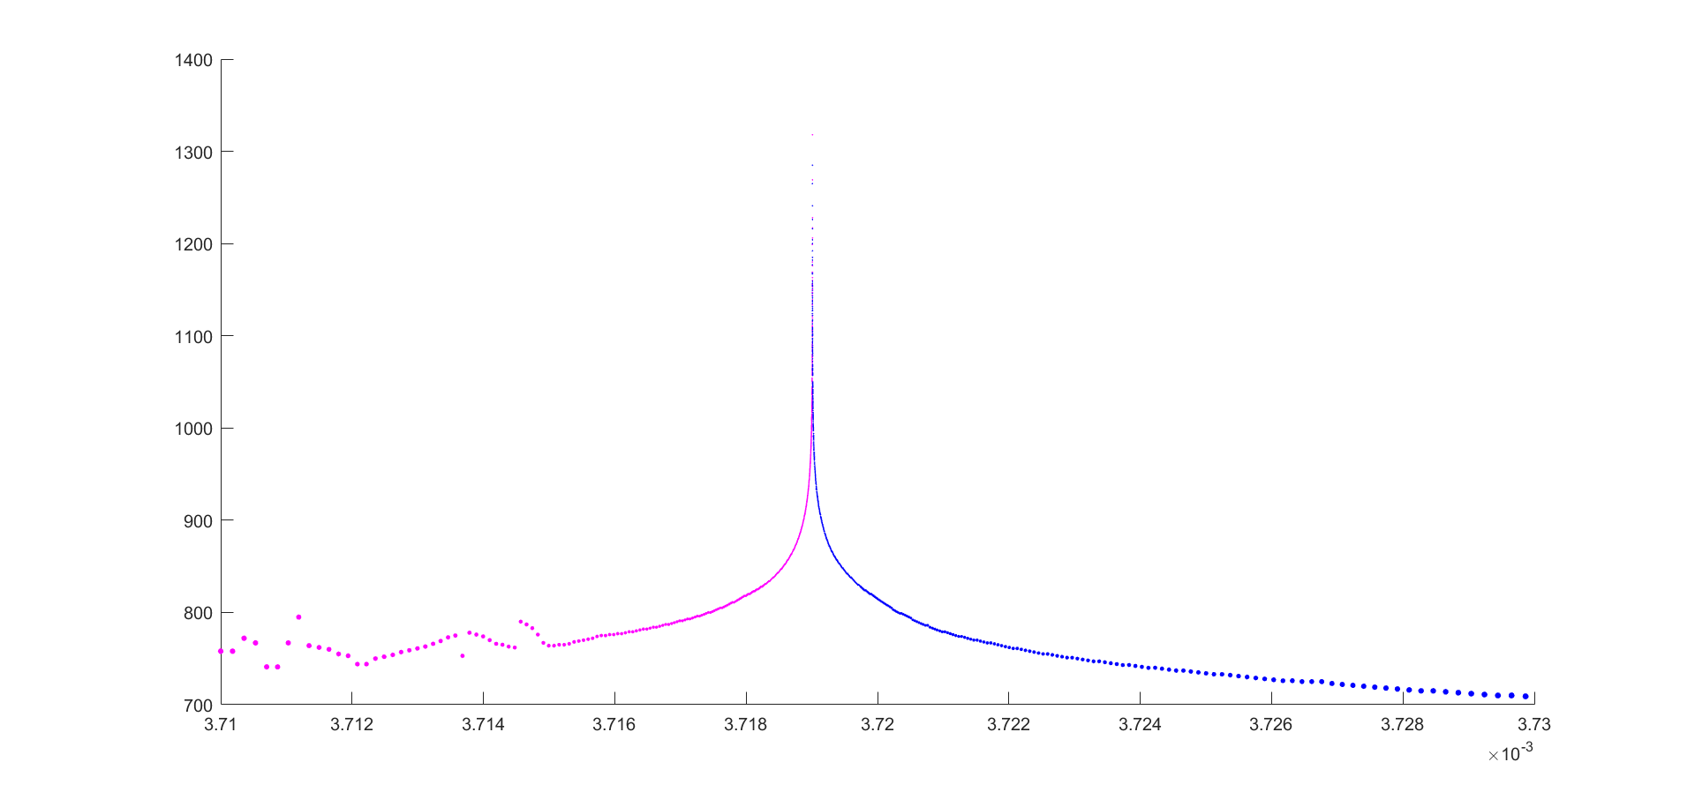

Slide 26
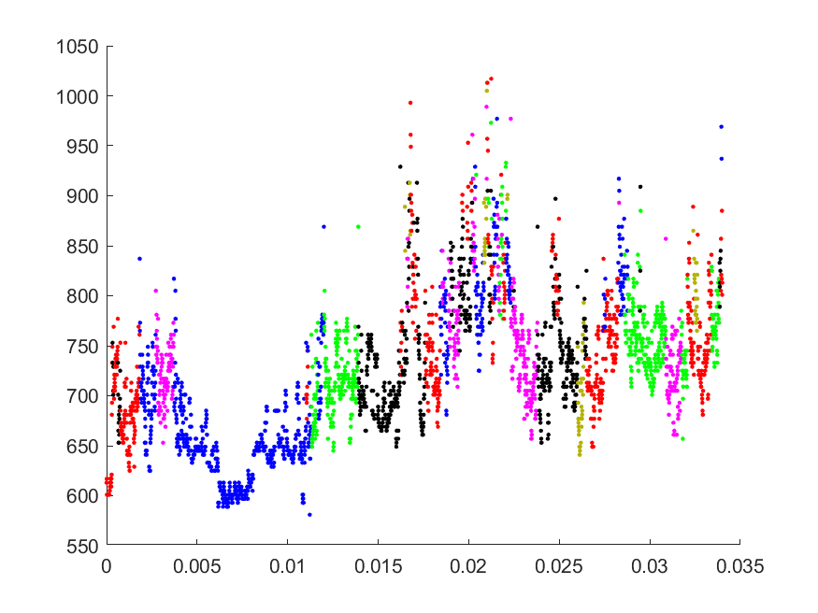
Naïve (honest) sampling

Slide 27
Dynamic (cheating) sampling

Slide 28
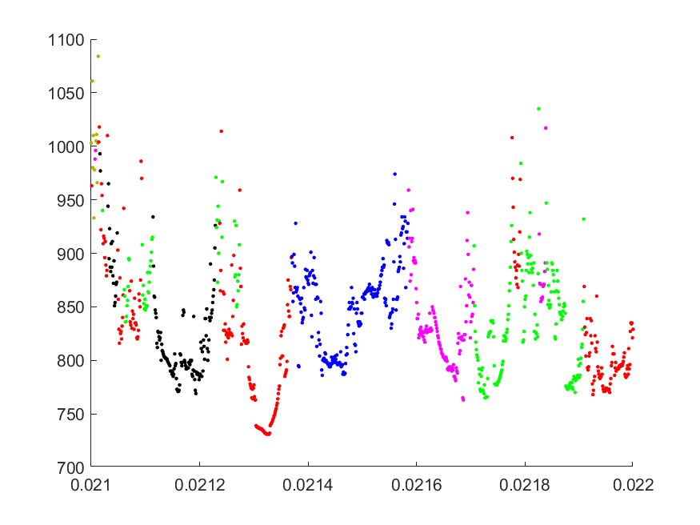
“Party”

Slide 29
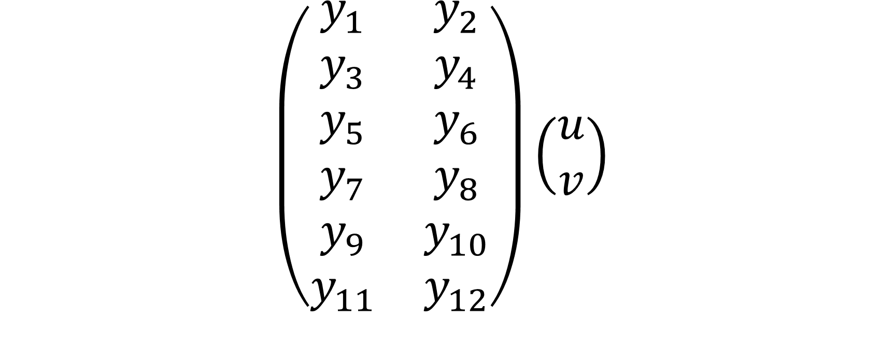
Take a plane in the 6D space
$$\left(\begin{matrix}y_{1} & y_{2} \\ y_{3} & y_{4} \\ y_{5} & y_{6} \\ y_{7} & y_{8} \\ y_{9} & y_{10} \\ y_{11} & y_{12}\end{matrix}\right)\left(\begin{matrix}u \\ v\end{matrix}\right)$$

Slide 30
2D dynamic sampling algorithm

Slide 31
2D dynamic sampling algorithm

Slide 32
2D dynamic sampling algorithm
SKIP

Slide 33
2D dynamic sampling algorithm
SKIP

Slide 34
2D dynamic sampling algorithm
SKIP
SKIP
SKIP
SKIP
SKIP
SKIP
SKIP
SKIP

Slide 35
2D dynamic sampling algorithm
…
…
SKIP
…
SKIP
SKIP
…
…
SKIP
SKIP
…
SKIP
SKIP

Slide 36
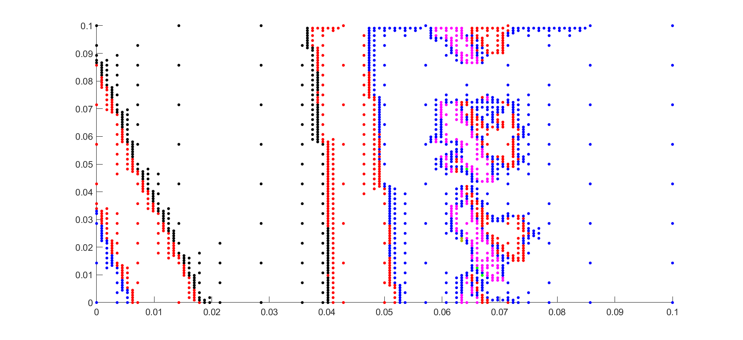
Dynamic (cheating) sampling

Slide 37
Dynamic (cheating) sampling

Slide 38
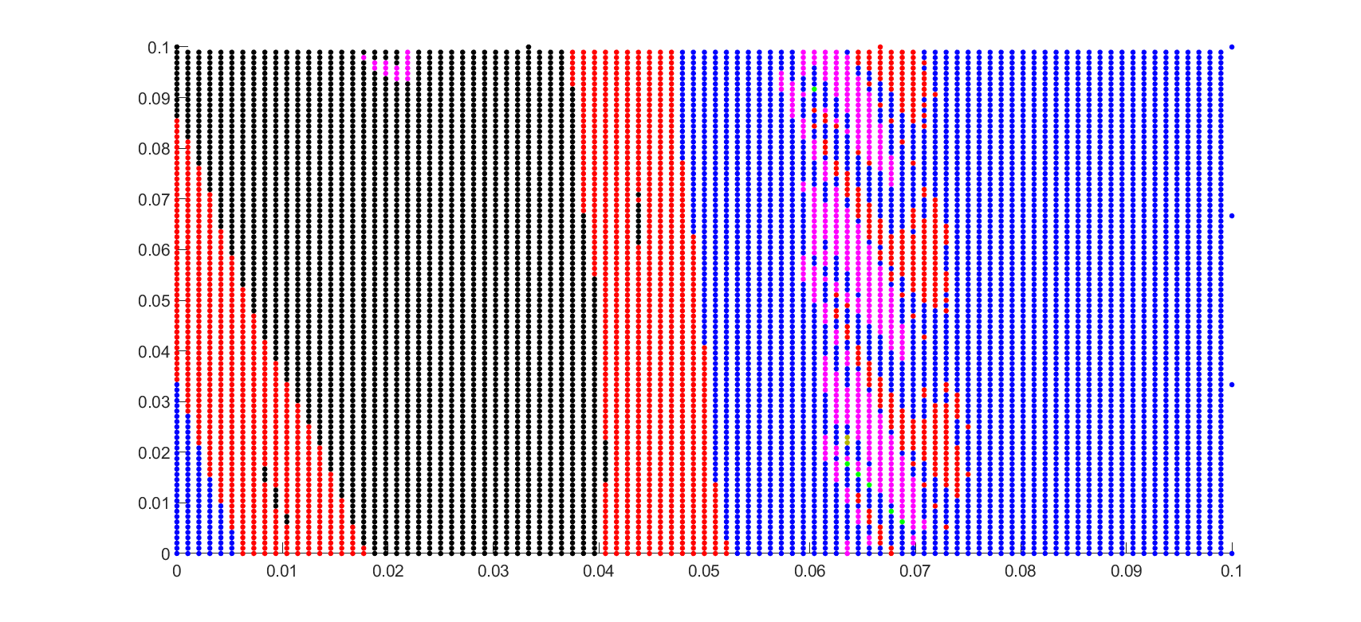
Dynamic (cheating) sampling

Slide 39
Dynamic (cheating) sampling

Slide 40
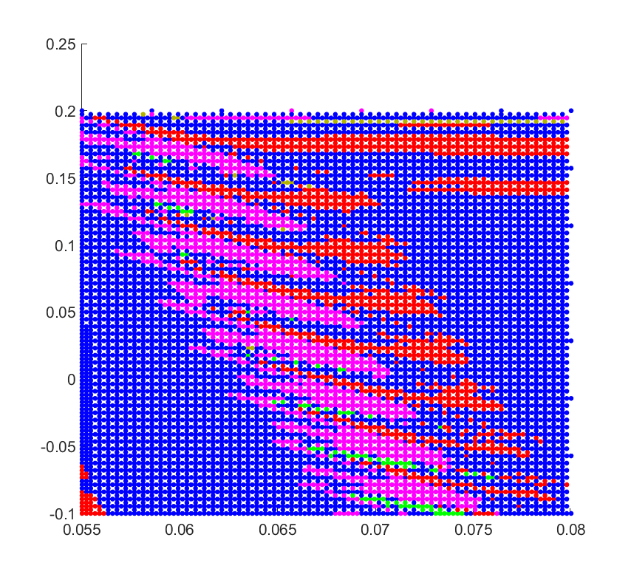
“Ripples”

Slide 41
Model implementation
Rigid body motion
Interaction with the ground

Slide 42
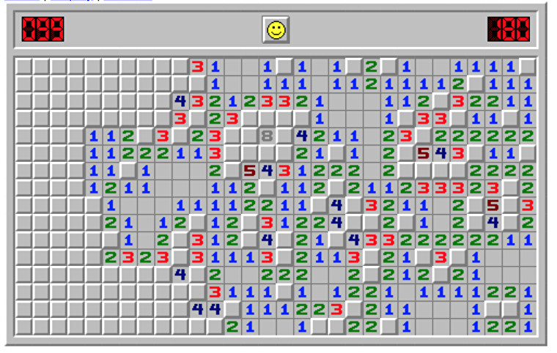
Loose ends
Color the numbers

Slide 43
Init condition: not considering h. set h=0, let go and have 6
Does standing on edge exists as exact solutions? Ring climbs hump rail analogy
How to call which face is facing up?
Told the program to never exit binary search mode and got forever.mat. “After a couple of iterations, MATLAB froze. I thought I wrote a bug. No. It’s a simulation that just didn’t end.”
simulation time before settle down. Think: how can you tell it's settled down? Velocity never reaches zero. 10 to the minus sth. Even better: call the end of simulation before settle down. We used total energy.

Slide 44

Rounding operation
$$floor\left(1±ε\right)$$
=
$$floor\left(1\right)$$
When $ε$ is sufficiently small???

Slide 45
Take a plane in the 6D space
$$\left(\begin{matrix}y_{1} & y_{2} \\ y_{3} & y_{4} \\ y_{5} & y_{6} \\ y_{7} & y_{8} \\ y_{9} & y_{10} \\ y_{11} & y_{12}\end{matrix}\right)\left(\begin{matrix}u \\ v\end{matrix}\right)$$
These better be perpendicular

