Slide 1
MINIOO Report
Daniel Chin
11/1/2021

Slide 2
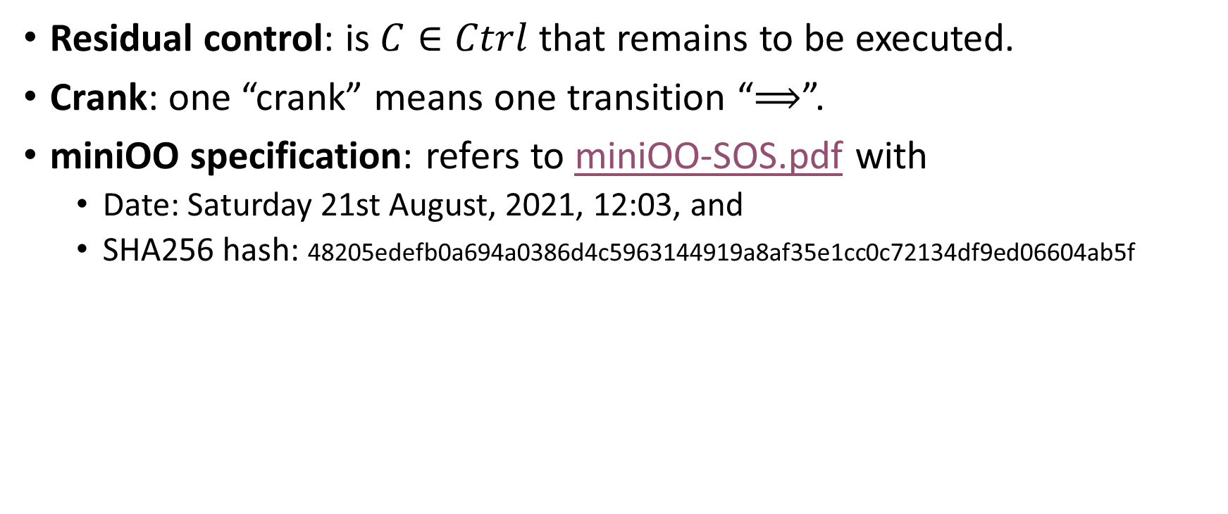
Glossary
Residual control: is $C∈Ctrl$ that remains to be executed.
Crank: one “crank” means one transition “$⟹$”.
miniOO specification: refers to miniOO-SOS.pdf with
Date: Saturday 21st August, 2021, 12:03, and
SHA256 hash: 48205edefb0a694a0386d4c5963144919a8af35e1cc0c72134df9ed06604ab5f

Slide 3
Project directory structure
Types.mli AST types definition.
LEX.mll Lexer definition.
MENHIR.mly Parser definition.
miniOO.ml miniOO interpreter.
build Bash script that builds ./miniOO from source.
tests/ Directory of miniOO tests scripts.
test Bash script that runs test scripts with ./miniOO. E.g. `./test 0`.

Slide 4
How to run
Download the project from https://github.com/Daniel-Chin/HPL/tree/main/miniOO.
`./build` should give you an executable ./miniOO that interprets stdin as miniOO source code.
Alternatively, write a miniOO script file and save as ./tests/myTest.miniOO and run `./test myTest`.
There are two verbosity levels. At the top of ./miniOO.ml, `verbose = true` makes each crank print the stack, the heap, and the residual control; while `verbose = false` makes each crank pretty print the object representations.

Slide 5
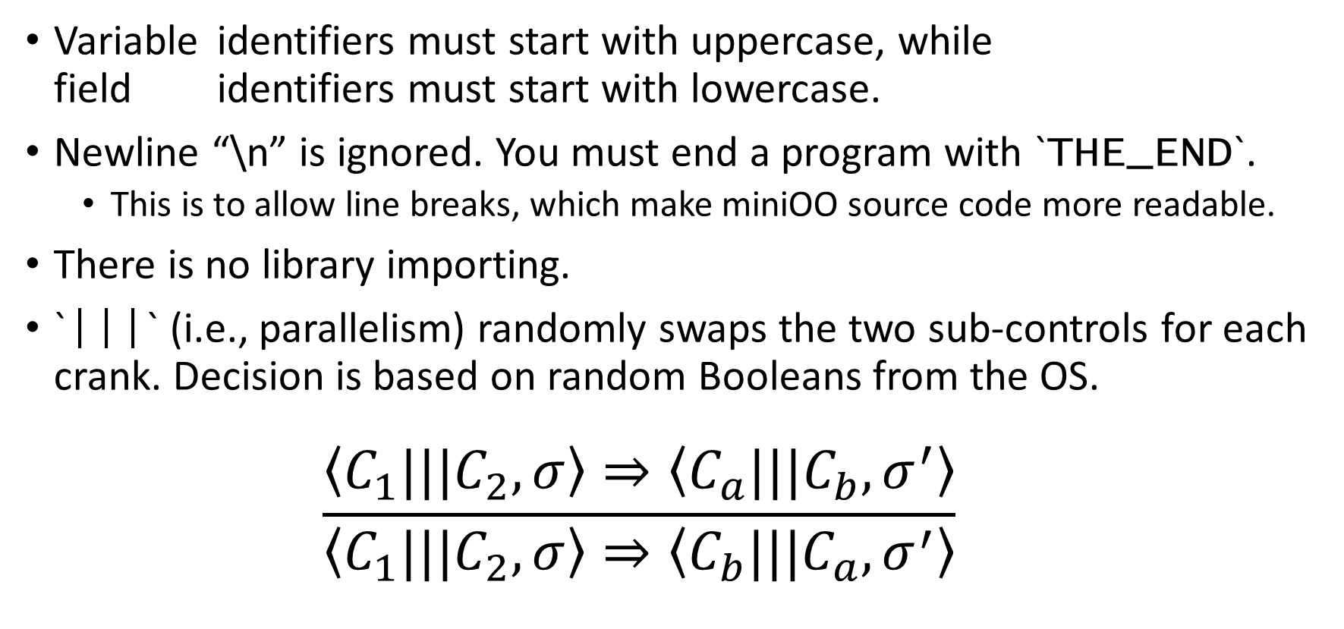
Specialties
Variable identifiers must start with uppercase, while field identifiers must start with lowercase.
Newline “\n” is ignored. You must end a program with `THE_END`.
This is to allow line breaks, which make miniOO source code more readable.
There is no library importing.
`|||` (i.e., parallelism) randomly swaps the two sub-controls for each crank. Decision is based on random Booleans from the OS.
$$\frac{\left\langle C_{1}|||C_{2},σ\right\rangle ⇒\left\langle C_{a}|||C_{b},σ^{′}\right\rangle }{\left\langle C_{1}|||C_{2},σ\right\rangle ⇒\left\langle C_{b}|||C_{a},σ^{′}\right\rangle }$$

Slide 6
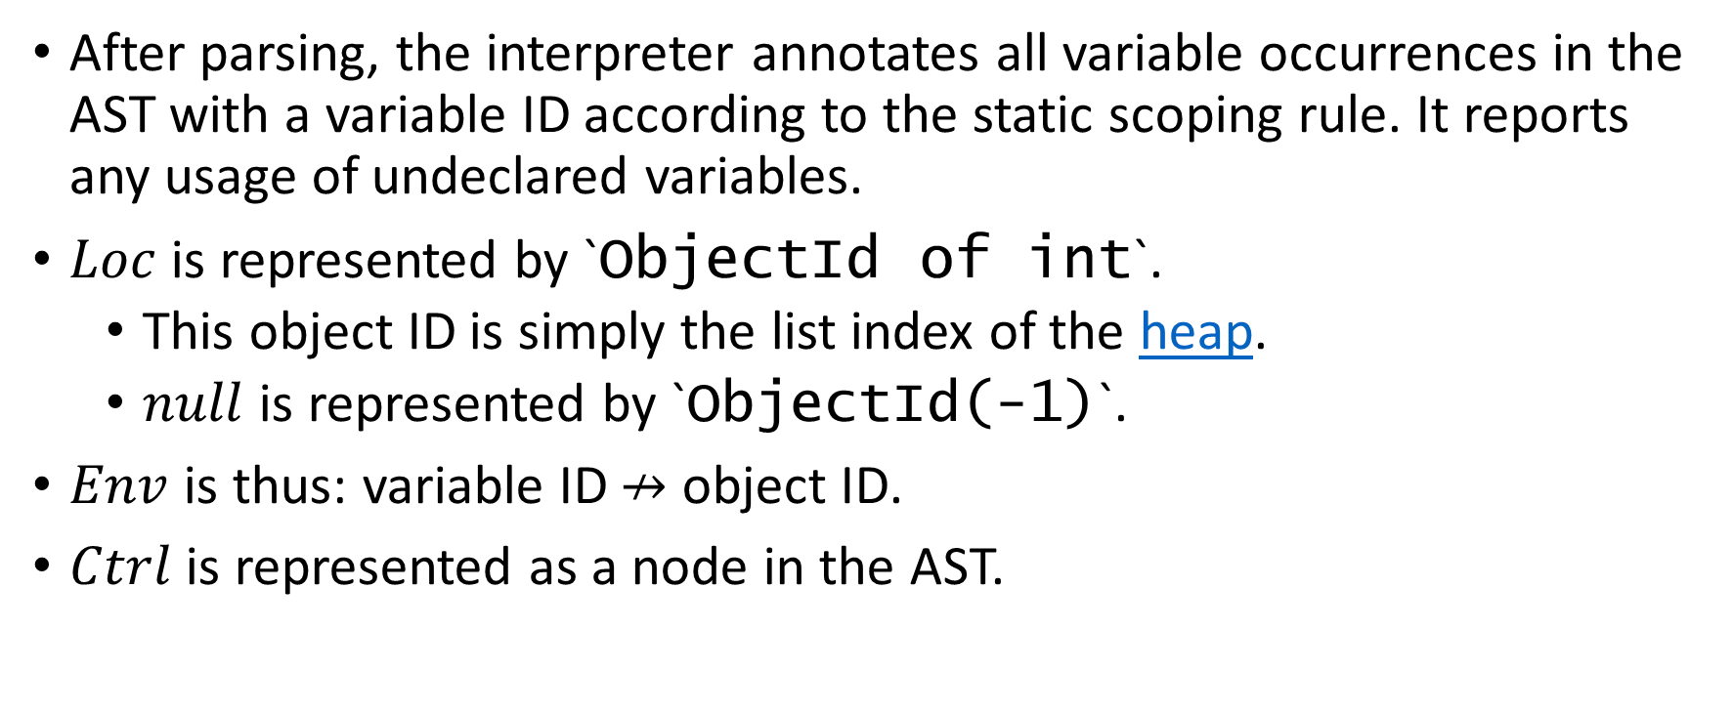
Implementation tricks
After parsing, the interpreter annotates all variable occurrences in the AST with a variable ID according to the static scoping rule. It reports any usage of undeclared variables.
$Loc$ is represented by `ObjectId of int`.
This object ID is simply the list index of the heap.
$null$ is represented by `ObjectId(-1)`.
$Env$ is thus: variable ID $↛$ object ID.
$Ctrl$ is represented as a node in the AST.

Slide 7
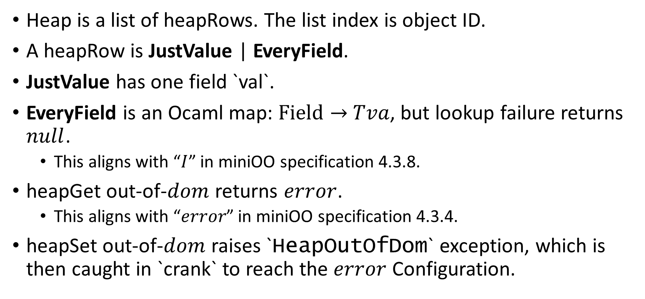
Implementation tricks
Heap is a list of heapRows. The list index is object ID.
A heapRow is JustValue | EveryField.
JustValue has one field `val`.
EveryField is an Ocaml map: $Field→$ $Tva$, but lookup failure returns $null$.
This aligns with “$I$” in miniOO specification 4.3.8.
heapGet out-of-$dom$ returns $error$.
This aligns with “$error$” in miniOO specification 4.3.4.
heapSet out-of-$dom$ raises `HeapOutOfDom` exception, which is then caught in `crank` to reach the $error$ Configuration.

Slide 8
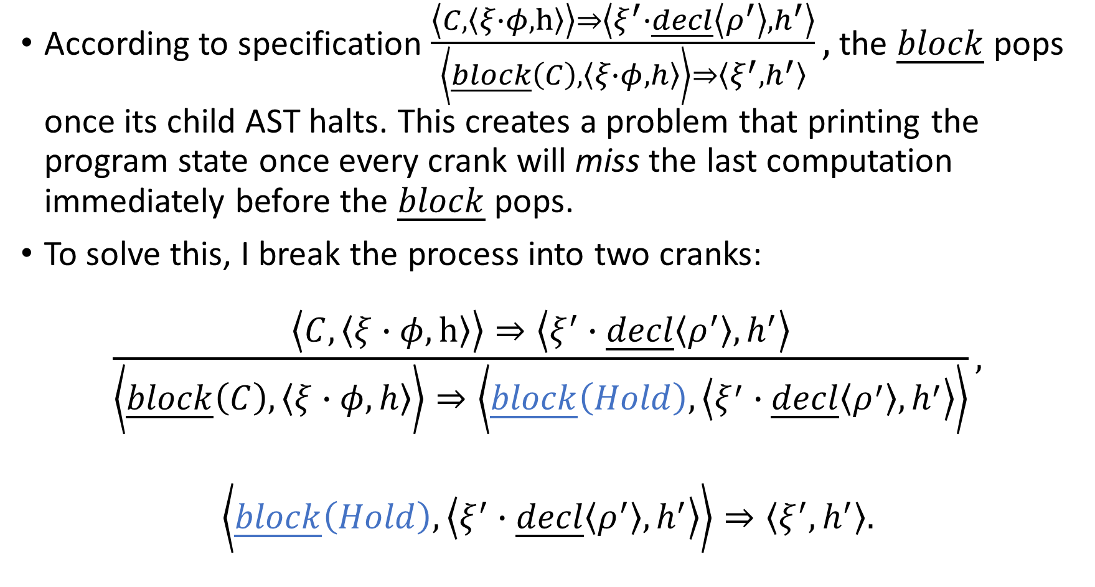
Implementation tricks
According to specification $\frac{\left\langle C,\left\langle ξ∙φ, h\right\rangle \right\rangle ⇒\left\langle ξ^{′}∙\underline{decl}\left\langle ρ^{′}\right\rangle , h^{′}\right\rangle }{\left\langle \underline{block}\left(C\right), \left\langle ξ∙φ,h\right\rangle \right\rangle ⇒\left\langle ξ^{′},h^{′}\right\rangle },$ the $\underline{block}$ pops once its child AST halts. This creates a problem that printing the program state once every crank will miss the last computation immediately before the $\underline{block}$ pops.
To solve this, I break the process into two cranks:
$$\frac{\left\langle C,\left\langle ξ∙φ, h\right\rangle \right\rangle ⇒\left\langle ξ^{′}∙\underline{decl}\left\langle ρ^{′}\right\rangle , h^{′}\right\rangle }{\left\langle \underline{block}\left(C\right), \left\langle ξ∙φ,h\right\rangle \right\rangle ⇒\left\langle \underline{block}\left(Hold\right), \left\langle ξ^{′}∙\underline{decl}\left\langle ρ^{′}\right\rangle , h^{′}\right\rangle \right\rangle },$$
$$\left\langle \underline{block}\left(Hold\right), \left\langle ξ^{′}∙\underline{decl}\left\langle ρ^{′}\right\rangle , h^{′}\right\rangle \right\rangle ⇒\left\langle ξ^{′},h^{′}\right\rangle .$$

Slide 9
Reporting parsing error with location
Menhir-generated parser sometimes raises an uninformative `MENHIR.MenhirBasics.Error`.
My interpreter catches that, read the Lexer’s current position, and reports a parsing error at that location. Like this:
Unknown error. Probably parsing error?
lexbuf is at char # 120
(Use ctrl+alt+G in VSCode to seek char pos.)
Fatal error: exception MENHIR.MenhirBasics.Error
This way, it’s easier to fix typos in the test scripts.

Slide 10
Recursive pretty printing of object representations
The objects that the stack frames point to can be printed as JavaScript-style objects.
This feature will be showcased extensively in later slides.
Self referencing:
What if an object X has a field that points to X itself?
A naïve implementation would recurse infinitely.
I check for self reference and stop the recursion Python-style.
For demo, see test 12 and test 13.

Slide 11
Additional remarks
Object ID is allocated as incrementing integers, so
There is no garbage collection.
Every object in the heap lives for the entire program duration.
Side note:
Even Ocaml doesn’t do garbage collection for us, because all data in the heap are accessible from the Ocaml script’s perspective.
From the miniOO user’s perspective, any object fully disconnected from the stack is inaccessible.

Slide 12
Features, tests, and correctness
Here we demo 17 tests to showcase the features of miniOO.
You can run the tests yourself: `./test {test_name}`

Slide 13
Test example1: static scoping
This is “Example 1” from the miniOO specification section 2.
var r; var h; h=1; var p; p = proc y: r = y+h; var h; h=2; p(4);
It showcases the static scoping rule.
I recommend `verbose` = `false`.

Slide 14
var R; var H;
{
H = 0 - 1
;
var P;
{
P = proc Y: R = Y - H
;
var H;
{
H = 0 - 2
;
P(4)
}
}
}
THE_END

Slide 15
---=== Annotated AST ===---
~declare |var_0 "R"| in
~ declare |var_1 "H"| in
~ first
~ assign to var |var_1 "H"| =
~ from
~ literally 0
~ subtract
~ literally 1
~ and then
~ declare |var_2 "P"| in
~ first
~ assign to var |var_2 "P"| =
~ proc taking |var_4 "Y"| that does
~ assign to var |var_0 "R"| =
~ from
~ var identifier |var_4 "Y"|
~ subtract
~ var identifier |var_1 "H"|
~ and then
~ declare |var_3 "H"| in
~ first
~ assign to var |var_3 "H"| =
~ from
~ literally 0
~ subtract
~ literally 2
~ and then
~ call proc
~ var identifier |var_2 "P"|
~ with argument
~ literally 4

Slide 16
var R; var H;
{
H = 0 - 1
;
var P;
{
P = proc Y: R = Y - H
;
var H;
{
H = 0 - 2
;
P(4)
}
}
}
THE_END
|var_1 "H"| = `null`
|var_0 "R"| = `null`
|var_2 "P"| = some closure
|var_1 "H"| = int -1
|var_0 "R"| = `null`
|var_3 "H"| = int -2
|var_2 "P"| = some closure
|var_1 "H"| = int -1
|var_0 "R"| = `null`
|var_3 "H"| = int -2
|var_2 "P"| = some closure
|var_1 "H"| = int -1
|var_0 "R"| = int 5

Slide 17
Test example2: recursive procedure
This is “Example 2” from the miniOO specification section 2.
var p; p = proc y: if y < 1 then p = 1 else p(y - 1); p(1)
It showcases recursive procedure definition and call.
I recommend `verbose` = `true` to see frame repetition in the stack.

Slide 18
var P;
{
P = proc Y : if Y < 1 P = 1 else P(Y - 1)
;
P(1)
}
THE_END

Slide 19
Crank 2 / 10
Assign to variable "P"
STACK
|var_0 "P"| <obj @ 0>
HEAP
<obj @ 0>
val : some closure
Residual CTRL
~ BLOCK
~ call proc
~ var identifier |var_0 "P"|
~ with argument
~ literally 1

Slide 20
Crank 3 / 10
Call proc
STACK
|var_1 "__FuncArg__"| <obj @ 1>
Stashed:
|var_0 "P"| <obj @ 0>
|var_0 "P"| <obj @ 0>
HEAP
<obj @ 0>
val : some closure
<obj @ 1>
val : int 1
Residual CTRL
~ BLOCK
~ BLOCK
~ if
~ whether
~ var identifier |var_1 "Y"|
~ is less than
~ literally 1
~ then
~ assign to var |var_0 "P"| =
~ literally 1
~ else
~ call proc
~ var identifier |var_0 "P"|
~ with argument
~ from
~ var identifier |var_1 "Y"|
~ subtract
~ literally 1

Slide 21
Crank 4 / 10
If clause selects else
STACK
|var_1 "__FuncArg__"| <obj @ 1>
Stashed:
|var_0 "P"| <obj @ 0>
|var_0 "P"| <obj @ 0>
HEAP
<obj @ 0>
val : some closure
<obj @ 1>
val : int 1
Residual CTRL
~ BLOCK
~ BLOCK
~ call proc
~ var identifier |var_0 "P"|
~ with argument
~ from
~ var identifier |var_1 "Y"|
~ subtract
~ literally 1

Slide 22
Crank 5 / 10
Call proc
STACK
|var_1 "__FuncArg__"| <obj @ 2>
Stashed:
|var_1 "__FuncArg__"| <obj @ 1>
Stashed:
|var_0 "P"| <obj @ 0>
|var_0 "P"| <obj @ 0>
|var_0 "P"| <obj @ 0>
HEAP
<obj @ 0>
val : some closure
<obj @ 1>
val : int 1
<obj @ 2>
val : int 0
Residual CTRL
~ BLOCK
~ BLOCK
~ BLOCK
~ if
~ whether
~ var identifier |var_1 "Y"|
~ is less than
~ literally 1
~ then
~ assign to var |var_0 "P"| =
~ literally 1
~ else
~ call proc
~ var identifier |var_0 "P"|
~ with argument
~ from
~ var identifier |var_1 "Y"|
~ subtract
~ literally 1

Slide 23
Crank 6 / 10
If clause selects then
STACK
|var_1 "__FuncArg__"| <obj @ 2>
Stashed:
|var_1 "__FuncArg__"| <obj @ 1>
Stashed:
|var_0 "P"| <obj @ 0>
|var_0 "P"| <obj @ 0>
|var_0 "P"| <obj @ 0>
HEAP
<obj @ 0>
val : some closure
<obj @ 1>
val : int 1
<obj @ 2>
val : int 0
Residual CTRL
~ BLOCK
~ BLOCK
~ BLOCK
~ assign to var |var_0 "P"| =
~ literally 1

Slide 24
Crank 7 / 10
Assign to variable "P"
STACK
|var_1 "__FuncArg__"| <obj @ 2>
Stashed:
|var_1 "__FuncArg__"| <obj @ 1>
Stashed:
|var_0 "P"| <obj @ 0>
|var_0 "P"| <obj @ 0>
|var_0 "P"| <obj @ 0>
HEAP
<obj @ 0>
val : int 1
<obj @ 1>
val : int 1
<obj @ 2>
val : int 0
Residual CTRL
~ BLOCK
~ BLOCK
~ BLOCK
~ HOLD

Slide 25
Crank 8, 9, 10 / 10
Pop *block*
...
Pop *block*
...
Pop *block*
...
Halted.

Slide 26
var P;
{
P = proc Y : if Y < 1 P = 1 else P(Y - 1)
;
P(1)
}
THE_END
|var_0 "P"| = int 1

Slide 27
Test example3: object creation
This is “Example 3” from the miniOO specification section 2.
var x; malloc(x);
x.c = 0;
x.f = proc y:if y < 1 then x.r = x.c else x.f(y - 1);
x.f(2)
It showcases object creation and field access.
I recommend `verbose` = `false`.

Slide 28
var X;
{
{
malloc(X)
;
X.c = 0
}
;
{
X.f = proc Y : if Y < 1 X.r = X.c else X.f(Y - 1)
;
X.f(2)
}
}
THE_END
|var_0 "X"| = <obj @ 1> {
}
|var_0 "X"| = <obj @ 1> {
c : int 0
f : some closure
}
|var_0 "X"| = <obj @ 1> {
c : int 0
f : some closure
r : int 0
}

Slide 29
Test 0
Store a field in a variable.
Refer to a field using an expression that evaluates to a field.
I recommend `verbose` = `false`.

Slide 30
var X;
var Y;
{
{
malloc(X)
;
Y = someField
}
;
{
X.Y = proc I : X.otherField = I - 1
;
X.someField(7 - 4)
}
}
THE_END
|var_1 "Y"| = field [someField]
|var_0 "X"| = <obj @ 2> {
}
|var_1 "Y"| = field [someField]
|var_0 "X"| = <obj @ 2> {
someField : some closure
}
…
otherField : int 2
…

Slide 31
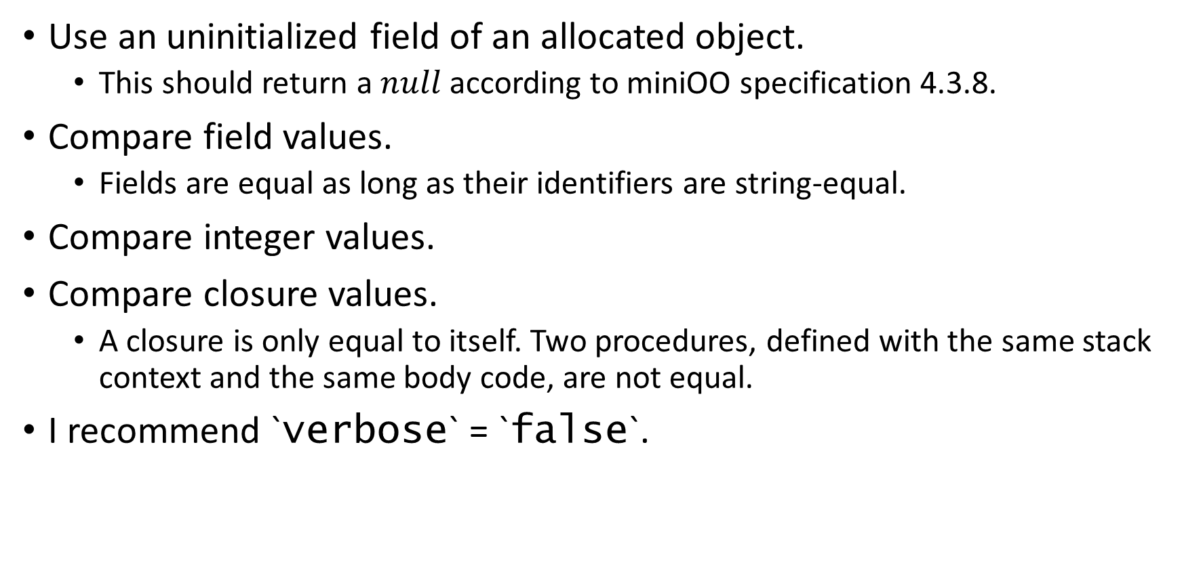
Test 1
Use an uninitialized field of an allocated object.
This should return a $null$according to miniOO specification 4.3.8.
Compare field values.
Fields are equal as long as their identifiers are string-equal.
Compare integer values.
Compare closure values.
A closure is only equal to itself. Two procedures, defined with the same stack context and the same body code, are not equal.
I recommend `verbose` = `false`.

Slide 32
var X;
var Y;
{
{
{
malloc(X)
;
X.this = X.that
}
;
{
if X.this == null X.ans = 1 else X.ans = 0
;
{
Y = 3
;
if Y < 1 X.arith = 0 else X.arith = Y
}
}
}
;
{
{
X.procA = proc T : Y = 7
;
X.procB = proc T : Y = 7
}
;
{
X.procC = X.procA
;
{
if X.procA == X.procB
X.closureDifferent = 0
else X.closureDifferent = 2333
;
if X.procA == X.procC
X.procIdentity = 2333
else X.procIdentity = 0
}
}
}
}
THE_END
|var_1 "Y"| = `null`
|var_0 "X"| = <obj @ 2> {
this : `null`
}
|var_1 "Y"| = int 3
|var_0 "X"| = <obj @ 2> {
ans : int 1
arith : int 3
closureDifferent : int 2333
procA : some closure
procB : some closure
procC : some closure
procIdentity : int 2333
this : `null`
}

Slide 33

Test 2
Use recursion to compute
$$\sum_{n=1}^{10}{n.}$$
I recommend `verbose` = `true` to see frame repetition in the stack.

Slide 34
var F;
var Ans;
{
{
Ans = 0
;
F = proc X : if X == 0 skip else {
Ans = Ans - X
;
F(X - 1)
}
}
;
F(10)
}
THE_END

Slide 35
A snapshot at some point
Call proc
STACK
|var_2 "__FuncArg__"| <obj @ 11>
Stashed:
|var_2 "__FuncArg__"| <obj @ 10>
Stashed:
|var_2 "__FuncArg__"| <obj @ 9>
Stashed:
|var_2 "__FuncArg__"| <obj @ 8>
Stashed:
|var_2 "__FuncArg__"| <obj @ 7>
Stashed:
|var_2 "__FuncArg__"| <obj @ 6>
Stashed:
|var_2 "__FuncArg__"| <obj @ 5>
Stashed:
|var_2 "__FuncArg__"| <obj @ 4>
Stashed:
|var_2 "__FuncArg__"| <obj @ 3>
Stashed:
|var_2 "__FuncArg__"| <obj @ 2>
Stashed:
|var_1 "Ans"| <obj @ 1>
|var_0 "F"| <obj @ 0>
|var_1 "Ans"| <obj @ 1>
|var_0 "F"| <obj @ 0>
|var_1 "Ans"| <obj @ 1>
|var_0 "F"| <obj @ 0>
|var_1 "Ans"| <obj @ 1>
|var_0 "F"| <obj @ 0>
|var_1 "Ans"| <obj @ 1>
|var_0 "F"| <obj @ 0>
|var_1 "Ans"| <obj @ 1>
|var_0 "F"| <obj @ 0>
|var_1 "Ans"| <obj @ 1>
|var_0 "F"| <obj @ 0>
|var_1 "Ans"| <obj @ 1>
|var_0 "F"| <obj @ 0>
|var_1 "Ans"| <obj @ 1>
|var_0 "F"| <obj @ 0>
|var_1 "Ans"| <obj @ 1>
|var_0 "F"| <obj @ 0>
|var_1 "Ans"| <obj @ 1>
|var_0 "F"| <obj @ 0>
HEAP
<obj @ 0>
val : some closure
<obj @ 1>
val : int -54
<obj @ 2>
val : int 10
<obj @ 3>
val : int 9
<obj @ 4>
val : int 8
<obj @ 5>
val : int 7
<obj @ 6>
val : int 6
<obj @ 7>
val : int 5
<obj @ 8>
val : int 4
<obj @ 9>
val : int 3
<obj @ 10>
val : int 2
<obj @ 11>
val : int 1
Residual CTRL
~ BLOCK
~ BLOCK
~ BLOCK
~ BLOCK
~ BLOCK
~ BLOCK
~ BLOCK
~ BLOCK
~ BLOCK
~ BLOCK
~ BLOCK
~ BLOCK
~ if
~ whether
~ var identifier |var_2 "X"|
~ equals
~ literally 0
~ then
~ skip
~ else
~ first
~ assign to var |var_1 "Ans"| =
~ from
~ var identifier |var_1 "Ans"|
~ subtract
~ var identifier |var_2 "X"|
~ and then
~ call proc
~ var identifier |var_0 "F"|
~ with argument
~ from
~ var identifier |var_2 "X"|
~ subtract
~ literally 1

Slide 36
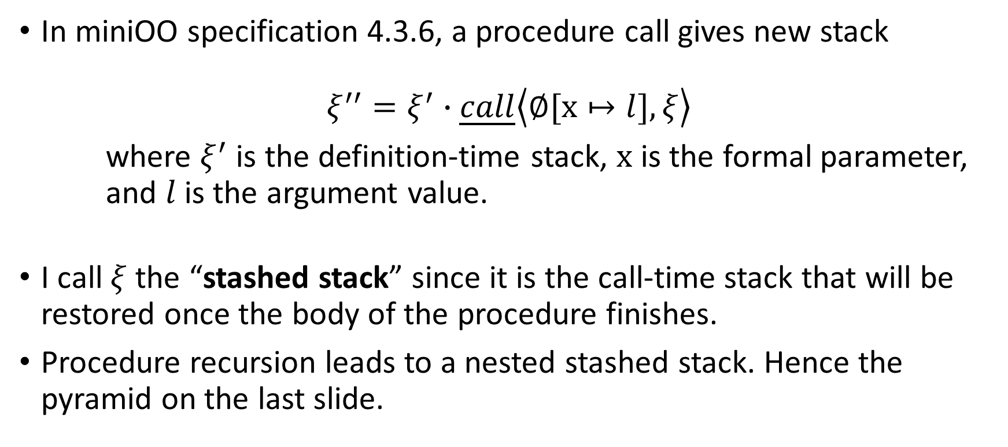
Pyramid of “stashed stack” on the last slide
In miniOO specification 4.3.6, a procedure call gives new stack
$$ξ^{′′}=ξ^{′}∙\underline{call}\left\langle ∅[x↦l],ξ\right\rangle$$
where $ξ^{′}$ is the definition-time stack, $x$ is the formal parameter, and $l$ is the argument value.
I call $ξ$ the “stashed stack” since it is the call-time stack that will be restored once the body of the procedure finishes.
Procedure recursion leads to a nested stashed stack. Hence the pyramid on the last slide.

Slide 37
var F;
var Ans;
{
{
Ans = 0
;
F = proc X : if X == 0 skip else {
Ans = Ans - X
;
F(X - 1)
}
}
;
F(10)
}
THE_END
|var_1 "Ans"| = int -55
|var_0 "F"| = some closure

Slide 38
Test 3
Use unallocated field.
This is not allowed per miniOO specification 4.3.7.
In other words, only `malloc` creates objects, and only objects can have fields.
I recommend `verbose` = `false`.

Slide 39
var X;
{
X = 7
;
X.unallocatedField = 3
}
THE_END
ConfigError! During field assignment, the l.h.s. of the dot is non-location

Slide 40
Test 4
Declare two variables with the same name, and test the scoping.
Static scoping is ensured at the annotation step.
I recommend `verbose` = `false`.

Slide 41
var X;
{
var X;
X = 5
;
X = 4
}
THE_END
|var_1 "X"| = int 5
|var_0 "X"| = `null`
|var_0 "X"| = int 4
---=== Annotated AST ===---
~declare |var_0 "X"| in
~ first
~ declare |var_1 "X"| in
~ assign to var |var_1 "X"| =
~ literally 5
~ and then
~ assign to var |var_0 "X"| =
~ literally 4

Slide 42
Test 5
Use undeclared variable.
Reported at the annotation step.
I recommend `verbose` = `false`.

Slide 43
Execution cursor
{
var X;
X = 5
;
X = 4
}
THE_END
Fatal error: exception MiniOO.UsingUndeclaredVariable("X")
Annotation cursor

Slide 44
Test 6
Store an object in a field.
Access nested fields.
Test some association precedence.
`.` should take precedence before `-`.
Test the pretty printing of object representation.
I recommend `verbose` = `false`.

Slide 45
var X;
var Y;
{
{
malloc(X)
;
malloc(Y)
}
;
{
{
X.theY = Y
;
Y.nine = 9
}
;
{
Y.six = 6
;
X.theY.someField =
2 - X.theY.six - Y.nine
}
}
}
THE_END
|var_1 "Y"| = <obj @ 3> {
}
|var_0 "X"| = <obj @ 2> {
theY : <obj @ 3> {
}
}
|var_1 "Y"| = <obj @ 3> {
nine : int 9
six : int 6
someField : int -13
}
|var_0 "X"| = <obj @ 2> {
theY : <obj @ 3> {
nine : int 9
six : int 6
someField : int -13
}
}

Slide 46

Test 7
Use a while loop to compute
$$\sum_{n=1}^{100}{n}$$
I recommend `verbose` = `false`.

Slide 47
var X;
var Ans;
{
{
Ans = 0
;
X = 100
}
;
while 0 < X {
Ans = Ans - X
;
X = X - 1
}
}
THE_END
|var_1 "Ans"| = int -5050
|var_0 "X"| = int 0

Slide 48
The last few lines of the runtime log
...
While loop promotes body
|var_1 "Ans"| = int -5047
|var_0 "X"| = int 2
Assign to variable "Ans"
|var_1 "Ans"| = int -5049
|var_0 "X"| = int 2
Assign to variable "X"
|var_1 "Ans"| = int -5049
|var_0 "X"| = int 1
While loop promotes body
|var_1 "Ans"| = int -5049
|var_0 "X"| = int 1
Assign to variable "Ans"
|var_1 "Ans"| = int -5050
|var_0 "X"| = int 1
Assign to variable "X"
|var_1 "Ans"| = int -5050
|var_0 "X"| = int 0
While loop ends
|var_1 "Ans"| = int -5050
|var_0 "X"| = int 0
Pop *block*
|var_0 "X"| = int 0
Pop *block*
Halted.

Slide 49
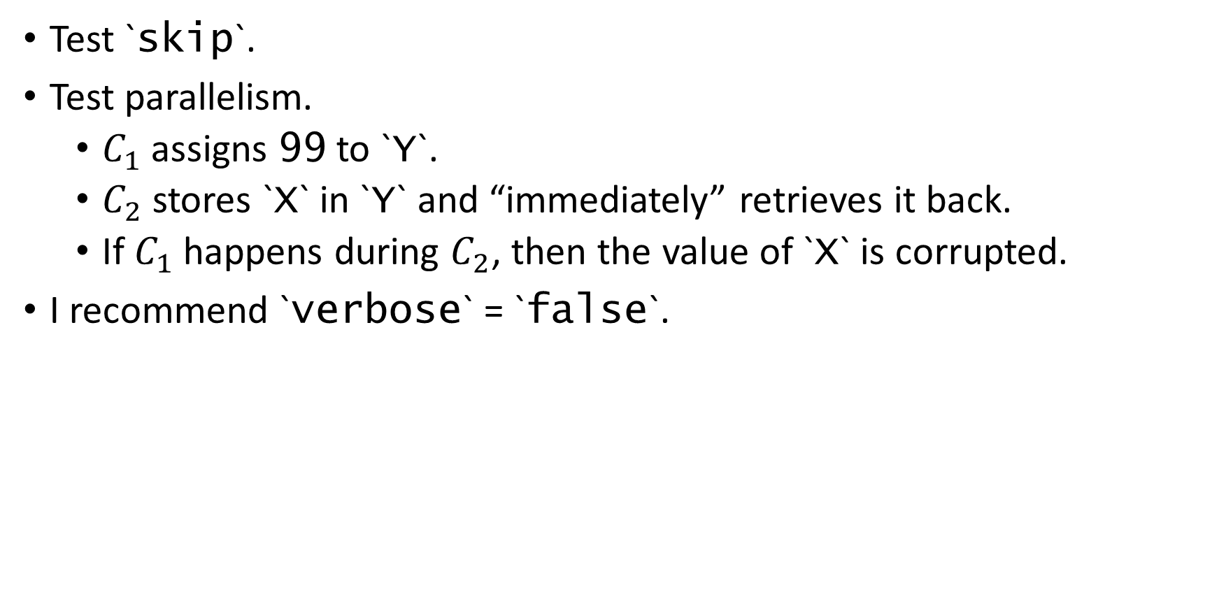
Test 8
Test `skip`.
Test parallelism.
$C_{1}$ assigns 99 to `Y`.
$C_{2}$ stores `X` in `Y` and “immediately” retrieves it back.
If $C_{1}$ happens during $C_{2}$, then the value of `X` is corrupted.
I recommend `verbose` = `false`.

Slide 50
var X;
var Y;
{
{
X = 5
;
skip
}
;
{
Y = 99
|||
{
Y = X
;
X = Y
}
}
}
THE_END
|var_1 "Y"| = int 99
|var_0 "X"| = int 5
|var_1 "Y"| = int 5
|var_0 "X"| = int 5
Randomly
|var_1 "Y"| = int 99
|var_0 "X"| = int 99

Slide 51

Test 9
Test atomicity.
Compared to test 8, $C_{2}$ is now wrapped in `atom()`.
This time, `X` cannot be corrupted. `Y` can still be whatever.
I recommend `verbose` = `false`.

Slide 52
var X;
var Y;
{
{
X = 5
;
skip
}
;
{
Y = 99
|||
atom({
Y = X
;
X = Y
})
}
}
THE_END
|var_1 "Y"| = int 99
|var_0 "X"| = int 5
|var_1 "Y"| = int 5
|var_0 "X"| = int 5
Randomly

Slide 53
Test 10
Compare objects.
Multiple `malloc()`s on the same variable should create different objects.
I recommend `verbose` = `false`.

Slide 54
var X;
var Y;
{
{
malloc(X)
;
malloc(Y)
}
;
{
Y.theX = X
;
{
if Y.theX == X Y.a = 2333 else Y.a = 0
;
{
malloc(X)
;
if Y.theX == X Y.b = 0 else Y.b = 2333
}
}
}
}
THE_END
|var_1 "Y"| = <obj @ 3> {
a : int 2333
b : int 2333
theX : <obj @ 2> {
}
}
|var_0 "X"| = <obj @ 4> {
}

Slide 55
Test 11
Access a field with a non-field.
This is not allowed per miniOO specification 4.3.7.
I recommend `verbose` = `false`.

Slide 56
var X;
{
malloc(X)
;
X.null = 9
}
THE_END
ConfigError! During field assignment, the r.h.s. of the dot is non-field

Slide 57
Test 12
Pretty print the object representation of a self-referencing object.
I recommend `verbose` = `false` to actually see the pretty print.

Slide 58
var X;
{
malloc(X)
;
{
X.self = X
;
X.child = 666
}
}
THE_END
|var_0 "X"| = <obj @ 1> {
child : int 666
self : recursive <obj @ 1>
}

Slide 59
Test 13
Pretty print the object representation of two inter-referencing objects.
I recommend `verbose` = `false` to actually see the pretty print.

Slide 60
var X;
var Y;
{
{
malloc(X)
;
malloc(Y)
}
;
{
Y.theX = X
;
{
X.theY = Y
;
{
X.six = 6
;
Y.nine = 9
}
}
}
}
THE_END
|var_1 "Y"| = <obj @ 3> {
nine : int 9
theX : <obj @ 2> {
six : int 6
theY : recursive <obj @ 3>
}
}
|var_0 "X"| = <obj @ 2> {
six : int 6
theY : <obj @ 3> {
nine : int 9
theX : recursive <obj @ 2>
}
}

Slide 61
Test 14
How to break my miniOO interpreter.

Slide 62
var F;
{
F = proc X : F = X
;
{
var T;
skip
|||
F(3)
}
}
THE_END
Do you see a potential problem?

Slide 63

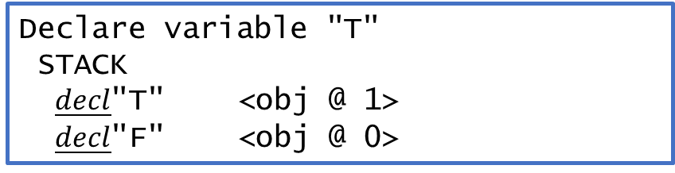
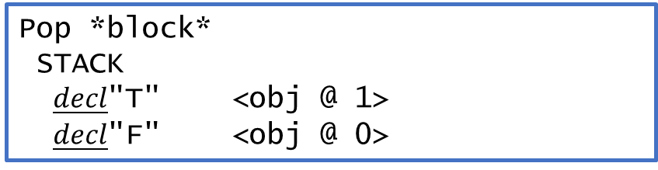
...
var F;
{
F = proc X : F = X
;
{
var T;
skip
|||
F(3)
}
}
THE_END
Declare variable "T"
STACK
$\underline{decl}$"T" <obj @ 1>
$\underline{decl}$"F" <obj @ 0>
Call proc
STACK
$\underline{call}$“X" <obj @ 2>
Stashed:
$\underline{decl}$"T" <obj @ 1>
$\underline{decl}$"F" <obj @ 0>
$\underline{decl}$"F" <obj @ 0>
Pop *block*
STACK
$\underline{decl}$"T" <obj @ 1>
$\underline{decl}$"F" <obj @ 0>
Assign “X” to variable “F”
Error: “X” not found in stack.

Slide 64

Different branches in a parallelism operate the same stack.
In this test, the $\underline{block}$ created by $\underline{decl}$ ended up pulling the $\underline{call}$ frame. This messed up the execution of the procedure body.

Slide 65
Thank you.

