Slide 1
Python 3 and miniPy
From the perspectives of HPL 2021.
Daniel Chin. 11/21/2021.
Notes:
What is miniPy? You can imagine it is Python 3 for now. Every time I say “miniPy”, you can pretend you hear “Python 3”.

Slide 2

NYU Shanghai now teaches in Python 3
Notes:
I did my undergrad at NYU Shanghai. Almost all undergrad CS courses there now teaches in Python 3.

Slide 3
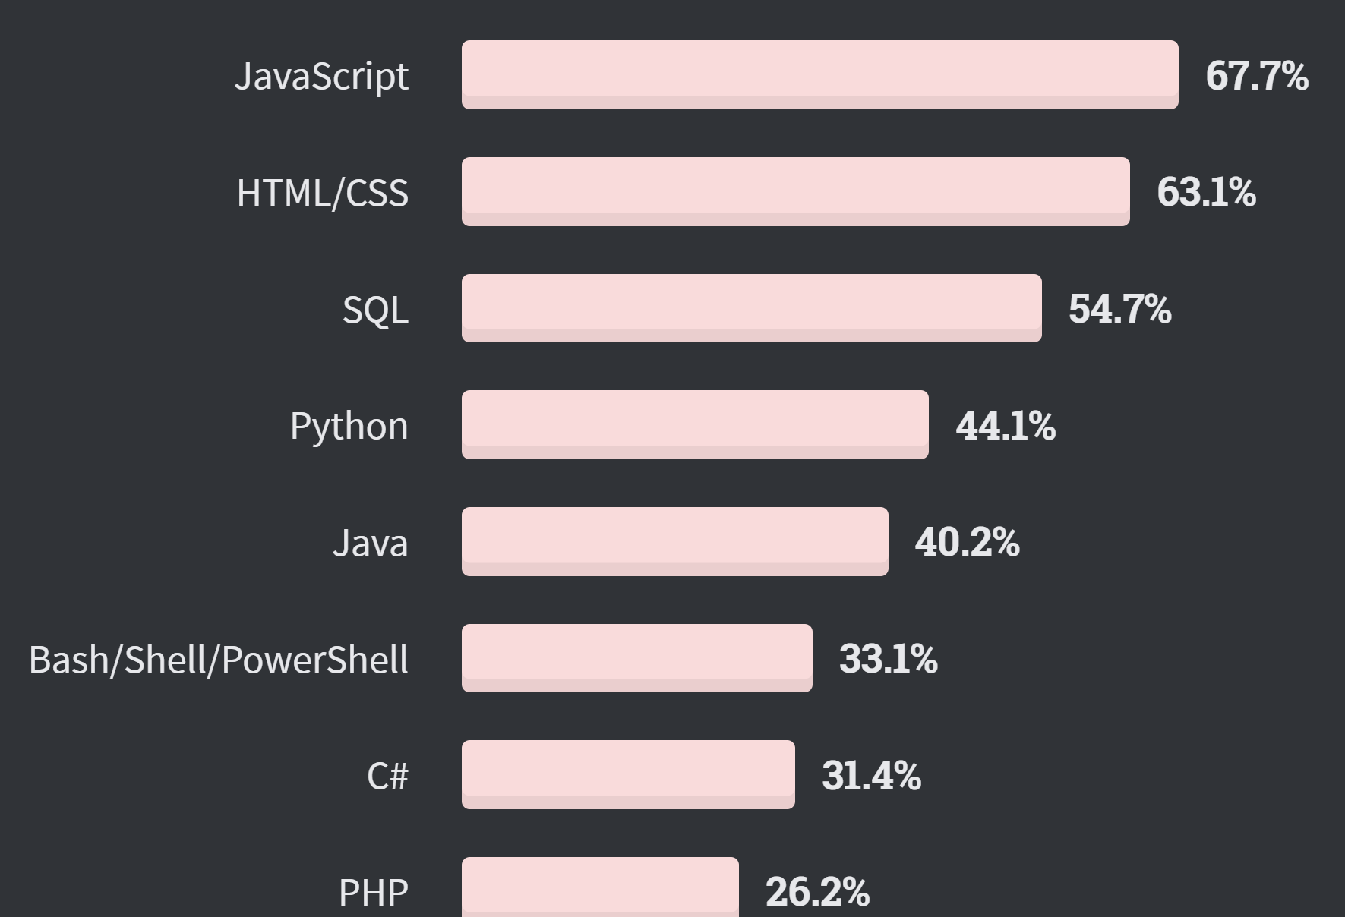
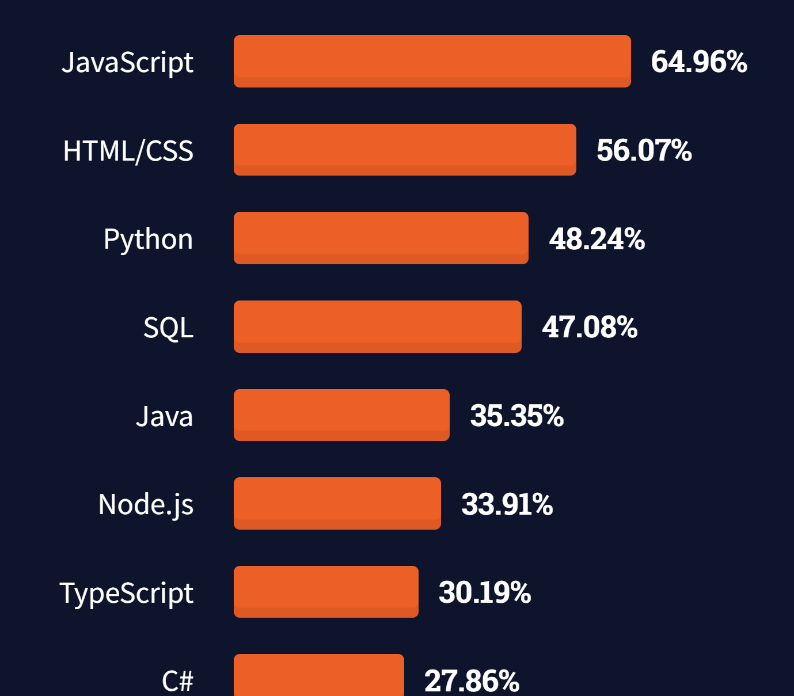
Most popular programming languages
2020
https://insights.stackoverflow.com/survey/2020#most-popular-technologies
2021
https://insights.stackoverflow.com/survey/2021#technology-most-popular-technologies
Notes:
This is a survey by StackOverflow. This year Python is the 3rd most widely-used language.

Slide 4
Python 3 is my personal favorite language.

Slide 5
miniPy uses Duck Typing.

Slide 6

Duck Typing
“If it walks like a duck, and it quacks like a duck, then it must be a duck.”
There is no type checking.
Notes:
From the perspectives of this course, there is basically no type checking at all.

Slide 7
Duck Typing
>>> class Employee:
... def fire(self):
... print(‘bye’)
>>> def fireEmployee(e):
... e.fire()
>>> class Gun:
... def fire(self):
... print(‘Bang!’)
>>> myGun = Gun()
>>> fireEmployee(myGun)
Bang!
Notes:
Here is an example. … So only the name matters. Everything is stored with its definition name even at runtime.

Slide 8
miniPy is an OOP language.
Notes:
Everything’s an object. Even classes are objects.

Slide 9
class ‘class’ as a fixpoint
>>> class(0)
<class 'int’>
>>> class(int)
<class ‘class’>
>>> class(class)
<class ‘class'>
Notes:
Here 0 is the object, and it is an instance of class int. …

Slide 10
Everything is an object
Even classes are objects.
Objects | Class
0, 1, 2, 3 | <class 'int'>
print, fireEmployee | <class 'function'>
int, function, Employee | <class 'class'>
class | <class 'class'>

Slide 11
So, you can have metaclass
Class = template for objects
Instantiation of a class gives an object.
Metaclass = template for classes
Instantiation of a metaclass gives a class.
In fact, miniPy doesn’t care about whether an object is a class. Again, duck typing only cares about whether an object is capable of instantiation.

Slide 12
miniPy object relation graph
instantiate
inherit
class ‘class’
class ‘Concept’
class ‘function’
class ‘int’
class ‘Employee’
class ‘Janitor’
print
0
Jane
Notes:
Multiple layers of instantiation. Here, class class is the class whose class is itself. Functions and ints are instances of class. 0 is an instance of int. Concept is a metaclass. Employee is a concept. Janitor inherits from Employee, and Jane is a Janitor.
Again, we have multiple layers of instantiation in miniPy. Traditional OOP, for example Java, can be seen as a special case where there are only two layers, one layer for all classes and one layer for all objects.

Slide 13
Dictionary, namespace, object

Slide 14
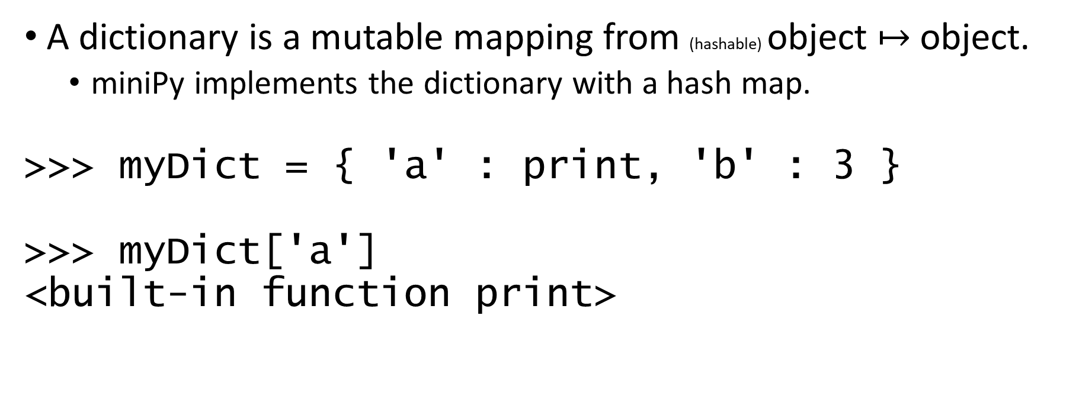
Dictionary
A dictionary is a mutable mapping from (hashable) object $↦$ object.
miniPy implements the dictionary with a hash map.
>>> myDict = { 'a' : print, 'b' : 3 }
>>> myDict['a']
<built-in function print>
Notes:
The dictionary is a data structure central to miniPy. A dictionary is … Actually partial mapping, but not important for today’s purposes. … Nothing unusual.

Slide 15
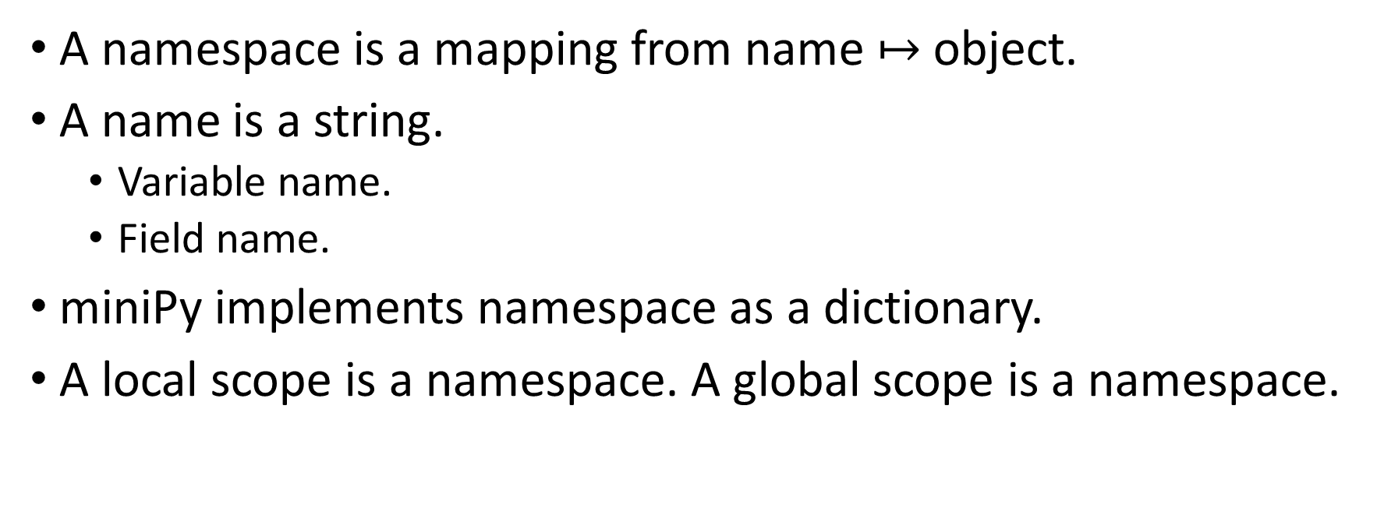
Namespace
A namespace is a mapping from name $↦$ object.
A name is a string.
Variable name.
Field name.
miniPy implements namespace as a dictionary.
A local scope is a namespace. A global scope is a namespace.
Notes:
… it’s like the “identifier” in miniOO.

Slide 16
Scopes are exposed to the user
>>> a = 3
>>> def f():
... b = 7
... print(locals())
... print(globals())
>>> f()
{'b': 7}
{…, 'a': 3, 'f': <function …>}
>>> exec('a = 4')
>>> a
4
Notes:
… so the scopes are exposed to the user as a dictionary. Furthermore, you can exec… At this point Python has no idea what I’m going to type next. This shows that the names of variables are stored during runtime, and the names are how Python accesses the objects.

Slide 17
Object
An object is | a namespace | a primitive value .
More romantically,
An object is a dictionary of objects.

Slide 18
>>> class Employee:
... def __init__(self, age, name):
... self.age = age
... self.name = name
>>> e = Employee('22', 'Jane')
>>> e.age
‘22’
Under the hood, `e` is a namespace {
‘age’: 22,
‘name’: ‘Jane’,
}
Notes:
A dictionary is all we need to store an object.

Slide 19
Tangled hierarchy
Wait… how can the definition of miniPy use a miniPy feature?
namespace
depends on
depends on
object
dictionary
depends on
Notes:
Dictionary is a feature provided by miniPy. A dictionary is an object, whose definition is a namespace. But a namespace is implemented as a dictionary!
Things like this are actually very common in miniPy. There is a tendency to mix the built-in space with the user space. It is not easy to bootstrap, as we will see later.

Slide 20
Operators are calls to methods
`a + b` is transformed to `a.__add__(b)`.
`f(a, b, c)` is transformed to `f.__call__([a, b, c])`.*
User can override double-underscore functions.
Notes:
Does this make sense? [If not, start python and demo custom __call__]

Slide 21
Summary:
An object is a namespace of objects (or a primitive).
The type of an object does not matter. You only care about what the object (as a namespace) contains. (Duck typing)
Namespaces have two roles:
to represent objects, and
To represent scopes.
Notes:
… You see why it’s duck typing? … we have seen how namespaces represent objects. Now let’s see how namespaces represent scopes.

Slide 22
Name scoping
# file test.py
a = 0
def f():
print('a =', a)
del a
a = 1
f()
# output
a = 1
Notes:
… so in this example, Python looks like a dynamic scoping language.

Slide 23
# file test.py
def f():
a = 0
def g():
print('a =', a)
return g
def h():
g = f()
a = 1
g()
h()
# output
a = 0
Notes:
Why is this the case? [flip]

Slide 24
namespace = {
g: <function>,
a: 0,
}
def f():
a = 0
def g():
print('a =', a)
return g
def h():
g = f()
a = 1
g()
h()
namespace = {
g: <function>,
a: 1,
}
namespace = {
**built-ins,
f: <function>,
h: <function>,
}
Notes:
In miniPy, each function is associated with a namespace. When defining g, miniPy saves the definition-time stack of namespaces with g.

Slide 25
Scoping rule
A function’s scope is a stack of namespaces.
Inner namespaces have precedence over outer namespaces.
local
…
non-local
global

Slide 26
# file test.py
a = 0
def f():
print('a =', a)
del a
a = 1
f()
namespace = {
}
namespace = {
**built-ins,
a: 1,
f: <function>,
}
Notes:
Let’s look back to the previous example that looks like dynamic scoping. Mutates the namespace. Shallow copy of the stack of namespaces. In miniOO, you can push and pop the stack, but you cannot modify a declaration six level deep in the stack.

Slide 27
# file test.py
def f(x):
if x in (0, 1):
return 1
return f(x - 1) + f(x - 2)
for x in range(10):
print(x, f(x))
# output
0 1
1 1
2 2
3 3
4 5
5 8
6 13
7 21
8 34
9 55
Notes:
Recursion depends on its function name to work.

Slide 28
# file test.py
def f(x):
if x in (0, 1):
return 1
return f(x - 1) + f(x - 2)
for x in range(10):
print(x, f(x))
g = f
del f
print('\n Renamed f to g. \n')
for x in range(10):
print(x, g(x))
# output
0 1
1 1
2 2
3 3
4 5
5 8
6 13
7 21
8 34
9 55
Renamed f to g.
0 1
1 1
NameError: name 'f' is not defined

Slide 29
Function
A function is
a stack of namespaces,
its body AST,
and a list of formal parameters.

Slide 30
What is miniPy?
Notes:
Up till now, whenever I said “miniPy”, you can just think “python 3”. But here I’m going to explain what miniPy is.

Slide 31
miniPy
miniPy is my attempt to implement an interpreter in Python 3 to interpret a subset of Python 3.
Notes:
Studying miniPy will shed some light onto the challenges about implementing the semantics of a language.

Slide 32
Features given up
decorator
with ... as ...
f'{1}'
'%d kg' % 3
many built-ins (file system...)
package import
multi inheritance
lambda function
1 if 0 else 2
[*'asd']
| ^ & << >> @ ~
await, :=
1 < 2 < 3
4 // 2
import ... as ...
+=
re-raise exception with raise
except Exception as e
yield
tuple cannot omit ()
multi commands cannot be on same line
except (Exc1, Exc2): is not allowed.
help()
10e-5
Variable names starting with "__" does not rename the variable into private.
Instead of super().__init__(), you do self.__base__.__init__(self)
no __str__, only __repr__.
Notes:
These are the features of Python 3 that I give up. We don’t have to look in details. Some are hard to parse, some have difficult semantics, some are trivial things but I didn’t have time to implement.

Slide 33
Python 3, interpreter | miniPy, interpreted
Thing | Object
Non-Thing objects | God-world concepts
Notes:
We do need to invent one more term. The objects in minipy are represented by things in the interpreter’s python 3 runtime. In other words, Thing is a custom class defined by the interpreter in python 3, where the Thing class represents objects in the simulated miniPy runtime. The only purpose of using this new term, thing, is to avoid confusion.

Slide 34
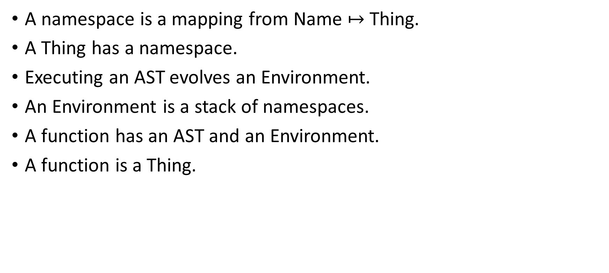
Guidelines
A namespace is a mapping from Name $↦$ Thing.
A Thing has a namespace.
Executing an AST evolves an Environment.
An Environment is a stack of namespaces.
A function has an AST and an Environment.
A function is a Thing.

Slide 35
class Thing:
def __init__(self) -> None:
self._class : Thing = None
self.namespace = Namespace()
...

Slide 36
Why mix the user space and the built-ins?
The built-in objects seem to be written in the language being defined.
Rules become more general – they apply to both user objects and built-in objects. The language feels more coherent – even if the coherence is faked.
The user can override default behaviors of built-in concepts.

Slide 37
Mixing the user space and the built-ins
def wrapFuncion(func):
thing = instantiate(builtin.Function)
thing.call = func
return thing
def wrapClass(clas):
thing = instantiate(builtin.Class)
for key, value in clas.__dict__.items():
if type(value) is Thing:
thing.namespace[key] = value
return thing
Notes:
How do we do the mixing? Here is the wrapFunction function that takes a function as the parameter. The parameter here is a python 3 function in the interpreter runtime. …

Slide 38
class Builtin:
@wrapClass
class bool:
@wrapFuncion
def __init__(thing, x = None):
...
@wrapFuncion
def __bool__(thing):
...
...
Notes:
… But in the end, trying to mix the user space and the built-ins leads to hard bootstrapping problems.

Slide 39
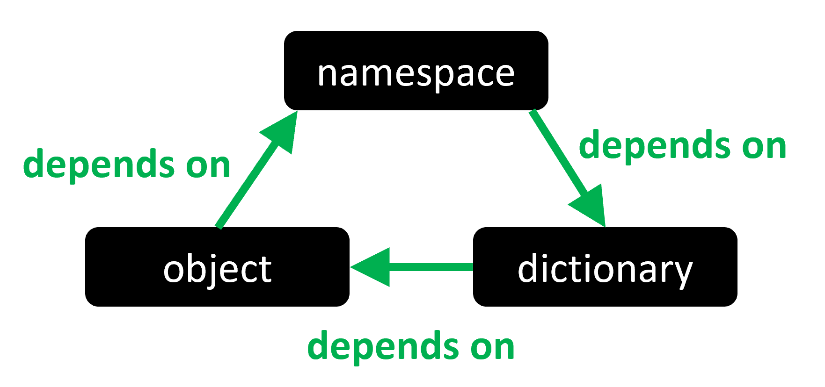
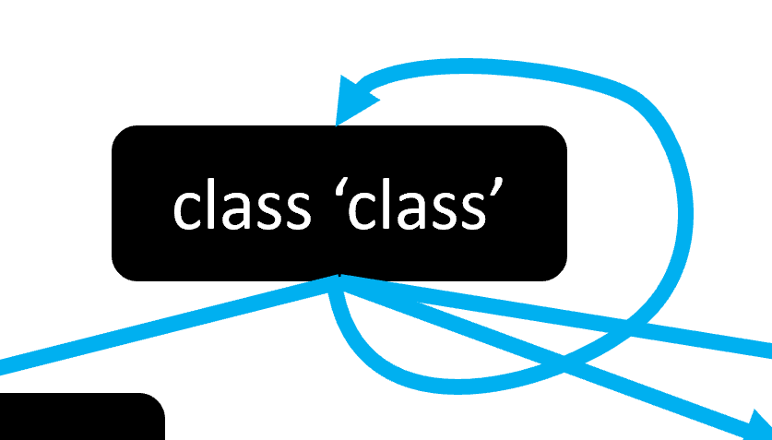
What’s so hard about bootstrapping?
We have seen a couple of self loops…
They all need bootstrapping.
Let me show a third example in the next slide.

Slide 40
>>> print(3)
3
>>> print.__call__(3)
3
>>> print.__call__.__call__(3)
3

Slide 41
>>> print
<built-in function print>
>>> print.__call__
<method-wrapper '__call__' of builtin_function_or_method object at 0x000002C1CF100E50>
>>> print.__call__.__call__
<method-wrapper '__call__' of method-wrapper object at 0x000002C1CF4F5520>
>>> print.__call__.__call__.__call__
<method-wrapper '__call__' of method-wrapper object at 0x000002C1D12A2C10>

Slide 42
What’s so bad about self loops?
Some concepts are fundamentally infinitely recursive.
A naïve implementation of any of those concepts easily leads to infinite recursion at definition-time.
This means, when you run the interpreter, it goes into an infinite recursion, trying to expand the concept of e.g. “class”.
The solution is to contain the infinity to run-time. The definition of such infinitely recursive concepts should reflect the infinite recursion while not using any infinite recursion.
(This usually leads to uglier definitions.)
Notes:
… This is like how we can write infinite loop using finite code. However, what we have here is one level more meta. The code needs to be finite. The definition time needs to be finite. Only the runtime may be infinite.

Slide 43
Trick 1: First define, then link
The naïve way
class builtin:
@wrapClass
class Class(Class):
pass
The solution
class builtin:
pass
builtin.Class = Thing()
builtin.Class._class = builtin.Class
Notes:
The naïve method fails because Class is undefined. The solution … Notice the solution is quite ugly. We prepared @wrapClass but we can’t even use it here.

Slide 44

<class ‘class’> and <class ‘function’> are defined in terms of each other
<class ‘function’> is an instance of <class ‘class’>.
Meanwhile, the universal methods that all objects share (e.g. __repr__) should be defined in <class ‘class’>.
Drawing Hands, 1948. M.C. Escher
Notes:
This is much more subtle.

Slide 45
Trick 2: Amortized definition
Define the bare minimum of <class ‘class’>.
Instantiate <class ‘function’>. Define its methods.
Define the methods of <class ‘class’>.

Slide 46
builtin.Class = Thing()
builtin.Class._class = builtin.Class
def buildFunc():
Function = Thing()
Function._class = builtin.Class
def __func_repr__(thing):
if '__name__' in thing.namespace:
name = thing.namespace['__name__’] .primitive_value
else:
name = 'anonymous'
return unprimitize(f'<function {name}>')
Function.namespace['__repr__'] = Thing()
Function.namespace['__repr__']._class = Function
Function.namespace['__repr__'].call = __func_repr__
builtin.Function = Function
buildFunc()
def rebuildClassFunc():
builtin.Class.namespace['__repr__'] = wrapFuncion(
lambda thing : unprimitize(
f'<class "{thing.namespace["__name__"]
.primitive_value}">'
)
)
setNameJobs.append((
builtin.Class.namespace['__repr__'], '__repr__',
))
setNameJobs.append((
builtin.Class, 'Class',
))
setNameJobs.append((
builtin.Function.namespace['__repr__’],
'__repr__',
))
setNameJobs.append((
builtin.Function,
'Function',
))
rebuildClassFunc()
Drawing Hands, 1948. M.C. Escher
Notes:
We don’t have to look at the details, but just generally, this section…

Slide 47
Trick 3: Postpone expansion to runtime
>>> print
<built-in function print>
>>> print.__call__
<method-wrapper '__call__' of builtin_function_or_method object at 0x000002C1CF100E50>
>>> print.__call__.__call__
<method-wrapper '__call__' of method-wrapper object at 0x000002C1CF4F5520>
>>> print.__call__.__call__.__call__
<method-wrapper '__call__' of method-wrapper object at 0x000002C1D12A2C10>
>>> print.__call__.__call__.__call__
<method-wrapper '__call__' of method-wrapper object at 0x000002C1D12A2D30>

Slide 48
Review of self loop
Some concepts are fundamentally infinitely recursive.
A naïve implementation of any of those concepts easily leads to infinite recursion at definition-time.
The solution is to contain the infinity to run-time. The definition of such infinitely recursive concepts should reflect the infinite recursion while not using any infinite recursion.
(This usually leads to uglier definitions.)

Slide 49
The end of abstract hell. Time for something fun.

Slide 50
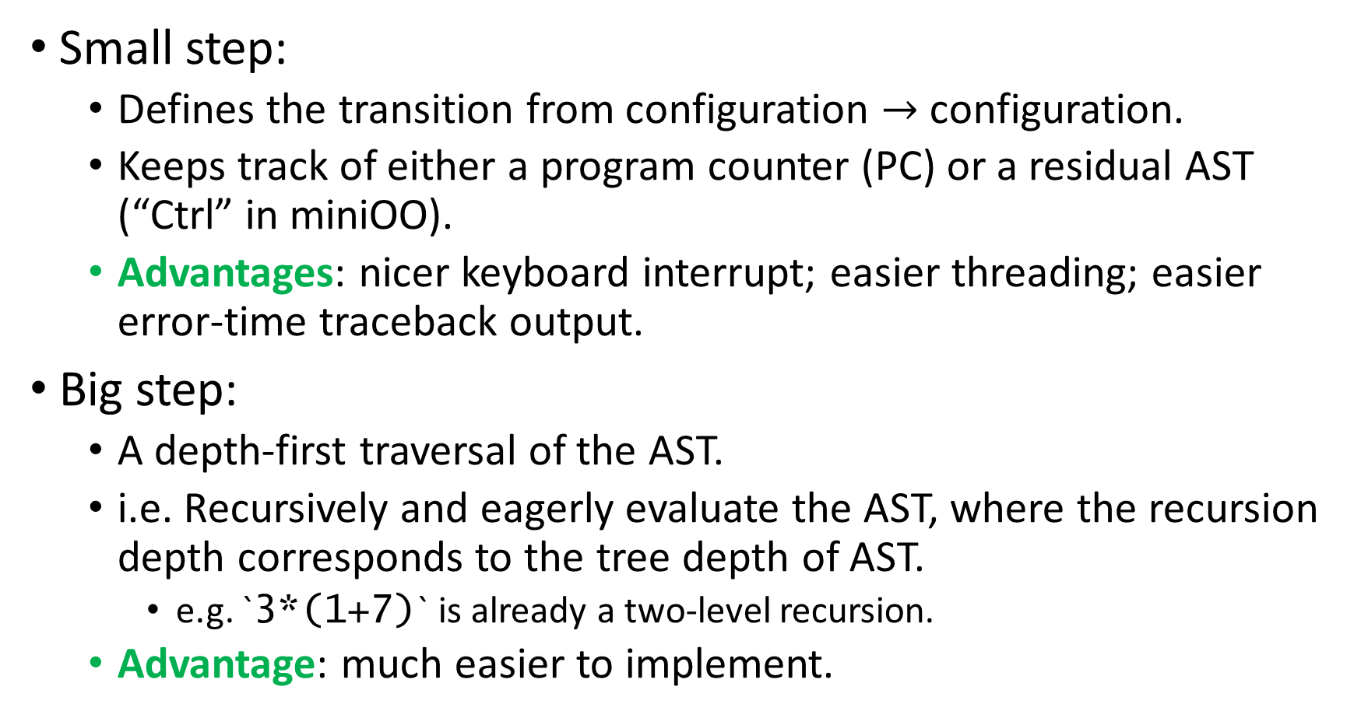
miniPy uses big-step interpretation
Small step:
Defines the transition from configuration $→$ configuration.
Keeps track of either a program counter (PC) or a residual AST (“Ctrl” in miniOO).
Advantages: nicer keyboard interrupt; easier threading; easier error-time traceback output.
Big step:
A depth-first traversal of the AST.
i.e. Recursively and eagerly evaluate the AST, where the recursion depth corresponds to the tree depth of AST.
e.g. `3*(1+7)` is already a two-level recursion.
Advantage: much easier to implement.
Notes:
… Big step does not do the above. … adventages. … remember while loop from miniOO?

Slide 51
return, break, and continue as exceptions
def executeWhileLoop(conditionAst, bodyAst):
try:
while isTrue(eval(conditionAst)):
try:
executeAst(bodyAst)
except ContinueAsException:
pass
except BreakAsException:
pass
Notes:
The benefit of big step

Slide 52
miniPy exception promotion and handling
Python 3 has a nice traceback output in times of a runtime error.
def f():
1 / 0
def g():
print('This is g,', f())
return 97
if g() == 97:
pass
This is trivial in small-step.
How can I do this in big-step?
Traceback (most recent call last):
File "stackTraceTest.py", line 8, in <module>
if g() == 97:
File "stackTraceTest.py", line 5, in g
print('This is g,', f())
File "stackTraceTest.py", line 2, in f
1 / 0
ZeroDivisionError: division by zero

Slide 53
miniPy exception raises a helicopter in interpreter
class Helicopter(Exception):
def __init__(self, minipyException):
super().__init__()
self.content : Thing = instantiate(
minipyException,
)
self.stack = []
Notes:
Whenever miniPy raises a miniPy exception, I raise a helicopter in Python 3. [pause] Since a helicopter is also a python 3 exception, it makes its way up the big-step execution recursion.

Slide 54
Catch, record trace, and reraise at function level
def executeFunction(ast):
try:
...
except Helicopter as h:
h.stack.append(
(ast.filename, ast.line_number),
)
raise h
Notes:
The helicopter then gathers information as it percolates. At top level you have it.

Slide 55
Conclusion
Implementing miniPy made me learn a lot.
I hope my presentation today could provide you with new understanding of Python 3.
Q&A begins!

Slide 56
Bibliography
Python 3 official docs. https://docs.python.org/3/.
miniPy project repo. https://github.com/Daniel-Chin/mini-Python.

