Slide 1
Laser Dance

Slide 2
Tristan, I will just do the parts that I am familiar with.
Plz supplement the photos afterwards.
Daniel

Slide 3
Motivation
The control of the drawing machine is very interesting.
Why don’t we develop on that control mechanism, And give everyone one more chance to investigate the control?

Slide 4
Modelling: Fusion 360
Photo here

Slide 5
Problem:
Photo
potentiometer is hard to fiddle with
Especially, for example, I have big fingers

Slide 6
Solution: handle V2
Photo
Enhance usability of potentiometer

Slide 7
Problem:
Photo (GIF)
How to let the laser stay on?

Slide 8
Solution: Clip
Photo (GIF)
[Clicks!]

Slide 9
User feedbacks and our changes
photos

Slide 10
User feedbacks and our changes
“What should I hit?”
“I shall hit the other player’s laser emitter”!
Solution: bullseye
Photo

Slide 11
User feedbacks and our changes
User: thinks the potentiometer was a joystick
Marcela recommendation: photo
Solution: changed from handle V1 to handle V2.
Photo

Slide 12
User feedbacks and our changes
User: when the laser reflects, I don’t know where I’m aiming at
Solution: non-reflective tape
photo

Slide 13
User feedbacks and our changes
User: When the enemy is at the right border, no one can hit the other.
Problem identified: target movement rage skewed to the right
Solution: change movement angle range
photo

Slide 14
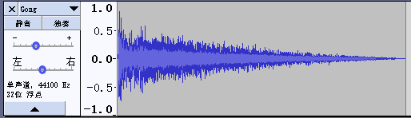
User feedbacks and our changes
User: I want a clear drumbeat to indicate my winning moment.
Us: here you go.

Slide 15

User feedbacks and our changes
User: It’s hard to tell who won
Us: But the winner dances when they win!
User: oh, so that was a dance!!! I thought your hardware went crazy.
Solution: Records cringy voices

Slide 16
Coding: Python package recommendation:
pyserial
It let your python script do Serial communication with Arduino.

Slide 17

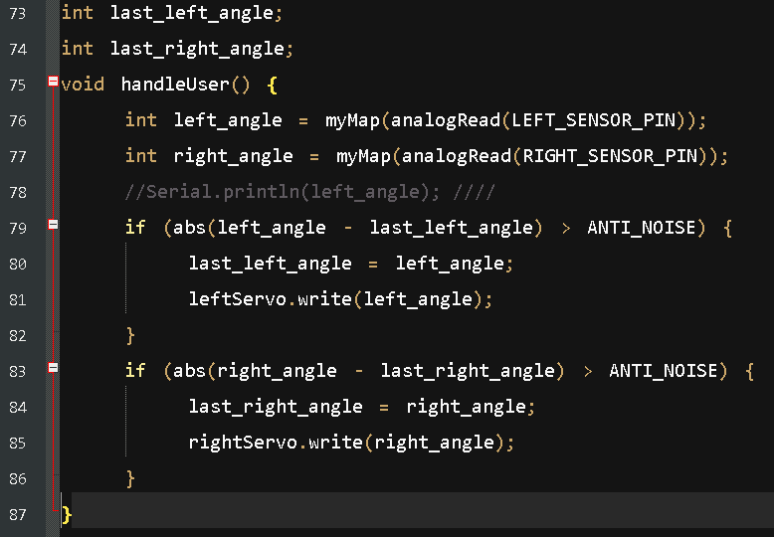
Coding: Anti noise technology

Slide 18

Coding:
Photo of light sensor

Slide 19
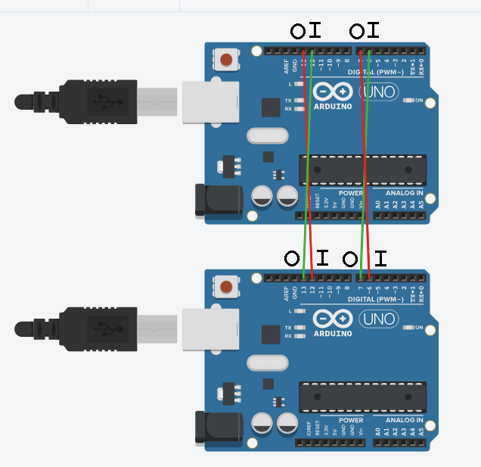
Coding: Distributed Computing
Lines:
DEATH_SIGNAL: the left two
RESET_SIGNAL: the right two
Communication:
When dead, send DEATH_SIGNAL
When received DEATH_SIGNAL, win
After winning and dancing, send RESET_SIGNAL
When receiving RESET_SIGNAL, reset.
WARNING:
Race condition => undefined behavior

